Slide 1
The dispenser that cares
Why thinking out of the box just led back into it

Slide 2
What you will see
A LoraWAN enabled medication dispenser
Autonomous of available internet- and mobilephone connections
Low energy consuming and portable
Safe yet easy way of dispensing the configured medication at the configured time
Alarm use case in case of not having retrieved medication within a given period
Reporting to get a quick medication overview in case of emergency
Use case of easy integration of additional sensor data providers

Slide 3

Meet Rose
Rose is 76 years old
She lives at home and wants to stay there as long as she can
Rose does not have a TV or mobile phone...she loves listening to the radio
Rose needs to take several medication doses per day.
Overdosing some of them could be dangerous
Rose sometimes forgets to take her medication when she is working in the garden or is visiting friends
From time to time Roses’s grandchildren (5 & 7) stay at her’s when their parents are at work

Slide 4

Meet Laurence
Laurence takes care after Rose
He cannot come over daily due to a lot of patients
Laurence makes Rose’s medication plan

Slide 5
Daily routine
DEMO

Slide 6
Rose forgets to take her meds
DEMO

Slide 7
Rose has an accident
The emergency doctor can easily access Rose’s medication plan and knows what meds she has taken when today
Additionally he/she sees the person who filled the dispenser for additional information and questions
Rose gets the right treatment as fast as possible with mitigated risk of contraindication

Slide 8
Benefits of the actual solution
A safe way to dispense medication with no big technical effort for the end-user
Through LoraWAN and Swisscom LPN you have a mobile network with 80% coverage in Switzerland without the need of a mobile phone or internet connection
Full reporting on the refill and the dispense side
Integrates easily into 3rd party sensor solutions (e.g. Bosch XDK) and can work as a portable LoraWAN gateway for them

Slide 9
outlook
Scalability for multi-patient scenarios like retirement homes
Include GPS coordinates into alarm messages for easy search and rescue scenarios
Automatic medication-assemblage with output check in case of discrete medication dispense scenarios (psychiatric wards etc)
extended medication reporting
Further integration into smarthome solutions as a working LoraWAN gateway

Slide 10

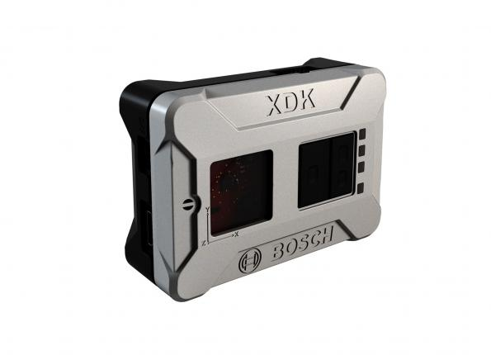





Thank you for you support

Slide 11
Questions?

Slide 12
Thank you for you interest

