Slide 1
Training set
Training
Classifier
Image 1 … N
(DOG)
Image 1 … M
(CAT)
Image
(unknown animal)
Input
Classifier
Prediction
Class: DOG

Slide 2
Class 1
Unsupervised Learning
Class 2
Input

Slide 3
S (log)
N (log)

Slide 4
Input layer
Output layer
Output
Input vector
Hidden layer

Slide 5
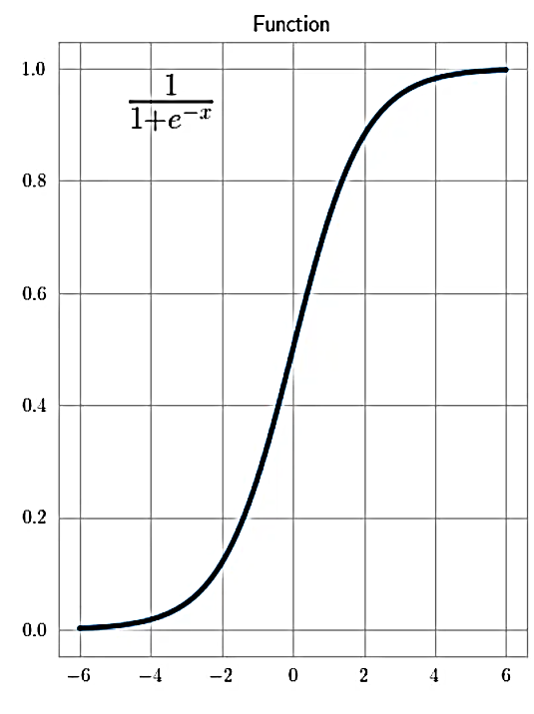
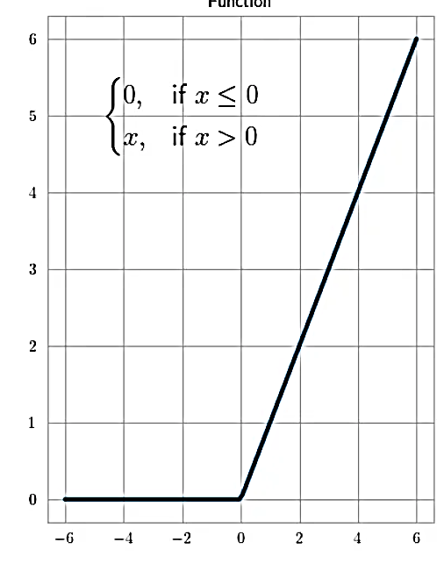
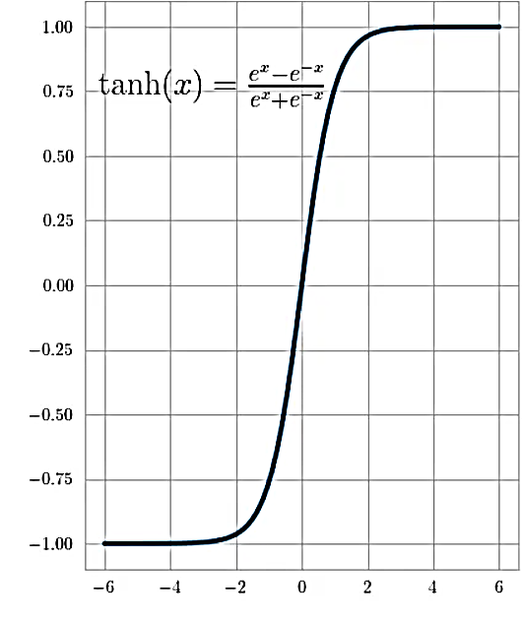
Sigmoid Function
Rectified Linear Unit (ReLU)
Tanh Function

Slide 6
x0
w0
w1
SUM
z
Activation function
y
x1
w2
x2

Slide 7
1
2
1
2
3
3
4
5
6
4
7
8
9
5
…

Slide 8
Polynomial with varied parameters
Original polynomial
y
y
x
x

Slide 9
100px
100px
Overhanging parts are cut off
300px
100px
Overhanging parts are cut off
and resolution is reduced
100px
150px
100px
125px

Slide 10
456
5
34
-6
234
4
6
55
MinMax-Scaling in range [-1,1]
1
-0.95
-0.8
-1
0.03
-0.95
-0.94
-0.73

Slide 11
Stress
Stress
Time
Time

Slide 12
Stress-level
Stress
Time
Occurrences

Slide 13
All load sequences
Load Sequence 1, D = 0.834
Load Sequence 2, D = 1,053
Load
Load Sequence 3, D = 1,130
Time
Class: -1
Class: 0
Class: 1
Load
Load
Load
Time
Time
Time

Slide 14
Load
Load
Time
Time
Load
Load
Time
Time

Slide 15
All load sequences of Class 1
Fatigue Failure Point
D = 1
D = 0.6
Load
Time
Shortened sequences of Class 1
D = 0.6
Load
Time

Slide 16
Load sequence with label: 0.3
Load
Load sequence
Time
Load sequence with label: 0.5
1
Label function
Label
Load sequence with label: 0.8
0

