Slide 1
Binvox creation + Segmentation
Jan

Slide 2
.STL to .binvox
Max .binvox dim is 512x512x512 = squeezing everything into 512 voxels
Loss of resolution if a feature is less than 1/512 of max length
Otherwise increase of resolution
How to increase .binvox dim?
Crack binvox.exe / decompile – not a good idea / 99 $ (max 4200 voxels)
Segment STL into parts – then 512 binvox
Deleting vertices ?
Complicated , idk

Slide 3
Solution: Create binvox with python!
TIME-INTENSIVE but POSSIBLE!!! (memory problems ? ☹)
Any part can be voxelized
.Stl file in bounding box (x and y stay parallel) ➔ Orientation matters
y
Turning alg. Necessary !!!
X

Slide 4
Segmentation
HD picture from HD binvox
Subdivide into 64x64 pix with overlap
Subdivide into 128x128 pix with overlap – resize to 64
Subdivide into 256x256 pix with overlap - resize to 64
……

Slide 5






Results

Slide 6
Loop for precise location
Take all pictures
Find all features and position
Draw all BB on HD picture
If feature is found on 2 or more dimensioned pictures assume its true
Remove predictions with less then 99%
Remove predictions that occur only in 1 dimensioned picture set

Slide 7
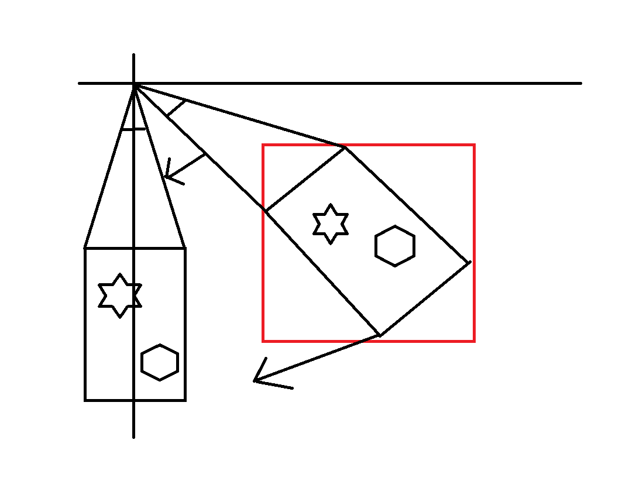
How To Turn a .Stl – minimizing BB

Slide 8
The big question
How to locate a feature on a slope ?
localization possible if surface in line with axes – how to turn ?

Slide 9
Problem and solution
picture from binvox that is not a cube
Dimensions not equal
Reading problem in high dimensions ????
WHY BINVOX AT ALL ??????
Pickledump everything !!!!!

Slide 10
Problem
If feature-depth is small compared to total depth:
Difficult to see (human) on .png

Slide 11
NEW 5.8.2021

Slide 12
New VOXELIZER
Create png-s
Remove bars
combine
y
Turning alg. Necessary !!!
X

Slide 13
The big question
How to locate a feature on a slope ?
localization possible if surface in line with axes – how to turn ?
Has to be done PRE-voxelisation

Slide 14
Turning
Take all normal of all planes
Add areas of normal that point in the same direction
Sort by area
Turn file so normal are parallel to axes
Voxelize

Slide 15





Result of turning
How to combine recognized features
Ascii VS binary
Have Z values of planes to turn back and assign to original stl

Slide 16
NEW 11.8.2021

Slide 17
How to glue everything together
BIG FLOWCHART NEEDED (TO DO)

Slide 18
Turning – problem = Size not constant

Slide 19
Turning – problem = Where is it placed ?
X2+x2 = c2 → c= q2 (2 x2) = x* q2 (2) f = c/x = q2(2)
orig
At top ?
a
X*(2)**0.5
A*squ(2)
L
X
At center ?
At bottom ?
X
X2 min max
Y2 min, max
Position needed – for Z direction
Angle needed - for turning
relative size change needed – for scaling

Slide 20
Turning – problem = Size not constant
Get
xmin, xmax
Yin,ymax
IS POSSIBLE

Slide 21
Small achievements ☺
Solved Deprecated version problem
Updated all libs to newest version

Slide 22
IDEAS
Time optimization ???
Small scale test to validate results
What is the best aspect ratio to find features
DO NOT CHANGE ALL .CPU TO. GPU !!!
Creating HD pictures takes the longest time ??????
Sometimes pushing to GPU is not recommended because not enough memory – ram better

Slide 23
Questions
End result
Grant extension

Slide 24
Flow
Visualized in 3D ???
IMAGE CREATION TAKES THE LONGEST !!!!!!! (90%)
WORST case 25 min per picture
Can be reduced to 5 min in precision is not very important
Check evaluation metric

