Slide 1
Testing Title 012233
Description of first slide

Slide 2
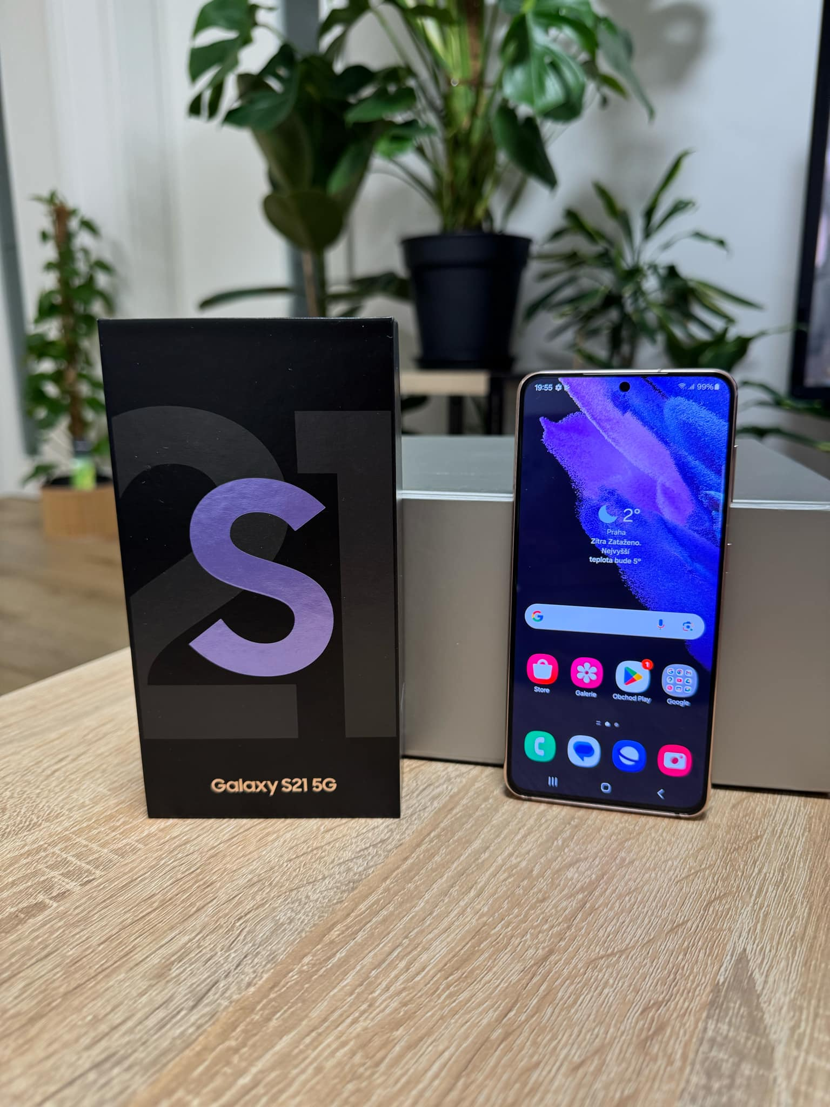
SECOND SLIDE 02 02
testing this description of slide 02

