Slide 1

Small Language Models
Building AI Pipelines with SLMs
What SLMs are, how they compare to LLMs and frontier models,
what to choose, what it costs to host, and a live tagging pipeline.

Slide 2

What is an SLM?
A Small Language Model is a language model deliberately built (or distilled) small — usually under 10 billion parameters — to run fast and cheap, often entirely on your own machine, with no API round-trip.
<10B
Specialist, not generalist
Tuned for a narrow job — classification, extraction, routing — rather than broad open-domain reasoning.
parameters, typically
Cheap & fast
Sub-second responses on modest hardware; no per-token API bill.
Examples
• Qwen2.5 (0.5B – 3B)
Runs locally
• Llama 3.2 (1B / 3B)
Fits on a laptop or edge device via tools like Ollama — your data never leaves the machine.
• Phi-3.5-mini
Good enough, often
• Gemma 2 (2B)
A well-prompted SLM can match a much larger model on a well-defined task.
SLMs in Practice
2

Slide 3

The Language Model Landscape
They're nested, not competing categories — all are “language models,” scaled differently.
SLM
Efficient specialist. Speed, low cost, on-device / on-prem control.
Small Language Model
Qwen2.5-3B, Phi-3.5-mini, Gemma 2B
< 10B params
LLM
Flexible generalist. Broad knowledge, nuanced reasoning across domains.
Large Language Model
Llama 3.1 70B, Qwen2.5 32B, Mixtral
10B+
FLM
State of the art. Deep multi-step reasoning, tool use, agentic planning.
Frontier Language Model
Claude Opus, GPT-5, Gemini Pro
100s of billions+
SLMs in Practice
3

Slide 4

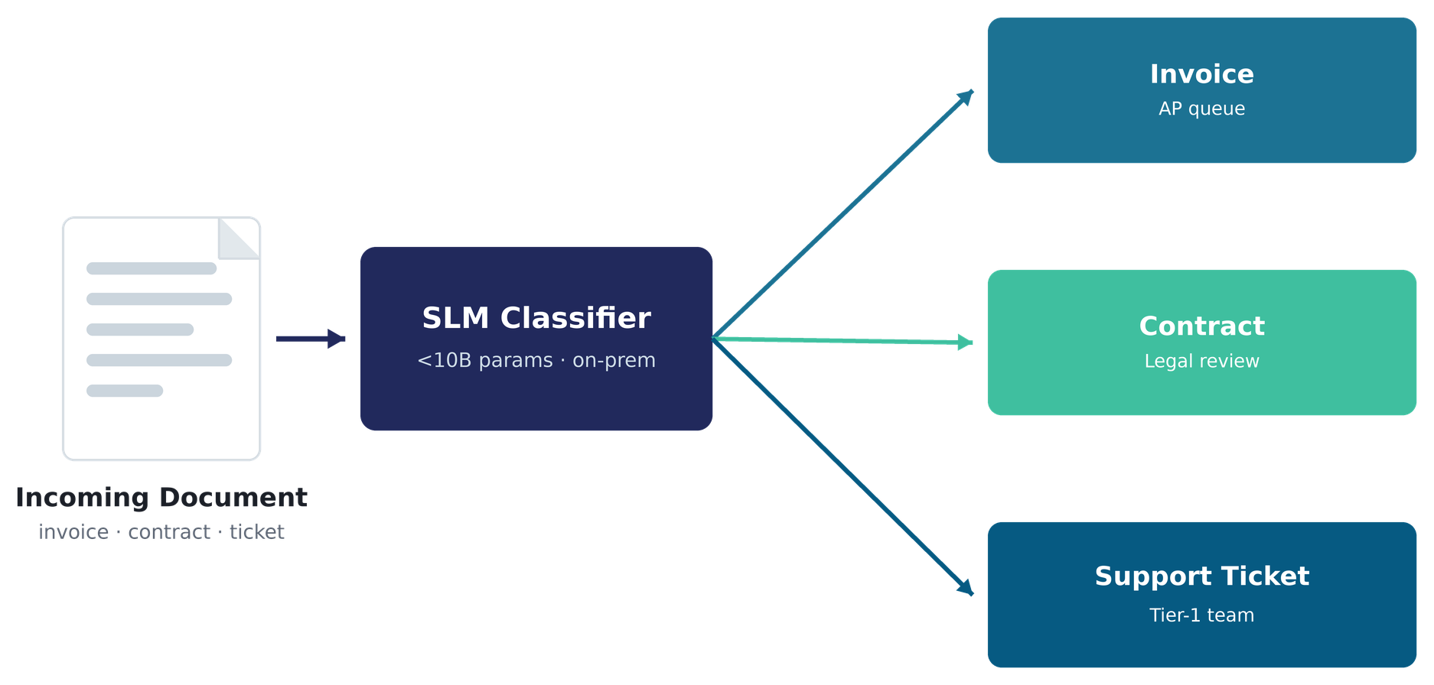
Why SLM?
Speed, Cost, Governance
USE CASE IN PRACTICE
Document Classification & Routing
A back-office pipeline ingests scanned invoices, contracts, and support tickets — an SLM reads each one and decides where it goes.
Inbound triage
The SLM classifies each document in a single pass — invoice, contract, ticket, or KYC form.
Confidence-based routing
High-confidence results go straight to the right queue; low-confidence cases fall back to a human reviewer.
Sub-second, on-prem
Classification runs next to the document store — no data leaves the network, no per-call API fees.
SLMs in Practice
4

Slide 5
What Should You Choose?
Match the model to the job — bigger is not automatically better.
SLM
LLM
Frontier (FLM)
Task shape
Fixed taxonomy / narrow rule
Broad, open-ended
Multi-step, ambiguous
Reasoning depth
Pattern match
Moderate synthesis
Deep, chained reasoning
Latency need
Sub-second
A few seconds
Seconds to minutes
Cost sensitivity
High volume, cheap
Moderate
Lower volume, high value
Data control
On-device / on-prem
Flexible
Usually hosted API
SLMs in Practice
4

Slide 6

Hosting AI & Machine Spec
What it actually takes to run these locally (e.g. via Ollama).
Model size
RAM/VRAM (Q4)
CPU laptop?
CPU vs. GPU inference
0.5B – 1B
~1 GB
Yes, fast
RAM stays flat
3B – 4B
~2–4 GB
Yes
Model weights load once; footprint doesn't grow with output length.
7B – 8B
~5–6 GB
Yes, slower
CPU is the ongoing cost
14B
~9 GB
Tight on 16 GB
Every generated token needs a full forward pass — compute, not storage.
30B (MoE, ~3B active)
~19 GB
GPU recommended
Memory bandwidth bottleneck
70B
~43 GB
GPU / server only
CPU often waits on data movement, not raw compute — usage looks moderate, not maxed.
GPU parallelizes this
Same model can run 10–50x faster — the single biggest lever for responsiveness.
SLMs in Practice
5

Slide 7



SLM Use Case & Demo
Live: tagging today's inbox with a local SLM and a fixed taxonomy.
Gmail
SLM
Taxonomy
Dashboard
Fetch today's
inbox (API)
Qwen2.5-3B via
Ollama, local
Fixed tag set +
descriptions
Streamlit UI,
tags + filter
What the demo showed
Per-tag descriptions beat a bare tag list — the single biggest accuracy lever, no bigger model needed.
“Thinking mode” models trade latency for reasoning depth — a real cost, not always a win for simple classification.
Debug visibility (raw output, parse-success flag) turns silent failures into visible, fixable ones.
SLMs in Practice
6

Slide 8
Small model. Well-engineered pipeline.
Thank you — questions welcome.

