Slide 1

Swagger
Software Engineering
Pfenning, Jan
TINF19B2
https://upload.wikimedia.org/wikipedia/commons/a/ab/Swagger-logo.png

Slide 2

What is an API?
OpenAPI
Swagger Cosmos
Hands-on experience!
Agenda

Slide 3
What is an API?

Slide 4






What is an API?

Slide 5
Application Programming Interface
Notes:
Wie der Name es bereits auf den Punkt bringt, ist eine API eine Programmierschnittstelle zwischen Anwendungen.
Ein Mechanismus der die Interaktion zwischen Anwendungen mit einem Regelsatz ermöglicht.

Slide 6

OpenAPI
https://avatars3.githubusercontent.com/u/16343502

Slide 7
OpenAPI
OpenAPI specification, an API description format
Available endpoints and corresponding operations
Operation parameters (Input and Output)
Meta information
Authentication methods
Contact information, license …
Notes:
The ability of APIs to describe their own structure is the root of all awesomeness in OpenAPI. Once written, an OpenAPI specification and Swagger tools can drive your API development further in various ways

Slide 8
Swagger
https://upload.wikimedia.org/wikipedia/commons/a/ab/Swagger-logo.png

Slide 9
Swagger Cosmos
Swagger HUB
ReadyAPI
Swagger Inspector
API managing for Companies / Teams
Security and Performance Testing
Quality Assurance validation
Swagger Editor
Swagger UI
Swagger Codegen
Edit API specification
Interactive API visualization
Server stubs and client SDKs
Notes:
Warum Swagger?
API Documentation
API Interactive Visualization
API Standartization
API Testing
The ability of APIs to describe their own structure is the root of all awesomeness in OpenAPI. Once written, an OpenAPI specification and Swagger tools can drive your API development further in various ways

Slide 10
Swagger HUB
Uniformation rules
Enforce consistency across APIs
Predefined checkboxes
Custom Rules
Notes:
The ability of APIs to describe their own structure is the root of all awesomeness in OpenAPI. Once written, an OpenAPI specification and Swagger tools can drive your API development further in various ways

Slide 11
Swagger Editor
Swagger UI
API specification
Interactive API visualization
Specify endpoints
Specify parameters
Overview all/grouped requests
Test requests
Notes:
The ability of APIs to describe their own structure is the root of all awesomeness in OpenAPI. Once written, an OpenAPI specification and Swagger tools can drive your API development further in various ways

Slide 12
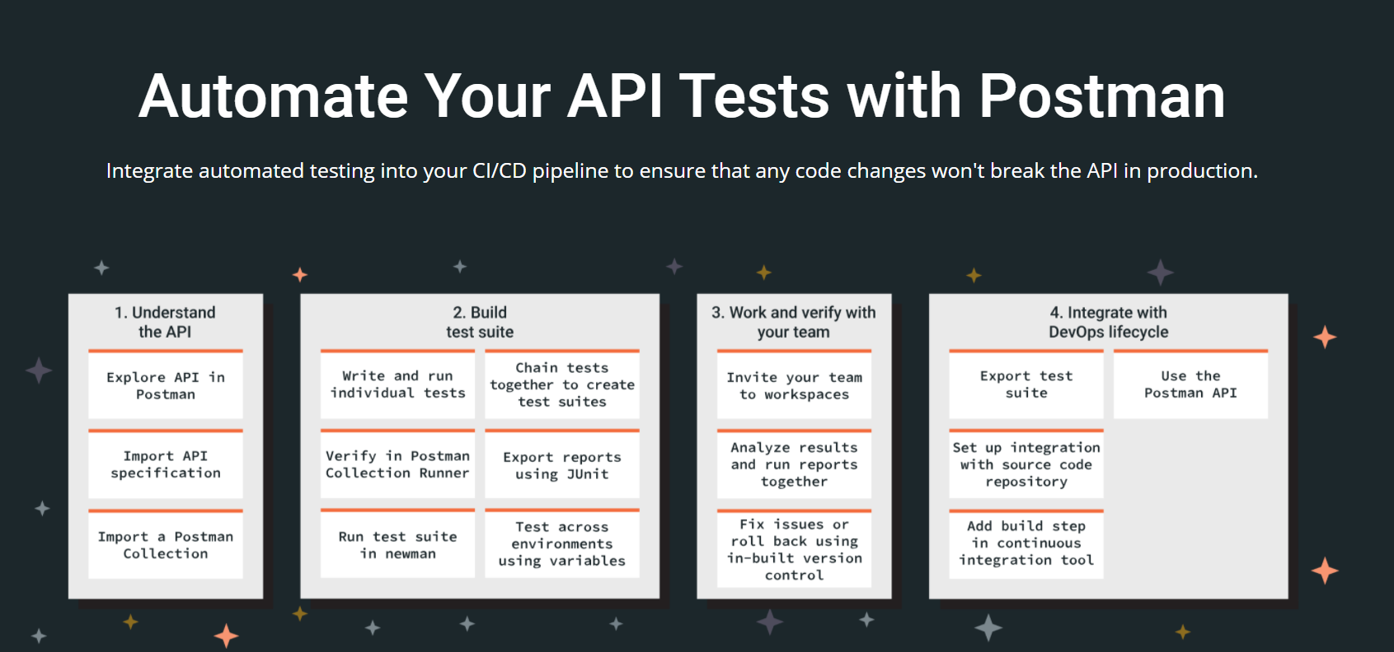
https://www.postman.com/use-cases/api-testing-automation/
Notes:
The ability of APIs to describe their own structure is the root of all awesomeness in OpenAPI. Once written, an OpenAPI specification and Swagger tools can drive your API development further in various ways

Slide 13
Swagger as a Plugin
Warning: Biased presentation because I like that one the most
API specification from Code
Endpoints are auto detected
Entpoints are grouped by Controller
Specify parameters
Notes:
Sein wir mal ehrlich, auch das wäre euch allen zu viel Aufwand.
Viele state of the art Backend systeme bieten die Swagger integration als eine Art Plugin an.
So wird aus mal mehr, mal weniger information aus dem Code direkt eine SwaggerUI erstellt.

Slide 14

Hands-on
https://d33wubrfki0l68.cloudfront.net/e937e774cbbe23635999615ad5d7732decad182a/26072/logo-small.ede75a6b.svg

Slide 15
NestJS API
Install Postman
Download and install NodeJS and npm
New NestJS Project: „nest new swagger_demo“
Install Swagger: „npm install –-save @nestjs/swagger swagger-ui-express“
_____________________________________________________________
Create route and define parameters
Handle request via Browser and Postman
Update main.ts to generate SwaggerUI
Handle request via Swagger
Warning: To apply changes to the System the Nest-Server has to be restarted by „npm start“

