Slide 1
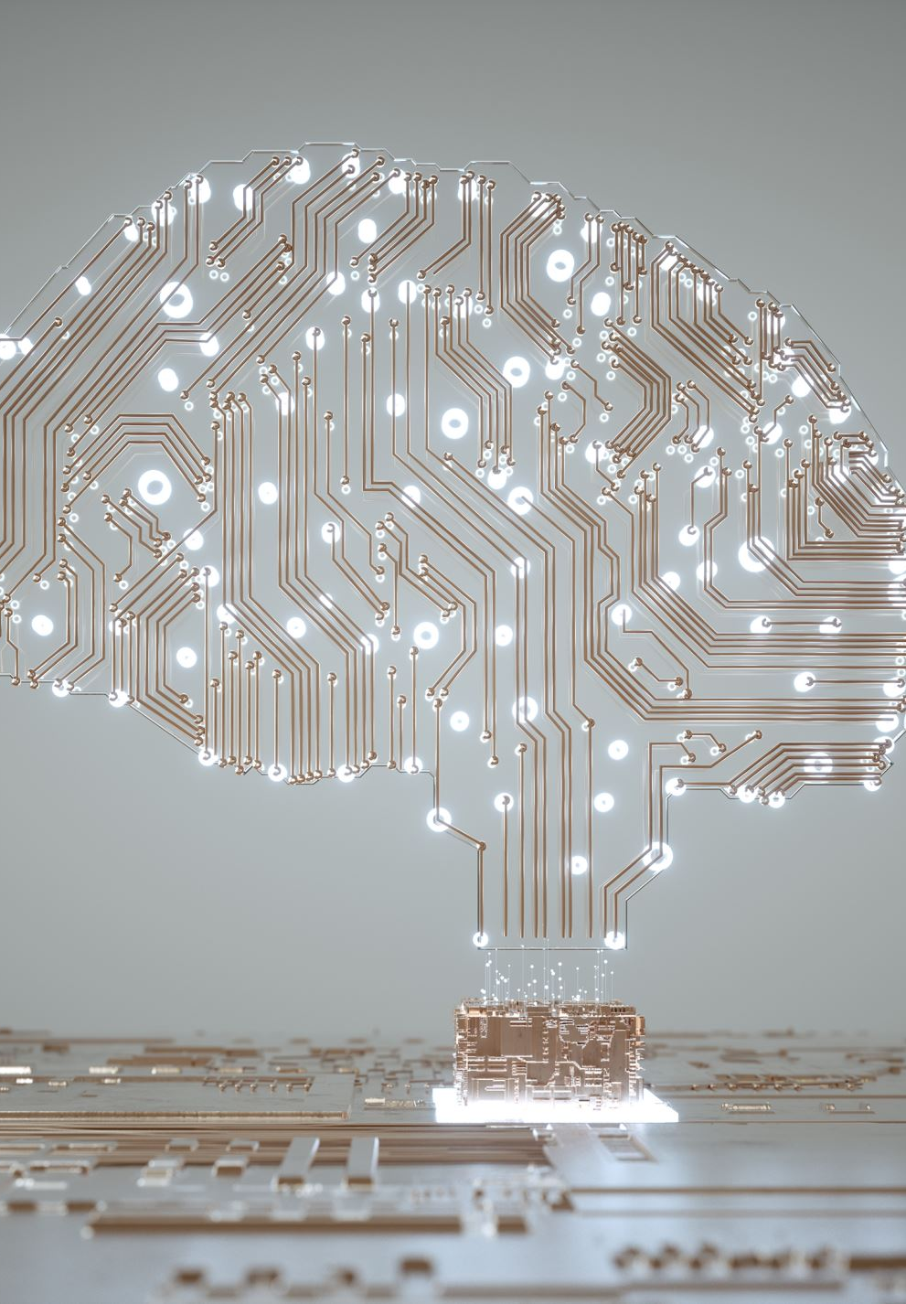
Topic - artificial intelligence
6511286 Jan Poonthong
6511566 Yoon Waddy Myo Myint
6511148 Waddy than Htike
6510866 Chit Su Thuzar

Slide 2
How did we research?
1. We googled
2. Look into the websites
3.Got the information and discuss among of us
4. Evaluate

Slide 3
What is AI?
Source - Bultin.com [https://builtin.com/artificial-intelligence] [access on 14 June 2022]
Artificial intelligence (AI) is a wide-ranging branch of computer science concerned with building smart machines capable of performing tasks that typically require human intelligence.

Slide 4
What is AI?
Source – oracel.com [https://www.oracle.com/th/artificial-intelligence/what-is-ai/] [access on 14 June 2022]
In the simplest terms, AI which stands for artificial intelligence refers to systems or machines that mimic human intelligence to perform tasks and can iteratively improve themselves based on the information they collect. AI manifests in a number of forms.
A few examples are:
Chatbots use AI to understand customer problems faster and provide more efficient answers
Intelligent assistants use AI to parse critical information from large free-text datasets to improve scheduling
Recommendation engines can provide automated recommendations for TV shows based on users’ viewing habits

Slide 5
What is AI?
Source – techtarget.com [https://www.techtarget.com/searchenterpriseai/definition/AI-Artificial-Intelligence] [access on 14 June 2022]
Artificial intelligence is the simulation of human intelligence processes by machines, especially computer systems. Specific applications of AI include expert systems, natural language processing, speech recognition and machine vision.

Slide 6
What is AI?
Source – hpe.com [https://www.hpe.com/asia_pac/en/what-is/artificial-intelligence] [access on 14 June 2022]
Artificial intelligence (AI) broadly refers to any human-like behavior displayed by a machine or system. In AI’s most basic form, computers are programmed to “mimic” human behavior using extensive data from past examples of similar behavior. This can range from recognizing differences between a cat and a bird to performing complex activities in a manufacturing facility.

Slide 7
Two best sites explaining about AI
Source – oracel.com [https://www.oracle.com/th/artificial-intelligence/what-is-ai/] [access on 14 June 2022]
In the simplest terms, AI which stands for artificial intelligence refers to systems or machines that mimic human intelligence to perform tasks and can iteratively improve themselves based on the information they collect. AI manifests in a number of forms.
A few examples are:
Chatbots use AI to understand customer problems faster and provide more efficient answers
Intelligent assistants use AI to parse critical information from large free-text datasets to improve scheduling
Recommendation engines can provide automated recommendations for TV shows based on users’ viewing habits
Source – hpe.com [https://www.hpe.com/asia_pac/en/what-is/artificial-intelligence] [access on 14 June 2022]
Artificial intelligence (AI) broadly refers to any human-like behavior displayed by a machine or system. In AI’s most basic form, computers are programmed to “mimic” human behavior using extensive data from past examples of similar behavior. This can range from recognizing differences between a cat and a bird to performing complex activities in a manufacturing facility.

Slide 8

Thank You

