Slide 1
Presentation
JH Pretorius

Slide 2
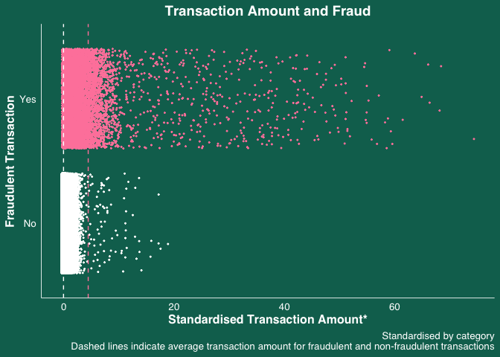
Scatter

Slide 3
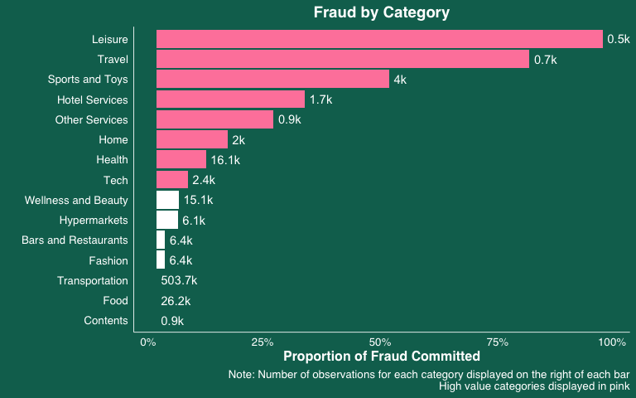
Bar plot

Slide 4
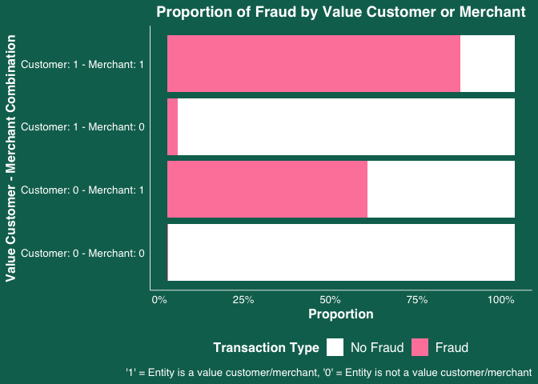
Stacked bar plot

Slide 5
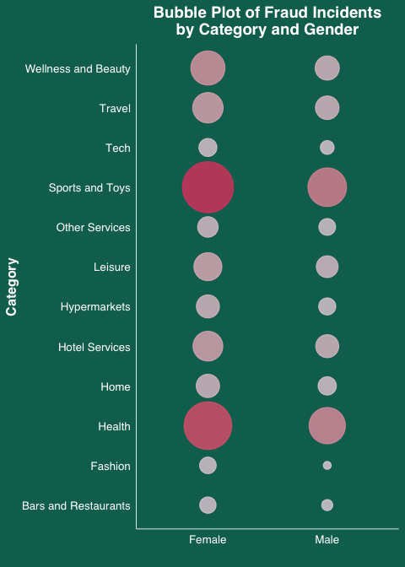
Bubble Plot

Slide 6
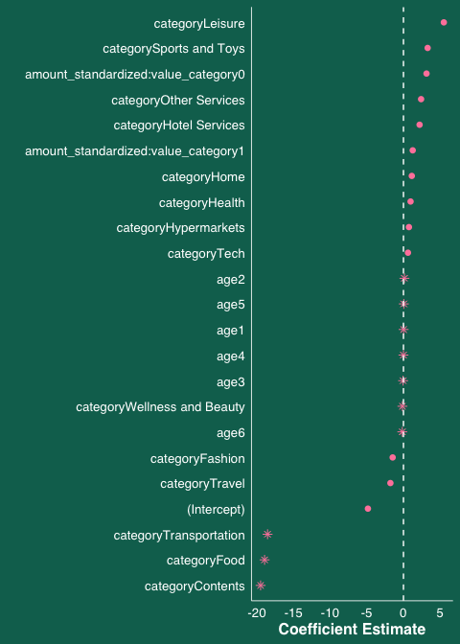
Logit
## Actual ## Predicted 0 1 ## 0 233980 976 ## 1 318 1906
## Area under the curve: 0.9928

Slide 7
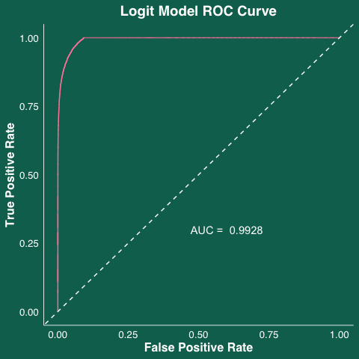

Slide 8
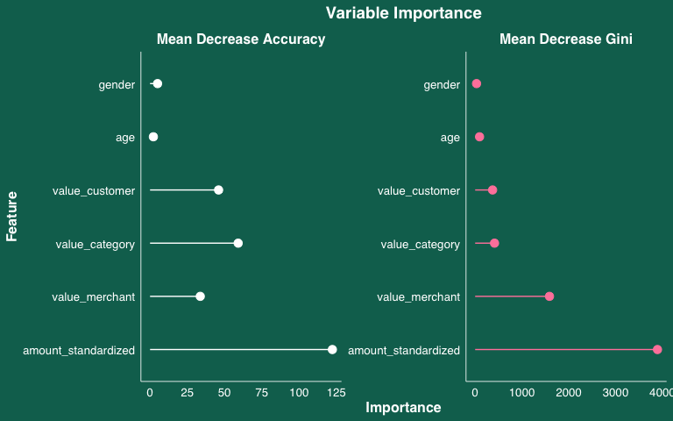
Random Forest
## Actual ## Predicted 0 1 ## 0 234034 868 ## 1 264 2014
## Area under the curve: 0.944
## [1] 0.9952273
## [1] 0.8841089
## [1] 0.9963048
## [1] 0.6988203

Slide 9
