Slide 1
Navigating Fraud Prediction with Data Science
Using a Random Forest classifier to identify fraudulent transactions
Presentation compiled by Jan-Hendrik Pretorius

Slide 2
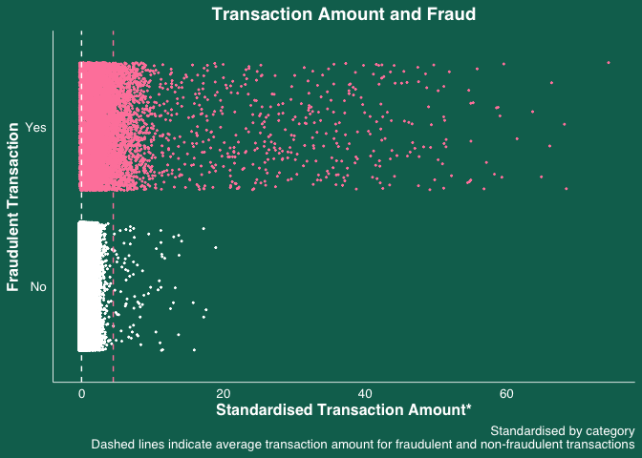
One of the most powerful fraud predictors is the transaction amount.
What's with the pink? It's like a fraud hotspot map—those rosy patches signal where the fraud is happening.
Keeping it even-steven: Standardized amounts are our level playing field. They help us spot the odd ones out and catch those sneaky patterns.
The higher, the shadier: Got a transaction that's scaling the heights on our standardized scale? Chances are, it's up to no good.

Slide 3
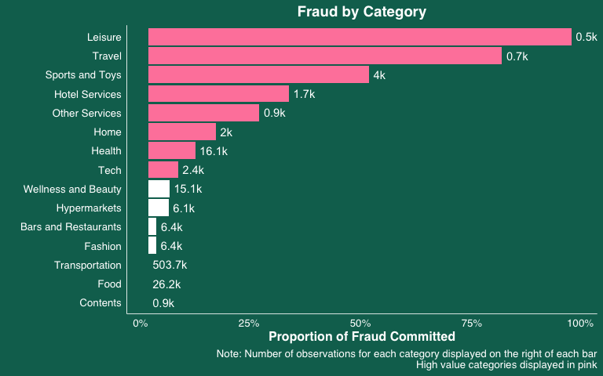
Some categories are more prone to fraud than others.
Clean as a whistle? Looks like 'Transportation', 'Food', and 'Contents' are playing it cool with no fraud on the radar.
Size matters... in data: Keep an eye out – the number of transactions in each category can throw us off the scent, shaping how we gauge fraud and chase it down.
Little fish, big splash: Don't let the small numbers fool you. 'Leisure' and 'Travel' might not have many transactions, but they pack a punch with their fraud rates and high-value transactions.

Slide 4
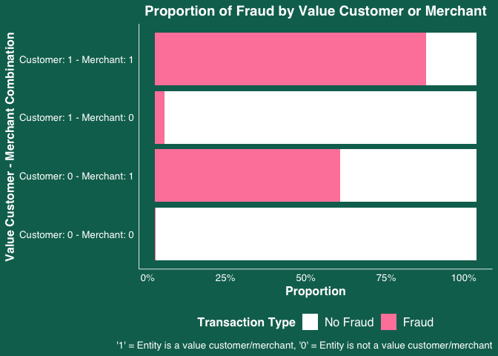
The usual suspects and fraudulent activity.
History may not repeat, but it definitely rhymes.
Spending Patterns as Fraud Signals: past spending habits can flag potential fraud.
High Stakes, High Suspicions: Those with lavish transactions might just have more to hide.
Double trouble: When big spenders on both sides of the counter team up, caution is warranted.

Slide 5
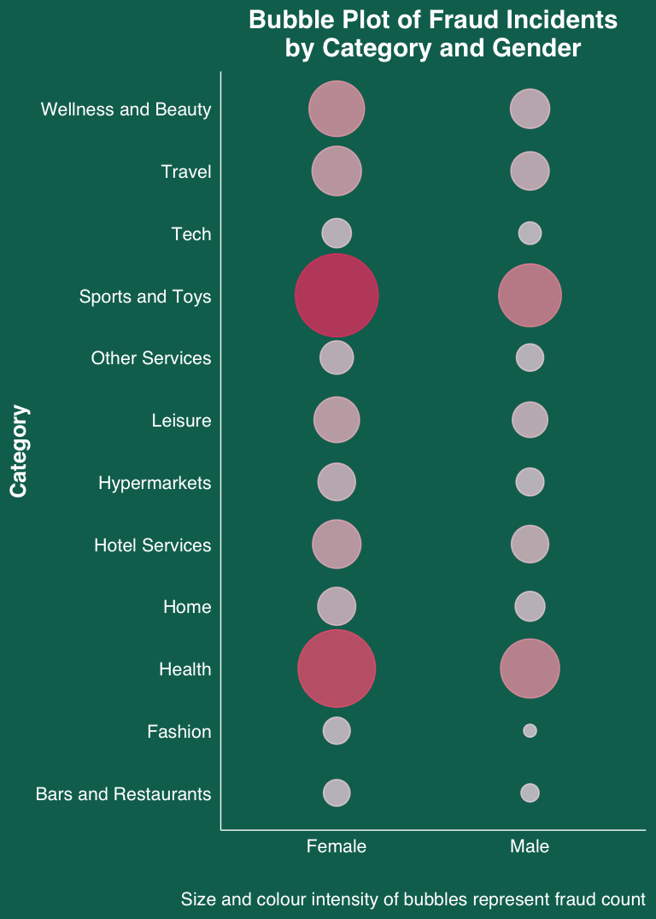
Gender may also predict fraud prevalence.
Looks like each category has its own little gender spin on fraud numbers. It's there, but just a whisper – females tend to have higher absolute fraudulent behaviour.
By tuning into these hints, we're in a good spot to tailor our fraud prevention playbook – keeping it gender-smart.
We're walking the fine line here, making sure we use these insights wisely to keep things cool, without tripping into gender bias territory.

Slide 6
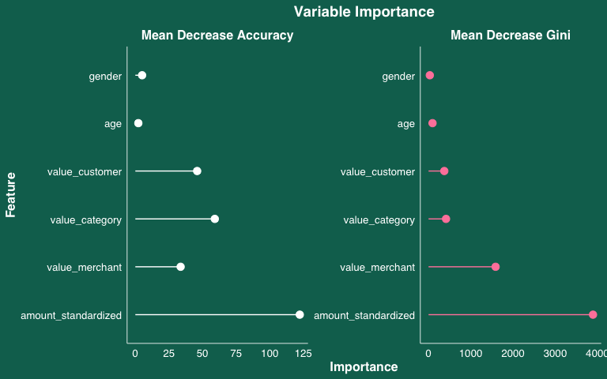
What actually matters in fraud detection.
Looks like transaction amount is our star player.
The accomplices – high value categories, merchants and customers also throw their weight around quite a bit.
Age before beauty? Maybe not here. Age and gender seem to be taking a backseat when it comes to calling out the fraudsters.
A tale of two metrics: Notice how the Gini index stretches further than accuracy? That's our hint that some features stir up more uncertainty in the mix than others.

Slide 7
Confusing or consistent? Deciphering our model’s verdict.
 |  | Actual
 |  | No Fraud | Fraud
Predicted | No Fraud | 234 034 | 868
 | Fraud | 264 | 2 014
Our model's predicting prowess looks stellar at first glance – but is it all sparkle and no substance?
Out-of-bag error rate is a tiny 0.48%, hinting at a high level of accuracy. But let's not throw caution to the wind.
Accuracy's high, but let's not get dizzy: At over 99% accuracy, we're in the green – but are we catching the real tricksters or just the clumsy ones?
Sensitivity vs. Precision - The Balancing Scale: Sensitivity's got some muscle, sure, but precision's not hitting the same weights. We're on the lookout, but perhaps we're also casting false suspicions a tad too often.
The Good, the Bad, and the Confusing: Our prediction confusion matrix (top left) shows a solid game, but those false positives and negatives? They're gate-crashers.
Accuracy | 99.5%
Sensitivity | 88.4%
Specificity | 99.6%
Precision | 69.9%

Slide 8
Concluding Insights: fine-tuning for trust.
Choosing Random Forest: We opted for the robustness of Random Forest due to its ensemble approach—combining multiple decision trees to reduce overfitting, increase accuracy, and provide a holistic view of the factors influencing fraud.
Using standardised amounts improves precision of the model.
We chose a 62% fraud detection threshold. This precise calibration strikes the sweet spot between false negatives and false positives.
High false positives could damage the bank’s reputation and lose customers. Each alert and customer trust is paramount.
Model Overview:
Diverse Ecosystem: Our Random Forest model uses 300 trees, creating a robust decision-making collective.
Decision Process: At each tree split, at least three variables are chosen from our predictors, ensuring democratic and diverse decisions.

Slide 9
Concluding Insights: Moving Forward Fraud Free.
Continuous Monitoring: The landscape of fraud is ever-shifting. We must keep our model under a watchful eye, ready to adapt and evolve.
Enhanced Data Collection: More data, especially on emerging fraud patterns, could sharpen our model's foresight.
Geospatial Data
Time-series data
Customer Education: Informing clients about the safeguards in place and how they can partner with us in fraud prevention.
Feedback Loop: Implementing a system to learn from false positives, turning every mistake into a stepping stone for improvement.

