Slide 1
CNN/LSTM P01
Lizeth Gonzalez

Slide 2
Onset info
dataset 3 Start time ['2996'] End time ['3036']
Initial time 700000
dataset 4 Start time ['1467'] End time ['1494']
Initial time 300000
dataset 15 Start time ['1732'] End time ['1772']
Initial time 400000
dataset 16 Start time ['1015'] End time ['1066']
Initial time 200000
dataset 18 Start time ['1720'] End time ['1810']
Initial time 400000
dataset 21 Start time ['327'] End time ['420']
Initial time 0
dataset 26 Start time ['1862'] End time ['1963']
Initial time 400000
Training data set
Test data set

Slide 3
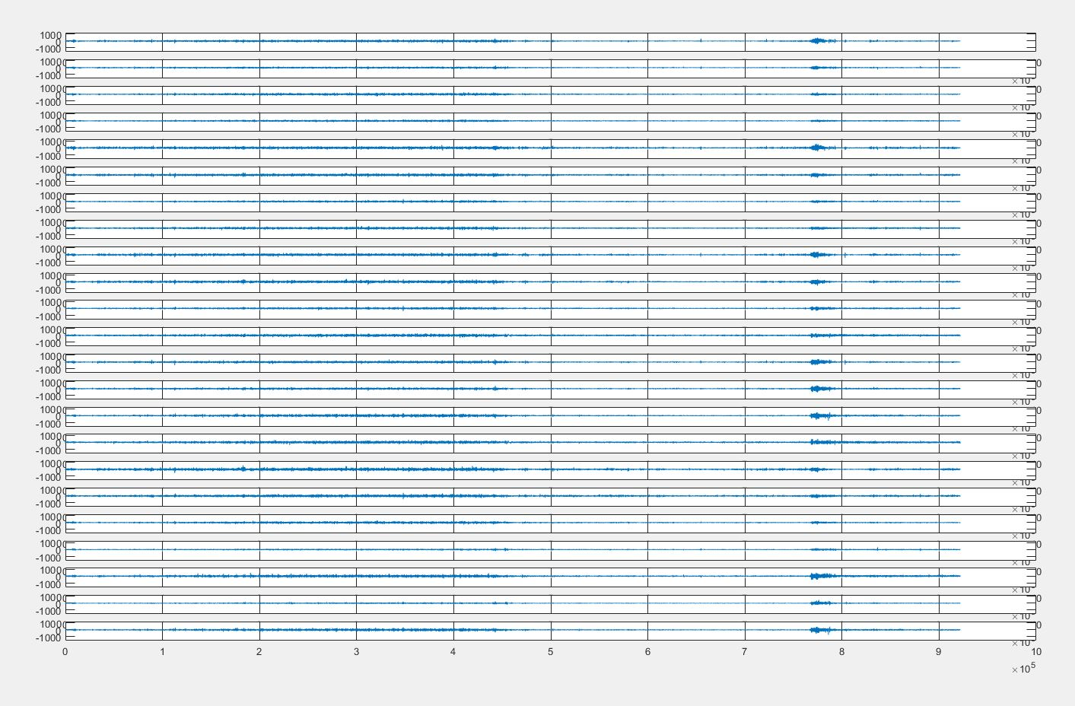
Onset graphs 03

Slide 4
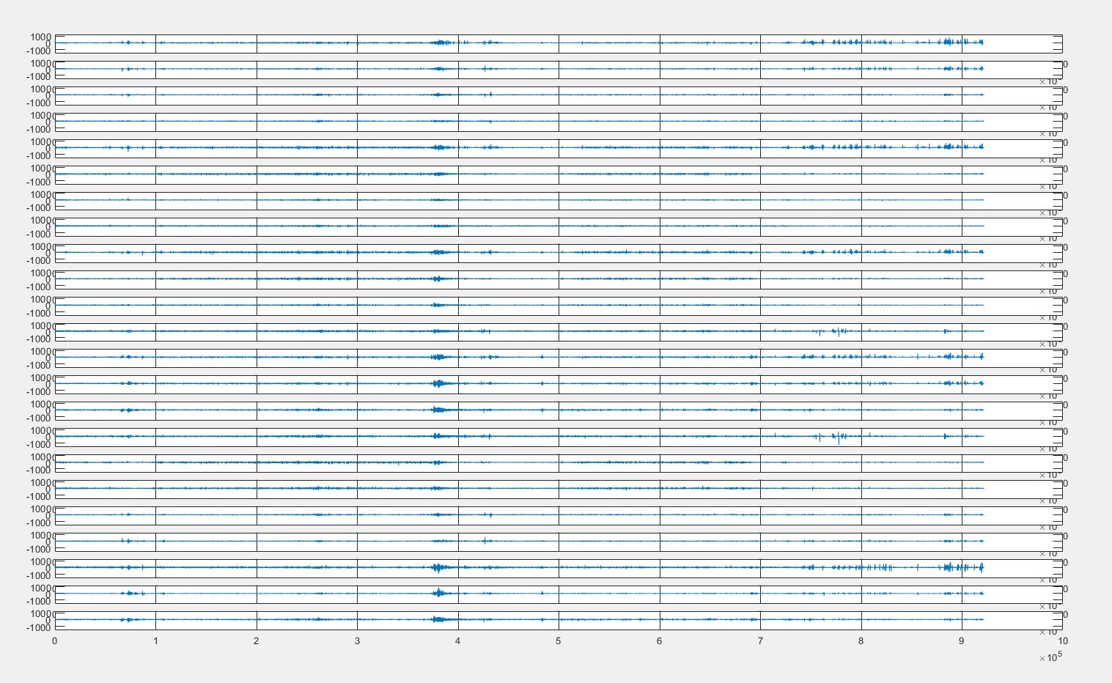
04

Slide 5
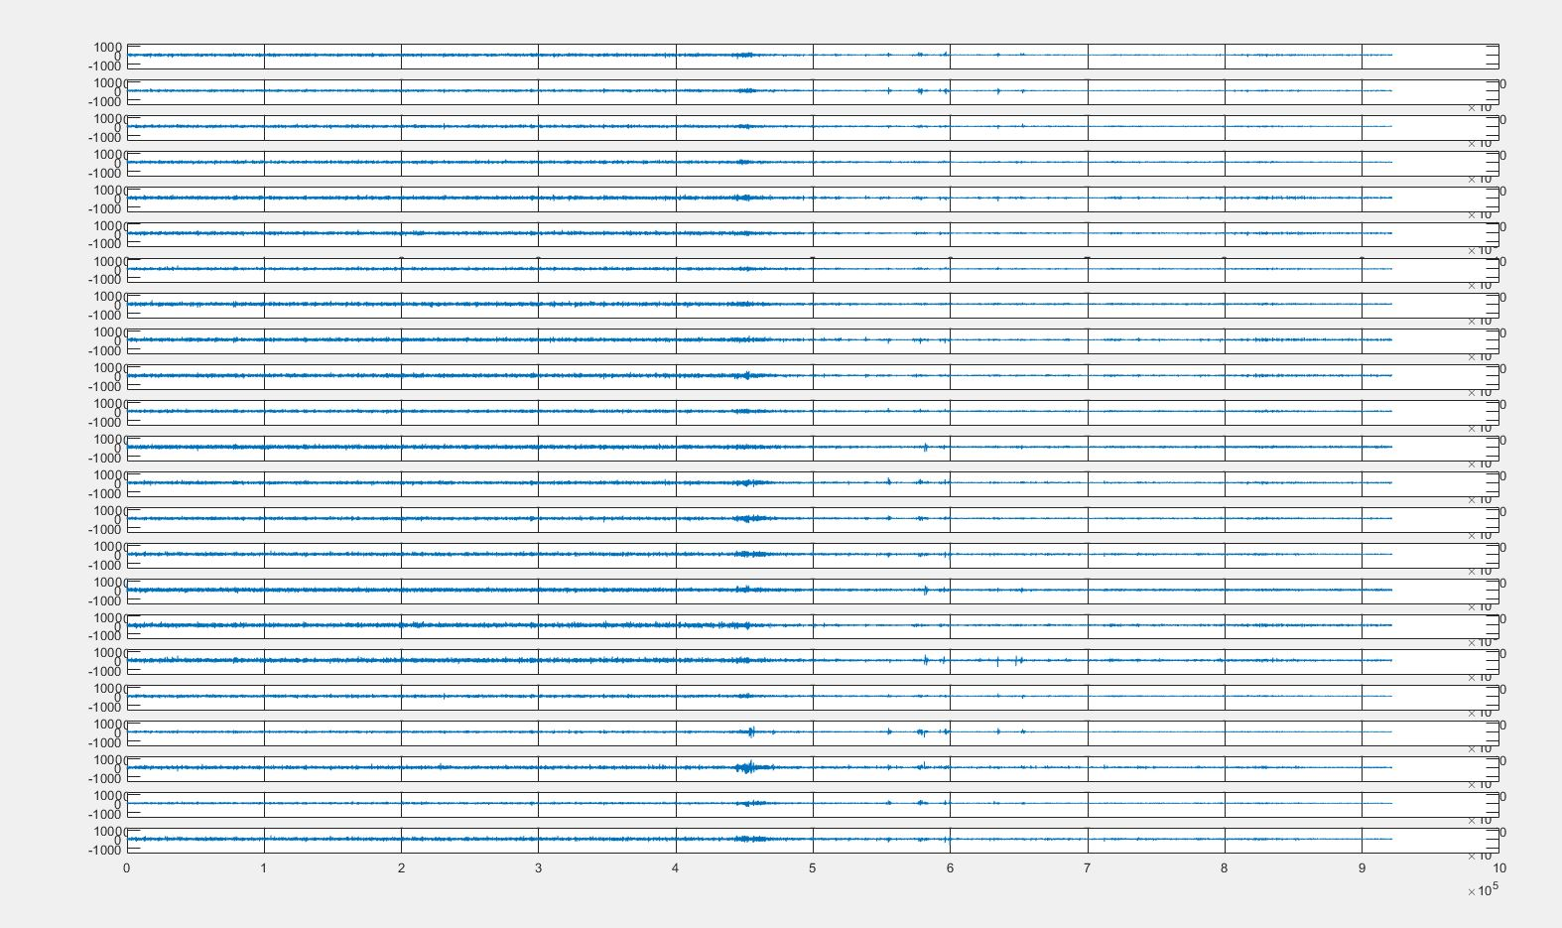
15

Slide 6
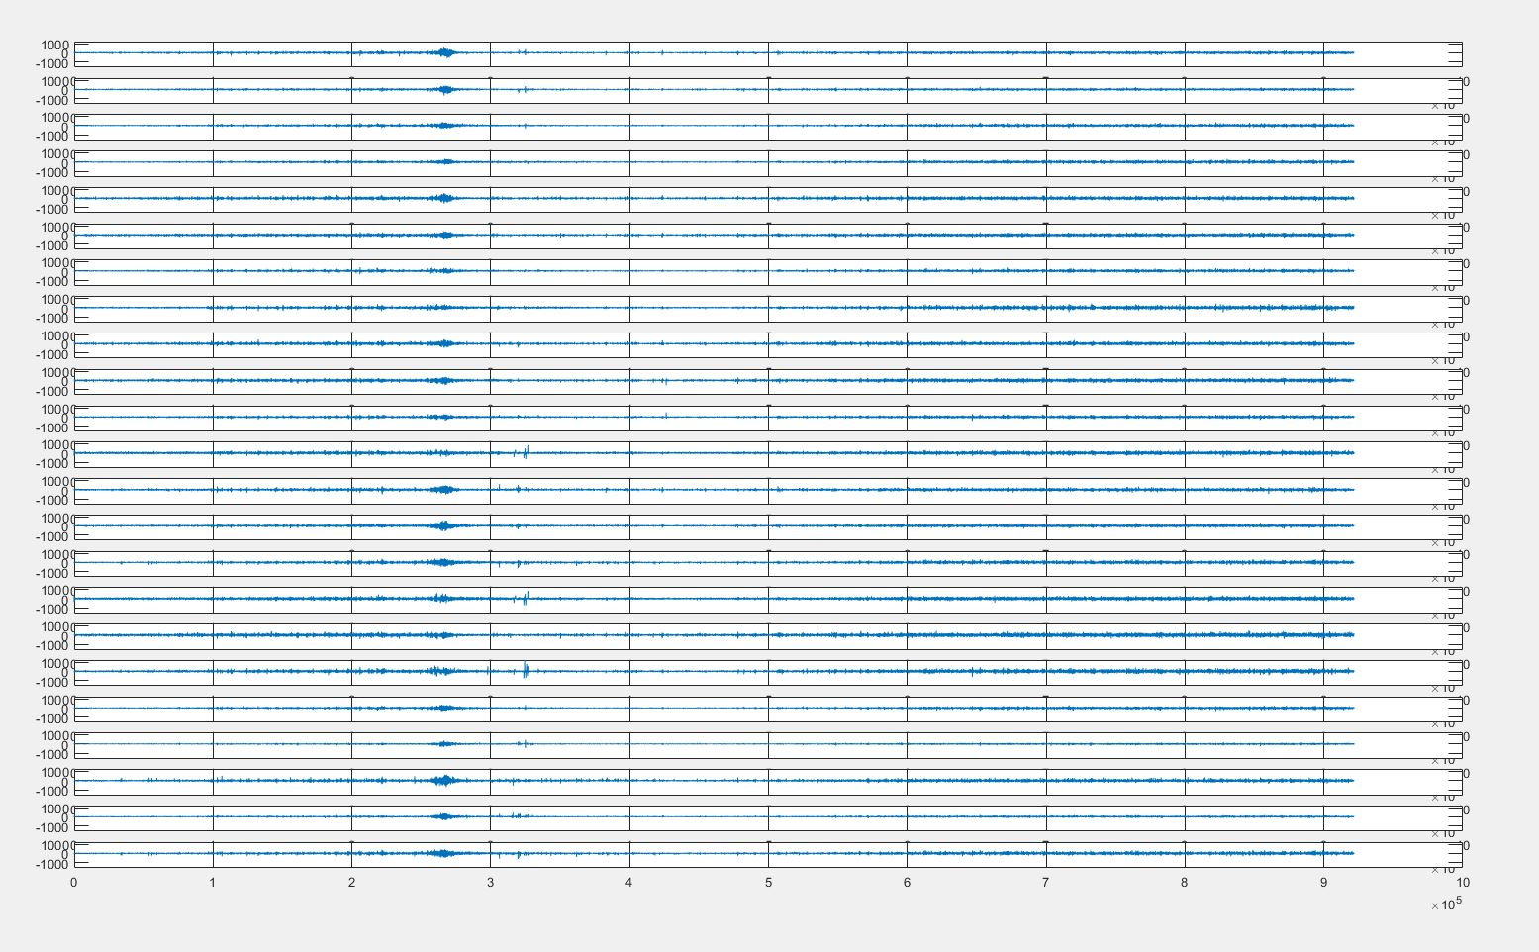
16

Slide 7
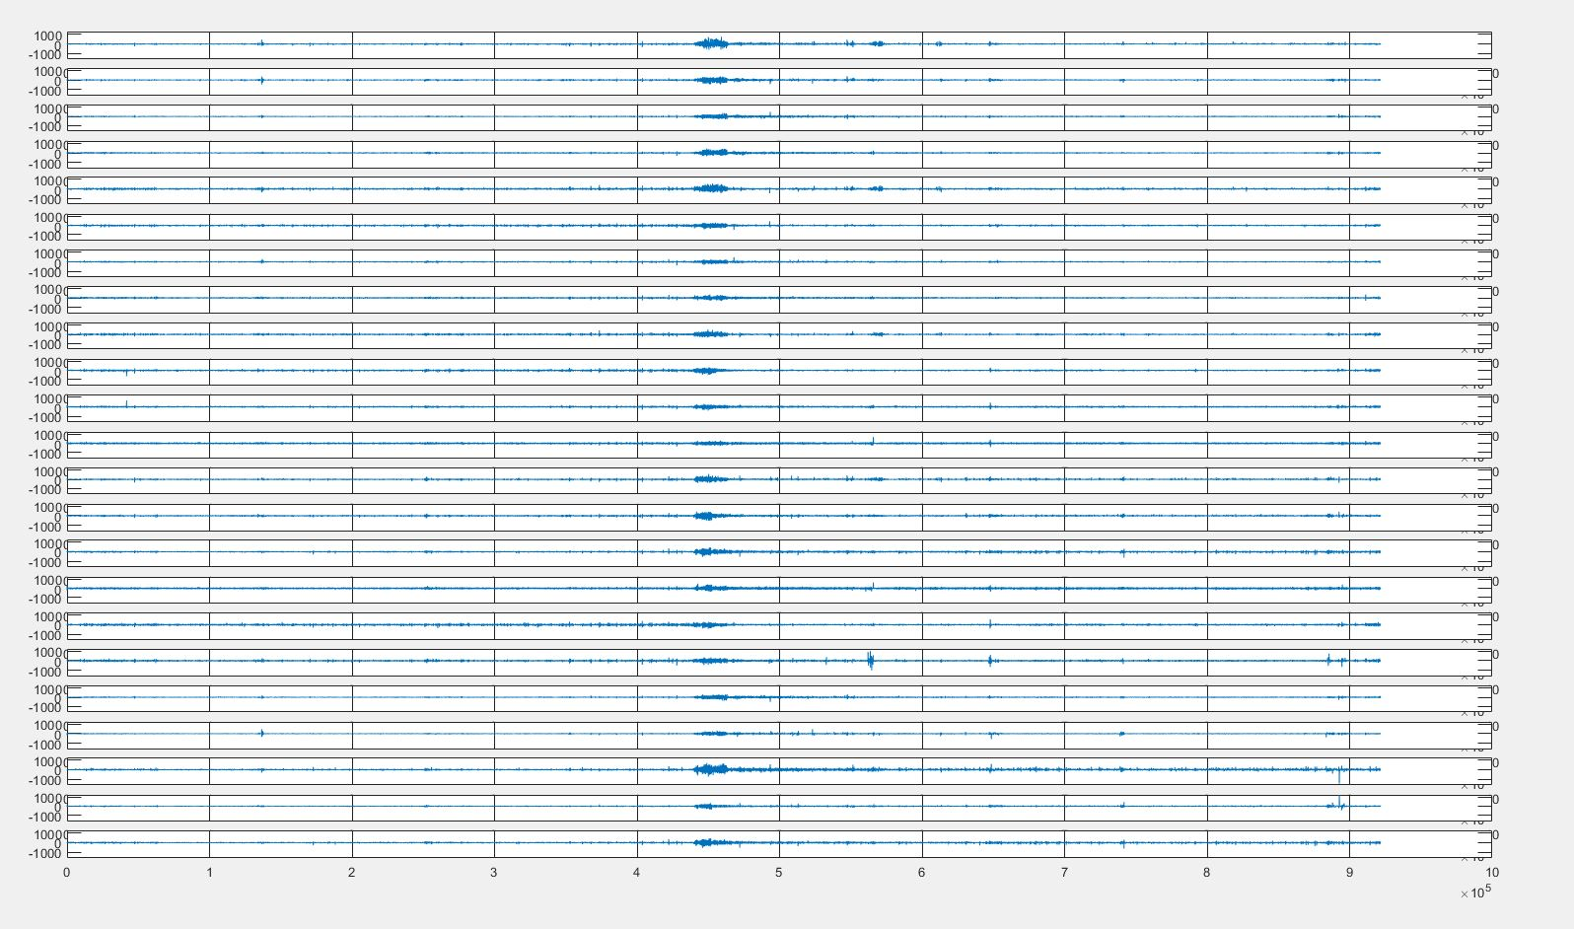
18

Slide 8
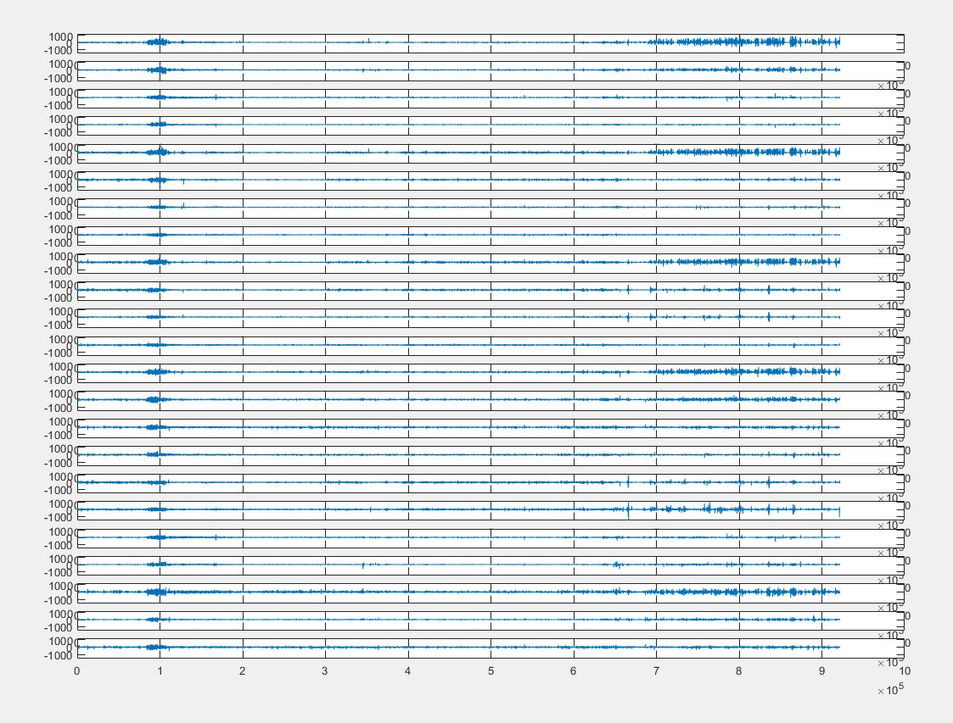
21

Slide 9
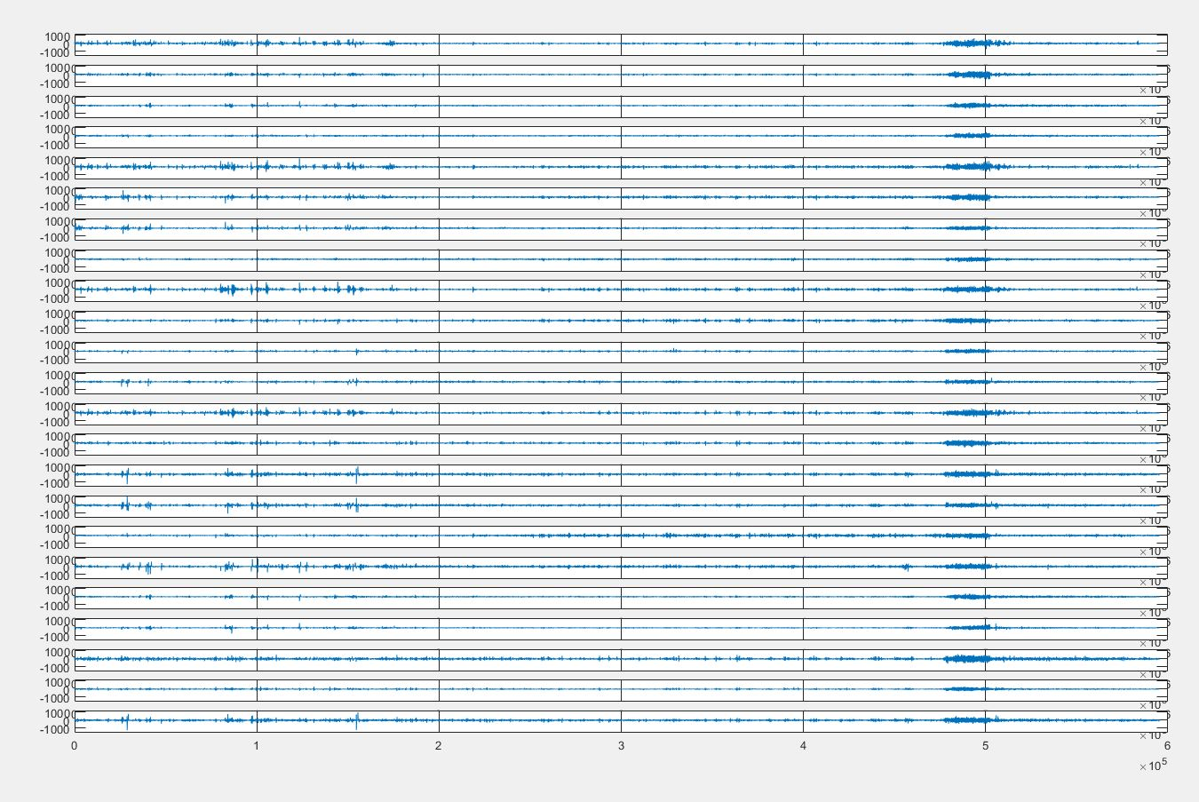
26

Slide 10
Back up

Slide 11
Onset_info script
#Generating target file for the COMPLETE DATA SET (=7)
#This file generates automatically input files and sizes
#translating EDF files from database (full dataset for patient = 1)
import pyedflib
import numpy as np
from matplotlib import pyplot as plt
import os
#import pandas as pd
import re
#defining parameters
output = 1
#X=np.array(sigbufs)
dataset_size = 40
initial_file = 0
def target_gen(output, dataset_size, file):
#target = np.zeros((dataset_size, batch_num, output))
filepath = file
dataset = 0
with open(filepath) as fp:
with open("onset_info.txt", 'w') as file1:
for cnt, line in enumerate(fp):
if line.startswith('File Name:'):
file_num = re.findall(r'\d+',line)
dataset = int(file_num[1]) + initial_file
if dataset == dataset_size + initial_file +1: #Finish when data set size is achieved
break
if line.startswith('Number of Seizures in File: 1'):
start_time = re.findall(r'\d+',fp.readline())
end_time = re.findall(r'\d+',fp.readline())
#batch_pos = int(abs((int(start_time[0]))*256/batch_size))
file1.write('dataset '+str(dataset)+' ')
file1.write('Start time '+str(start_time)+' ')
file1.write('End time '+str(end_time)+'\n')
initial_time = round(((int(start_time[0])*256)/100000)-0.5)*100000
file1.write('Initial time '+str(initial_time)+'\n')
print('INITIAL_TIME', start_time)
print('END_TIME', end_time)
#np.savetxt(file1, [start_time, end_time], delimiter="," )
#np.savetxt(file1, end_time, delimiter="," )
file1.close()
return print('File generated')
file = 'chb01-summary.txt'
target_gen(output, dataset_size, file )

Slide 12
CNN + LSTM
model = Sequential()
model.add(TimeDistributed(Conv2D(3,(2,2), activation = 'relu'), input_shape=(None,input_size_new,batch_size_new,1)))
model.add(TimeDistributed(MaxPooling2D(pool_size=(2,2))))
model.add(TimeDistributed(Conv2D(2,(2,2), activation = 'relu')))
model.add(TimeDistributed(MaxPooling2D(pool_size=(2,2))))
model.add(TimeDistributed(Flatten()))
model.add(LSTM(50))
model.add(Dense(output, activation='softmax'))
model.compile(loss='categorical_crossentropy', optimizer='adam')

Slide 13
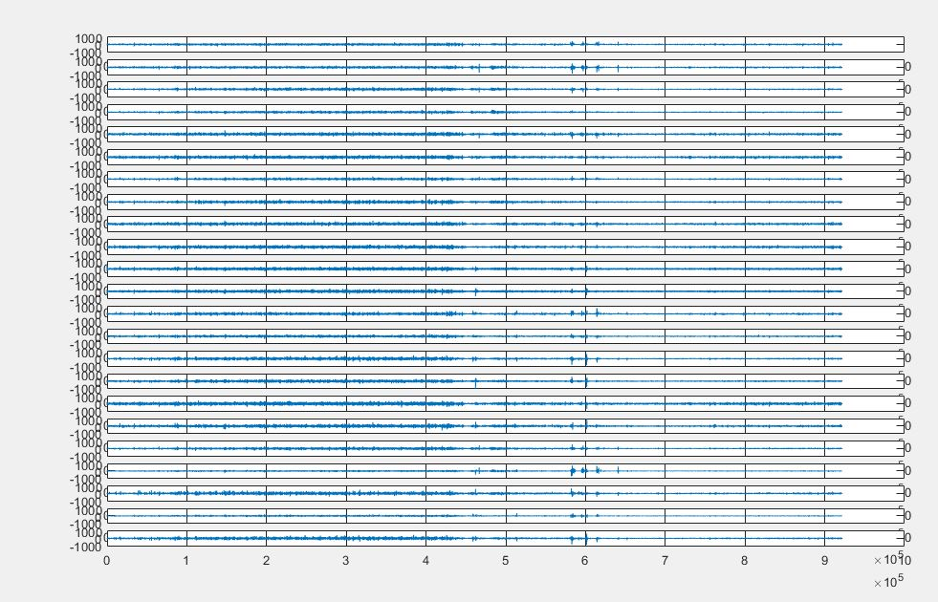
Wrong classify datasets : 34
Pre-ictal

Slide 14
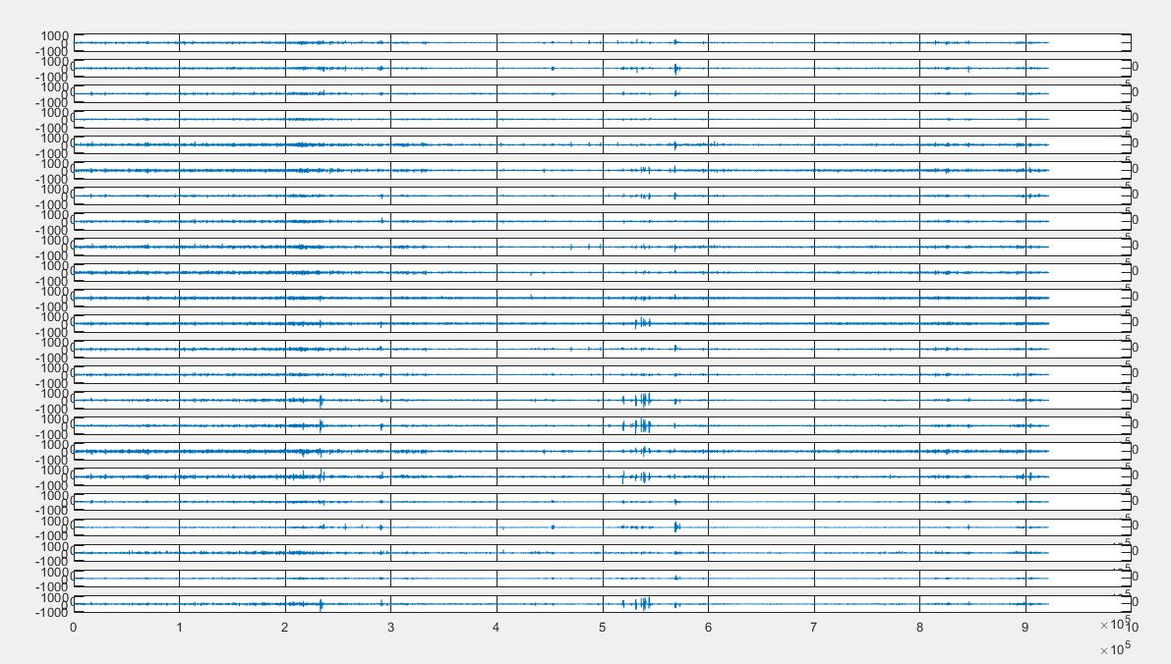
Dataset 35
Pre-ictal

Slide 15
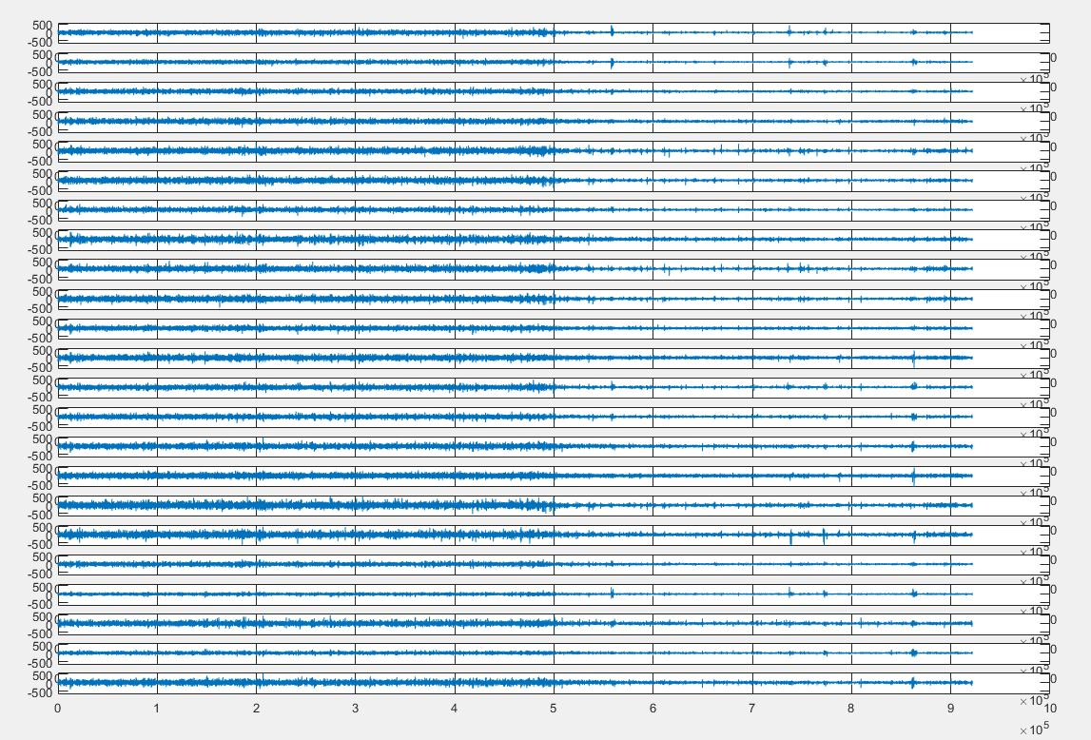
Dataset 17 (training - solved)

Slide 16
Results
_seq_NO_FILTER_epochs_EXTENDED_DATASET_TESTS
data_set inter-ictal pre-ictal ictal
0 50 0 0
1 18 31 1
2 50 0 0
3 47 3 0
4 44 6 0
5 50 0 0
6 17 27 2
7 47 3 0
8 26 0 24
9 50 0 0
10 48 2 0
11 49 1 0
12 50 0 0
13 50 0 0
14 23 27 0
15 8 42 0
16 50 0 0
17 50 0 0
18 50 0 0
19 49 1 0
TOTAL FALSE ICTAL 24
TOTAL FALSE PRE ICTAL 85
TOTAL DATASET WITH FALSE ICTAL 8
TOTAL DATASET WITH FALSE PRE ICTAL 1
Positive falses

