Slide 1
CNN/LSTM P03
Lizeth Gonzalez

Slide 2
Onset info
dataset 1 Start time ['362'] End time ['414']
Initial time 0
dataset 2 Start time ['731'] End time ['796']
Initial time 100000
dataset 3 Start time ['432'] End time ['501']
Initial time 100000
dataset 4 Start time ['2162'] End time ['2214']
Initial time 500000
dataset 34 Start time ['1982'] End time ['2029']
Initial time 500000
dataset 35 Start time ['2592'] End time ['2656']
Initial time 600000
dataset 36 Start time ['1725'] End time ['1778']
Initial time 400000
Training data set
Test data set

Slide 3
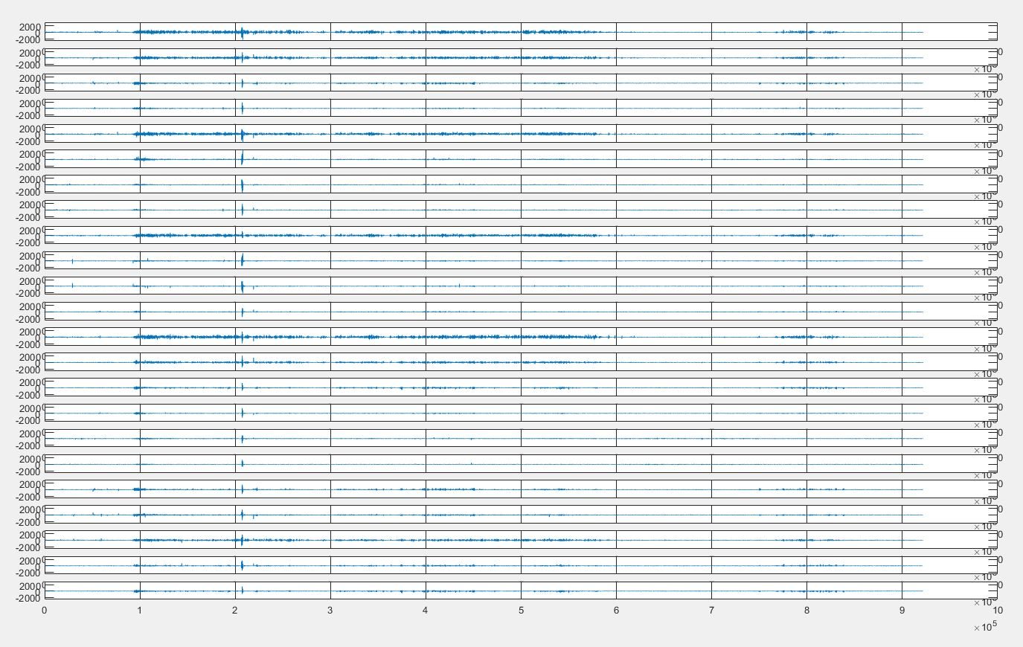
01

Slide 4
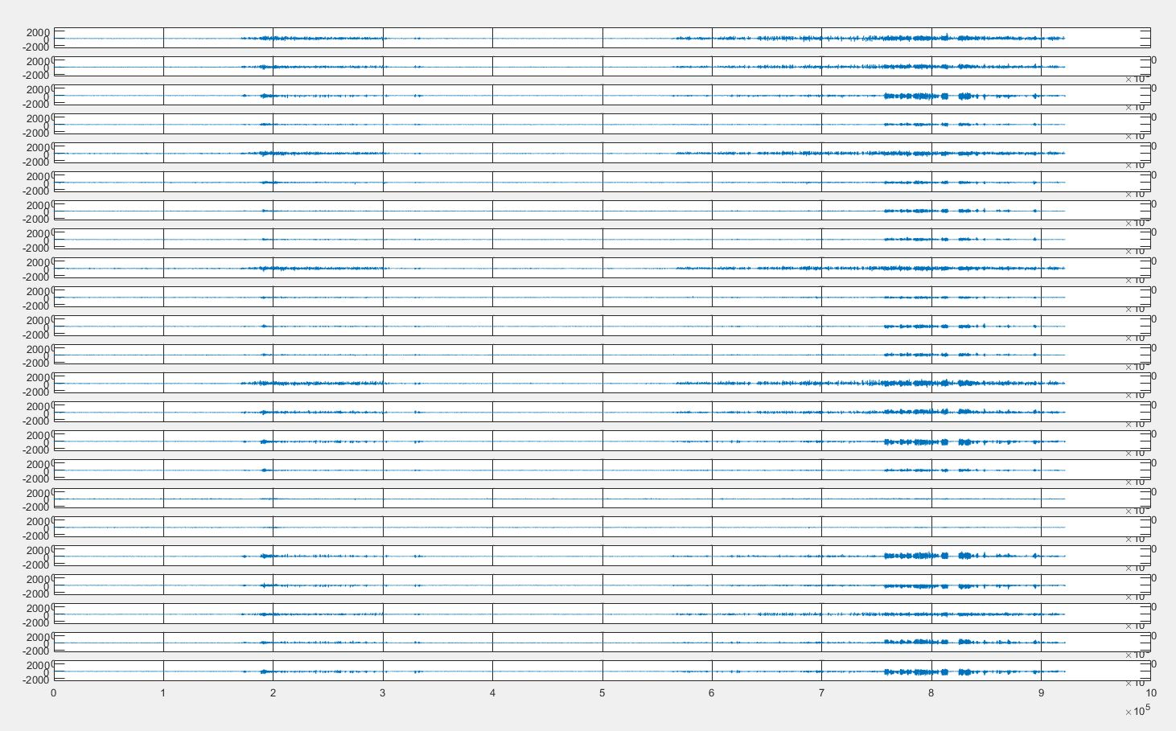
02

Slide 5
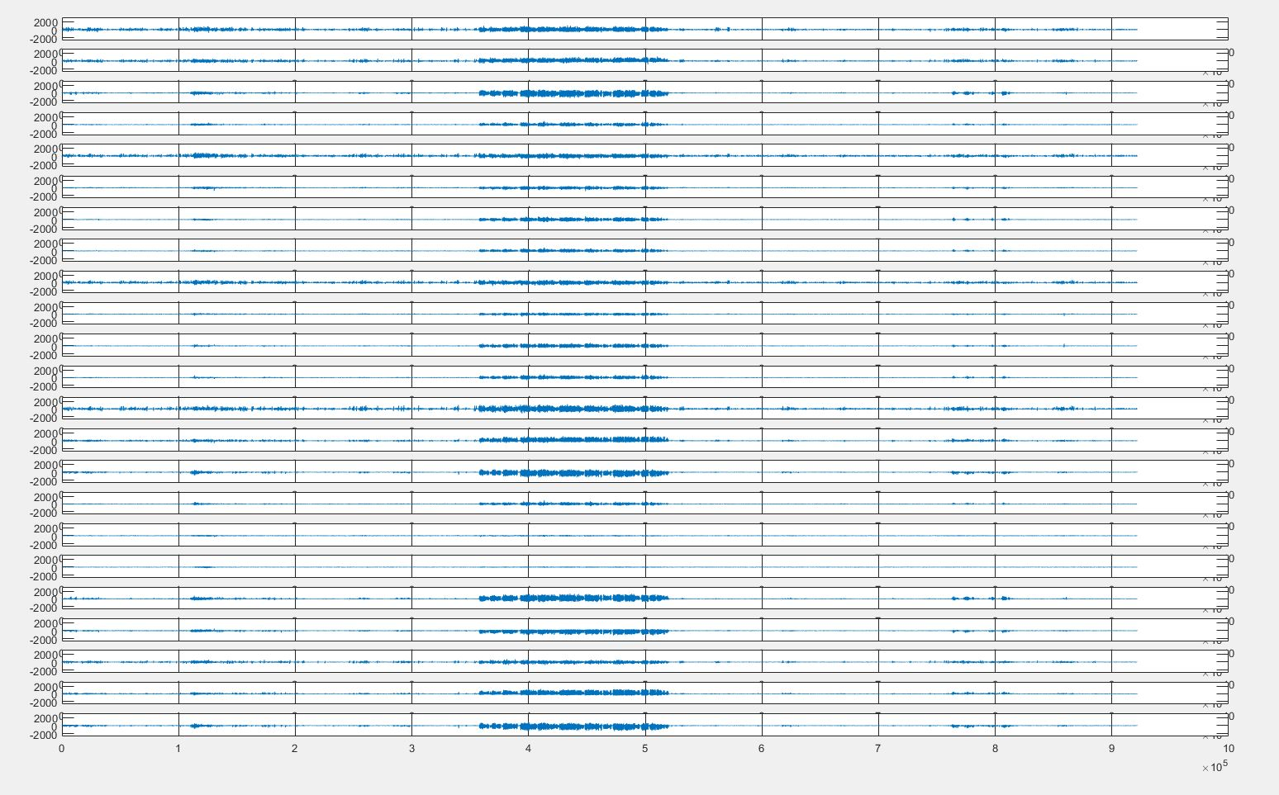
03

Slide 6
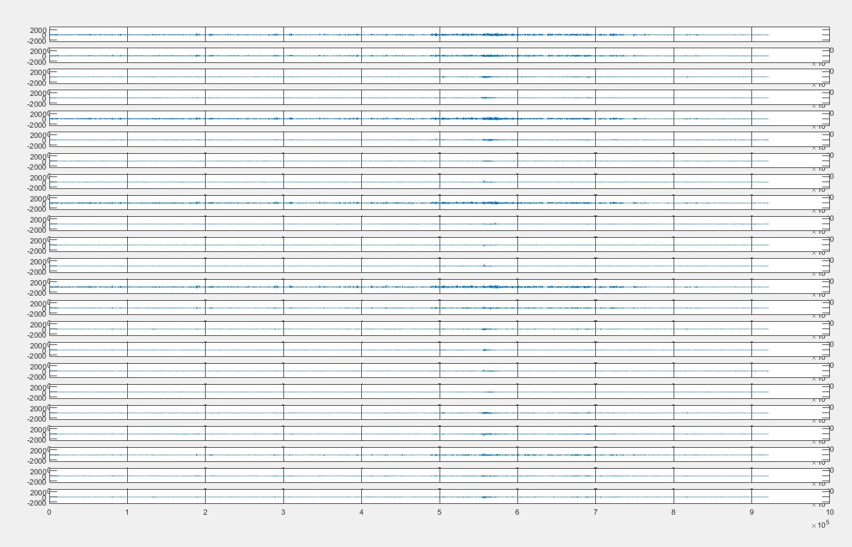
04

Slide 7
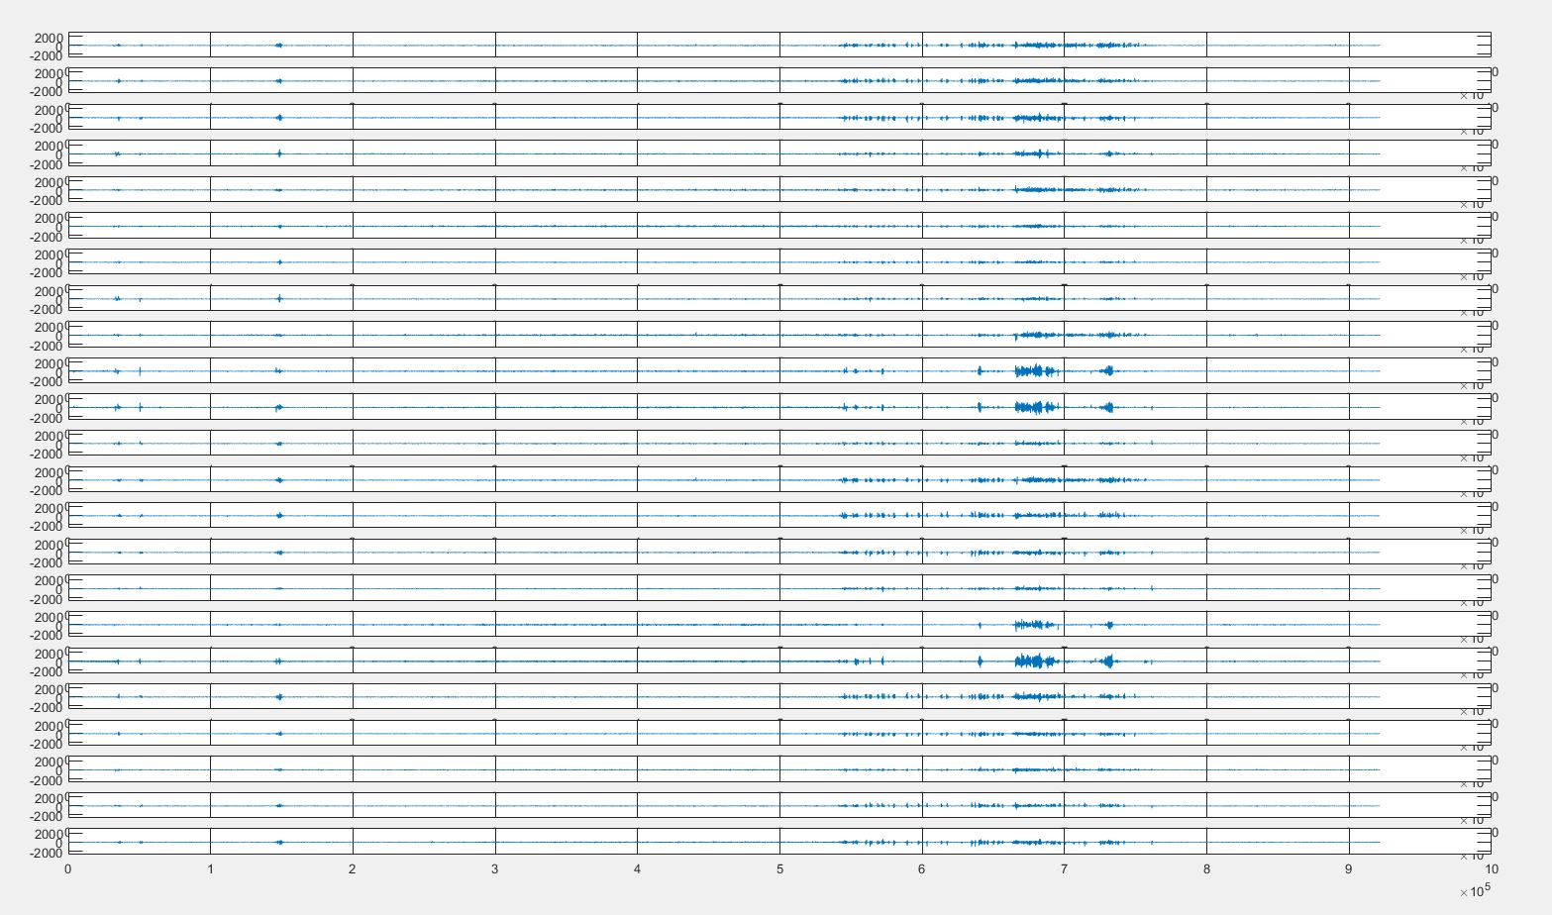
35

Slide 8
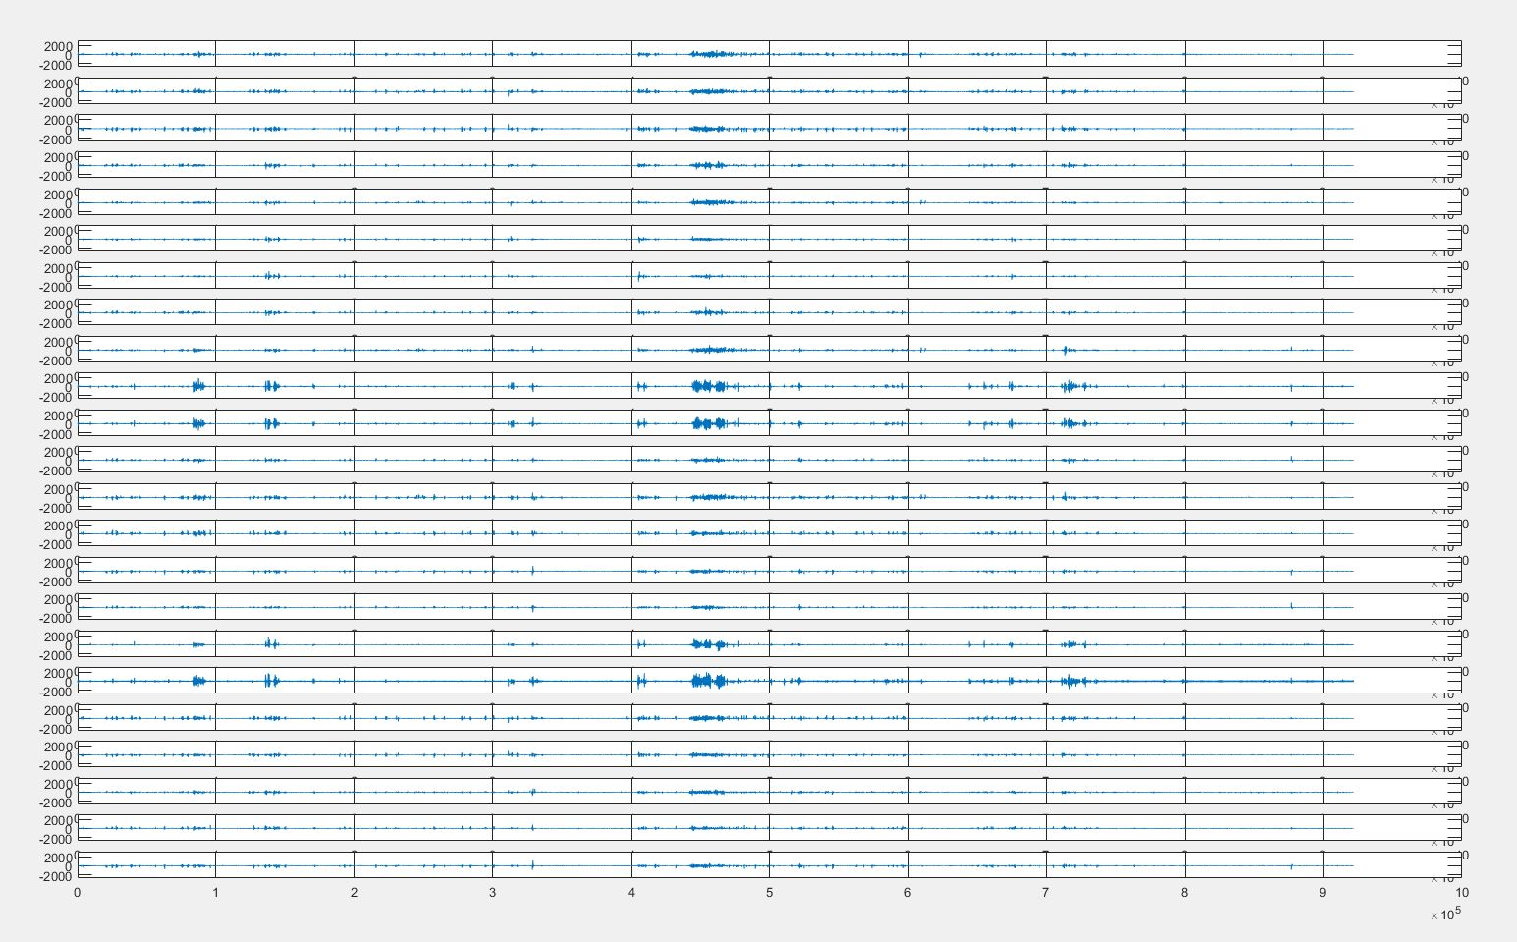
36

Slide 9
Back up

Slide 10
Onset_info script
#Generating target file for the COMPLETE DATA SET (=7)
#This file generates automatically input files and sizes
#translating EDF files from database (full dataset for patient = 1)
import pyedflib
import numpy as np
from matplotlib import pyplot as plt
import os
#import pandas as pd
import re
#defining parameters
output = 1
#X=np.array(sigbufs)
dataset_size = 40
initial_file = 0
def target_gen(output, dataset_size, file):
#target = np.zeros((dataset_size, batch_num, output))
filepath = file
dataset = 0
with open(filepath) as fp:
with open("onset_info.txt", 'w') as file1:
for cnt, line in enumerate(fp):
if line.startswith('File Name:'):
file_num = re.findall(r'\d+',line)
dataset = int(file_num[1]) + initial_file
if dataset == dataset_size + initial_file +1: #Finish when data set size is achieved
break
if line.startswith('Number of Seizures in File: 1'):
start_time = re.findall(r'\d+',fp.readline())
end_time = re.findall(r'\d+',fp.readline())
#batch_pos = int(abs((int(start_time[0]))*256/batch_size))
file1.write('dataset '+str(dataset)+' ')
file1.write('Start time '+str(start_time)+' ')
file1.write('End time '+str(end_time)+'\n')
initial_time = round(((int(start_time[0])*256)/100000)-0.5)*100000
file1.write('Initial time '+str(initial_time)+'\n')
print('INITIAL_TIME', start_time)
print('END_TIME', end_time)
#np.savetxt(file1, [start_time, end_time], delimiter="," )
#np.savetxt(file1, end_time, delimiter="," )
file1.close()
return print('File generated')
file = 'chb01-summary.txt'
target_gen(output, dataset_size, file )

Slide 11
Results

