Slide 1
Intro to Go
Jan Urbansky

Slide 2
What is Go?
Created at Google in 2009
Version 1.0 in 2012
Statically Typed
Compiled (Cross compilation)
Binaries (No VM or Engine needed)

Slide 3
Language Features
C-like syntax
Automatic type inference
Structs as „Classes“
Structs have Methods
Functions have multiple return values
Implicit Interfaces
Closures, defer
No exceptions
Arrays, Slices, Maps (no generics)
Packages as Namespaces

Slide 4
Goroutines
Goroutines are the concurrency of go
They are functions that run in the background
Comparable to threads but more lightweight
GR are mapped to OS threads
If all GR wait (deadlock), the program exits
Communication between GR is possible with shared Variables or Channels
Shared Variables → Need for mutex

Slide 5
Channels
Type safe message queue
Buffered or Unbuffered
Read:
x := ← myChan
Write:
myChan ← x

Slide 6
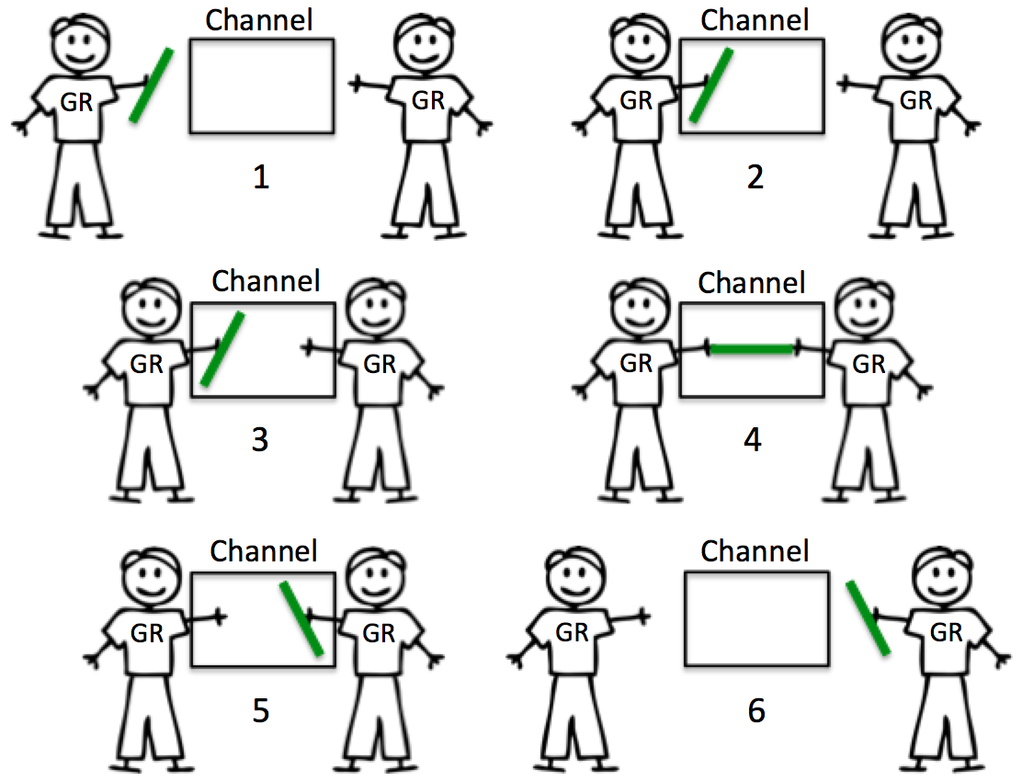
Unbuffered Channels

Slide 7
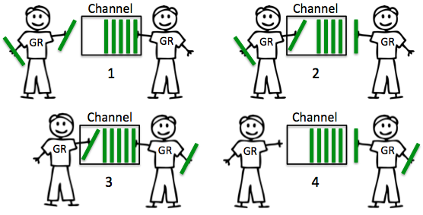
Buffered Channels

Slide 8
Example program
Task: Write a program that collects reports of events from different soft- or hardware components. The components send the report in random intervals.

Slide 9
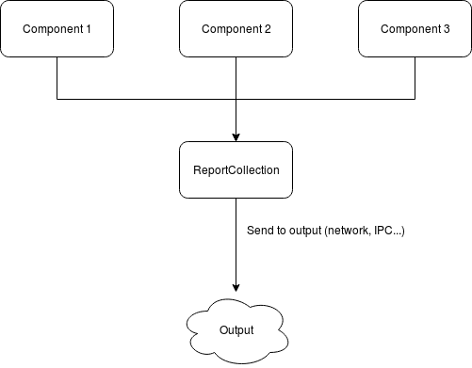
Architecture

Slide 10
Resources
Official Website: https://golang.org/
Language Design: https://talks.golang.org/2012/splash.article
Detailed Explanation of Channels:
https://www.ardanlabs.com/blog/2014/02/the-nature-of-channels-in-go.html
Article about the Goroutine Scheduler:
https://rakyll.org/scheduler/

Slide 11
Books
Learning the language:
- Introducing Go
- The Go Programming Language (extensive)
Recommendation if you want to get stuff done:
- Go in Action
The books are available on the shared server in the book section (buecher/go)
The other books are domain specific or of questionable quality

Slide 12
Source of Images
Unbuffered Channels:
https://www.ardanlabs.com/blog/images/goinggo/Screen+Shot+2014-02-16+at+10.10.54+AM.png
Buffered Channels:
https://www.ardanlabs.com/blog/images/goinggo/Screen+Shot+2014-02-17+at+8.38.15+AM.png

