Slide 1

Notes:
Open warm. JanVayu means 'People's Air'. This is a public record of India's air-quality crisis — the data, the health toll, the money, and the tools — built for citizens, not experts.

Slide 2
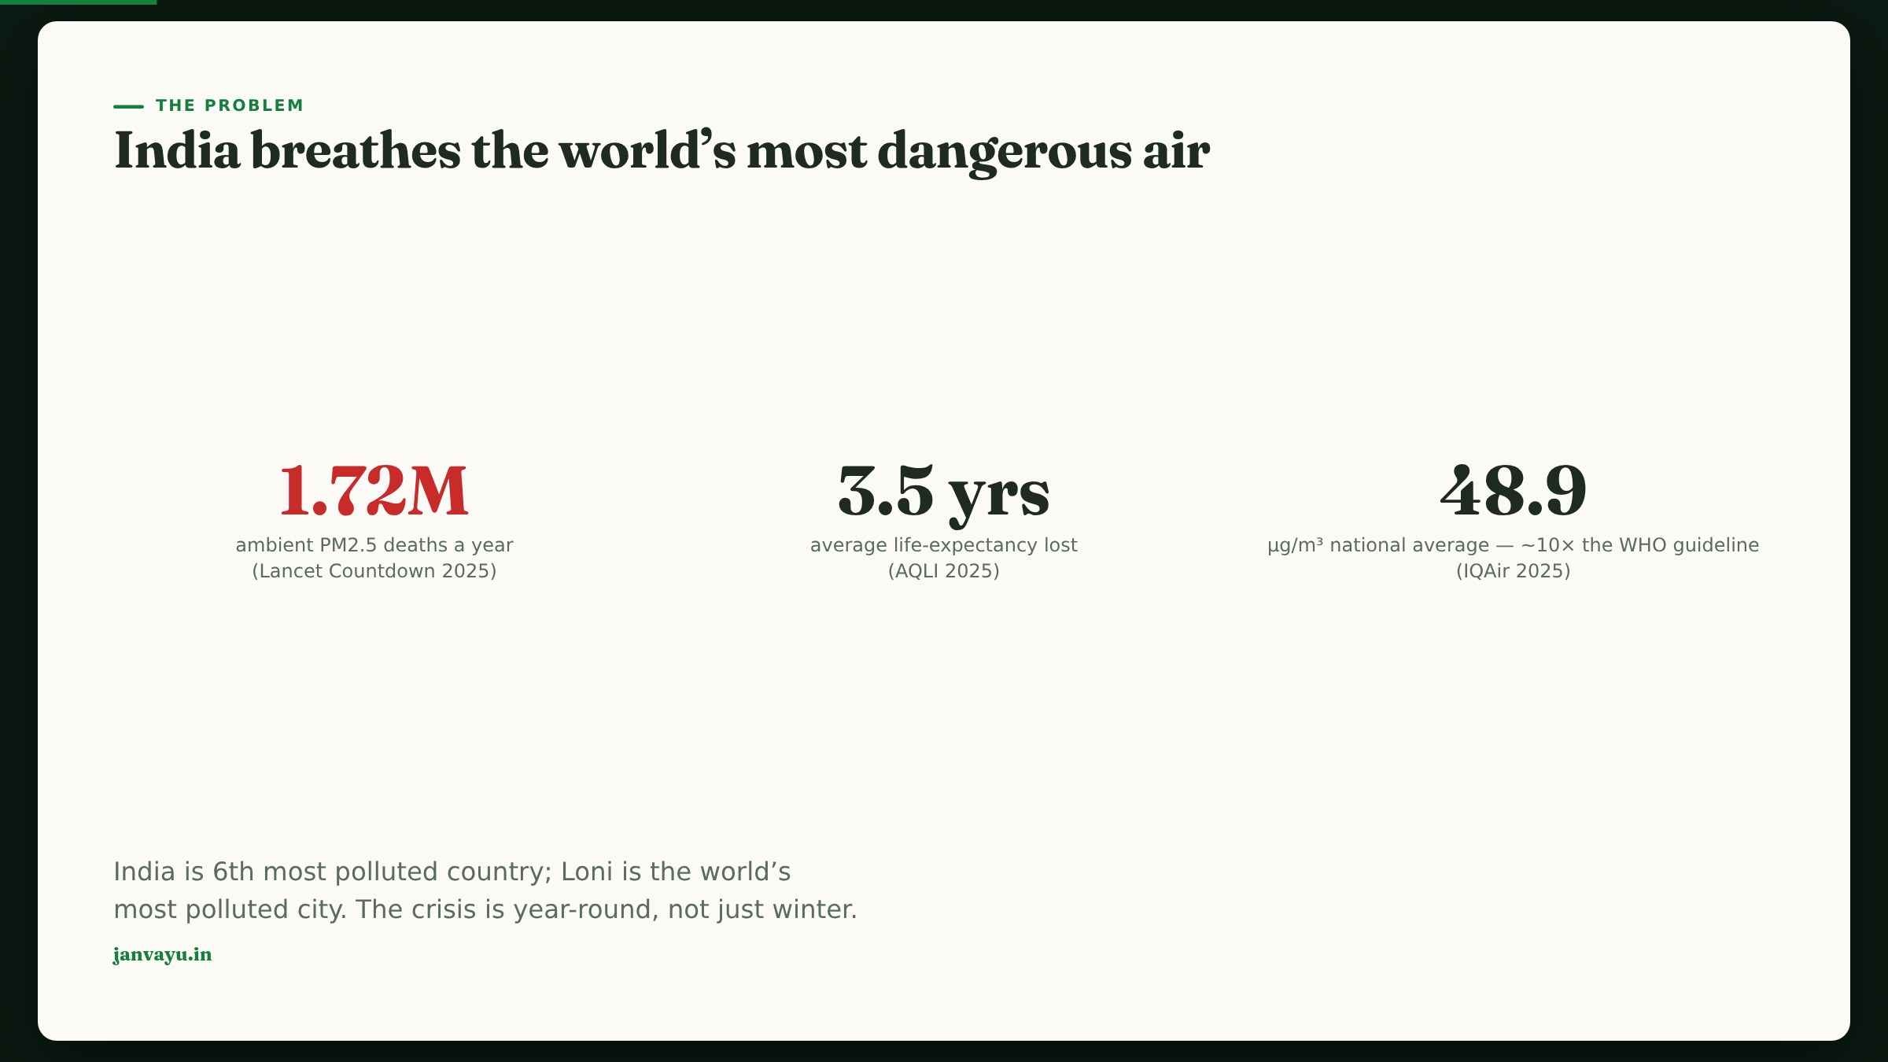
Notes:
Lead with the human cost, sourced. 1.72M ambient PM2.5 deaths (Lancet Countdown 2025); counting household air pollution the total is ~2.1M (SoGA 2024). 3.5 years of life lost on average. This is year-round, not just a Delhi-winter story.

Slide 3
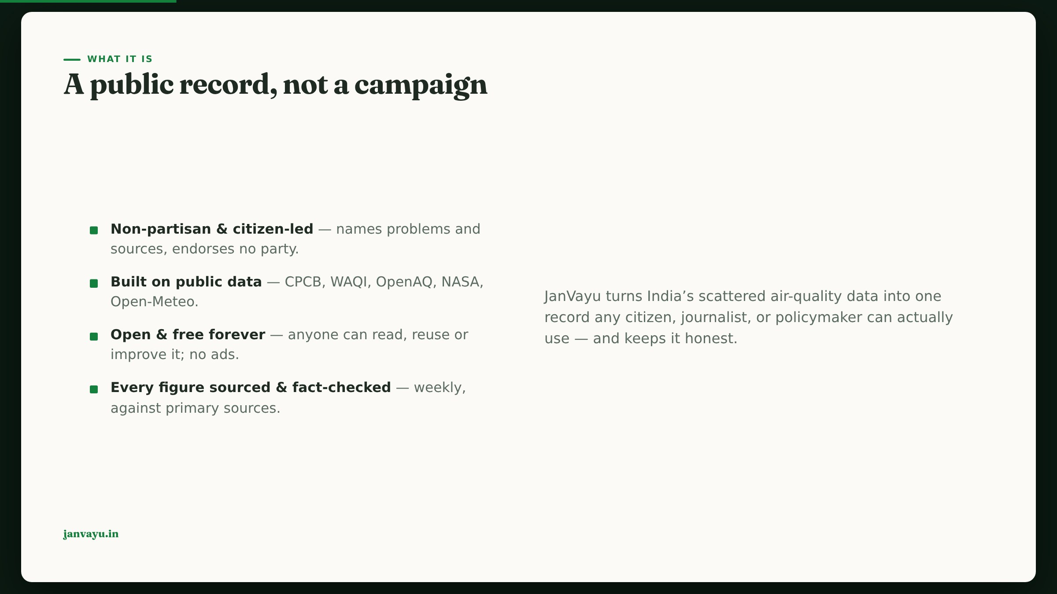
Notes:
Frame the stance: a record, not a campaign. Non-partisan, citizen-led, open source, and — crucially — fact-checked. That last point is the credibility anchor.

Slide 4
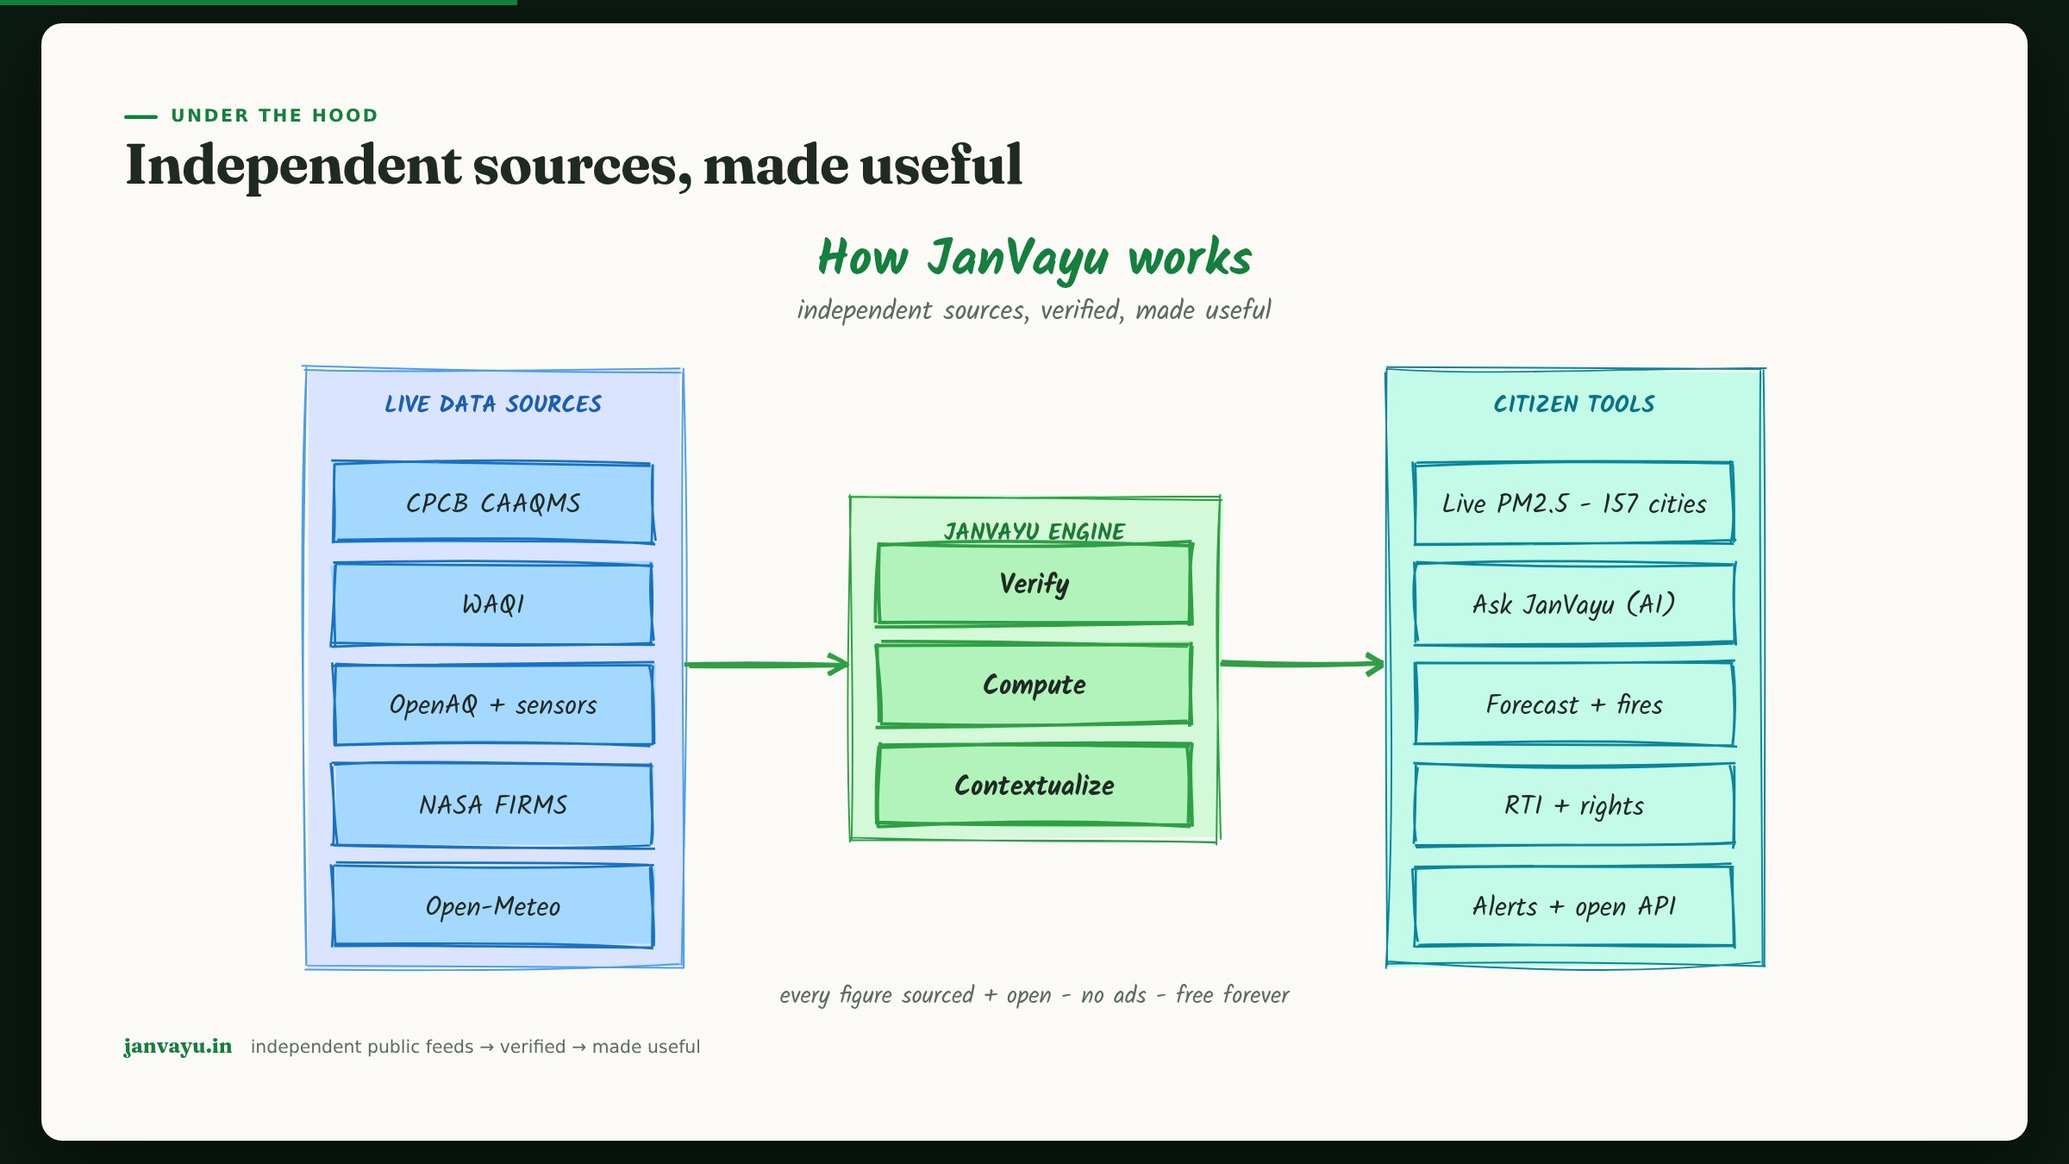
Notes:
The system diagram: independent public feeds are verified, computed and contextualised, then turned into citizen tools. No single source, no black box.

Slide 5
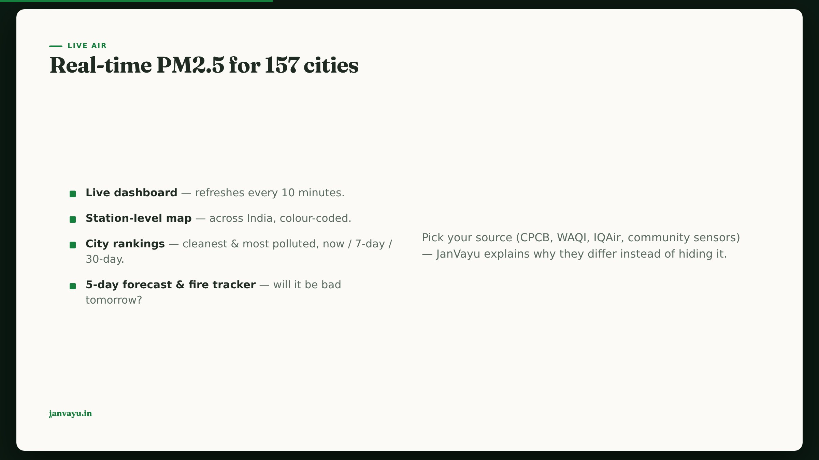
Notes:
Show the live product. Lead with PM2.5 in µg/m³, not the AQI — AQI is a derived index and PM2.5 is the pollutant that does the damage. 157 cities, 10-minute refresh, station map, rankings, forecast, fire tracker. Emphasise source transparency — we explain why CPCB/WAQI/IQAir differ.

Slide 6
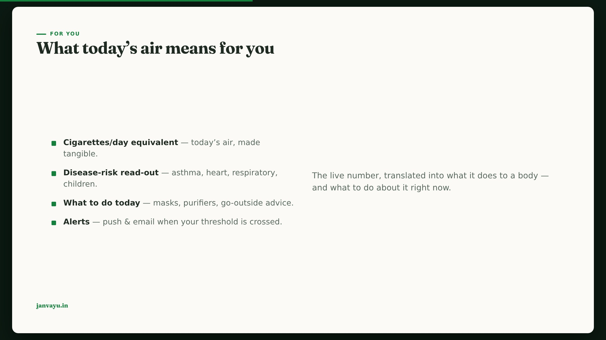
Notes:
Make it personal. The cigarettes-per-day metric lands with any audience. Then disease risk and concrete 'what to do today' advice, plus alerts.

Slide 7
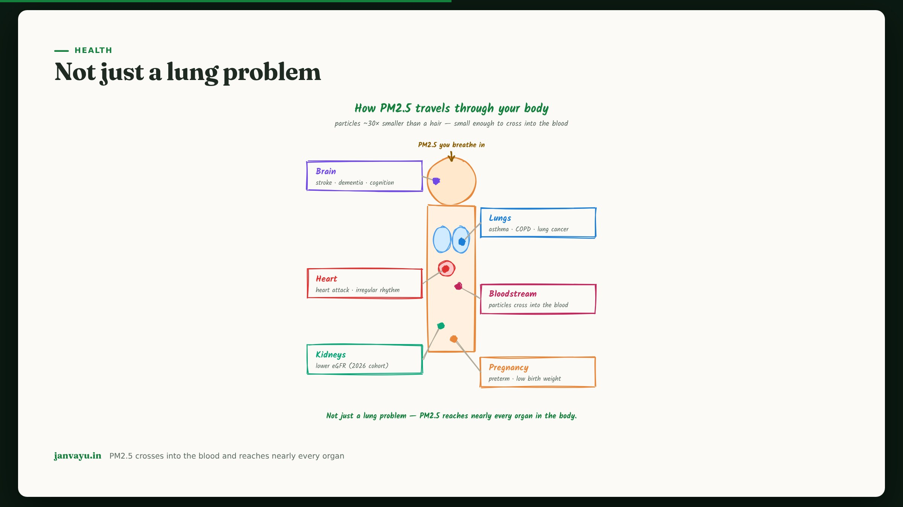
Notes:
Health beyond breathing: brain, heart, kidneys, bloodstream, pregnancy. The argument for health-complete alerts that don't stop at the lungs.

Slide 8
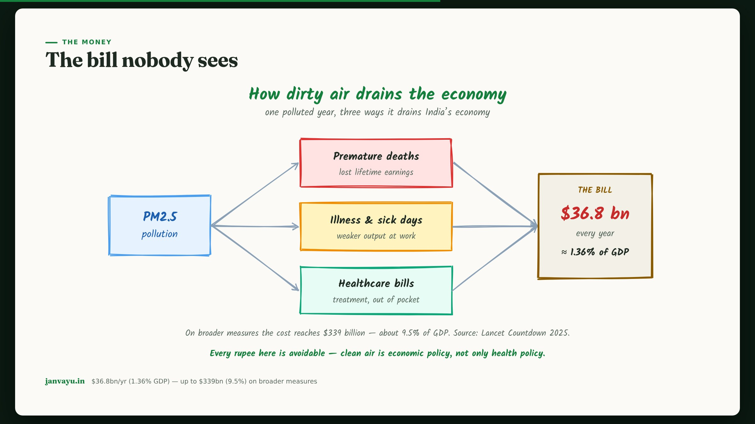
Notes:
The economic case — useful for policymakers. $36.8bn/yr on the narrower measure (1.36% GDP), up to $339bn (9.5%) broader. Clean air is economic policy.

Slide 9
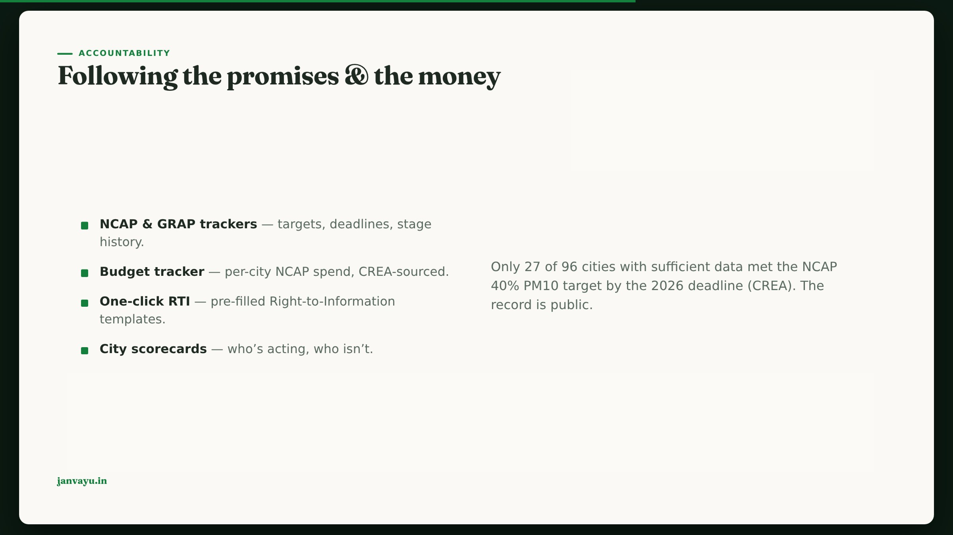
Notes:
Accountability is the differentiator. NCAP/GRAP trackers, per-city budgets, one-click RTI. Cite the CREA figure: 27 of 96 cities met the target.

Slide 10
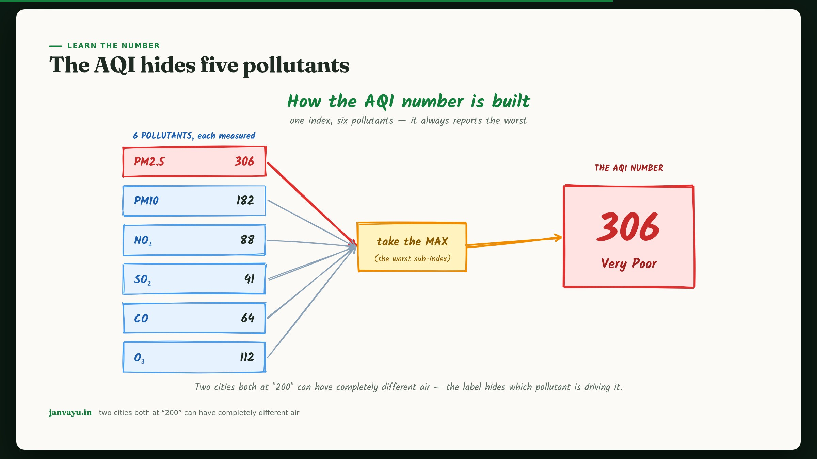
Notes:
A short teaching moment: the AQI reports only the worst of six pollutants, so the single number hides what's driving it. Good for journalists.

Slide 11
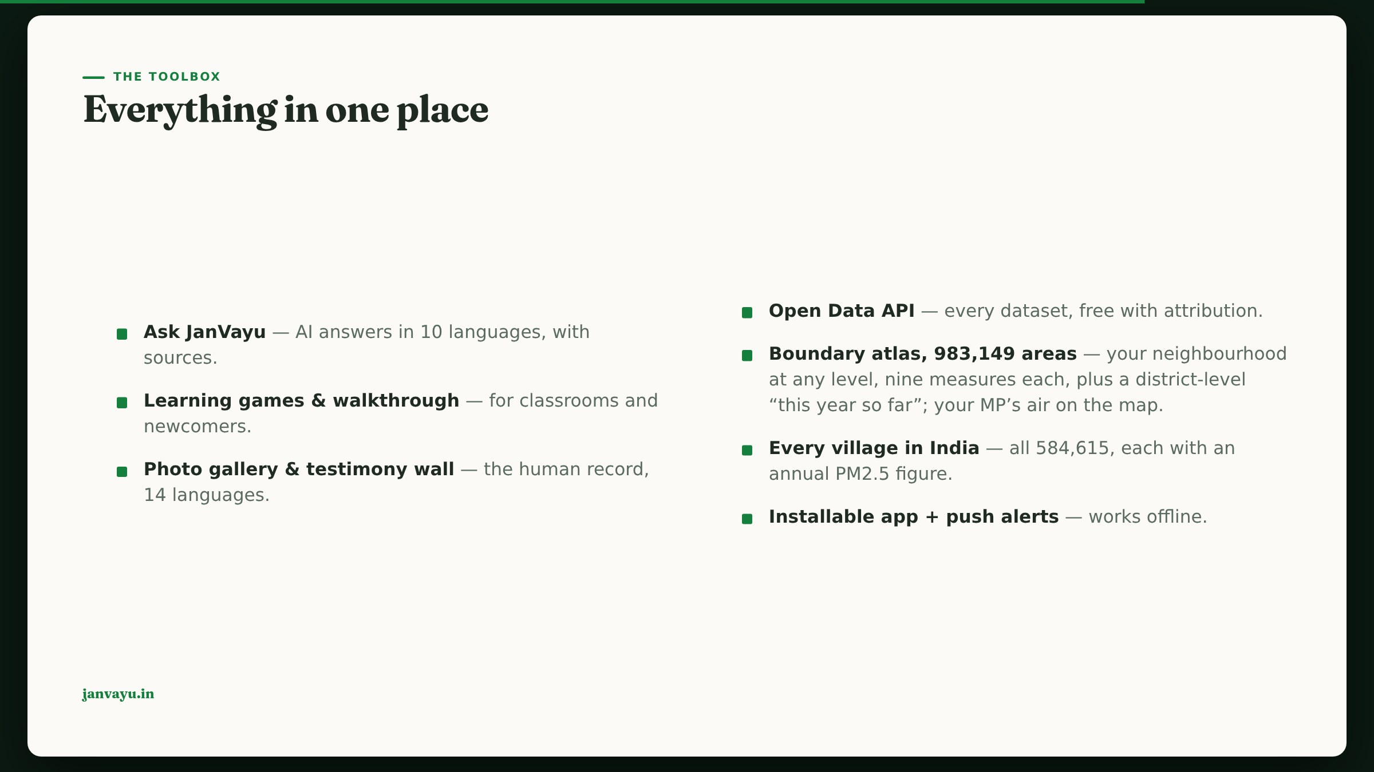
Notes:
Breadth without clutter: Ask JanVayu, games, gallery, testimony, open API, boundary atlas, installable app. One place.

Slide 12
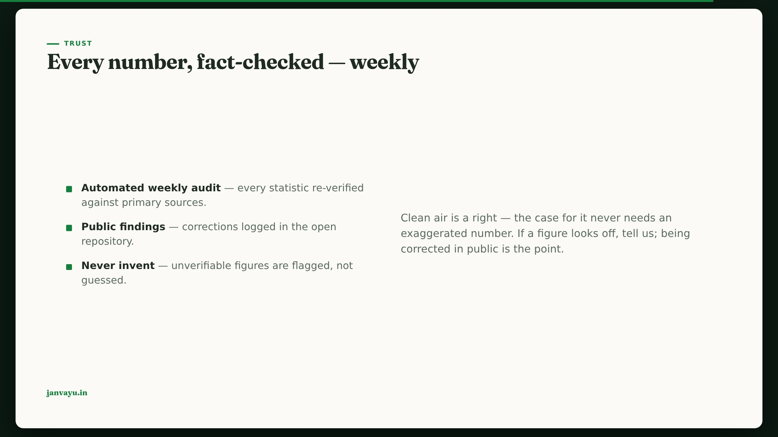
Notes:
Close the trust loop: the weekly automated fact-check. This is what lets us stand behind every number on stage.

Slide 13
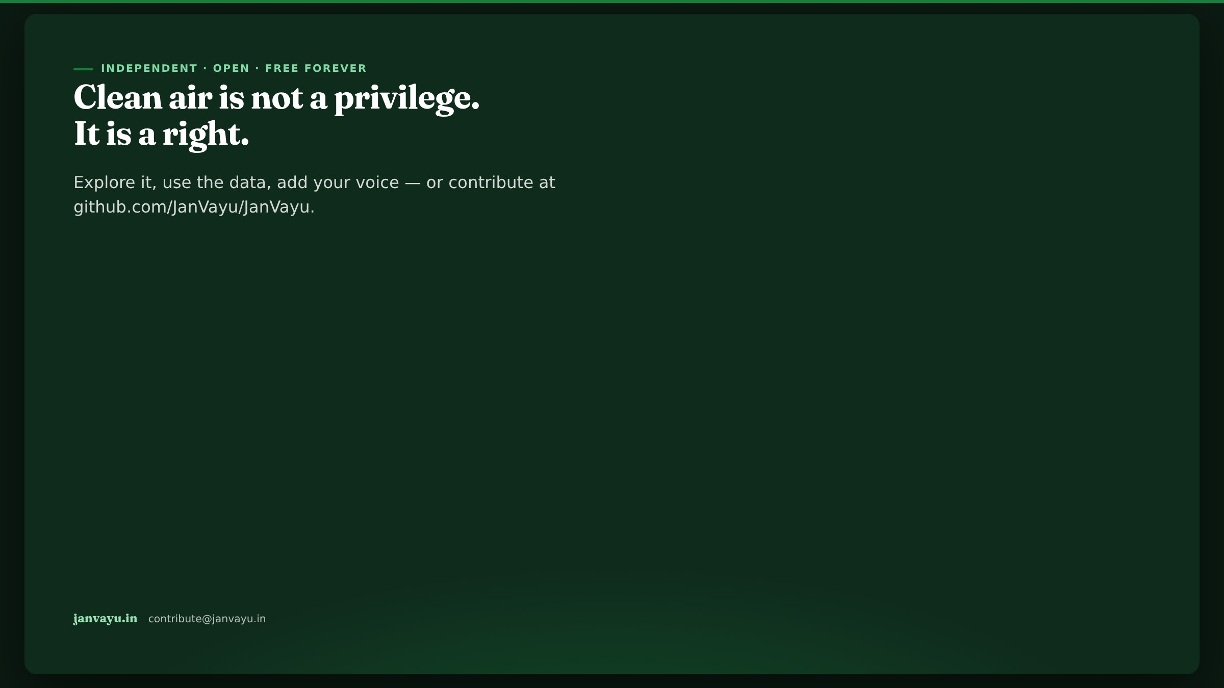
Notes:
Land the mission. Clean air is a right. Invite the audience to use the data and contribute. End on janvayu.in.

