Slide 1

Notes:
This is the long walkthrough: a slide for essentially every panel on the site. Use it to train a newsroom, brief a class, or onboard a collaborator. For a 10-minute overview instead, use the short deck.

Slide 2

Notes:
Chapter 1: Why it exists. Set the stakes and the stance before touching the product.

Slide 3
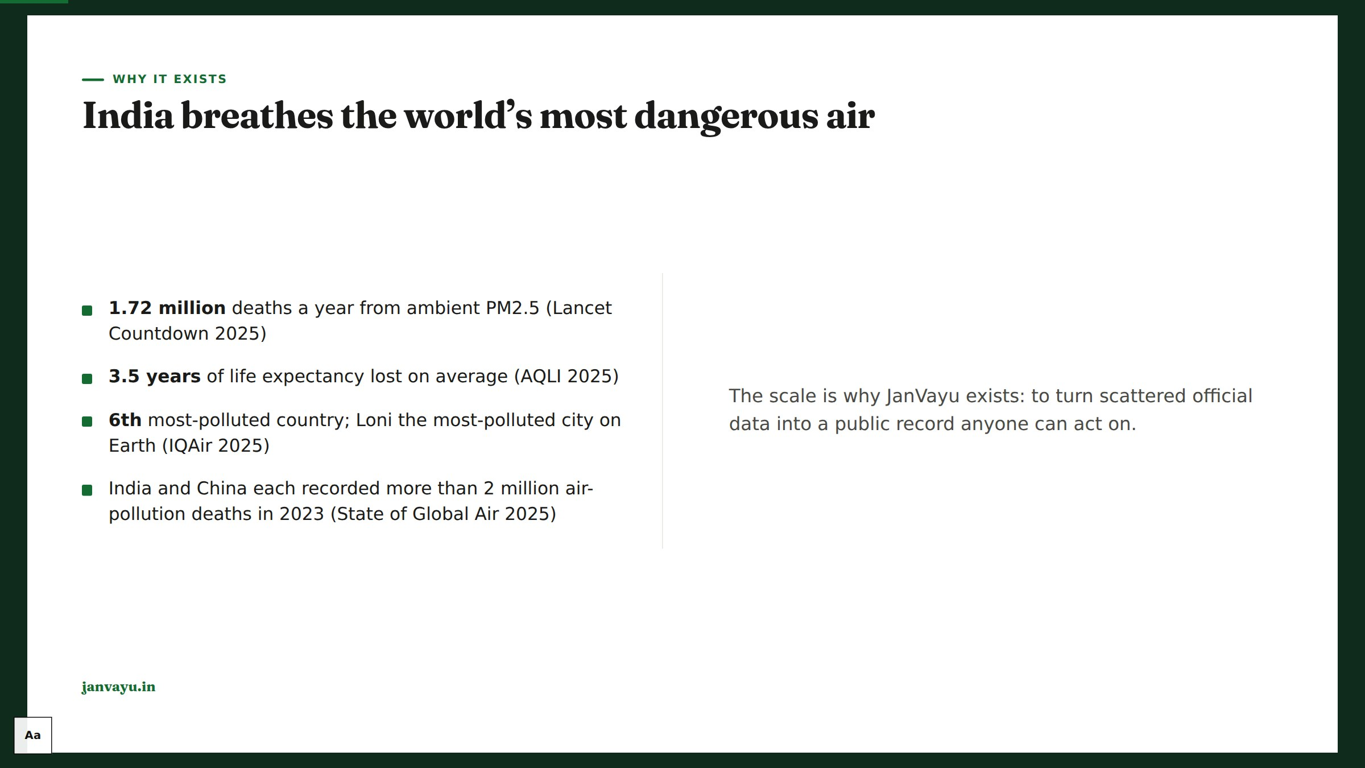
Notes:
Open on the human scale, sourced. These are the anchor numbers repeated across the site, each fact-checked against its primary source.

Slide 4
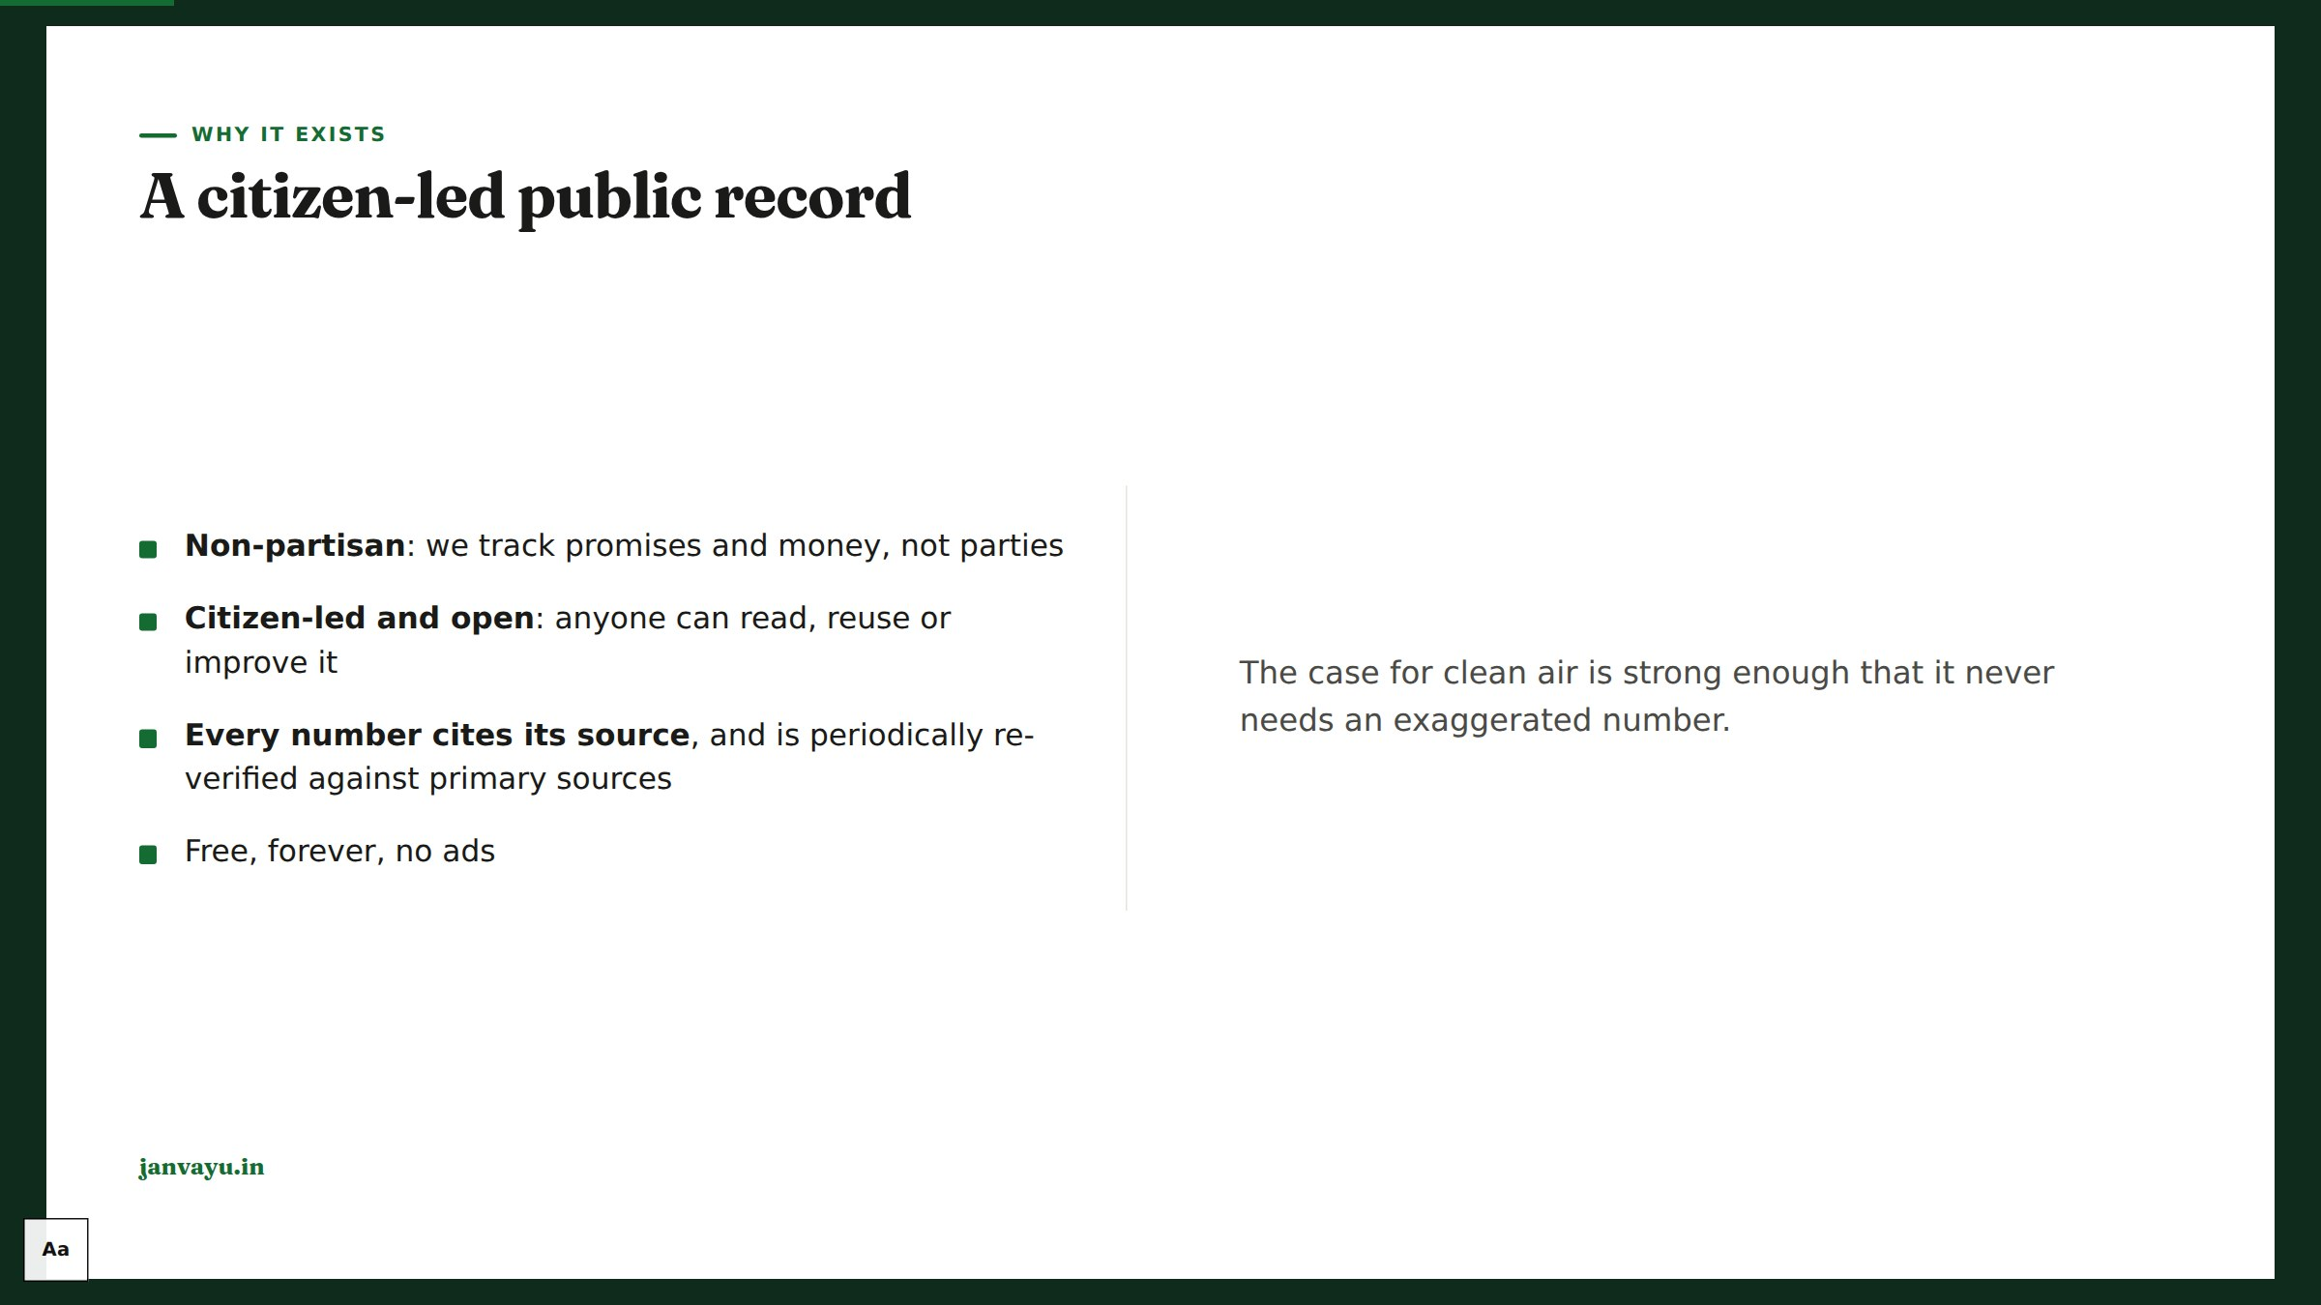
Notes:
Establish trust posture early: independence, sourcing, and the self-fact-checking discipline are the platform’s backbone.

Slide 5
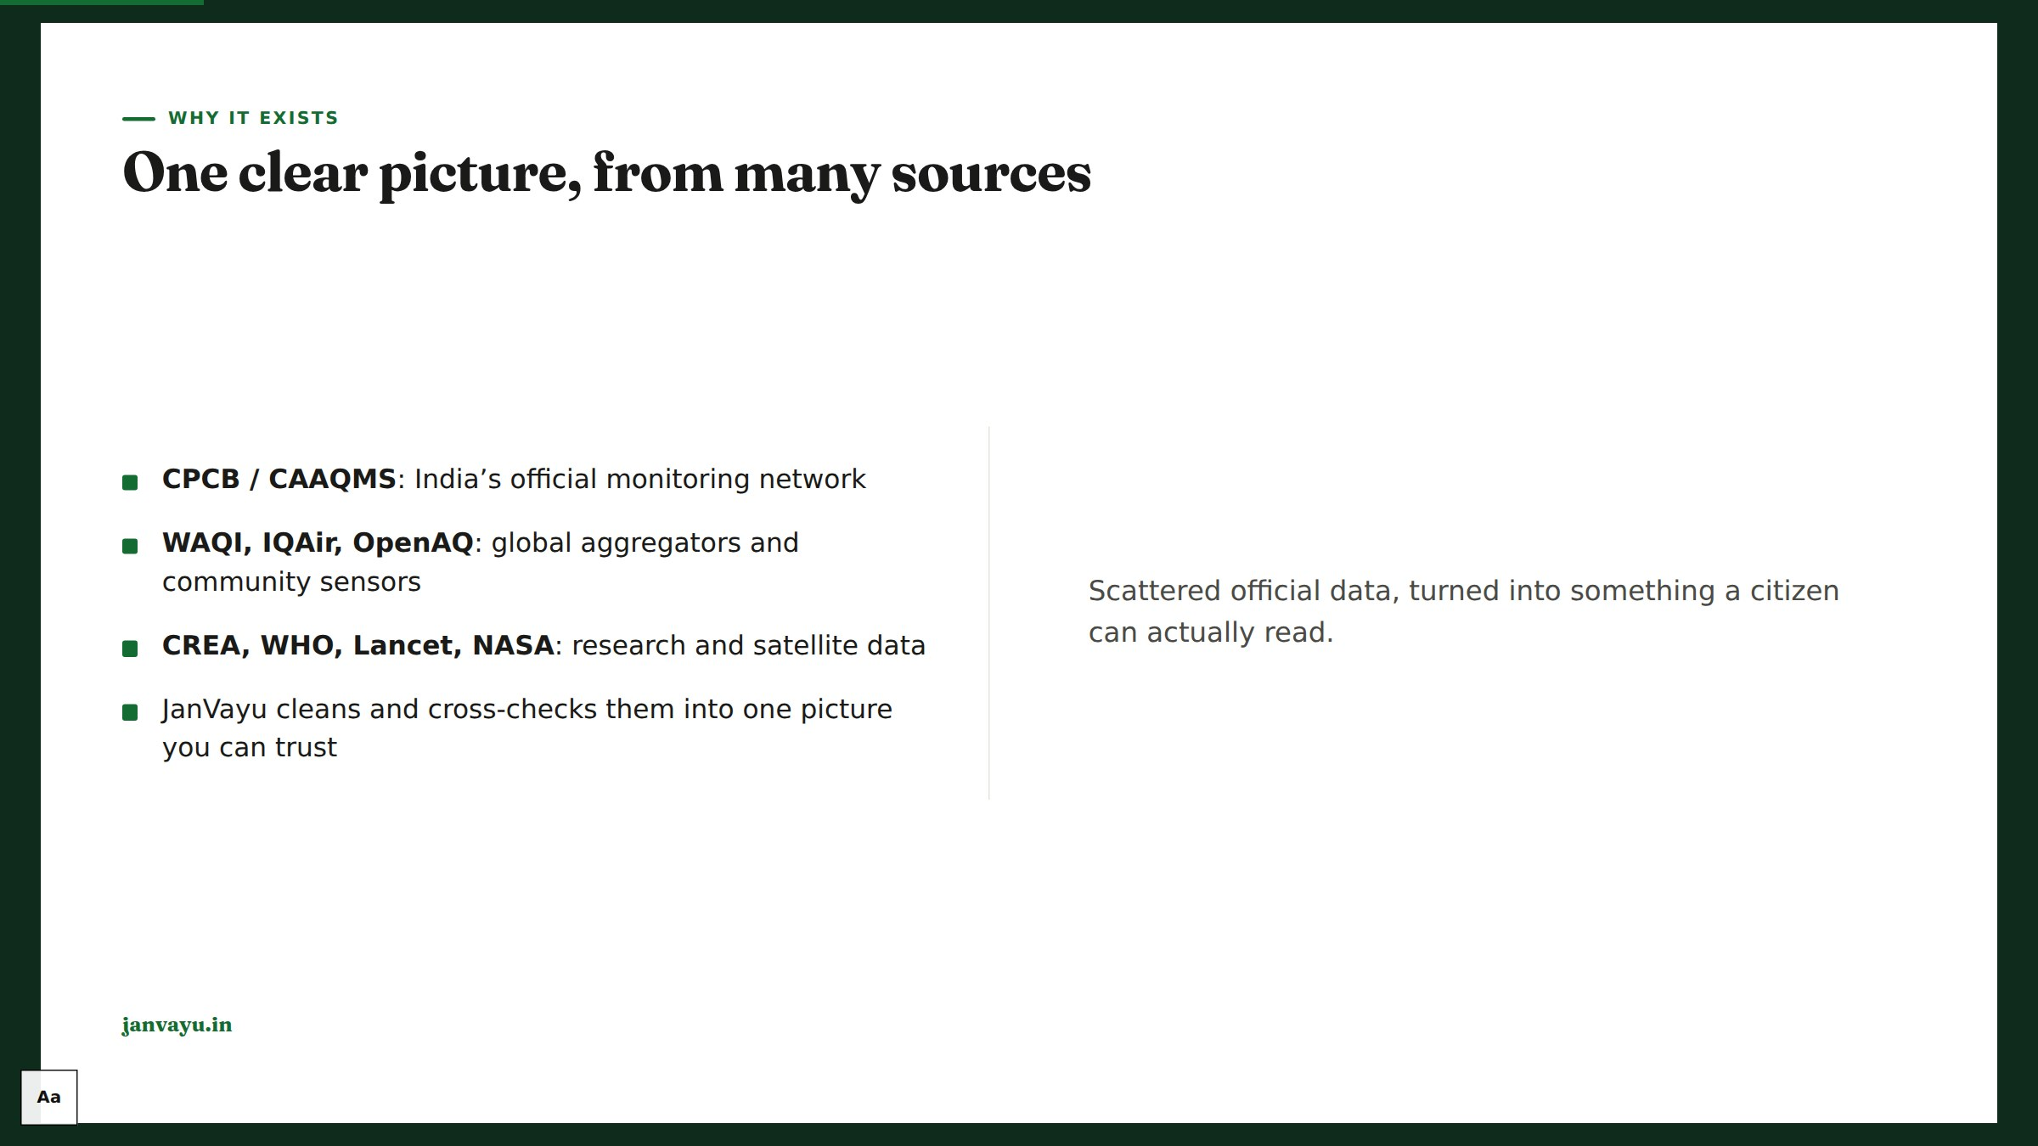
Notes:
The value-add is synthesis and honesty, not owning sensors. Name the sources so users can verify.

Slide 6

Notes:
Chapter 2: The live picture. The real-time panels, the ones people check daily.

Slide 7

Notes:
Walk the dashboard top to bottom; point out the city selector drives the whole page.

Slide 8
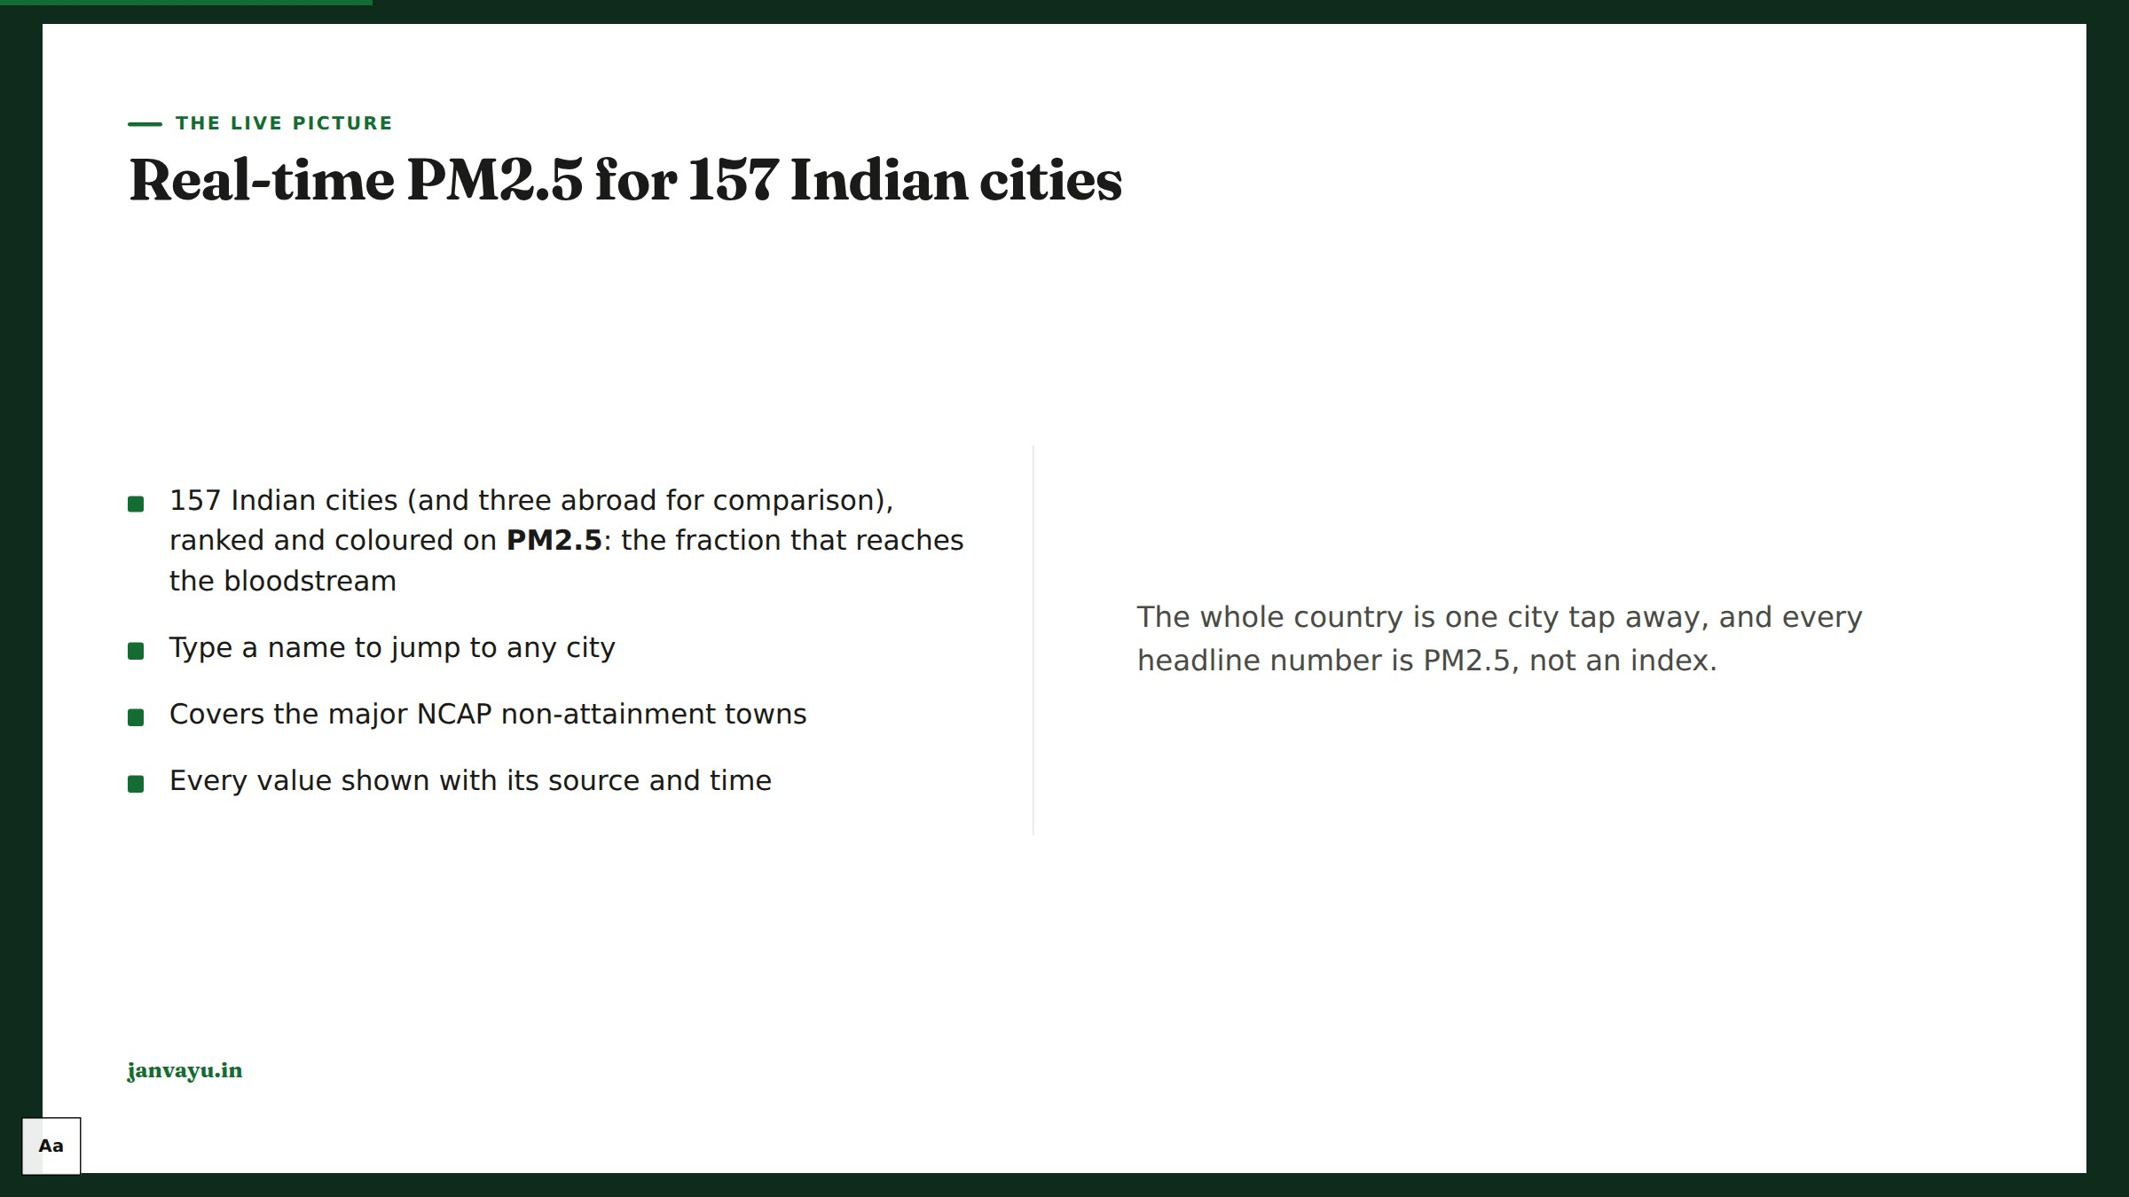
Notes:
Core cities load live; the rest load when picked, to stay inside the data source’s free tier.

Slide 9
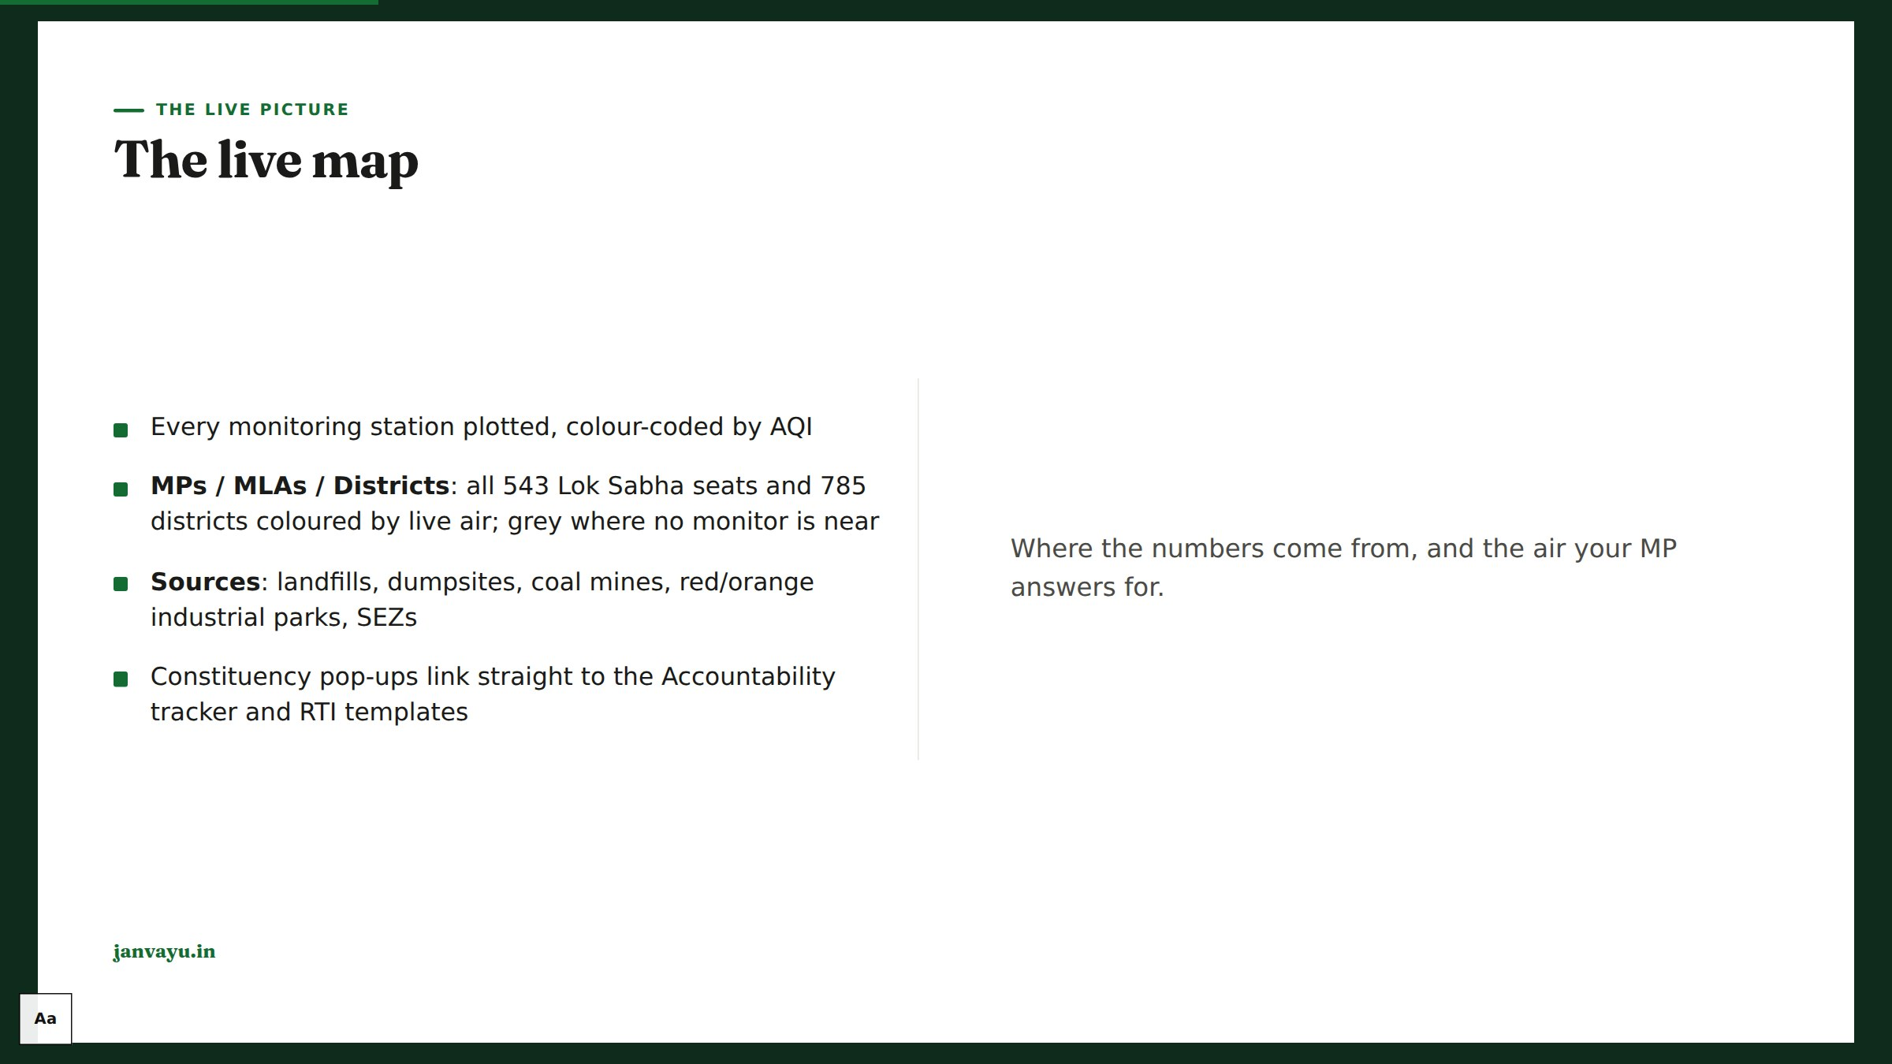
Notes:
Emphasise the grey constituencies: that is the real monitoring gap, not a rendering error. Boundaries and source locations come from indianopenmaps.com (SBM, LGD, GatiShakti mirrors), attributed on the map.

Slide 10
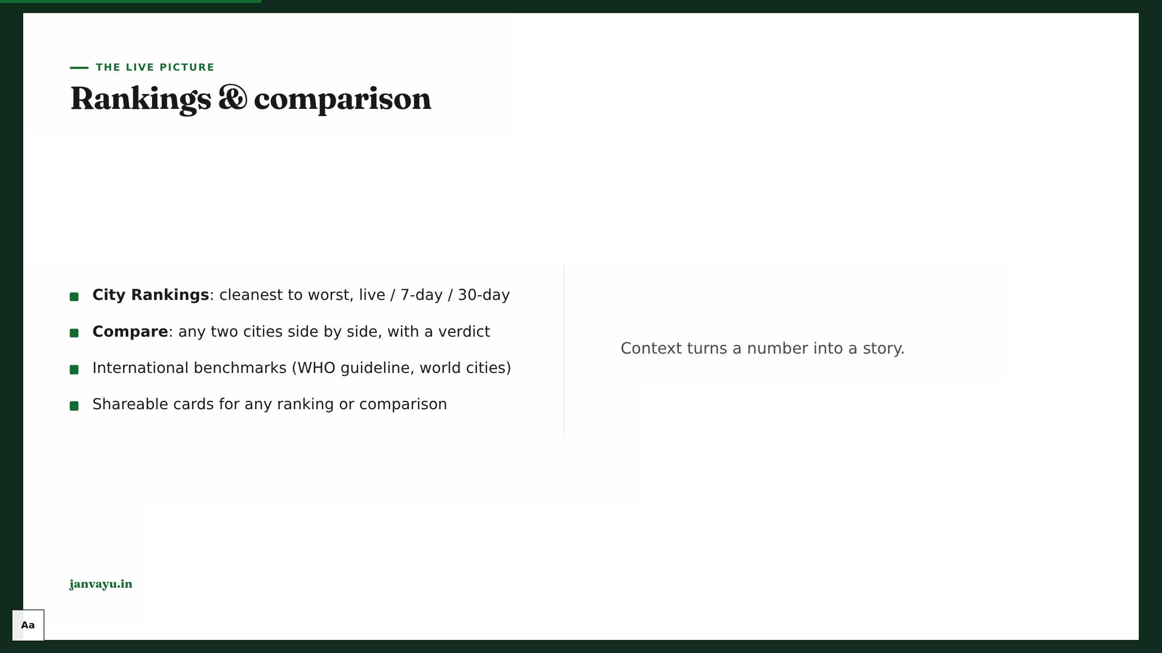
Notes:
Rankings and comparison are the most shared surfaces; show the share-card generator.

Slide 11
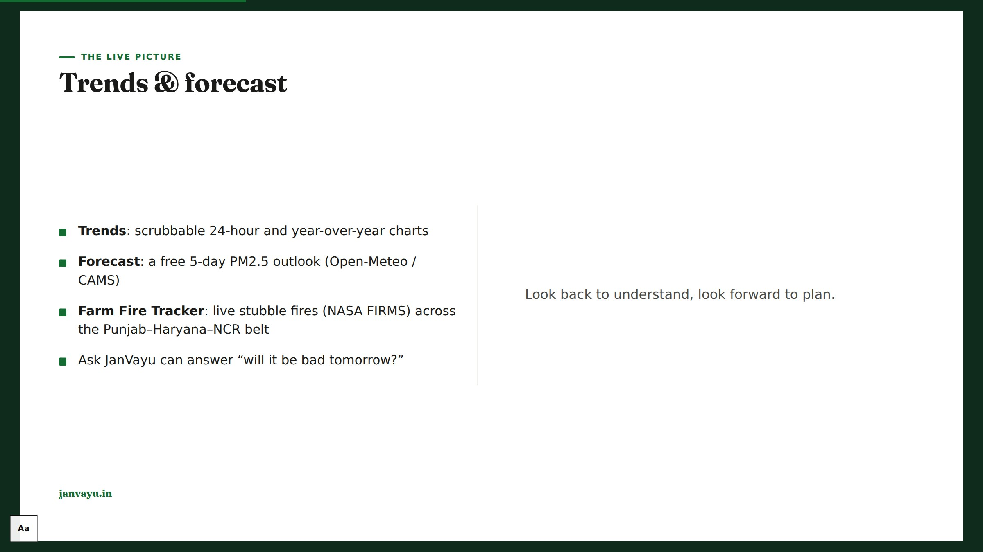
Notes:
The forecast is key-less and free; it feeds the chatbot’s tomorrow-answers too. Say plainly that the fire map is seasonal: the burning season it is built around runs from October into November.

Slide 12
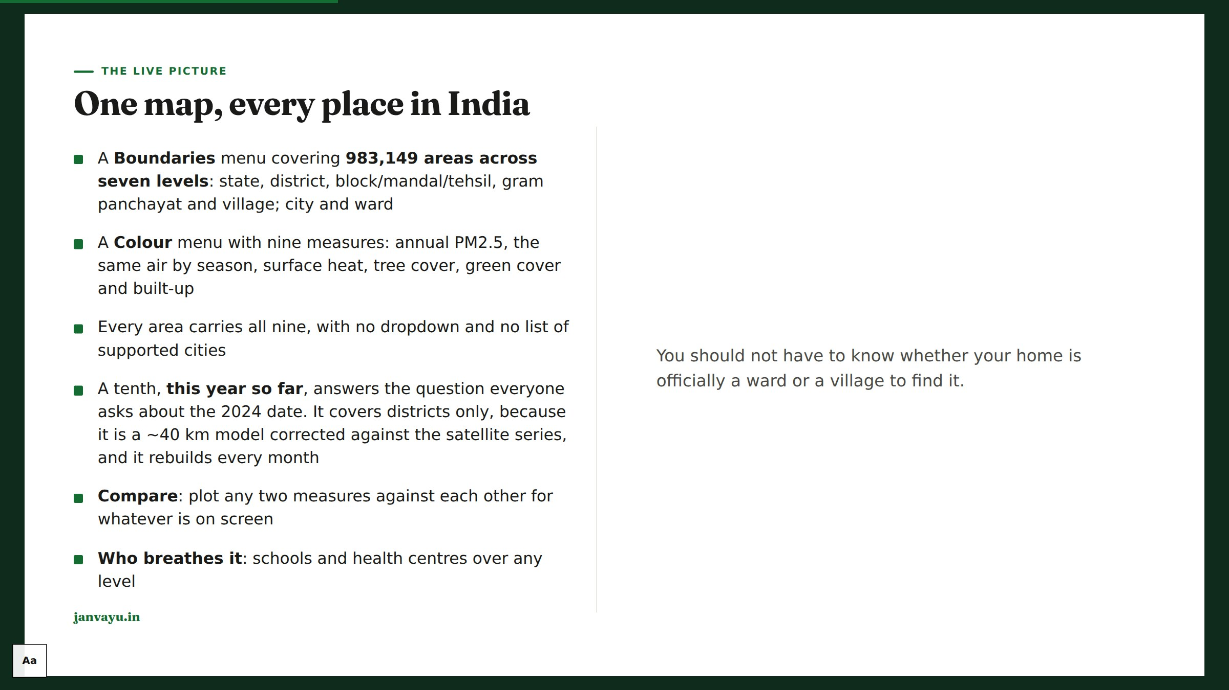
Notes:
The old version was a dropdown of 142 cities, and if your town was not on the list you got nothing. That was our database structure leaking into the navigation. Say the two timescales out loud: the dots are live monitors, the shading is a yearly satellite average, and they are never the same sentence. The green-vs-tree distinction is the one to demo: green counts cropland, so the typical Indian district is 97% green and 14% treed.

Slide 13
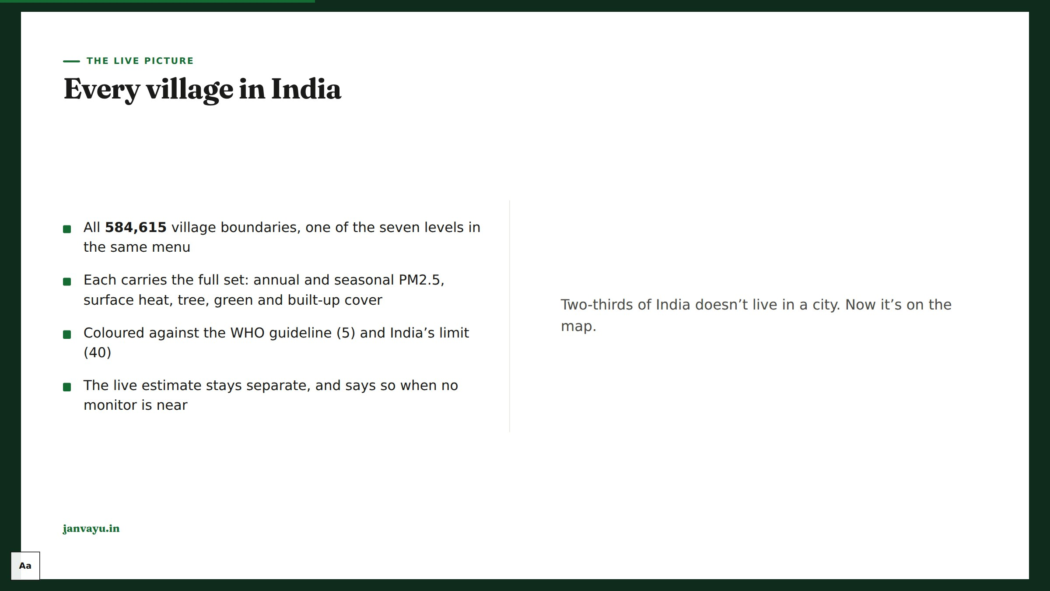
Notes:
The point of this slide is the monitoring gap: ~565 continuous CPCB stations against 584,615 villages, so the live network can never answer "how is my village's air". Satellite fills it on a DIFFERENT timescale: annual, not today. Keep the two apart out loud. Two honest caveats: a ~1 km product smooths hyperlocal sources (a kiln next door won't show), and it is modelled and calibrated, not measured in the village. The finding worth saying: not one Indian village meets the WHO guideline of 5, and 63.6% are above India's own limit of 40.

Slide 14
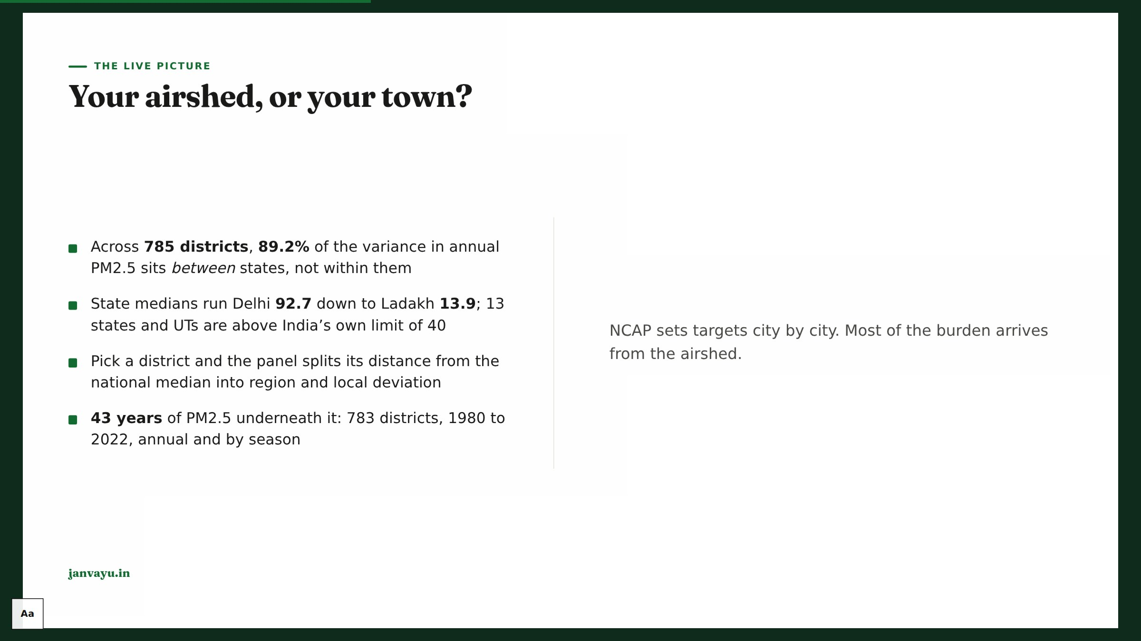
Notes:
This slide is the one negative result worth presenting. It came out of testing two global land-pressure rasters that correlated better with district PM2.5 than anything on the site, then collapsing under state fixed effects. What survived was the decomposition: where you are in India decides most of your air, and the town you live in decides the rest. Say the limit out loud, because it is the part people over-read: a district below its state median is NOT thereby well governed, and the figure names no cause at all. The history layer under it is LongPMInd (Wang et al. 2024, peer-reviewed, ~10 km, CC BY 4.0) and it is a RECONSTRUCTION: India had almost no continuous monitoring before the 2010s. It is not directly comparable with the 2024 satellite layer. Take the trend and shape from the history and the level from the annual figure. Delhi as a whole goes 50.9 in the 1980s to 91.6 over 2013-2022, which agrees with the decade means in Hawa Ka Hisab’s report (51 for the 1980s, 87 for the 2010s); that report is built on the same LongPMInd data, so this is a consistency check, not an independent reproduction.

Slide 15
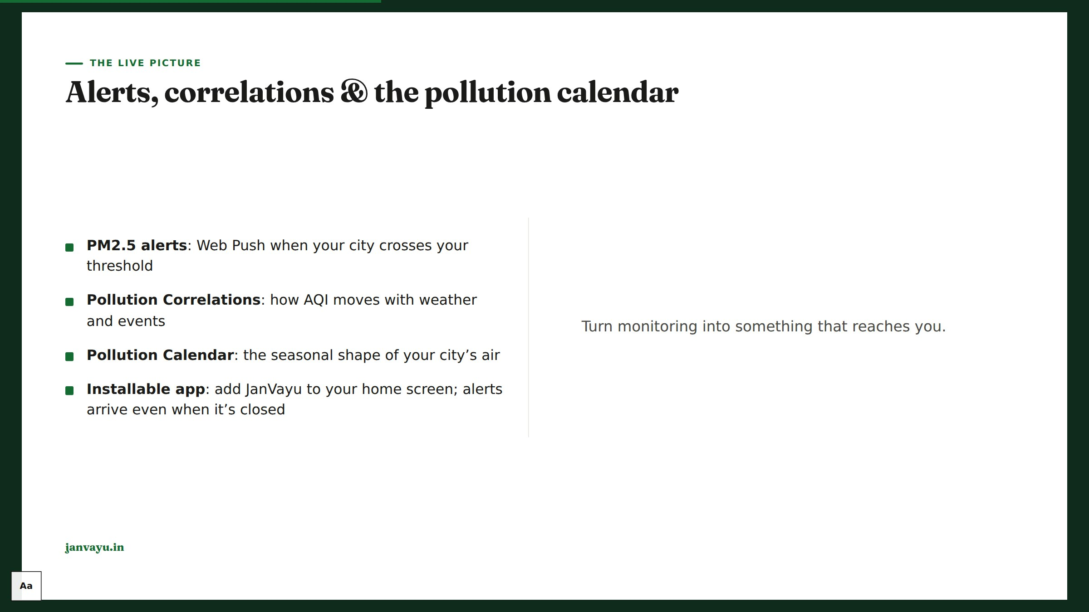
Notes:
These are real browser push notifications, sent only when your city crosses the threshold you picked. Both the main site and the standalone Ask JanVayu app can be installed on Android, iOS and desktop.

Slide 16

Notes:
Chapter 3: Health & exposure. Translate the numbers into what they mean for a body.

Slide 17
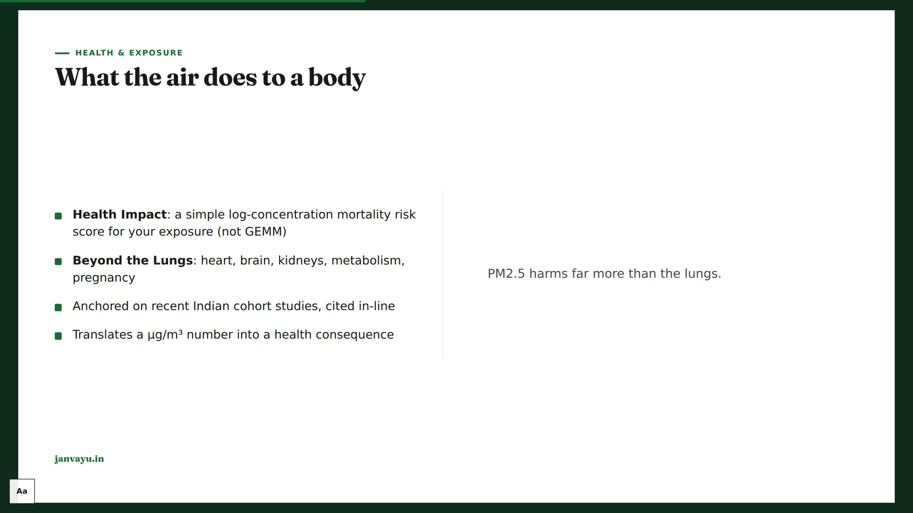
Notes:
Beyond-the-lungs is the emotional core; use the hand-drawn body diagram.

Slide 18

Notes:
Frame as an equity story; both panels carry the corrected, fact-checked figures.

Slide 19

Notes:
The diary is a habit tool; note it is localStorage-only today.

Slide 20

Notes:
These are the decision tools; the purifier sizing and GRAP rules are fact-checked.

Slide 21

Notes:
Chapter 4: The economic bill. The macroeconomic case, for policy audiences.

Slide 22
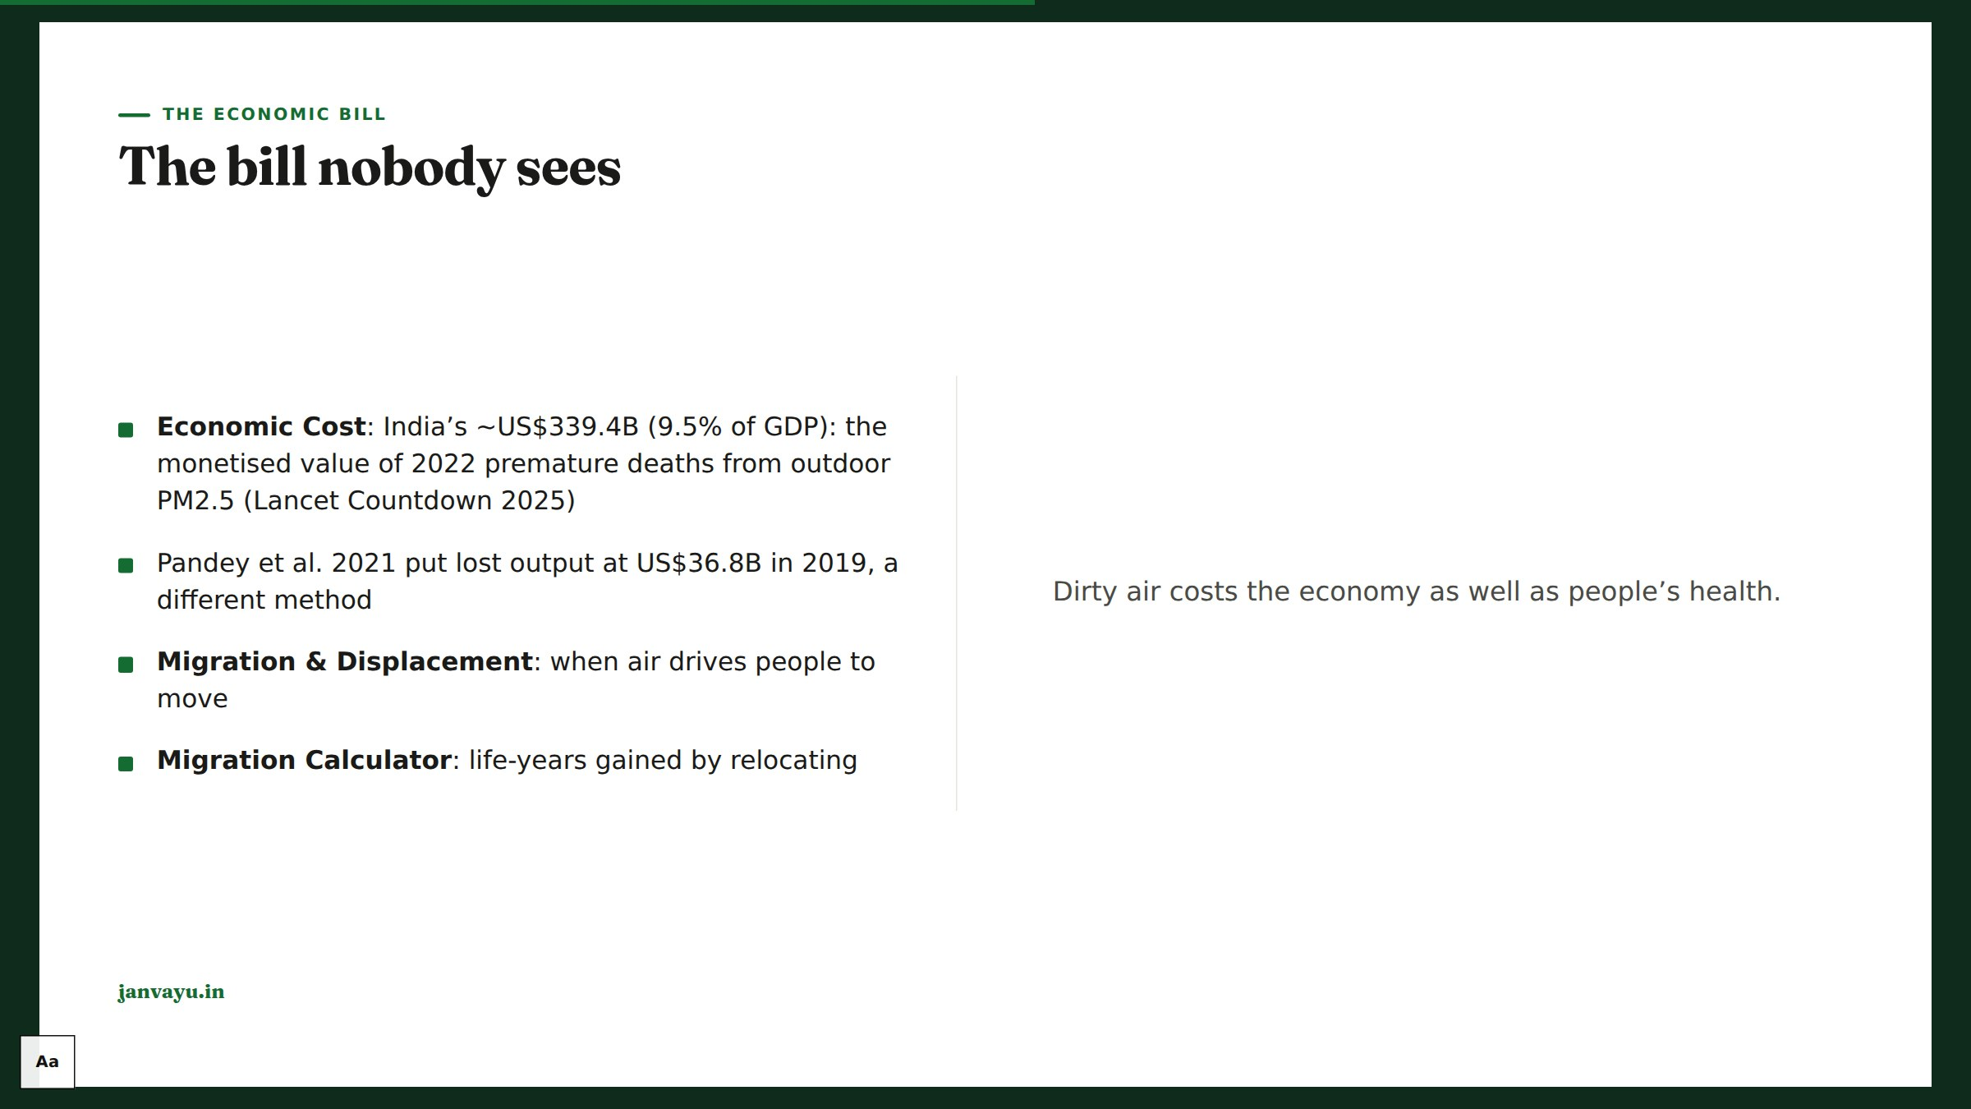
Notes:
Use the economy diagram; the $339B figure is the corrected, sourced value with its method noted.

Slide 23

Notes:
Chapter 5: Following the money. Accountability, which is what sets JanVayu apart from a plain dashboard.

Slide 24

Notes:
Budget figures were refreshed to CREA 2026 in the fact-check; note the dust-vs-source mismatch.

Slide 25
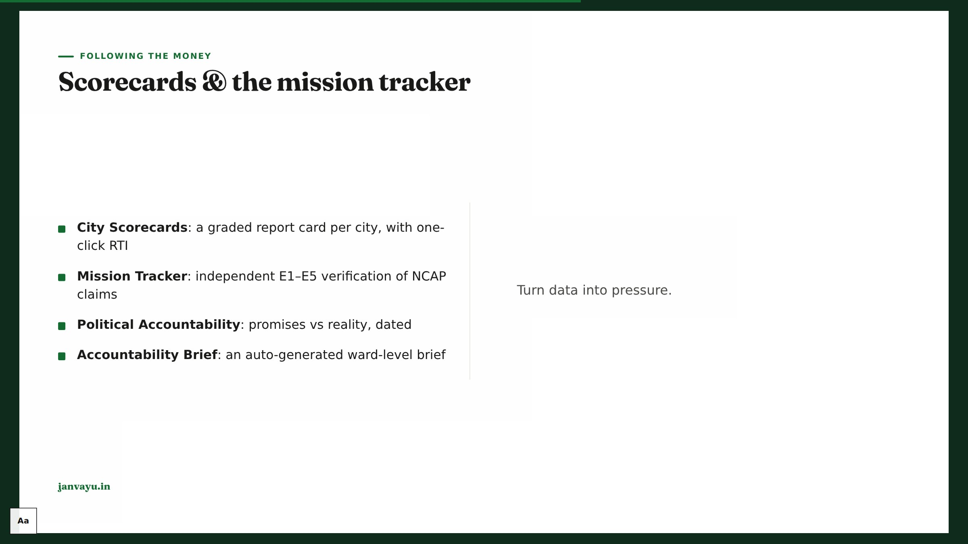
Notes:
The scorecard’s “File an RTI” pre-fills the RTI Assistant for that city.

Slide 26
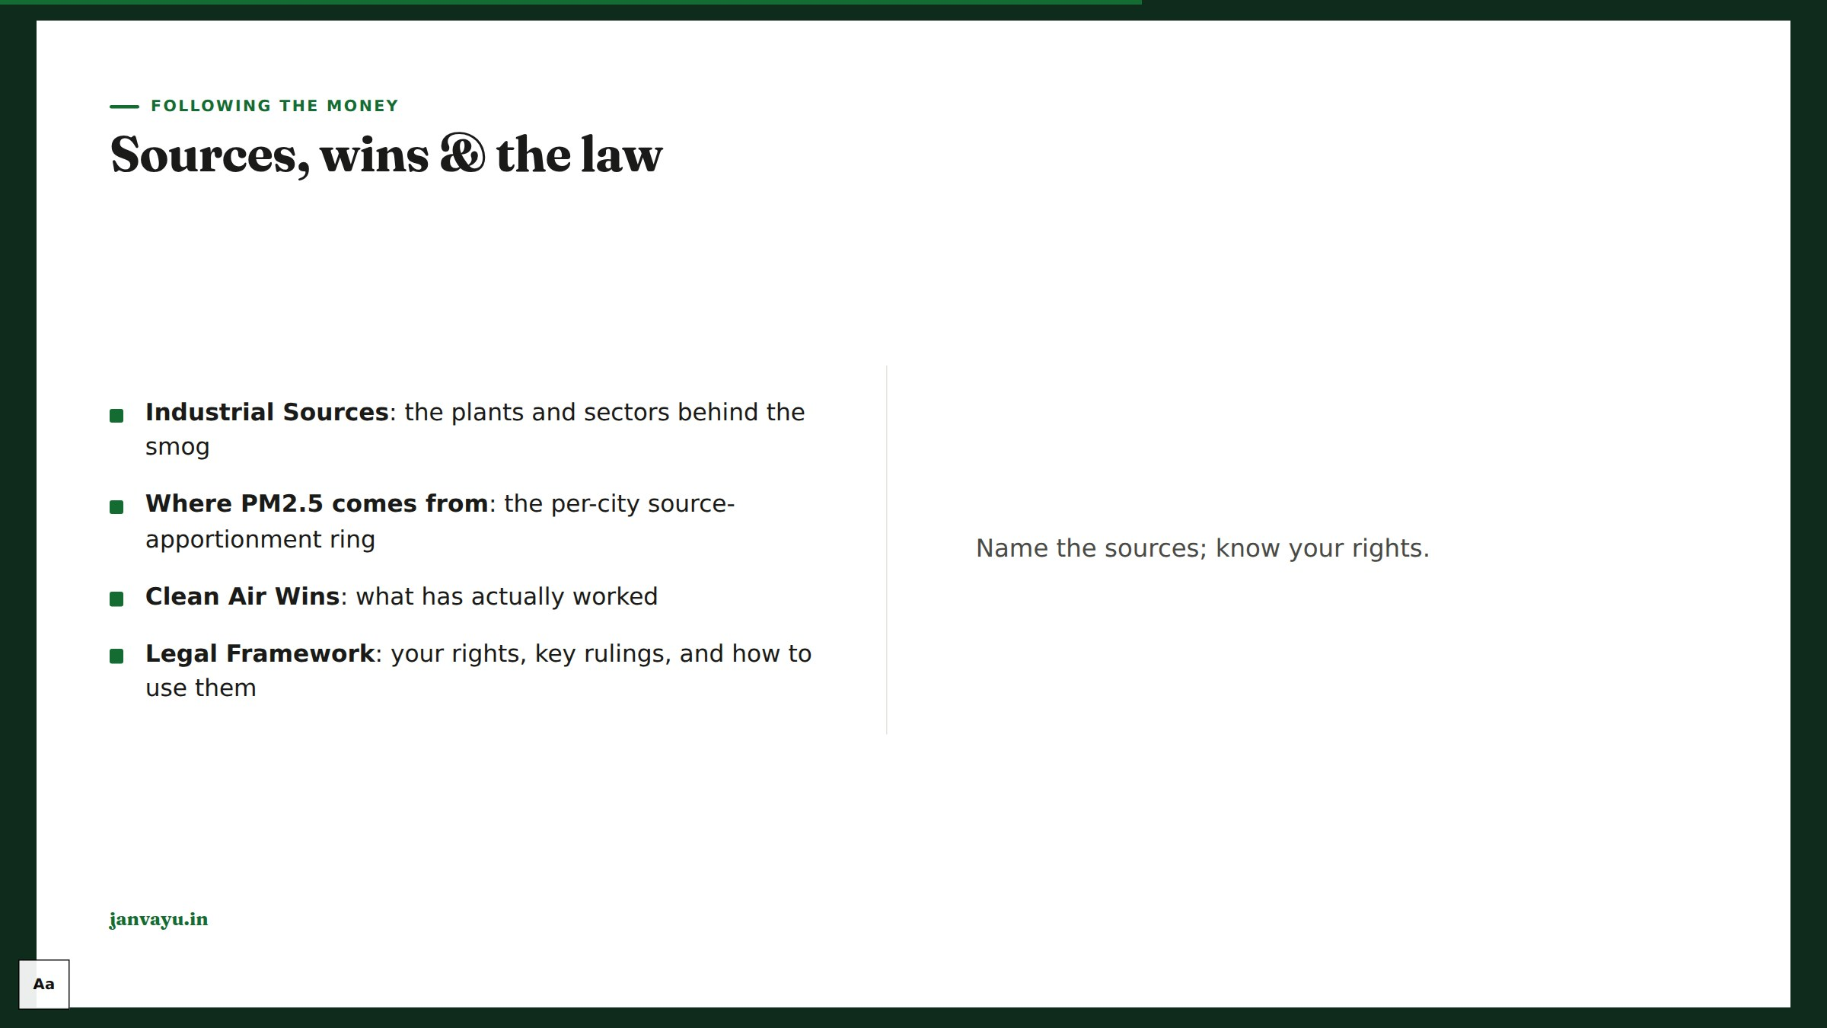
Notes:
The apportionment ring is the newest panel; each city cites its own study with a method caveat.

Slide 27
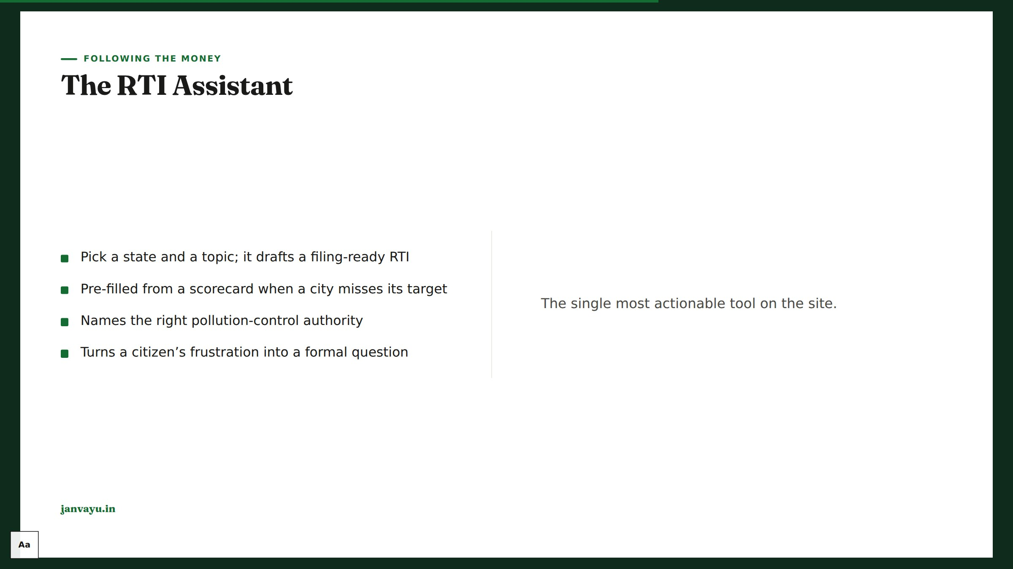
Notes:
Demo the scorecard → RTI hand-off; it’s the platform’s theory of change in one flow.

Slide 28

Notes:
Chapter 6: Citizen action. Turn readers into participants.

Slide 29

Notes:
Games + the new air-literacy quiz make this classroom-ready; workshops connect you to a live session leader.

Slide 30
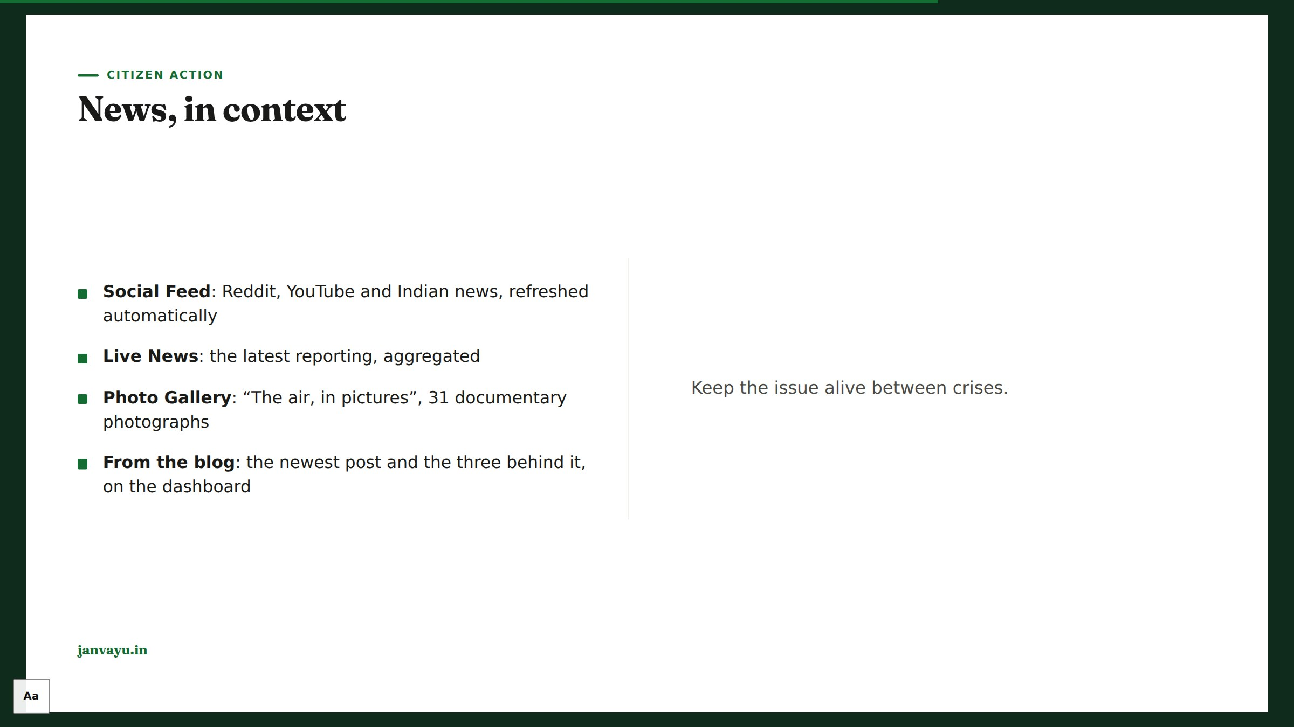
Notes:
If someone asks why X and Instagram are only links: neither can be read without a paid or authenticated API, so we link to the live search rather than show a feed that is not one. Every X link on the site is checked against X’s public embed endpoint before it ships. The blog section is generated from the blog index, so publishing is enough to reach the front page. Every gallery photograph carries its own credit and source link.

Slide 31

Notes:
Chapter 7: Tools & knowledge. The reference layer and the take-it-with-you surfaces.

Slide 32

Notes:
It answers from JanVayu’s own verified figures and cites them. It is tested against fabricated citations and invented orders or schemes before each release.

Slide 33

Notes:
Reading List is a real Zotero group; the AQI explainer’s CPCB-vs-EPA table was just corrected.

Slide 34

Notes:
The API + embeds are the “use JanVayu in your work” surface; licence and citation are included.

Slide 35

Notes:
Chapter 8: Trust. Close the loop on why any of these numbers can be believed.

Slide 36
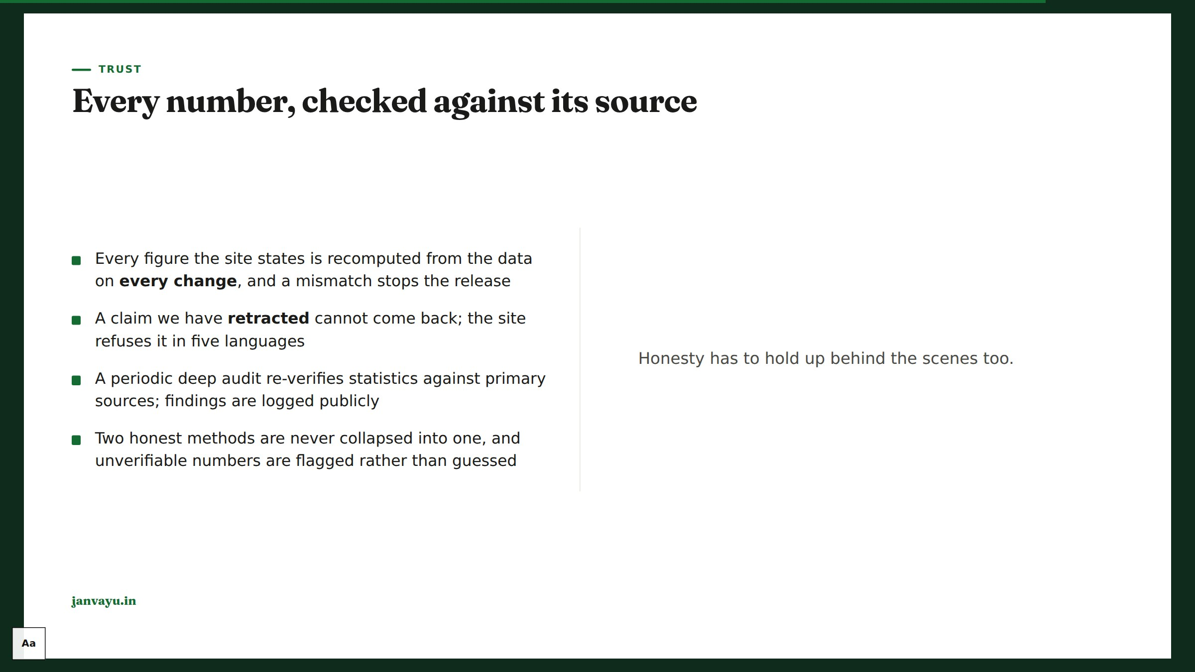
Notes:
This is what separates JanVayu from a marketing site, and it is worth being exact about which half is continuous and which is periodic. Continuous: every stated figure is recomputed from the underlying data whenever the site changes, a mismatch stops the release, and since September 2026 a claim the site has publicly retracted is refused too, including inside the Hindi, Bengali, Marathi and Tamil docs. Periodic: a deeper audit that re-verifies statistics against primary sources on the web, whose findings are written into dated files in docs/. That deeper audit ran weekly through July 2026 and the deck used to promise weekly; it is not on a schedule now, so the wording says periodic. The release is stopped automatically if the audit goes more than four months without running.

Slide 37
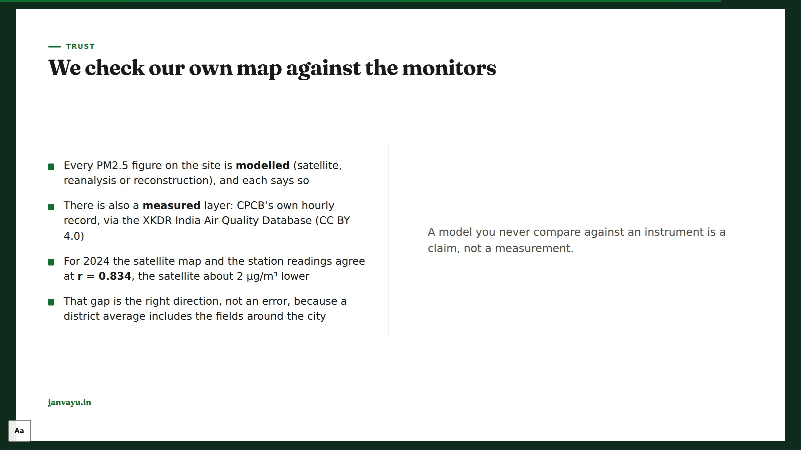
Notes:
This is the slide that answers "how do you know your map is right". Be careful not to oversell it: the comparison validates pattern, not level, and a point monitor is not a district mean. Two honest by-products worth mentioning. First, 250 of 534 stations cannot produce a defensible annual mean for 2024. They fail a twelve-month completeness test, which is a finding about the monitoring network, not a filter we should loosen. Second, the archive advertises coverage to March 2026 but CPCB’s feed into it stops on 1 September 2025; the months after are two US Embassy monitors. We documented that the day after we got it wrong ourselves.

Slide 38
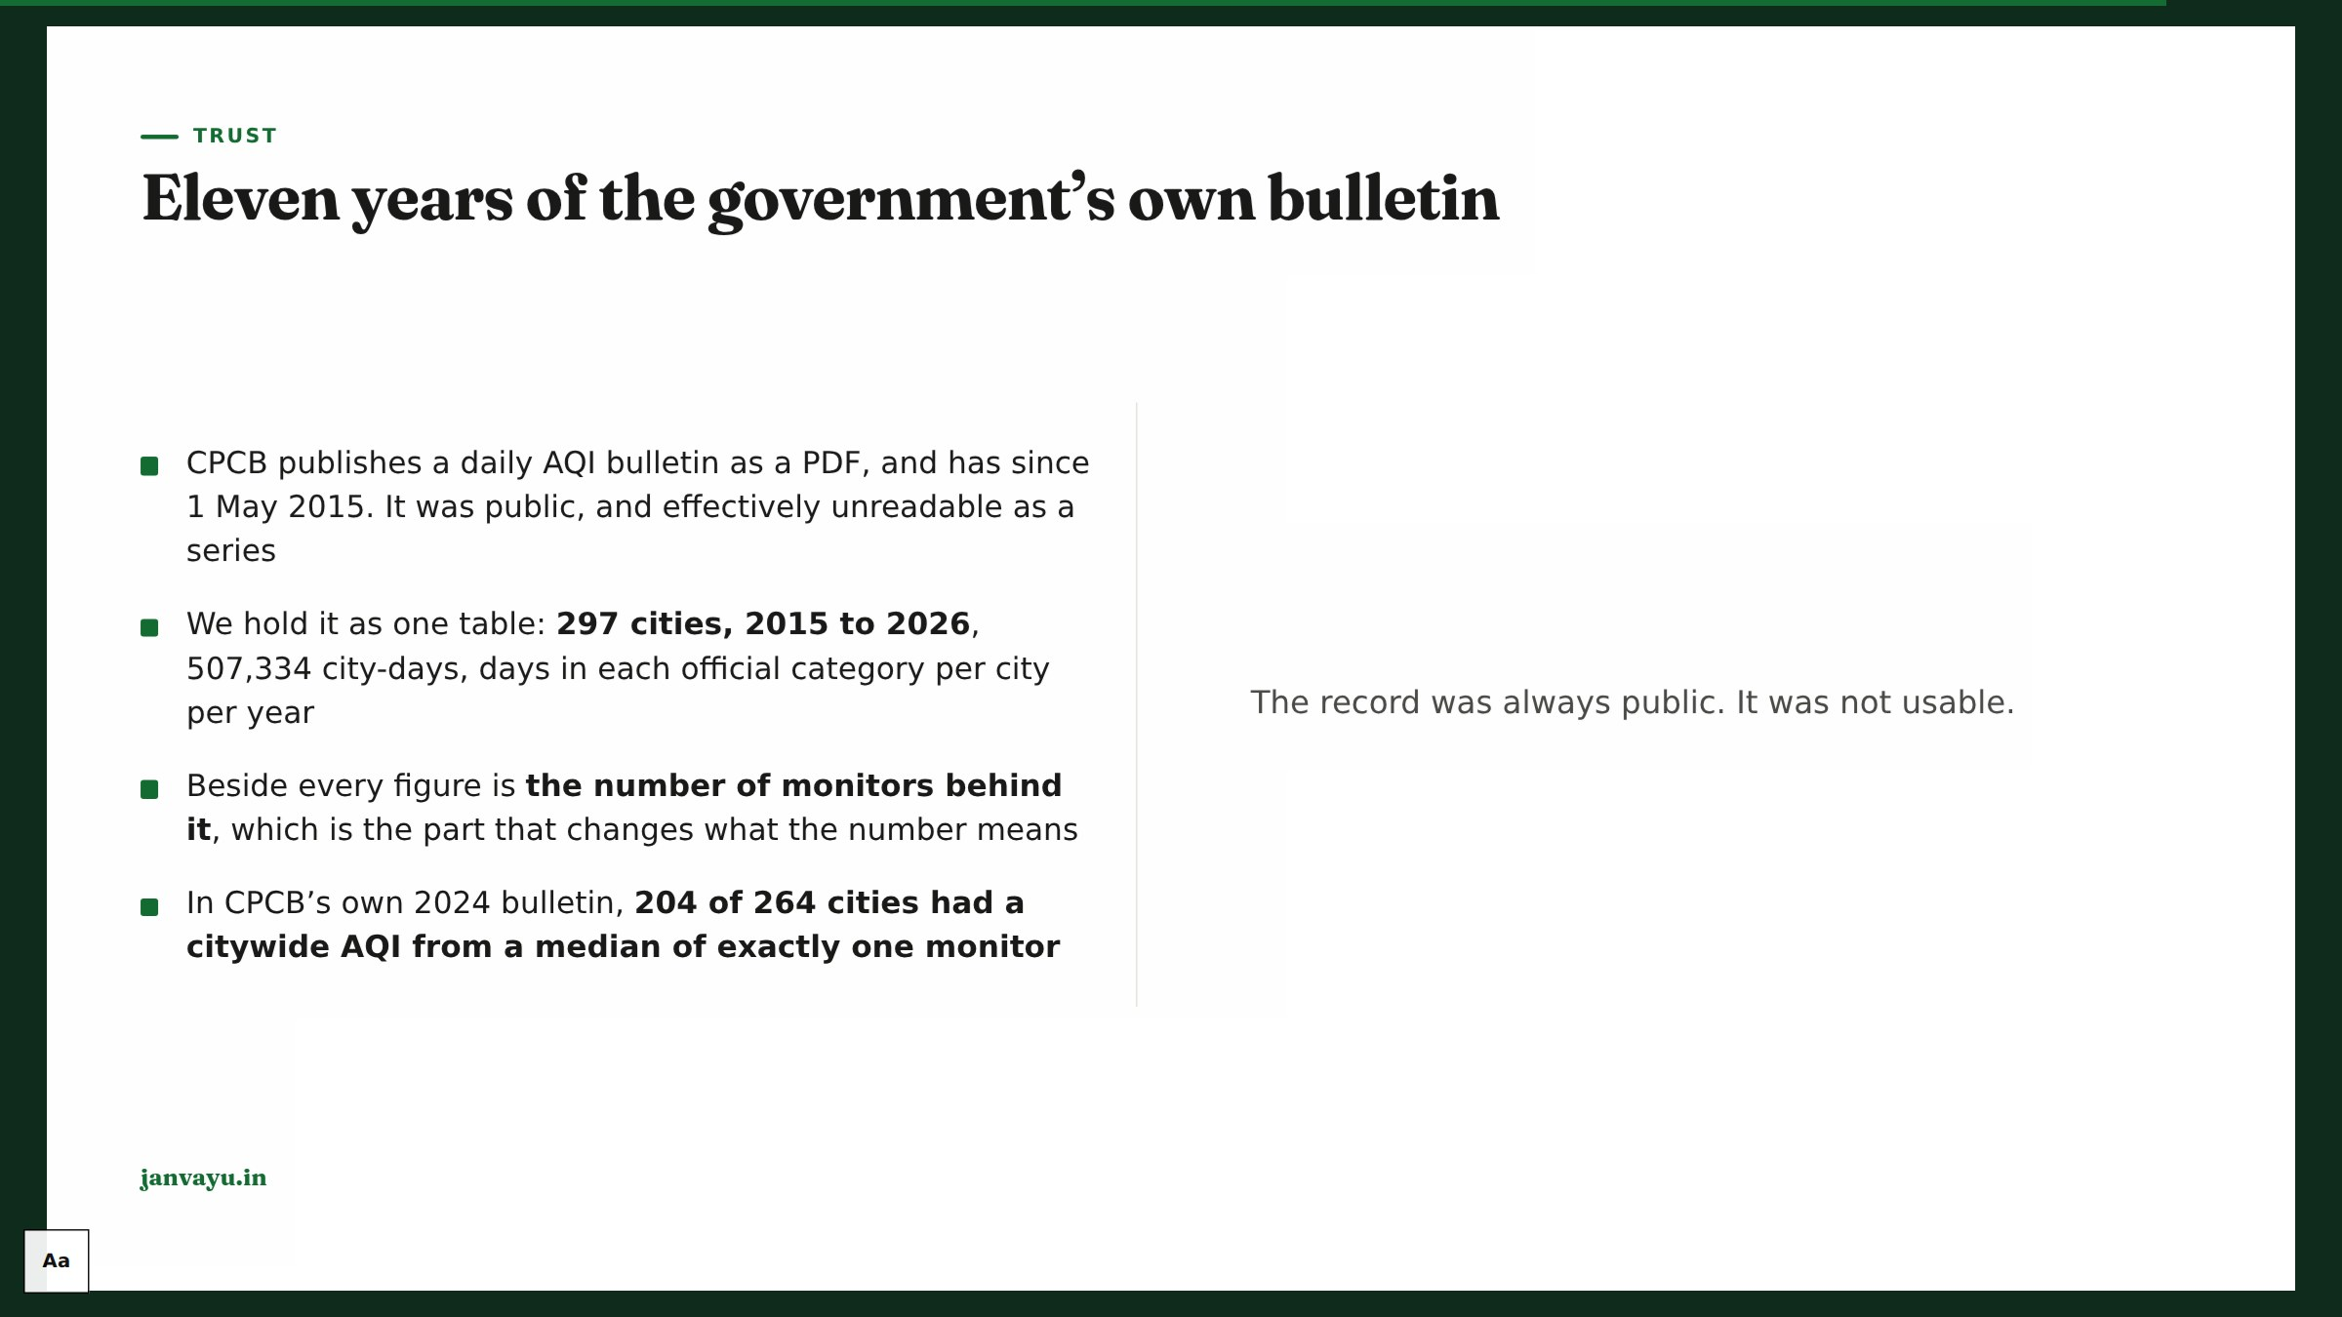
Notes:
Two things to be careful about if asked. First, there is deliberately no trend line across the window and the build refuses to let one in: reporting grew from 10 cities in 2015 to 264 in 2024 and the stations under each city grew with it, so a fall in Poor-or-worse days cannot be separated from a change in what was measuring. Read a single year. Second, 2015 and 2026 are part years and are marked as such next to the number, because 136 bad days of 235 in 2015 against 157 of 366 in 2024 reads as a rise and is a fall. 2015–2025 is UrbanEmissions.info’s extraction, credited on the panel; 2026 is our own parse of the same PDFs, and on three 2025 dates checked city by city the two agree on all 671 city-days they share.

Slide 39
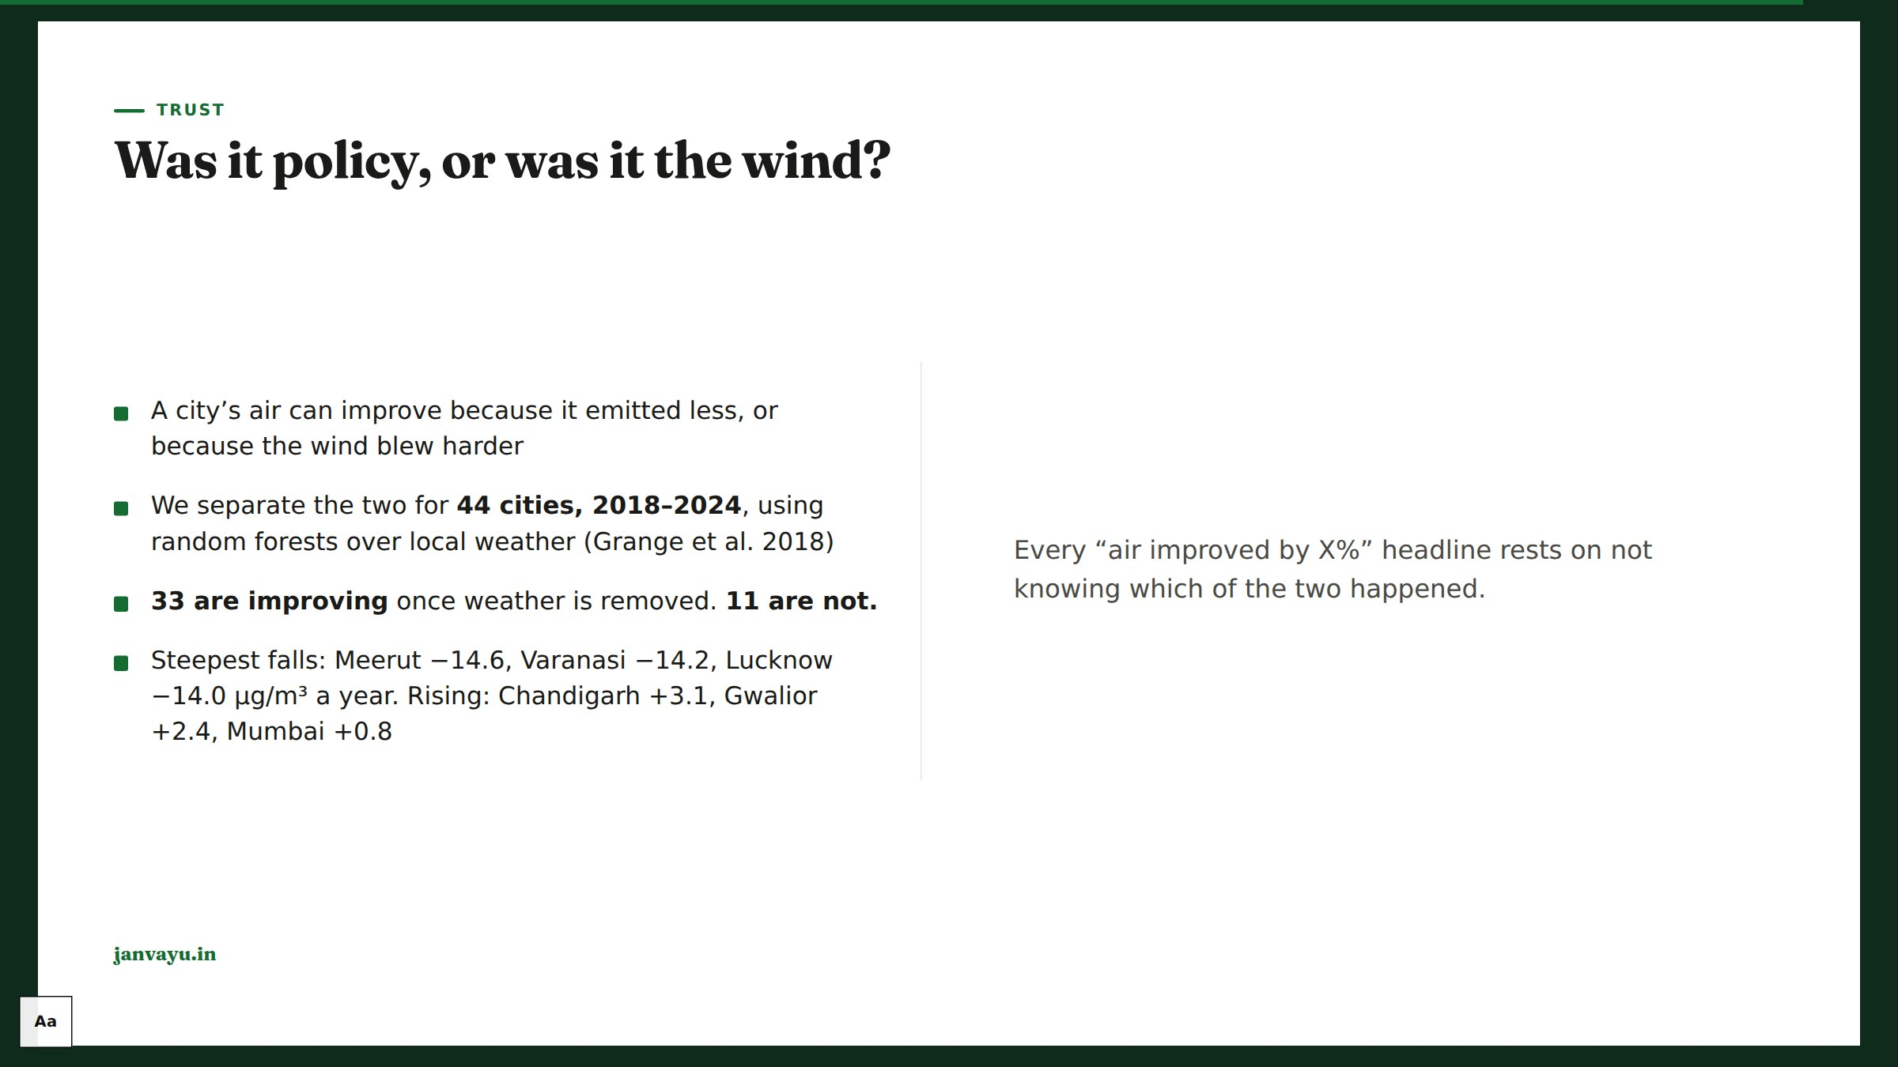
Notes:
The most quotable slide in the deck, so be precise about what it does and does not show. It removes weather as an explanation; it does not prove policy caused the rest. Emissions, fuel mix, construction and economic activity all sit inside what is left. Worth adding that normalisation mostly confirms the raw trend: only 6 of 44 cities move by a microgram a year or more, and in four of those the raw number understated the improvement, while in two (Agra, Pune) it overstated it, so the fear that a city is claiming credit the wind earned is rarer than people expect. R² runs 0.52 to 0.91; cities are not comparable to each other on it.

Slide 40

Notes:
The live-vs-annual honesty is a recurring theme; it protects the platform from over-claiming.

Slide 41

Notes:
Close on agency: the point of all this data is to be used. Point to the API, the RTI Assistant, and contribute@janvayu.in.

