Slide 1

Notes:
Open warm. JanVayu means 'People's Air'. This is a public record of India's air-quality crisis: the data, the health toll, the money and the tools. It is built for citizens, not experts.

Slide 2
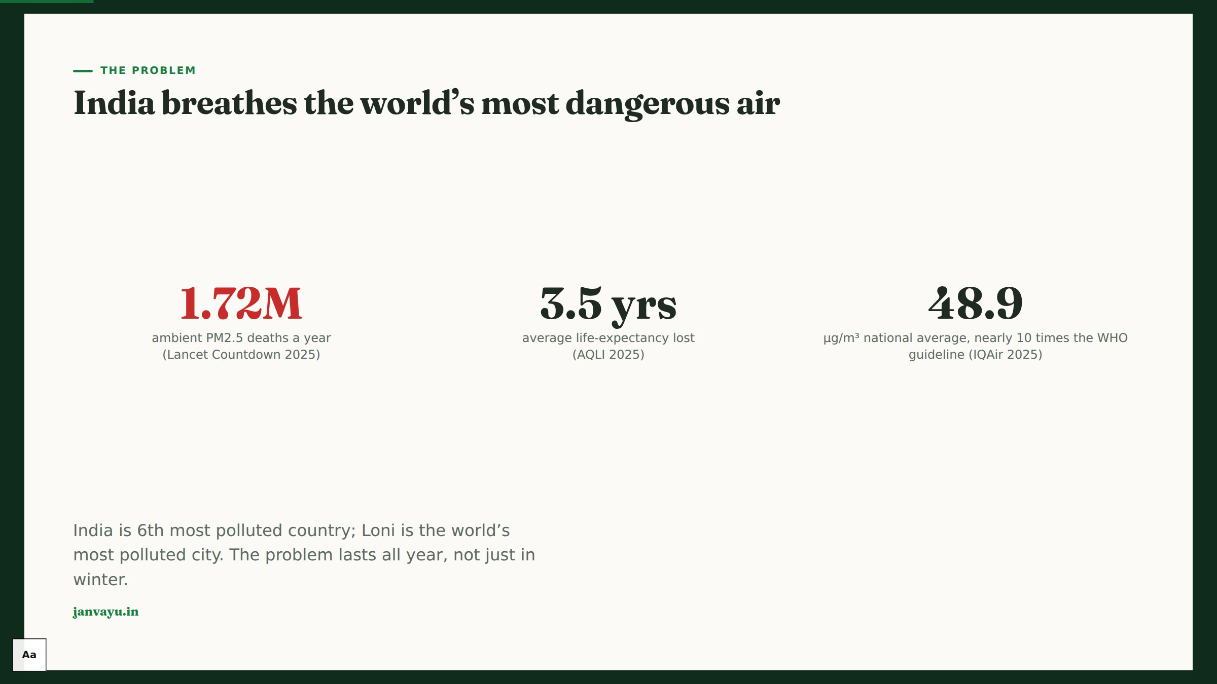
Notes:
Lead with the human cost, sourced. 1.72M ambient PM2.5 deaths (Lancet Countdown 2025); State of Global Air 2024 counts about 2.1M deaths from all air pollution (ambient + household + ozone, 2021), a different method from the Lancet Countdown 2022 estimate. 3.5 years of life lost on average. The problem runs all year, not only in Delhi's winter.

Slide 3
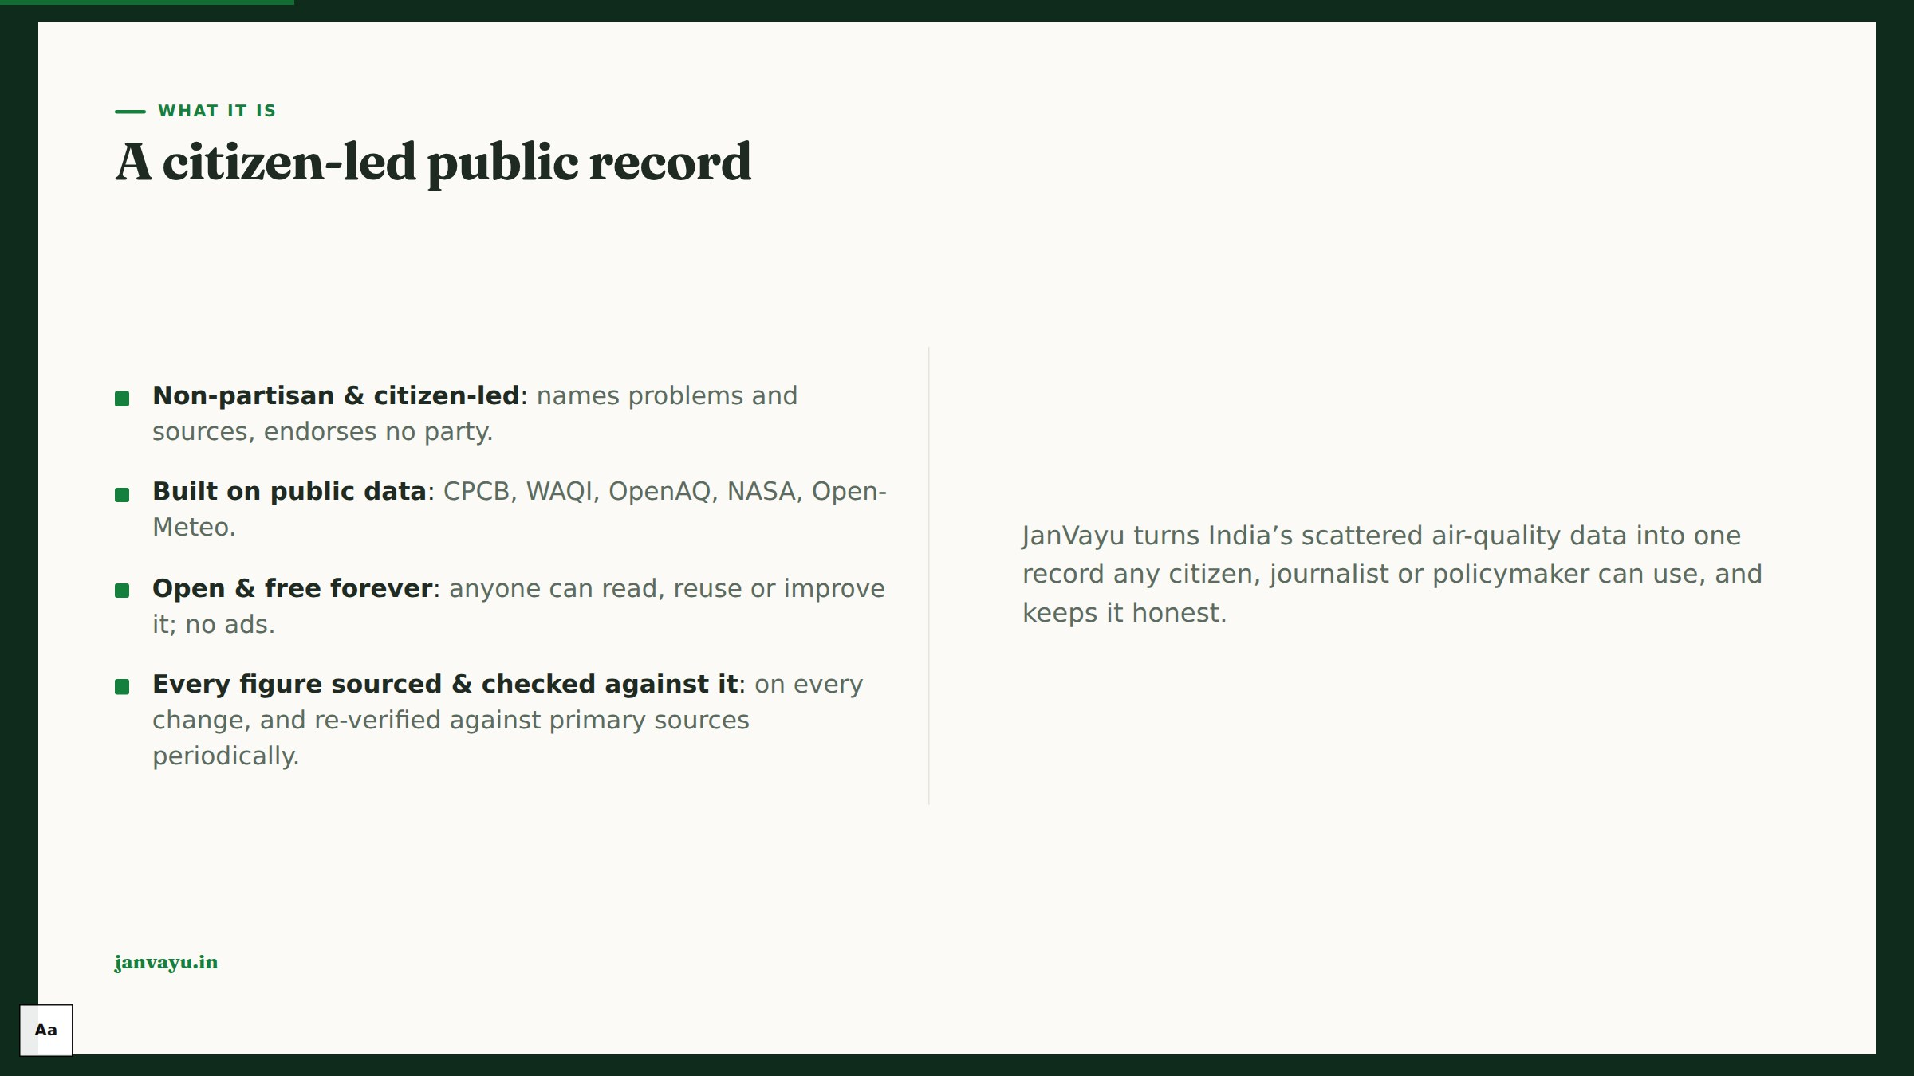
Notes:
Frame the stance: a record, not a campaign. Non-partisan, citizen-led, open source and fact-checked. The fact-checking is what makes the rest credible.

Slide 4
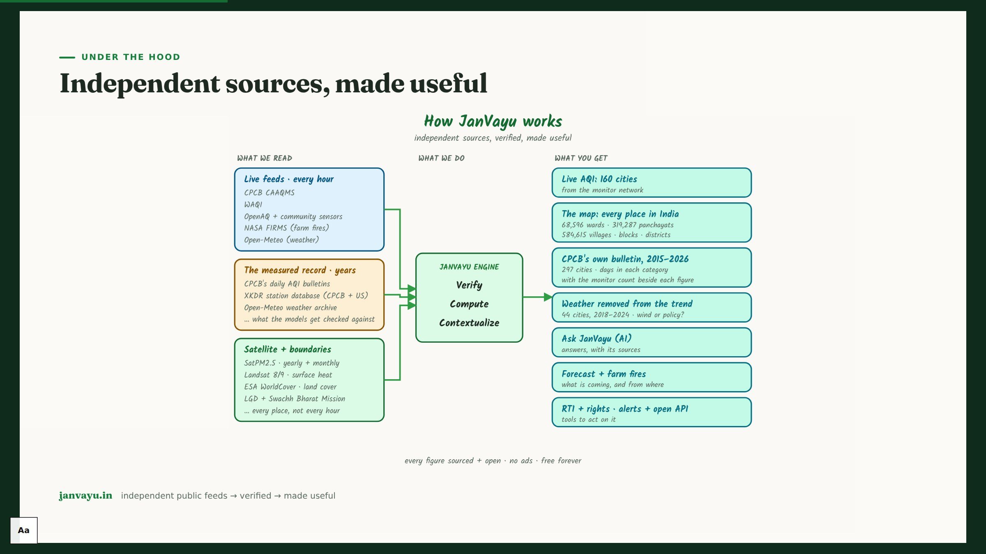
Notes:
The system diagram: independent public feeds are verified, computed and contextualised, then turned into citizen tools. No single source, no black box.

Slide 5
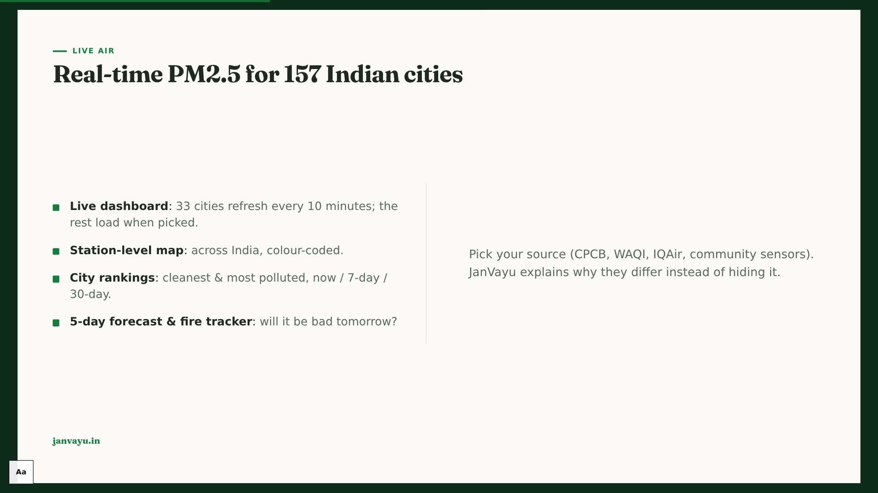
Notes:
Show the live product. Lead with PM2.5 in µg/m³ rather than the AQI: the AQI is a derived index, and PM2.5 is the pollutant that does the damage. 157 Indian cities (33 refreshed every 10 minutes, the rest loaded when picked), station map, rankings, forecast, fire tracker. Stress source transparency: we explain why CPCB/WAQI/IQAir differ.

Slide 6
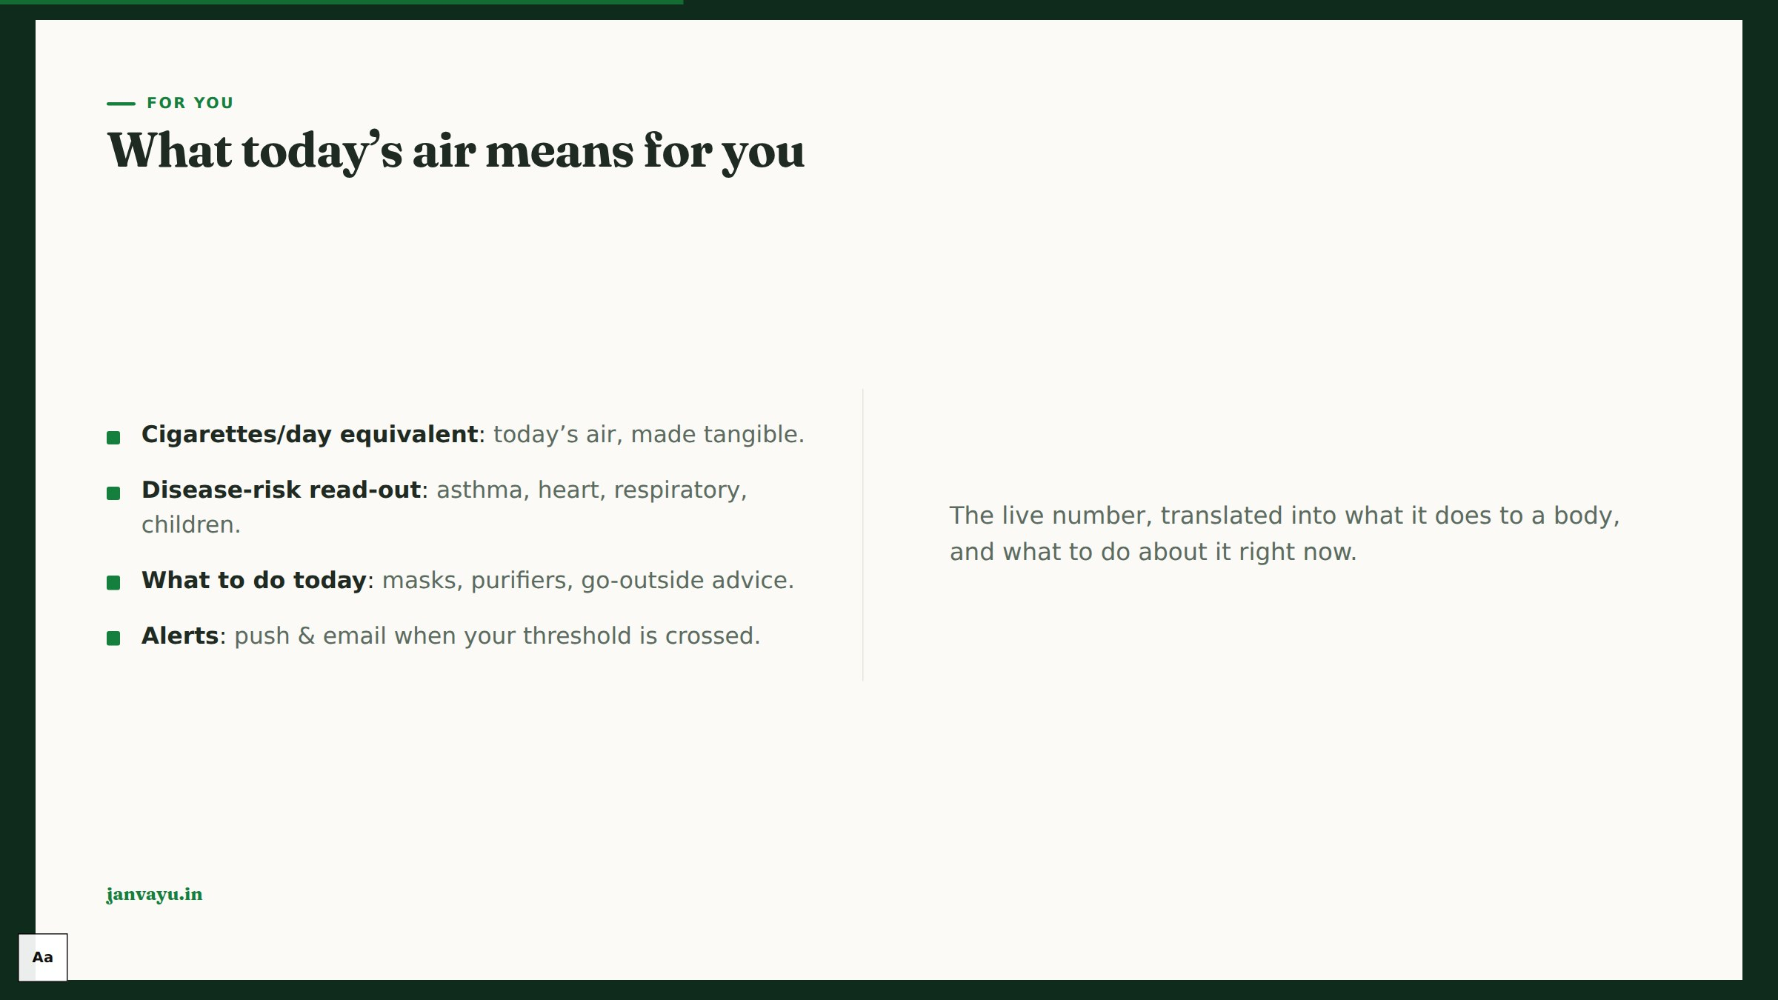
Notes:
Make it personal. The cigarettes-per-day metric lands with any audience. Then disease risk and concrete 'what to do today' advice, plus alerts.

Slide 7
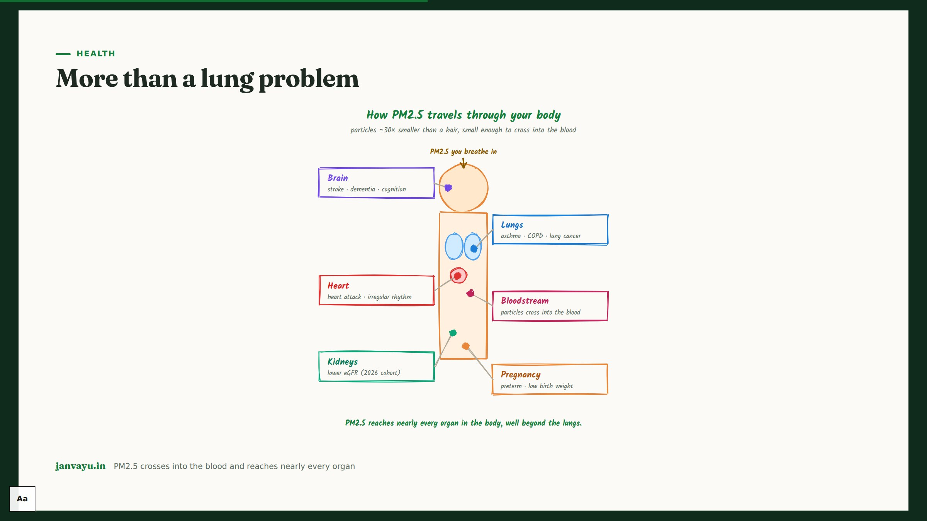
Notes:
Health beyond breathing: brain, heart, kidneys, bloodstream, pregnancy. The argument for health-complete alerts that don't stop at the lungs.

Slide 8
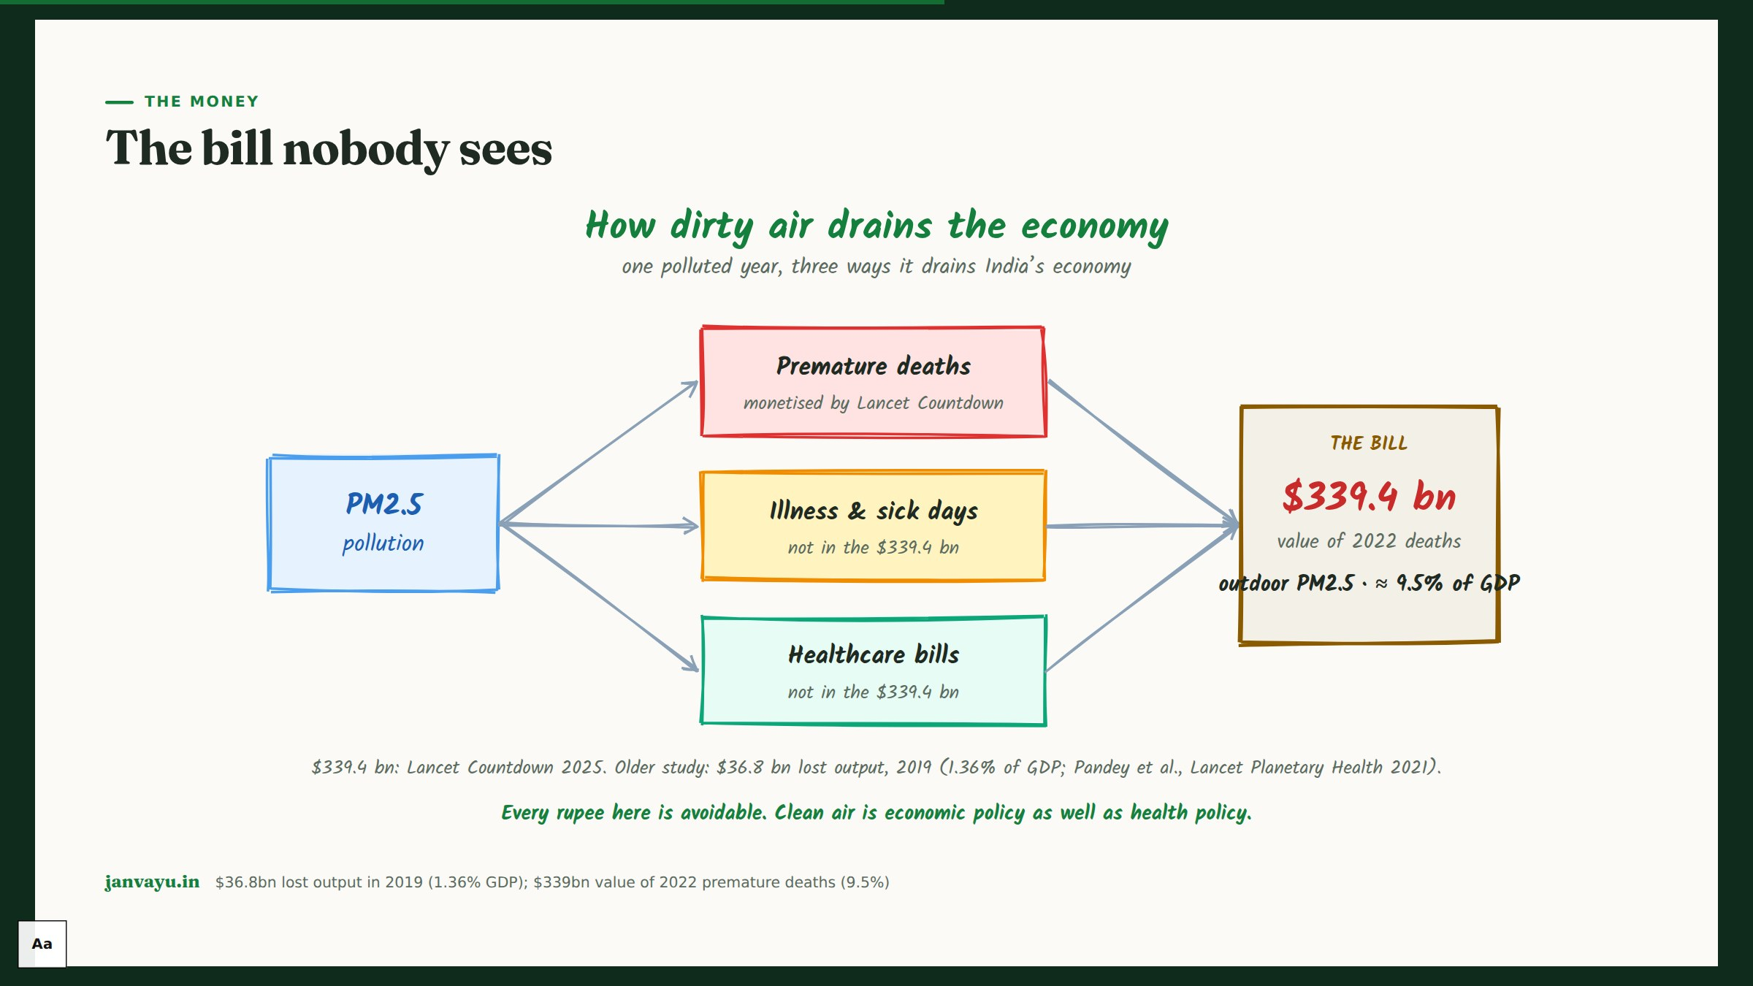
Notes:
The economic case, useful for policymakers. $36.8bn of lost output in 2019 (1.36% GDP; Pandey et al., Lancet Planetary Health 2021). Separately, the Lancet Countdown 2025 values 2022 premature deaths from outdoor PM2.5 at $339bn (9.5% of GDP); these are different methods and years, not a narrow and a broad version of one number. Clean air is economic policy.

Slide 9
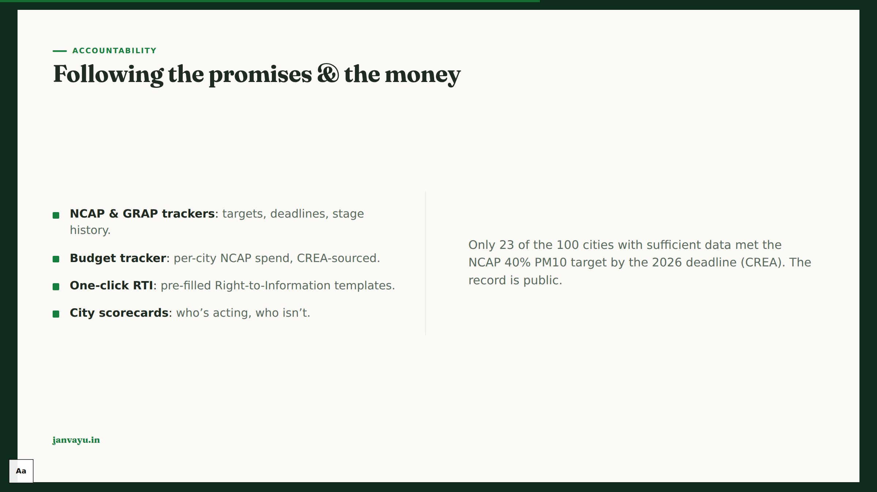
Notes:
Accountability is what sets JanVayu apart. NCAP/GRAP trackers, per-city budgets, one-click RTI. Cite the CREA figure: 23 of the 100 cities with sufficient PM10 data met the target.

Slide 10
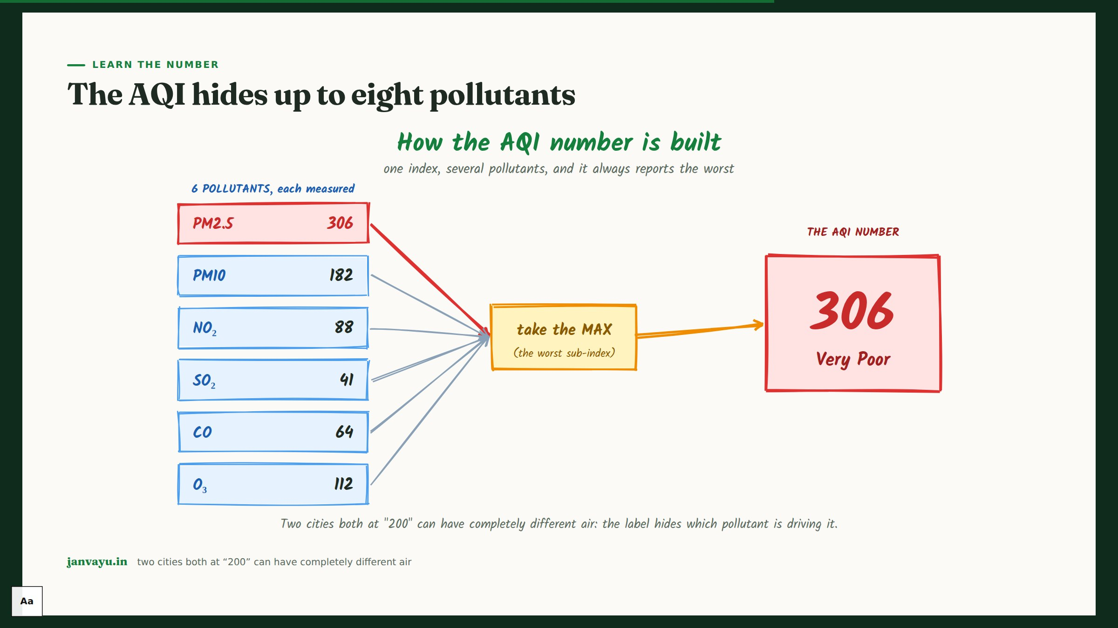
Notes:
A short teaching moment: the AQI reports only the worst of several pollutants, so the single number hides what's driving it. Good for journalists.

Slide 11
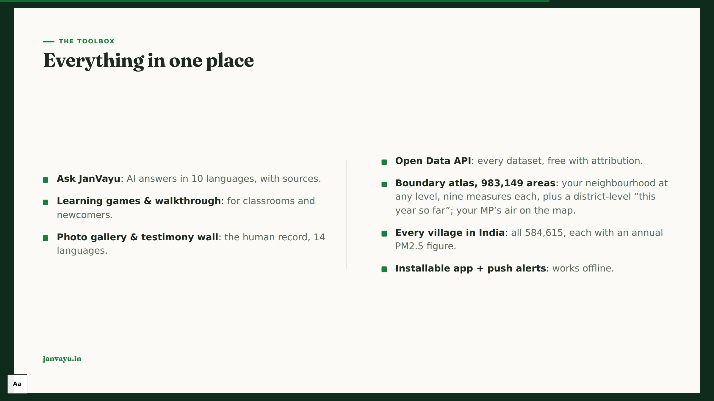
Notes:
Breadth without clutter: Ask JanVayu, games, gallery, testimony, open API, boundary atlas, installable app. One place.

Slide 12
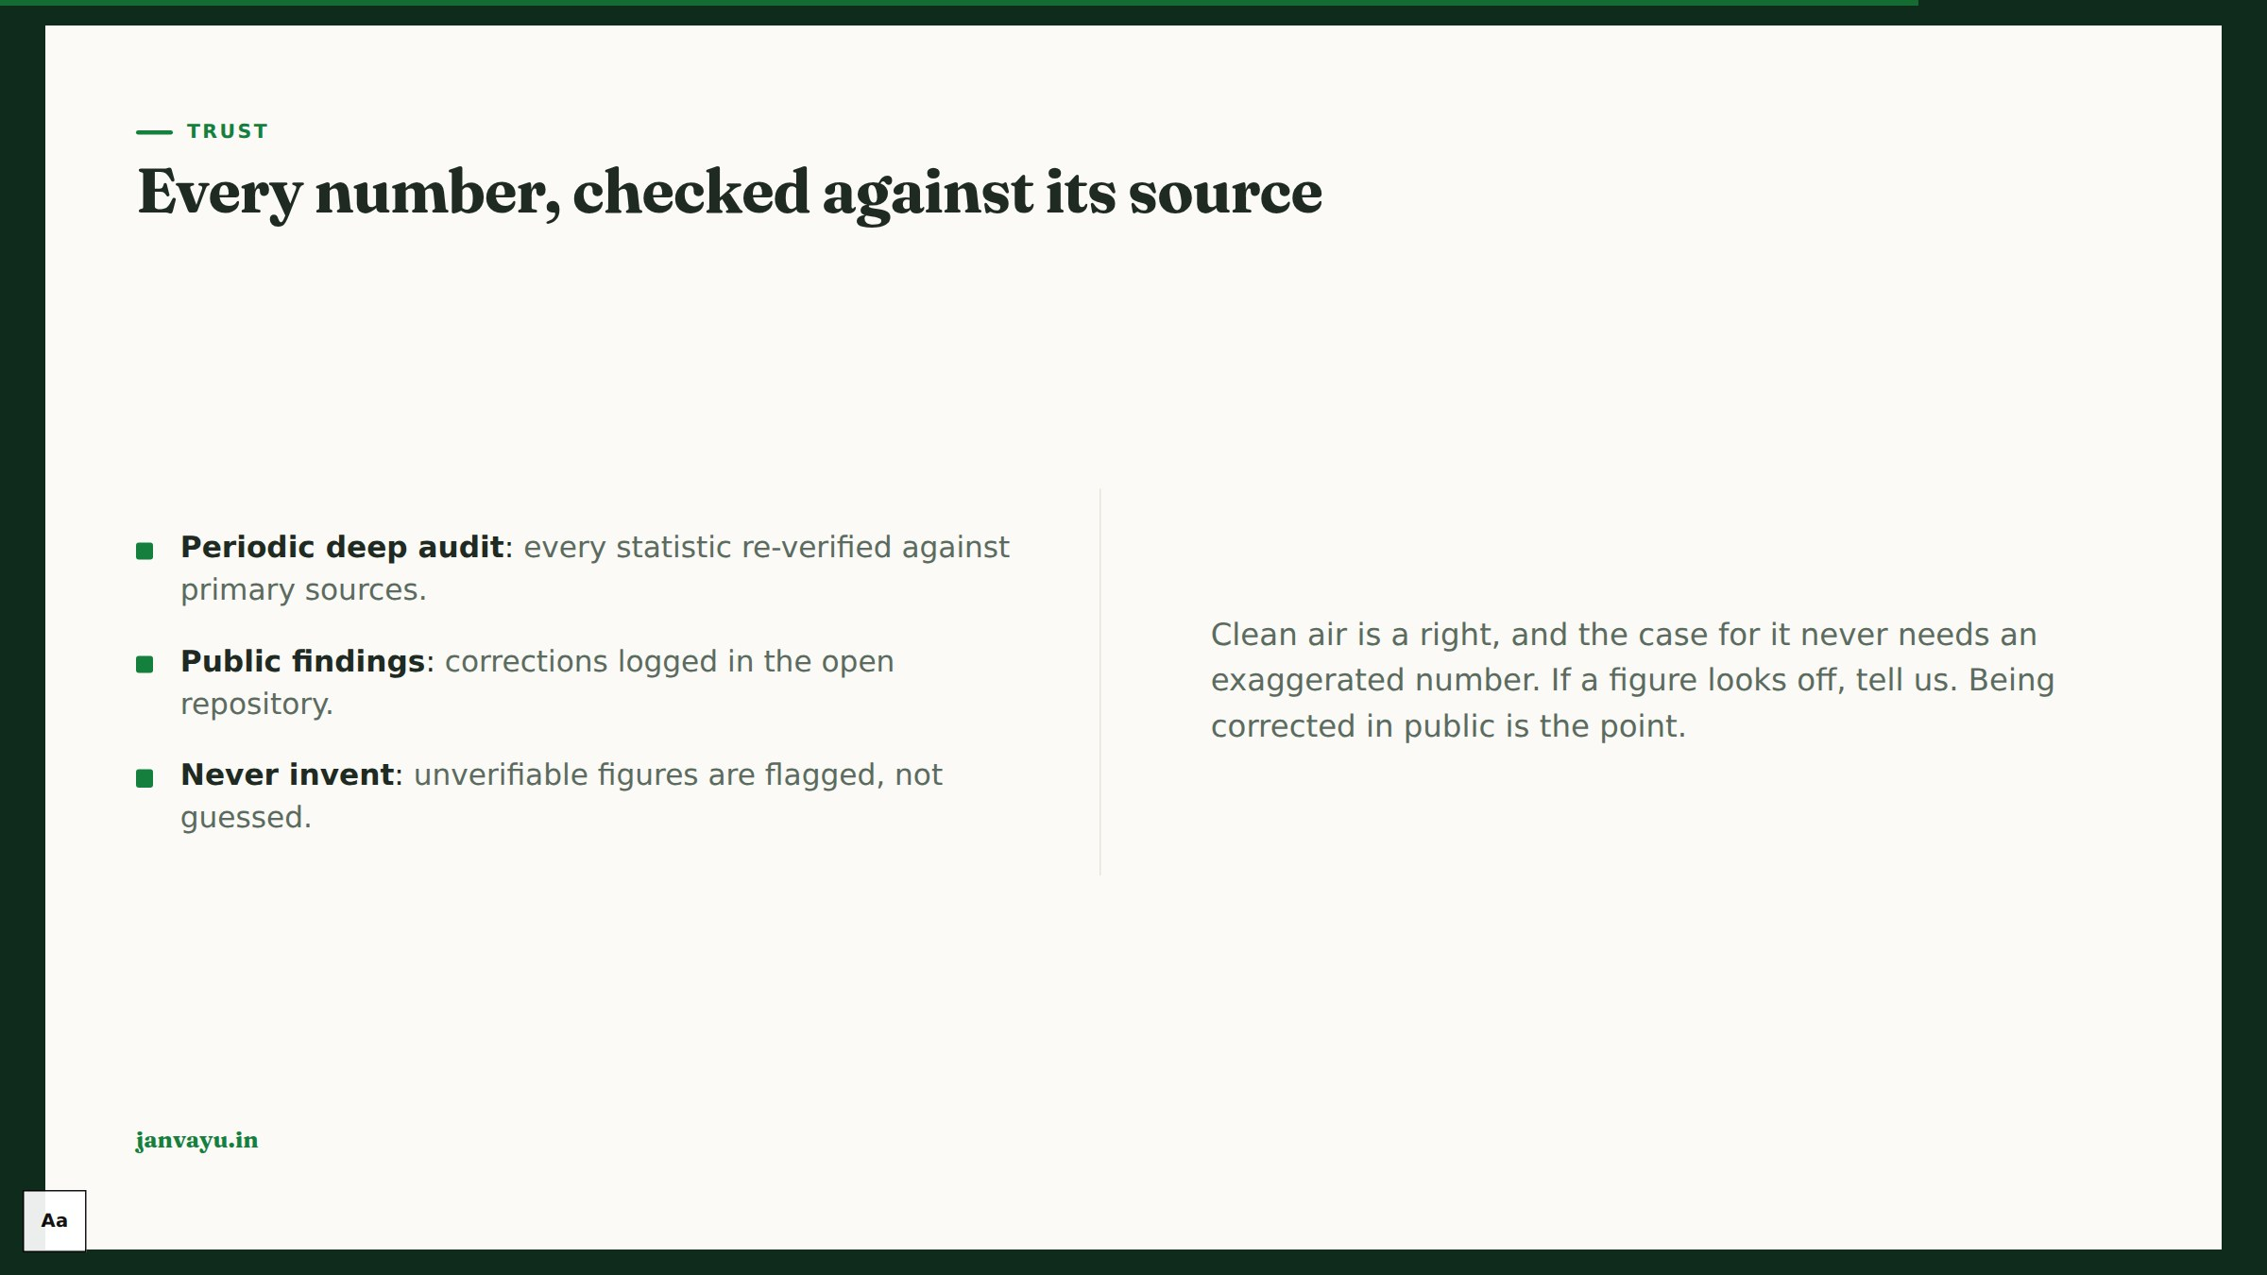
Notes:
Close the trust loop, and be exact about which half is which. Continuous: every stated figure is recomputed from the data whenever the site changes, a mismatch stops the release, and any claim we have publicly retracted is refused, translations included. Periodic: a deeper audit re-verifies statistics against primary sources, findings logged publicly. That deeper audit ran weekly through July 2026 and is not on a schedule now, which is why this deck no longer says weekly.

Slide 13
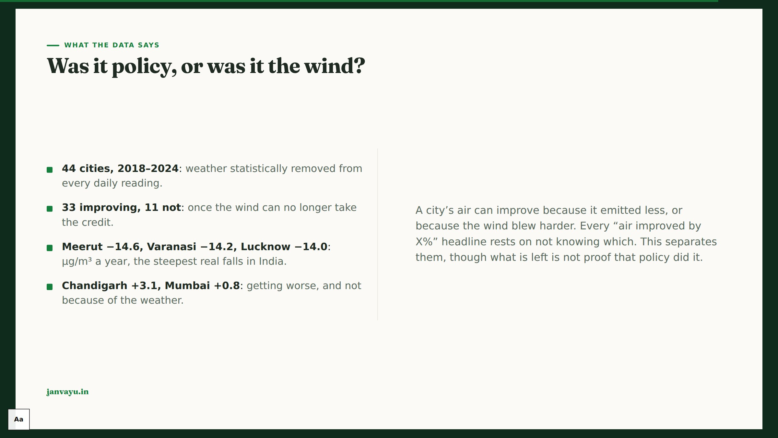
Notes:
The most quotable slide, so be precise about what it does and does not show. It removes weather as an explanation; it does not prove policy caused the rest. Emissions, fuel mix, construction and economic activity all sit inside what is left. 33 of the 44 cities are getting cleaner and 11 are not.

Slide 14
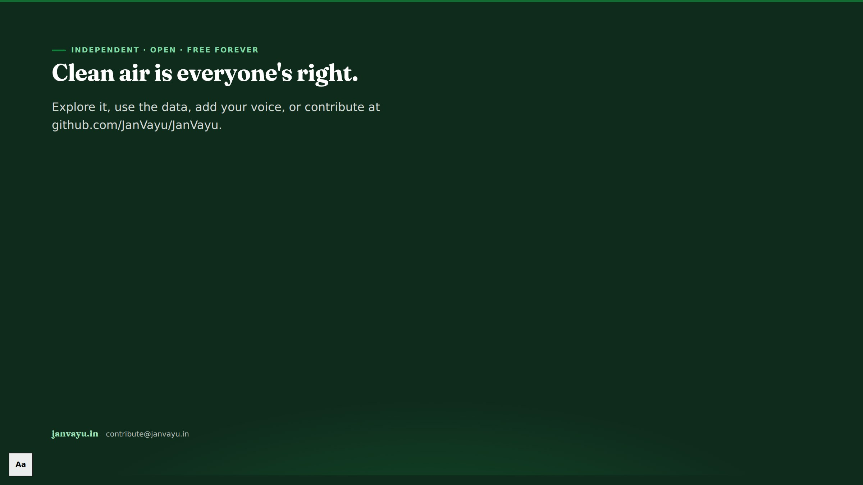
Notes:
Land the mission. Clean air is a right. Invite the audience to use the data and contribute. End on janvayu.in.

