Slide 1
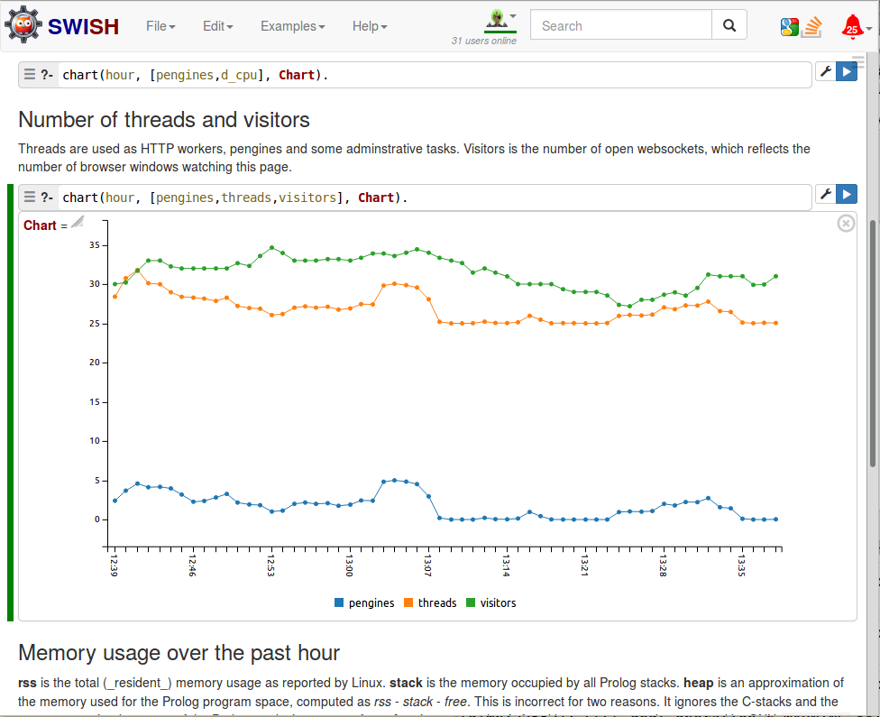
Markdown cell
Query settings
Run!
Query
Answer
Rendered using C3.js

