Slide 1
J A C I S
Java
atomic
consistent
isolated
store
J A C I S
a transactional in-memory store in Java
https://github.com/JanWiemer/jacis

Slide 2
ACID - atomicity
time
begin TX-1
update X from 1 to 2
update Y from 1 to 2
commit / rollback
object X
value: __
object Y
value: __
!
x=y=1 (rollback)
or
x=y=2 (commit)
Store

Slide 3
ACID - Consistency
time
!
consistent state
(constraints,
invariants,…)
begin TX-1
… (some updates)
commit
!
consistent state
(constraints,
invariants,…)
Store

Slide 4
ACID - Isolation
respect rules of isolation level (see later)
time
begin TX-1
…
commit
begin TX-1
…
commit
begin TX-2
…
commit
begin TX-2
…
commit
Store

Slide 5
ACID - Durability
time
begin TX-1
update X from 1 to 2
commit
Power off
object X
value: __
begin TX-2
read X → 2
commit
Store

Slide 6
Isolation - DIRTY READ
time
begin TX-1
update X from 1 to 2
commit
1
object X
value: __
begin TX-2
read X → 2
commit
dirty read
12z
3
Store

Slide 7
Isolation - Non-Repeatable Read
time
begin TX-2
read X → 1
read X → 2
commit
1
begin TX-1
update X from 1 to 2
commit
12z
object X
value: __
3
non-repeatable read
4
Store

Slide 8
Isolation - Phantom Read
time
begin TX-2
select sum → 5
select sum → 6
commit
1
begin TX-1
update X from 1 to 2
commit
12z
object X
value: __
3
phantom read
4
Store

Slide 9
Isolation - LOSt update
time
begin TX-1
read X → 1
update X from 1 to 2
commit
begin TX-2
read X → 1
update X from 1 to 3
commit
1
12z
3
object X
value: __
4
lost update
5
7
6
…
read X → 3
…
Store

Slide 10
Isolation levels
Isolation Level | Lost Updates | Dirty Read | Non-repeatable Read | Phantom Read
READ UNCOMMITTED |  | permitted | permitted | permitted
READ COMMITTED |  |  | permitted | permitted
REPEATABLE READ |  |  |  | permitted
SNAPSHOT ISOLATION |  |  |  | permitted
SERIALIZABLE
ANSI/ISO SQL-Standard (SQL-92)

Slide 11
Concurrency control mechanisms
Categories:
Pessimistic (prevent rule violations by blocking operations with locks)
optimistic (detect rule violations later and retry execution of the TX)
semi optimistic (sometimes pessimistic, sometimes optimistic)
Methods:
locking
serialization graph checking
timestamp ordering
commitment ordering
Methods:
multi-version concurrency control (MVCC)
index concurrency control (index locking)
private workspace model (deferred update)

Slide 12
CONCEpt - Pessimistic Locking
time
begin TX-1
write lock X
update X from 1 to 2
commit (release lock)
begin TX-2
read lock X
read X → 2
commit
1
object X
value: __
12z
3
wait
4
5
Store

Slide 13
CONCEpt - Pessimistic Locking
Lock Type | read-lock (shared lock) | write-lock (exclusive lock)
read-lock (shared lock) | allowed | incompatible
write-lock (exclusive lock) | incompatible | incompatible

Slide 14
CONCEpt - Pessimistic Locking
Lock Type | read-lock (shared lock) | write-lock (exclusive lock)
read-lock (shared lock) | allowed | incompatible
write-lock (exclusive lock) | incompatible | incompatible
Two-Phase Locking (2PL)
  Expanding phase (/ Growing phase): locks are acquired
  Shrinking phase: locks are released
Conservative 2PL prevents deadlocks
Strong strict two-phase locking or Rigorousness, or Rigorous scheduling, or Rigorous two-phase locking

Slide 15
CONCEpt - Optimistic Locking
time
begin TX-1
read X → 1 (v1)
update X (v1) to 2 (v2)
commit
begin TX-2
read X -> 1 (v1)
update X (v1) → 3 (v2)
→ ERROR
rollback (and retry)
1
object X
value: __
version: v. __
12z
3
4
5
optimistic lock exception
Store

Slide 16
CONCEpt – private workspace model
object X
value: 1
version: v1
object X
value: 1
version: v1
object X
value: 2
version: v1
Store
Workspace TX-1
Workspace TX-2

Slide 17
CONCEpt – private workspace & Optimistic locking
time
begin TX-1
read X → 1
update X to 2
commit
begin TX-2
read X → 1
update X to 3
read X → 3
commit → ERROR
object X
value: 1
version: v1
1
object X
value: 1
version: v1
1
2
object X
value: 1
version: v1
2
3
3
4
4
object X
value: 2
version: v1
object X
value: 3
version: v1
5
object X
value: 2
version: v2
optimistic lock exception
5
7
6
Store
7
Workspace TX-1
Workspace TX-2

Slide 18
JACIS
JacisStoreTxView
TX-1
JacisStoreTxView
TX-2
StoreEntry key = X
value = 42
version = 1
StoreEntry key = X
value = 42
version = 1
StoreEntry
key = X
value = 42
version = 1
get(X)
JacisStore

Slide 19
JACIS
JacisStoreTxView
TX-1
JacisStoreTxView
TX-2
StoreEntry key = X
value = 42
version = 1
StoreEntry key = X
value = 42
version = 1
StoreEntry
key = X
value = 42
version = 1
get(X)
StoreEntryTxView
key = X
txValue = 42
origVersion = 1
updated = false
42
clone
JacisStore

Slide 20
JACIS
JacisStoreTxView
TX-1
JacisStoreTxView
TX-2
StoreEntry key = X
value = 42
version = 1
StoreEntry key = X
value = 42
version = 1
StoreEntry
key = X
value = 42
version = 1
get(X)
StoreEntryTxView
key = X
txValue = 42
origVersion = 1
updated = false
42
JacisStore

Slide 21
JACIS
JacisStoreTxView
TX-1
JacisStoreTxView
TX-2
StoreEntry key = X
value = 42
version = 1
StoreEntry key = X
value = 42
version = 1
StoreEntry
key = X
value = 42
version = 1
update(X, 7)
StoreEntryTxView
key = X
txValue = 7
origVersion = 1
updated = true
JacisStore

Slide 22
JACIS
JacisStoreTxView
TX-1
JacisStoreTxView
TX-2
StoreEntry key = X
value = 42
version = 1
lockedFor
TX-1
StoreEntry key = X
value = 42
version = 1
StoreEntry
key = X
value = 7
version = 2
prepare
StoreEntryTxView
key = X
txValue = 7
origVersion = 1
updated = true
JacisStore

Slide 23
JACIS
JacisStoreTxView
TX-1
JacisStoreTxView
TX-2
StoreEntry key = X
value = 42
version = 1
lockedFor
TX-1
StoreEntry key = X
value = 42
version = 1
StoreEntry
key = X
value = 7
version = 2
commit
StoreEntryTxView
key = X
txValue = 7
origVersion = 1
updated = true
clone
JacisStore

Slide 24
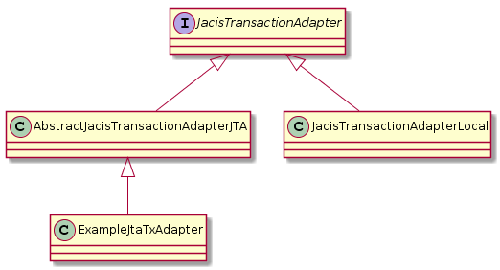
JACIS – Transaction Adapter
pass transaction adapter to the
constructor of the JacisContainer
default
public class ExampleJtaTxAdapter extends AbstractJacisTransactionAdapterJTA {
@Override
protected javax.transaction.TransactionManager getTransactionManager() {
return JtaHelper.getTransactionManager(); // provide access to the tx manager
}
}

Slide 25
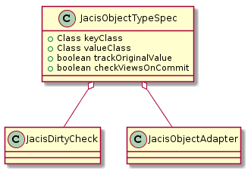
JACIS – Object type specification
specify as parameter when creating a JacisStore:
JacisContainer.createStore
<keyClass> key
<valueClass> value
JacisStore

Slide 26
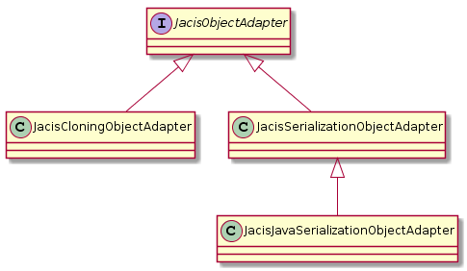
JACIS – OBJECT Adapter
Tell JACIS how to clone objects between store and TX view
cloneCommitted2WritableTxView
cloneTxView2Committed
cloneCommitted2ReadOnlyTxView
cloneTxView2ReadOnlyTxView
can be set at JacisObjectTypeSpec
read
only
default
JacisStore
read
only
read
only
JacisStore

Slide 27
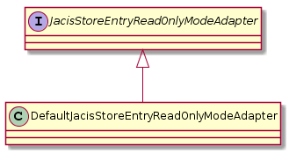
JACIS – Read only mode
passed to the constructor of the JacisCloningObjectAdapter
class ExampleValueClass extends AbstractReadOnlyModeSupportingObject {
private final String name;
public String getName() {
return name;
}
public ExampleValueClass setName(String name) {
checkWritable();
this.name = name;
return this;
}
}
default
read
only
read
only
avoid cloning

Slide 28
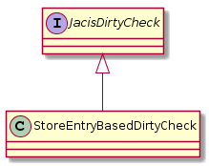
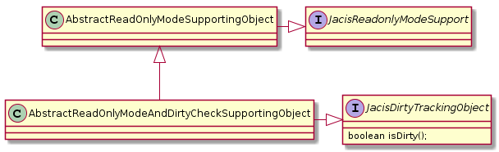
JACIS – dirty check
can be set at JacisObjectTypeSpec
(default is null)
By default there is no dirty check!
All changed have to be explicitly notified by:
JacisStore.update
!
Implementing dirty check by setting a dirty flag in the checkWritable method

Slide 29
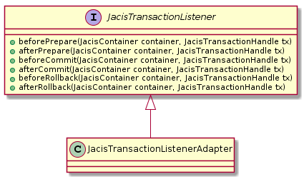
JACIS – Transaction listener
provides possibility to execute code on transaction demarcation events
register by calling JacisContainer. registerTransactionListener

Slide 30

JACIS – modification listener
provides possibility to execute code on each modification
executed when the modification is done in the store during commit
register by calling JacisStore. registerModificationListener

Slide 31
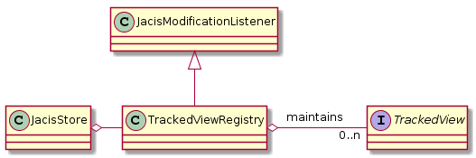
JACIS – tracked views
key = X
txValue = 6
key = X
txValue = 5
commit
ExampleTrackedViewSum
trackModification([X,5], [x,6])
→ sum = sum – 5 + 6
txView
JacisStore

Slide 32
JACIS – tracked views
time
begin TX-1
reads & updates
getView
commit
clone current value (based on the committed values)
of the view
View Snapshot (Clone)
View Snapshot (Clone)
ExampleTrackedViewSum
txView
JacisStore
merge TX local
modifications into
View Snapshot

Slide 33
JACIS – Microstream Persistence Adapter
MicrostreamPersistenceAdapter
key2entity
objectsToStore
Key-1
Store-
Root
Object
Object
Object
Object
Object
MicrostreamStoreRoot
MicrostreamStoreEntity
MicroStream

Slide 34

JACIS – Structure
JacisContainer
JacisTransactionAdapter
JacisTransactionListener
JacisTransactionListener
JacisTransactionListener
JacisStore
JacisStore
JacisObjectAdapter
JacisObjectAdapter
TrackedViewRegistry
Store
TrackedViewRegistry
Store
txViewMap
txViewMap
JacisModificationListener
JacisModificationListener
JacisModificationListener
JacisModificationListener
JacisModificationListener
JacisModificationListener

Slide 35
JACIS API – example value
static class Account extends AbstractReadOnlyModeSupportingObject
implements JacisCloneable<Account> {
private final String name;
private long balance;
public Account(String name) {
this.name = name;
}
@Override
public Account clone() {
return (Account) super.clone();
}
public Account deposit(long amount) {
checkWritable();
balance += amount;
return this;
}
public Account withdraw(long amount) {
checkWritable();
balance -= amount;
return this;
}
…
…
public Account withdraw(long amount) {
checkWritable();
balance -= amount;
return this;
}
public String getName() {
return name;
}
public long getBalance() {
return balance;
}
}
}

Slide 36
JACIS API – create store
the root class, containing all stores
JacisContainer container = new JacisContainer();
JacisObjectTypeSpec<String, Account> objectTypeSpec
= new JacisObjectTypeSpec<>(String.class, Account.class);
JacisStore<String, Account> store = container.createStore(objectTypeSpec);
key type
value type
store containing the values

Slide 37
JACIS API – CREate object
JacisLocalTransaction tx = container.beginLocalTransaction();
Account account1 = new Account("account1");
store.update(account1.getName(), account1);
tx.commit();
key
value

Slide 38
JACIS API – update object
executes the lambda
inside a local transaction
container.withLocalTx(() -> {
Account acc = store.get("account1");
acc.deposit(100);
store.update("account1", acc);
});
explicitly call the update method!
No dirty check!

Slide 39
JACIS API – get object
container.withLocalTx(() -> {
Account acc = store.get("account1");
System.out.println("balance of " + acc.getName() + ": " + acc.getBalance());
});
returns a writable instance
(changes are written back to the store during commit if update was called)

Slide 40
JACIS API – get Read-only object
container.withLocalTx(() -> {
Account acc = store.getReadOnly("account1");
System.out.println("balance of " + acc.getName() + ": " + acc.getBalance());
});
returns a read-only instance
(calls to modifying methods would throw a org.jacis.exception.ReadOnlyException)

Slide 41
JACIS API – stream API
// To cumulate values usually read only access is enough (this is possible without a transaction)
System.out.println("sum=" + store.streamReadOnly().mapToLong(acc -> acc.getBalance()).sum());
// streaming the objects starting with a filter
System.out.println("#>500=" + store.streamReadOnly(acc -> acc.getBalance() > 500).count());
// as an example to modify some objects add 10% interest to each account with a positive balance
container.withLocalTx(() -> {
store.stream(acc -> acc.getBalance() > 0).forEach(acc -> {
store.update(acc.getName(), acc.deposit(acc.getBalance() / 10));
});
});
// finally output all accounts
String str = store.streamReadOnly().//
sorted(Comparator.comparing(acc -> acc.getName())). //
map(acc -> acc.getName() + ":" + acc.getBalance()).//
collect(Collectors.joining(", "));
System.out.println("Accounts: " + str);
}

Slide 42
JACIS API – tracked view
public static class TotalBalanceView implements TrackedView<Account> {
private long totalBalance = 0;
@Override
public void trackModification(Account oldValue, Account newValue) {
totalBalance += newValue == null ? 0 : newValue.getBalance();
totalBalance -= oldValue == null ? 0 : oldValue.getBalance();
}
public long getTotalBalance() {
return totalBalance;
}
@Override
public void clear() {
totalBalance = 0;
}
@Override
public TrackedView<Account> clone() {
try {
return (TrackedView<Account>) super.clone();
} catch (CloneNotSupportedException e) {
throw new RuntimeException("clone failed");
}
}
…
…
@Override
public void checkView(List<Account> values) { // check method for testing
long checkValue = values.stream().mapToLong(Account::getBalance).sum();
if (totalBalance != checkValue) {
throw new IllegalStateException(
"Corrupt view! Tracked value=" + totalBalance + " computed value=" + checkValue);
}
}
}
// Register View:
store.getTrackedViewRegistry().registerTrackedView(new TotalBalanceView());

