Slide 1
DIGITAL EGYPT PIONEERS INITIATIVE · DATA ANALYTICS & AI TRACK
UK ROAD ACCIDENTS
DATA ANALYSIS
A Complete Data Analytics Journey — From Raw Records to Road Safety Strategy
TEAM MEMBERS
[Shahd Saad Abdelsalam Youssef] · [Reham Ali Salah El Din] · [Jana Mohamed Said AbdelAziz]
[Rahma Galal Ramadan] · [Tervina Atef Fariz] · [Marwa Esmail Abdelghaffar]
INSTRUCTOR
[Marwan Mokhtar]
Excel | SQL Server | Power BI

Slide 2
EXECUTIVE SUMMARY & BUSINESS PROBLEM
Why Road Safety Data Matters
THE PROBLEM
Thousands of casualties occur on UK roads every year, yet safety interventions are often planned without a clear, data-driven view of when, where, and why accidents happen.
307,973
417,883
TOTAL ACCIDENTS
ANALYZED
TOTAL
CASUALTIES
PROJECT OBJECTIVES
Clean & structure 307,973 real accident records (2021–2022)
Engineer an SQL Server workflow for reliable, repeatable analysis
Uncover the temporal, environmental & structural risk drivers
Deliver interactive Power BI & Tableau dashboards
Translate findings into actionable safety recommendations
1.3%
11.7%
OF ACCIDENTS
WERE FATAL
YoY DECLINE IN
ACCIDENTS ('21→'22)
This project turns raw government accident data into a strategic tool for reducing road fatalities.
02

Slide 3
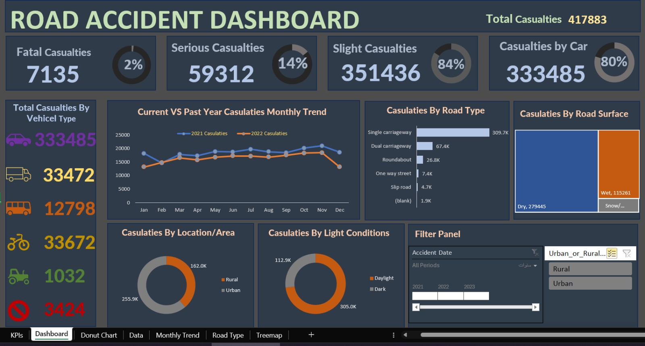
DATA SOURCE & INITIAL ANALYSIS · EXCEL PHASE
Cleaning & First-Pass Exploration
01
Missing-Value Audit
Scanned all 19 fields for gaps before any analysis began.
02
Category Standardization
Unified inconsistent labels (weather, severity, road type) into a single clean vocabulary.
03
Duplicate Check
Verified every accident_index is unique — no repeated records.
04
First-Pass Pivot Analysis
Built early Pivot Tables to preview severity & yearly distribution before deep SQL analysis.
03

Slide 4
DATABASE MANAGEMENT & DATA ENGINEERING · SQL PHASE
Structuring the Data in SQL Server
SAMPLE ANALYTICAL QUERY
TABLE: road_accident
307,973 rows loaded directly from CSV into a single, query-ready SQL Server table — 19 columns across four analytical dimensions.
SELECT road_type,
SUM(number_of_casualties) AS fatal_casualties
FROM road_accident
WHERE accident_severity = 'Fatal'
GROUP BY road_type
ORDER BY fatal_casualties DESC;
Temporal
accident_date · day_of_week · time
Environmental
KEY ENGINEERING PRINCIPLE
weather_conditions · light_conditions · road_surface
A single, flat table was a deliberate choice the dataset has no repeating groups, so a normalized multi-table schema would add JOIN overhead without analytical benefit. This let the team focus entirely on query design.
Location
local_authority · police_force · urban_or_rural_area
DATA QUALITY CHECKS PERFORMED IN SQL
Impact
Null-value audit per column (COUNT(*) − COUNT(column))
Duplicate accident_index detection
Categorical consistency checks (SELECT DISTINCT)
accident_severity · number_of_casualties · number_of_vehicles
04

Slide 5
DEEP-DIVE EXPLORATORY ANALYSIS · SQL INSIGHTS
What the Numbers Reveal
79.4%
of accidents happen in FINE weather
Driver behavior — not weather — is the dominant risk factor. Bad-weather campaigns alone won't move the needle.
FRIDAY
15:00–18:00
77.9%
74.9%
highest-risk day
(50,529 accidents)
peak evening
commute window
of accidents
involve a car
of accidents on
single carriageways
05

Slide 6
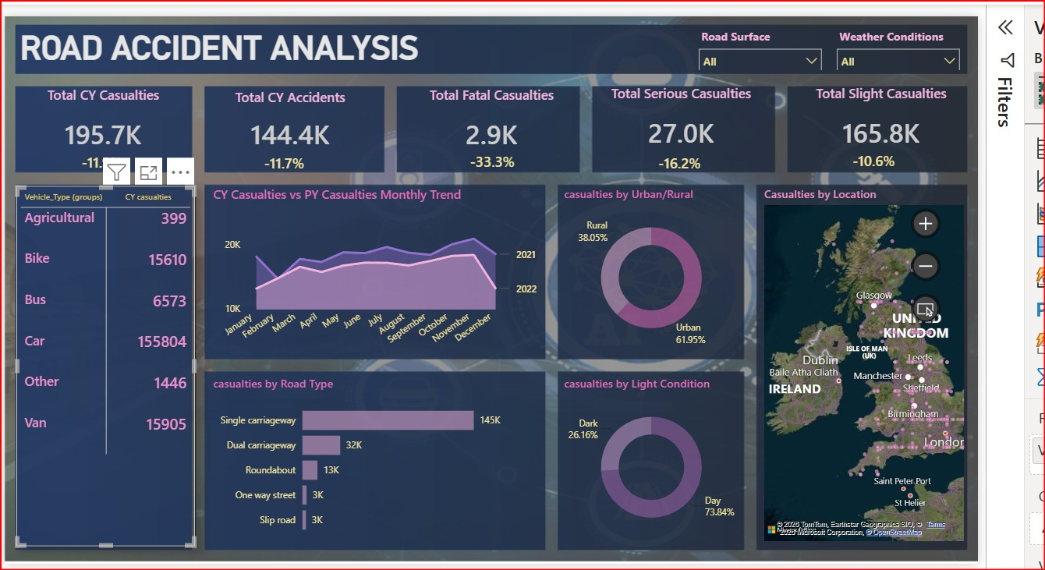
ADVANCED VISUALIZATIONS · POWER BI PHASE
From Queries to Interactive Intelligence
KEY FEATURES
Live KPI Cards
Total accidents & casualties by severity, each with a YoY % change indicator.
Monthly Trend Line
Current-year vs. prior-year casualties compared month by month.
Geographic Map
Casualty density plotted across the UK to surface regional hotspots.
Cross-Filtering
Clicking any chart — road type, weather, surface — filters the entire dashboard.
Interactive Power BI dashboard — filterable by road surface, and weather condition.
417,883 total casualties made explorable in real time.
06

Slide 7
STRATEGIC RECOMMENDATIONS & ACTIONABLE INSIGHTS
From Data to Decisions
01
02
03
Prioritize Single-Carriageway Upgrades
Shift Focus to Driver Behavior
Target Friday & Evening Peak Hours
74.9% of accidents & 74% of fatal casualties occur here — the top infrastructure investment target.
79.4% of accidents happen in fine weather — enforcement should target speeding & distraction, not weather alone.
Concentrate visible policing around Friday traffic and the 15:00–18:00 commute window.
04
05
06
Close the Rural Severity Gap
Expand Motorcycle Safety Campaigns
Sustain Year-over-Year Monitoring
Rural roads show higher severity per accident — invest in lighting, signage, and speed review.
Motorcyclists face disproportionate injury severity relative to their traffic share.
Accidents fell 11.7% and fatalities 35.6% (2021→2022) — track this trend with live dashboards.
07

Slide 8
THANK YOU
Questions & Discussion
UK Road Accidents Data Analysis · Digital Egypt Pioneers Initiative
Excel · SQL Server · Power BI

