Slide 1
EMPLOYMENT STABILITY OF WORKERS 55+
How job stability and career-change outcomes shift with age - a data analysis using real, publicly published data
Jana Dolečková
Data Analyst
Analysis and deck directed through iterative prompting, with the help of Claude (Anthropic)'s agentic coding.

Slide 2
Goal
Determine whether age is linked to greater job stability, focusing on the 55+ group
Primarily using U.S. data on job tenure (how long someone stays with the same employer, not academic tenure) by age and education
A secondary comparison against the best available Czech data, though considerably less detailed
Every chart in this project is built directly from filtered survey data
Employment Stability of Workers 55+
2

Slide 3
Data sources
BLS
EU
U.S. Bureau of Labor Statistics
Eurostat / Czech Statistical Office
Employee Tenure Summary (Jan 2024) - tenure by age, sex, education
The Economics Daily (Oct 2024) - tenure length distribution by age (primary analysis)
lfsa_egad - tenure data for Czechia, 2025 (secondary comparison, less granular)
Employment Stability of Workers 55+
3

Slide 4
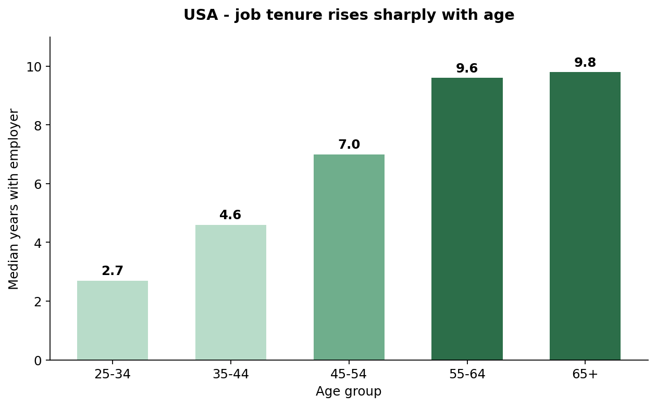
USA - does job tenure change with age?
2.7 → 9.8
years of median tenure
Median tenure with an employer rises almost monotonically with age - from 2.7 years for 25–34 year-olds to 9.6–9.8 years for workers 55+.
Employment Stability of Workers 55+
4

Slide 5
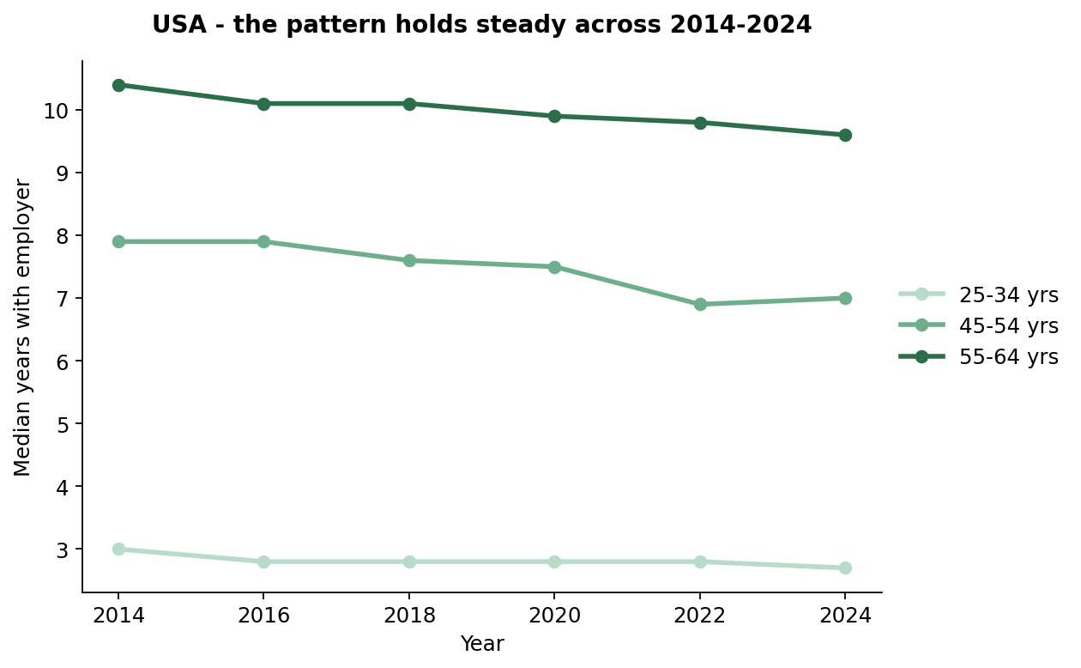
USA - is the pattern consistent over time?
Not a one-off blip: the age → tenure relationship is stable across 2014–2024, tracked every two years by the BLS Employee Tenure Summary.
Employment Stability of Workers 55+
5

Slide 6
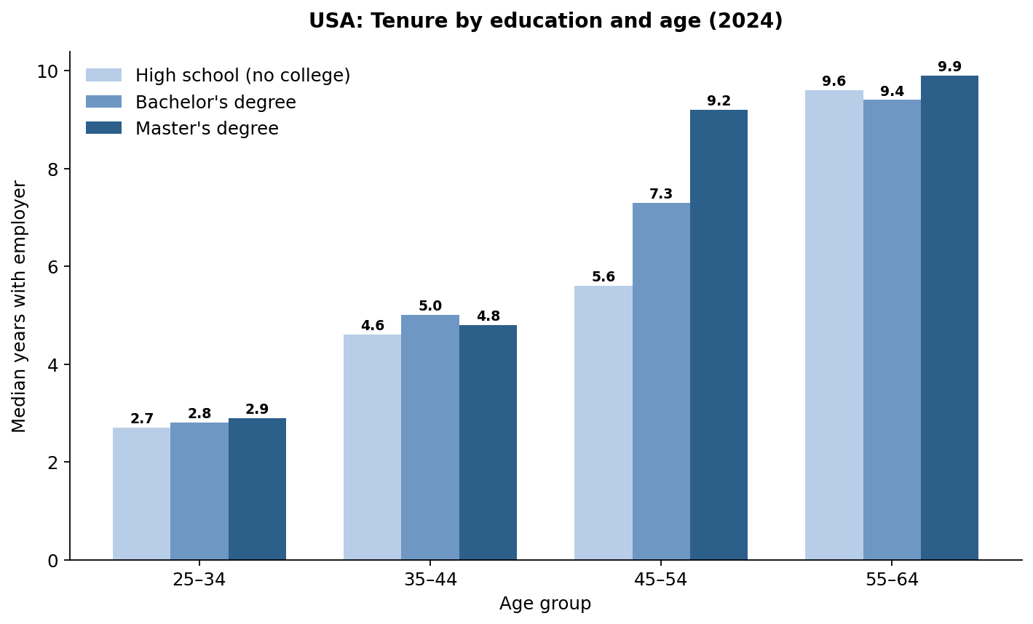
USA - does education influence stability?
Master's degree holders reach near-peak stability earlier than everyone else - a median of 9.2 years by age 45–54, already close to the 55–64 level (9.9). High-school and bachelor's-degree workers don't reach that level until 55–64.
Employment Stability of Workers 55+
6

Slide 7
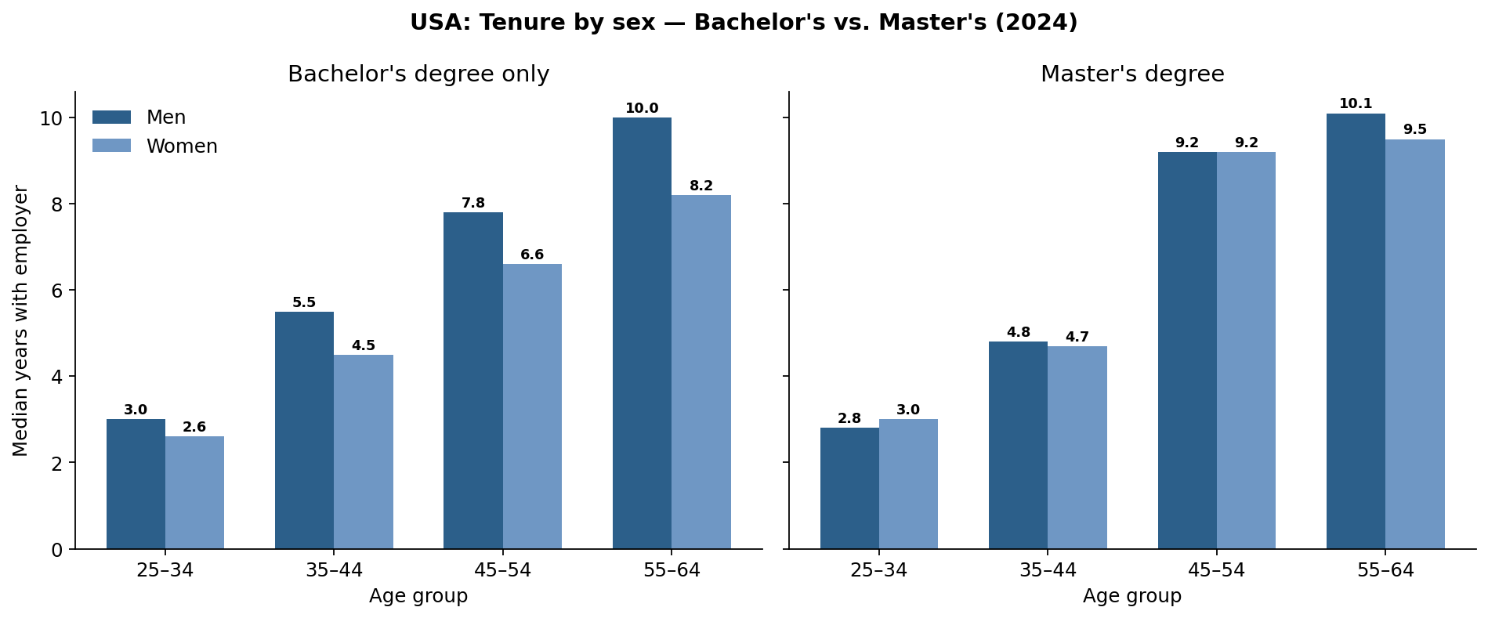
USA - does tenure differ by sex among college graduates?
The gender gap in tenure narrows at higher education levels: among bachelor's degree holders aged 55–64, men lead by 1.8 years (10.0 vs. 8.2); among master's degree holders the gap shrinks to 0.6 years (10.1 vs. 9.5), and disappears entirely at age 45–54 (9.2 vs. 9.2).
Employment Stability of Workers 55+
7

Slide 8
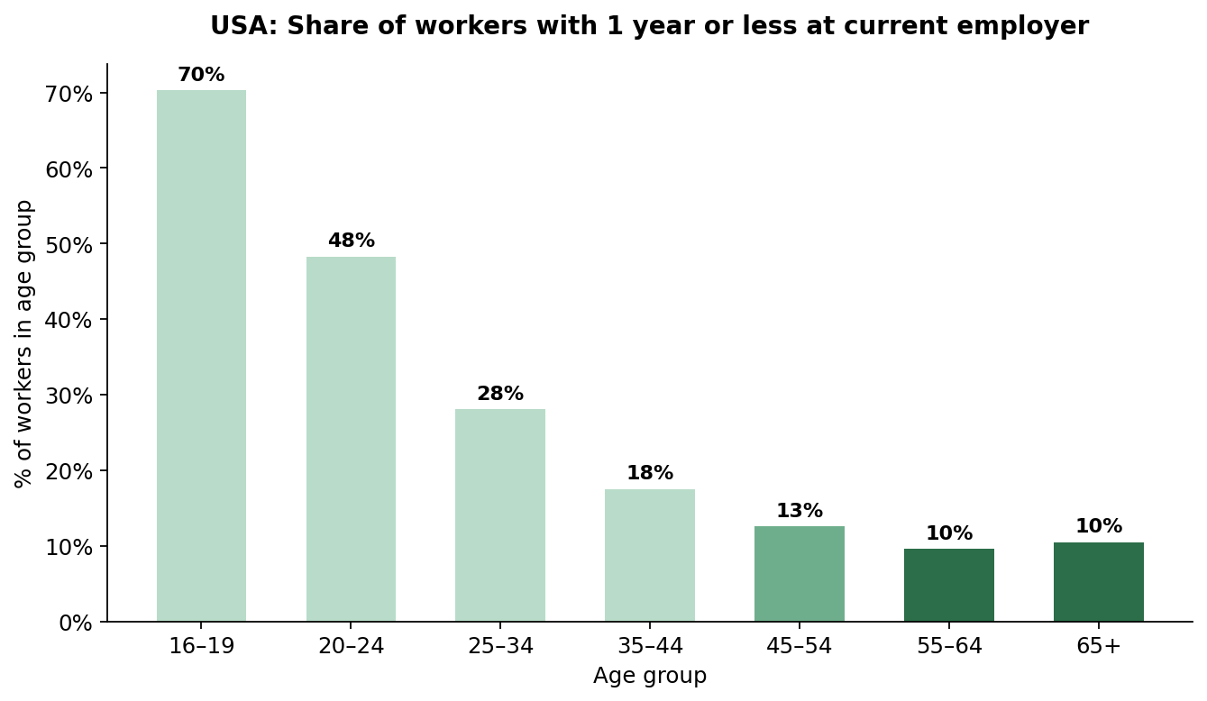
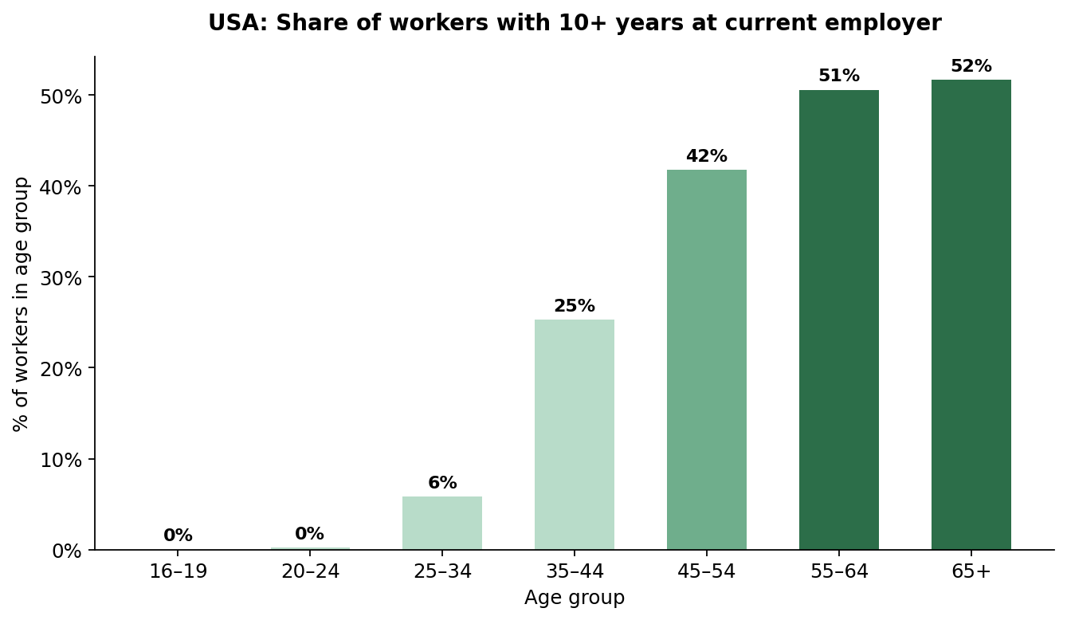
USA - how does tenure length vary by age?
Only 10% of workers 55–64 are in a job less than a year old, vs. 48% for 20–24 year-olds.
Conversely, 51% of workers 55–64 have been with their employer 10+ years.
Employment Stability of Workers 55+
8

Slide 9
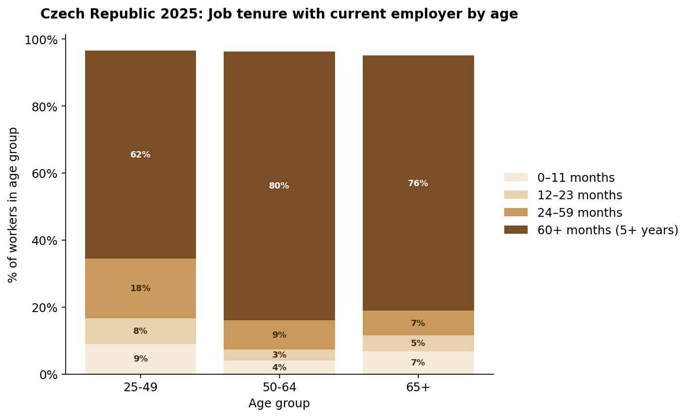
Does the same pattern appear in the Czech Republic (2025)?
80.3%
of employed 50–64 year-olds
have been with their employer 5+ years - vs. 62.1% for a derived 25–49 age group.
Eurostat's published age bands overlap; the 25–49 group was derived from published headcounts to make a fair, non-overlapping comparison. The duration bands also sum to slightly under 100% - the remainder is Eurostat's not-stated share.
Employment Stability of Workers 55+
9

Slide 10
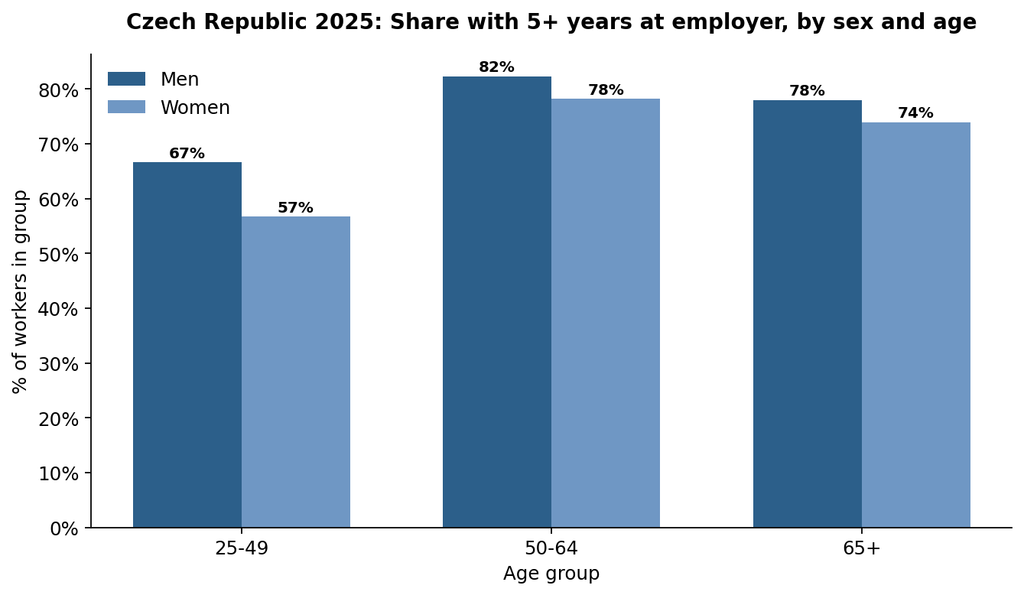
Czech Republic - does job tenure differ by sex, as in the USA?
Job tenure differs by sex across every age group: men consistently show longer tenure than women, though the gap is largest at 25–49 and narrows from 50+ onward. No causal claim is made here - the data shows the pattern, not the reason.
Employment Stability of Workers 55+
10

Slide 11
Key takeaways
1
USA: median tenure rises almost monotonically with age - 2.7 years (25–34) to 9.6–9.8 years (55+) - and the trend is stable over 2014–2024.
2
USA: the same pattern holds for college-educated workers; education doesn't affect turnover nearly as much as age does.
3
USA: only 10% of workers 55–64 are in a job under a year old (vs. 48% for 20–24 year-olds); 51% have 10+ years of tenure.
4
Czechia (2025, secondary comparison): 80.3% of employed 50–64 year-olds have 5+ years of tenure, vs. 62.1% for a derived 25–49 group - the same pattern as the U.S., though Eurostat data is far less granular.
Employment Stability of Workers 55+
11

Slide 12
Don't be afraid to hire 55+
Across every dataset in this analysis, employees 55+ show the longest tenure - hiring them is a bet on stability, not a risk.
Jana Dolečková · Data Analyst
+420 734 163 164

