Slide 1
STABILITY OF EMPLOYEES 55+
How employer tenure and career-change outcomes shift with age — a data analysis using real, publicly published data
Jana Dolečková
Data Analyst
Analysis built with Claude (Anthropic) — data collection, code, chart generation, and presentation design

Slide 2
Goal
Highlight the stability of employees aged 55+
Using real data on employer tenure by age and education
Every chart in this project is built directly from filtered survey data
Stability of Employees 55+
2

Slide 3
Data sources
BLS
EU
U.S. Bureau of Labor Statistics
Eurostat / Czech Statistical Office
Employee Tenure Summary, Jan 2024 — tenure by age, sex, education
lfsa_egad — tenure data for Czechia, 2025
Stability of Employees 55+
3

Slide 4
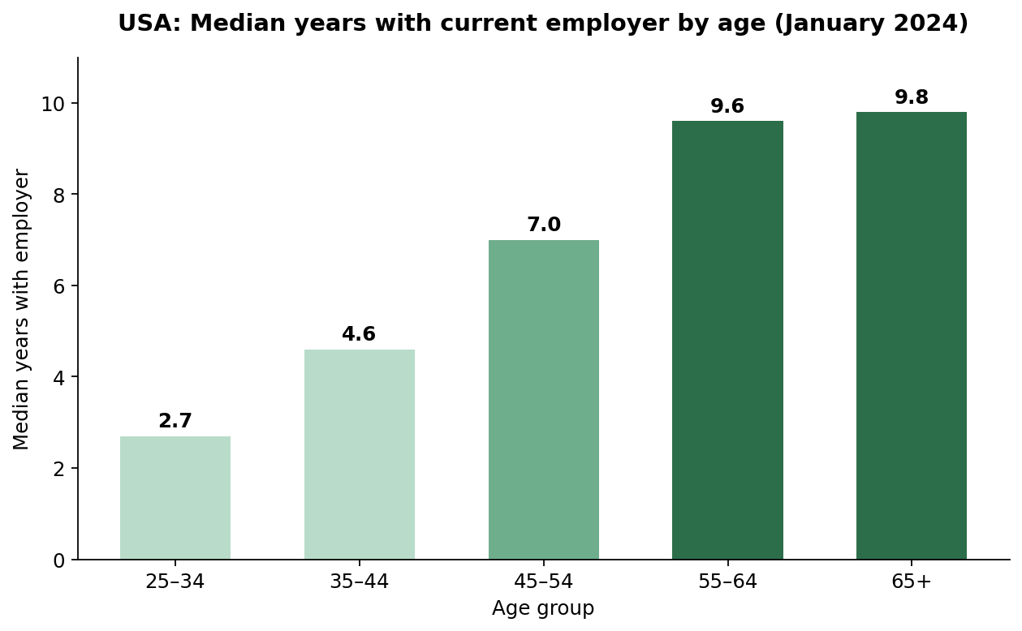
USA — does job tenure change with age?
2.7 → 9.6–9.8
years of median tenure
Median tenure with an employer rises almost monotonically with age — from 2.7 years for 25–34 year-olds to 9.6–9.8 years for workers 55+.
Stability of Employees 55+
4

Slide 5
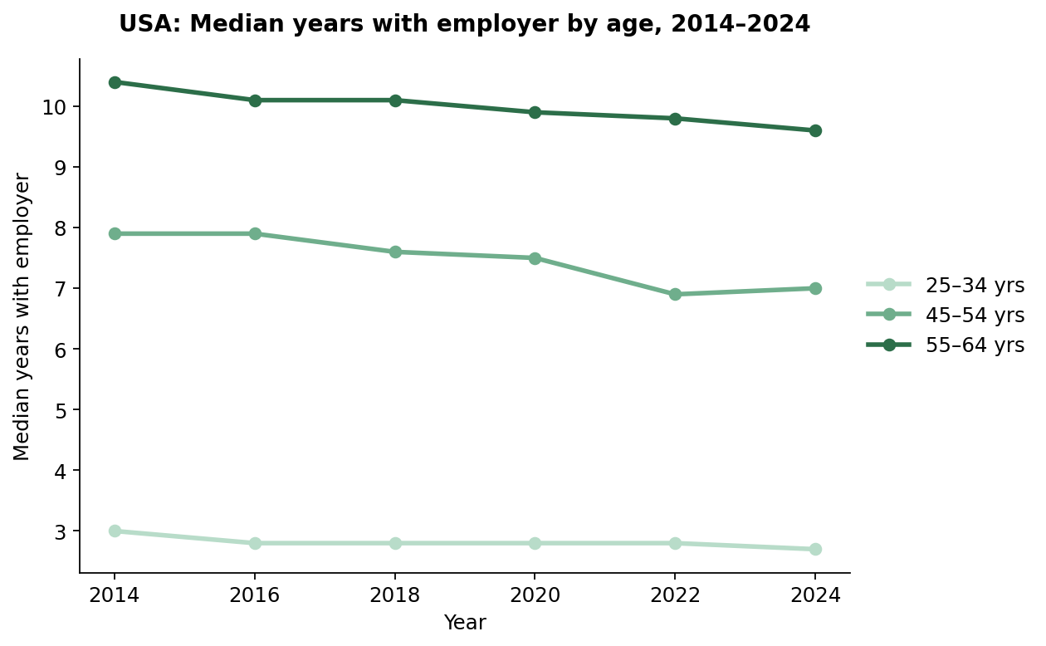
USA — is the pattern consistent over time?
Not a one-off blip: the age → tenure relationship is stable across 2014–2024, tracked every two years by the BLS Employee Tenure Summary.
Stability of Employees 55+
5

Slide 6
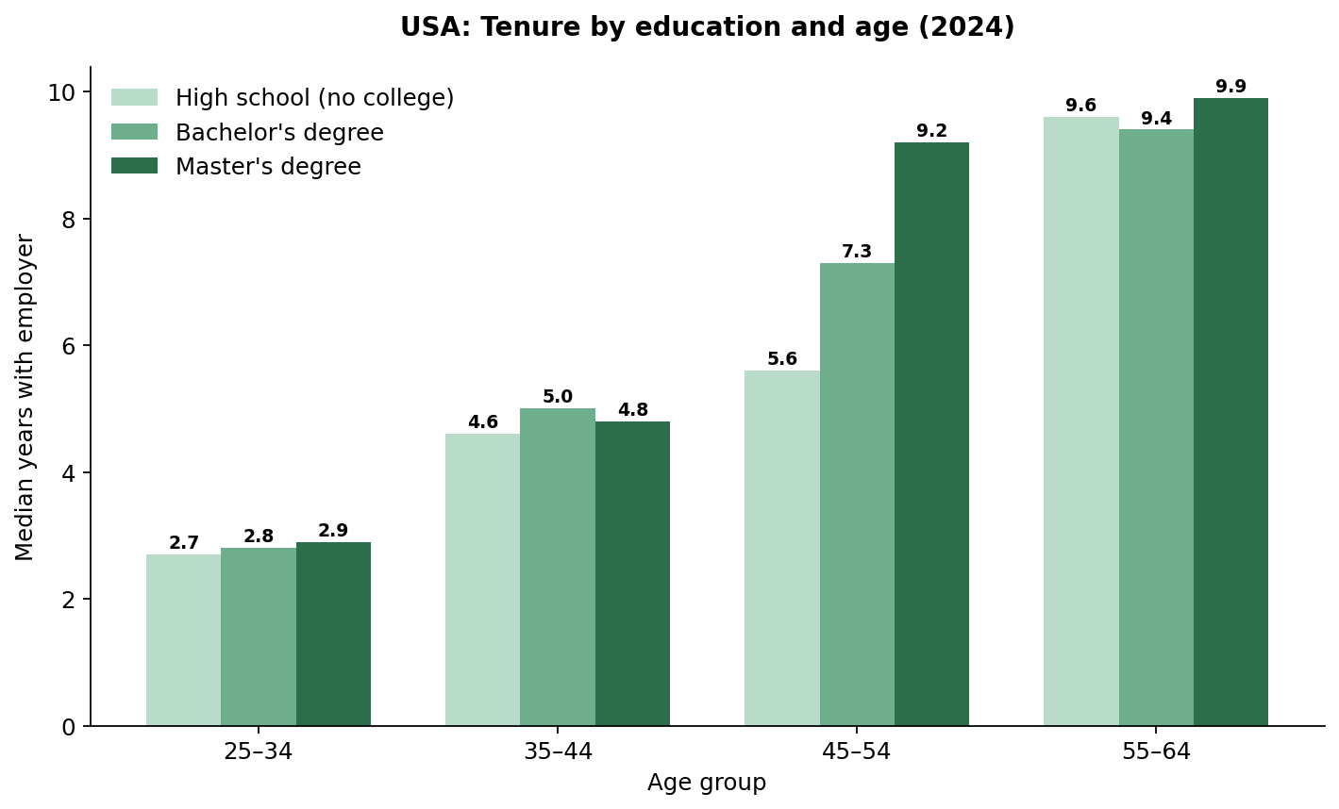
USA — does education influence stability?
Master's degree holders reach near-peak stability earlier than everyone else — a median of 9.2 years by age 45–54, already close to the 55–64 level (9.9). High-school and bachelor's-degree workers don't reach that level until 55–64.
Stability of Employees 55+
6

Slide 7
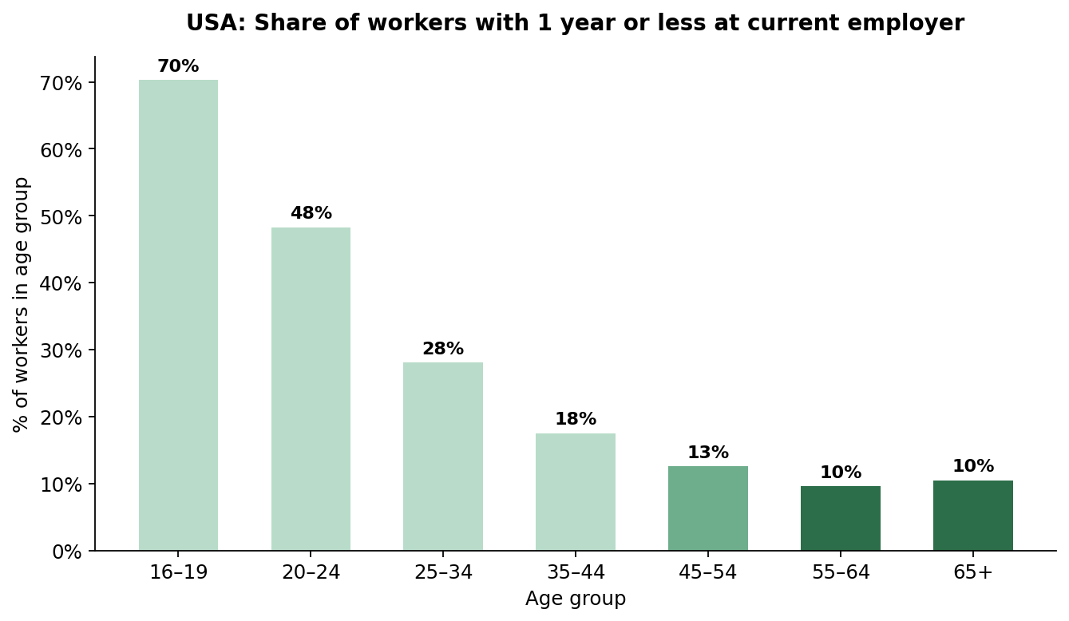
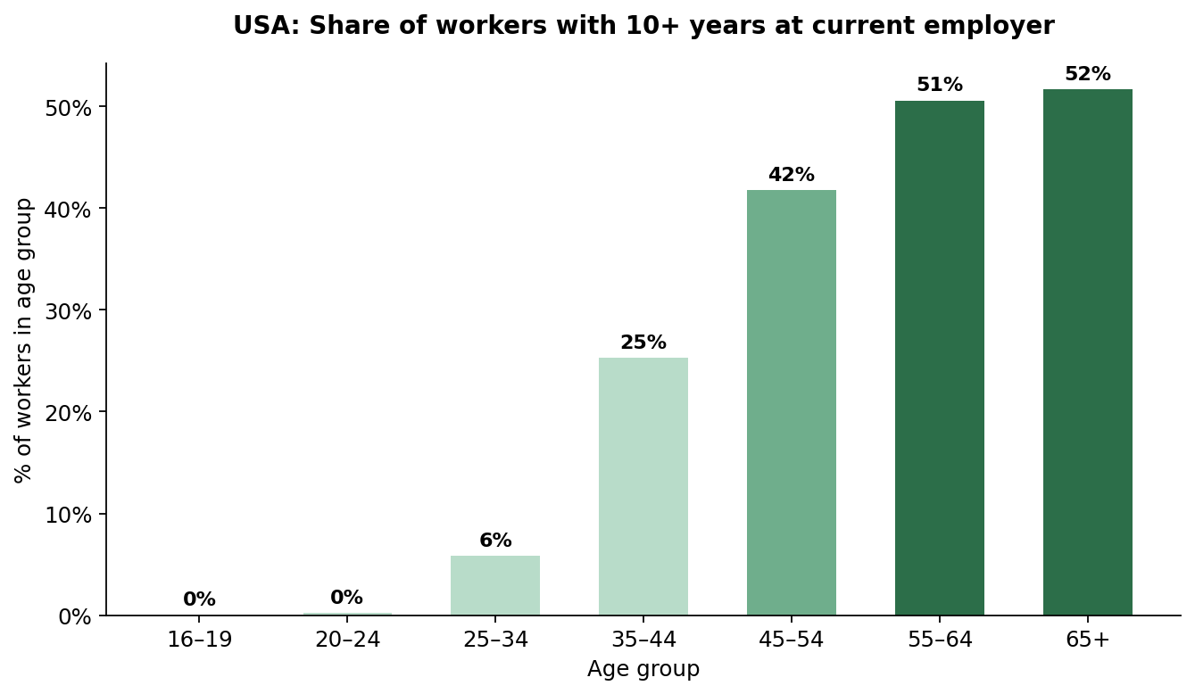
USA — how does tenure length vary by age?
Only 10% of workers 55–64 are in a job less than a year old, vs. 48% for 20–24 year-olds.
Conversely, 51% of workers 55–64 have been with their employer 10+ years.
Stability of Employees 55+
7

Slide 8
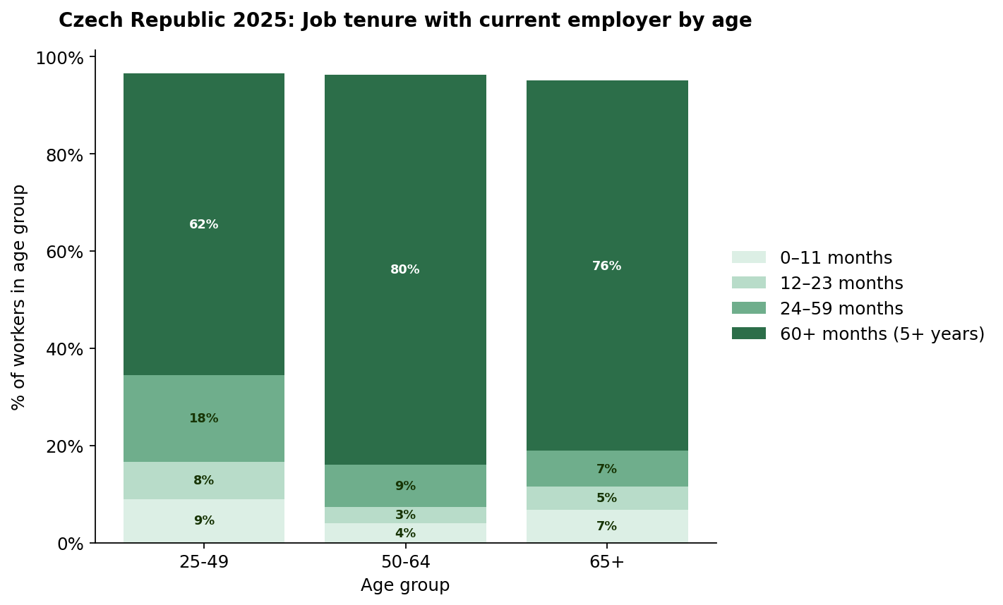
Does the same pattern appear in the Czech Republic (2025)?
80.3%
of employed 50–64 year-olds
have been with their employer 5+ years — vs. 62.1% for a derived 25–49 age group.
Eurostat's published age bands overlap; the 25–49 group was derived from published headcounts to make a fair, non-overlapping comparison.
Stability of Employees 55+
8

Slide 9
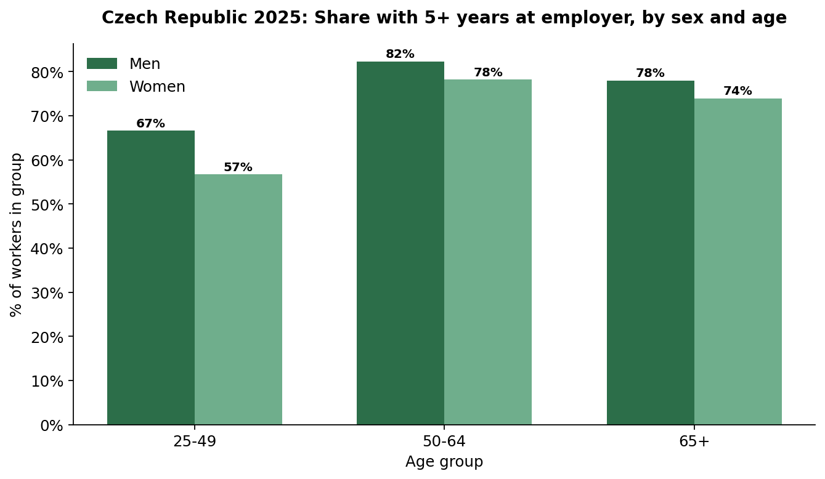
Czech Republic — does the gender gap narrow with age?
The gap in tenure between men and women is largest at 25–49 and narrows from 50+ onward. No causal claim is made here — the data shows the pattern, not the reason.
Stability of Employees 55+
9

Slide 10
Key takeaways
1
USA: median tenure rises almost monotonically with age — 2.7 years (25–34) to 9.6–9.8 years (55+) — and the trend is stable over 2014–2024.
2
USA: the same pattern holds for college-educated workers; education doesn't affect turnover nearly as much as age does.
3
USA: only 10% of workers 55–64 are in a job under a year old (vs. 48% for 20–24 year-olds); 51% have 10+ years of tenure.
4
Czechia (2025): 80.3% of employed 50–64 year-olds have 5+ years of tenure, vs. 62.1% for a derived 25–49 group — the same pattern seen in the U.S.
Stability of Employees 55+
10

Slide 11
Don't be afraid to hire 55+
Across every dataset in this analysis, employees 55+ show the longest tenure — hiring them is a bet on stability, not a risk.
Jana Dolečková · Data Analyst
Research direction · data source selection · review & interpretation
Claude (Anthropic AI assistant)
Data collection · code · chart generation · presentation design

