Slide 1
CAR SALES
ANALYSIS
End-to-End Data Analysis Project
558,799 cleaned vehicle-sale records • Python • Excel • Power BI
FINAL PROJECT PRESENTATION
Prepared from the uploaded project files only

Slide 2
Project Overview
Business-focused view of the car sales dataset and analysis workflow
Records
Variables
Makes
States
Transmission
558,799
22
97
38
3
Cleaned dataset
Columns in workbook
Distinct makes
Distinct state codes
Categories incl. Unknown
Project objective
Business problem
• Analyze car sales data to understand pricing patterns and vehicle characteristics.
• Turn cleaned data into decision-friendly dashboards and business insights.
• Understand how market reference value, vehicle age, mileage and condition relate to selling price.
• Provide an interactive view for exploring the sales dataset.
Main variables
Year • Make • Model • Trim • Body • Transmission • State • ConditionValue • Odometer • MMR • SellingPrice • SaleDate • VehicleAge • PriceToMMR • PriceDifference
Source: cleaned_car_sales.xlsx
2

Slide 3
Data Preparation
Only cleaning evidence visible in the uploaded cleaned workbook is reported
Missing values
Duplicate rows
Duplicate IDs
Flagged SellingPrice = 1
72
0
0
4
Odometer only
Full-row duplicates
ID duplicates
Flag column remains in workbook
Observed preparation steps
Feature engineering present
• The current cleaned file contains 72 missing Odometer values; all other columns have no missing values.
• The workbook contains 72 records marked by Odometer_999999_flag; the current Odometer field contains no 999999 values.
• 4 records are marked by SellingPrice_1_flag and still have SellingPrice = 1 in the cleaned file.
• No duplicate rows and no duplicate IDs were found in the uploaded cleaned dataset.
• VehicleAge
• PriceToMMR
• PriceDifference
• SellingPrice_1_flag
• Odometer_999999_flag
Important limitation: the Python cleaning notebook/script and the original raw dataset were not uploaded, so undocumented transformations cannot be reconstructed here.
Source: cleaned_car_sales.xlsx
3

Slide 4
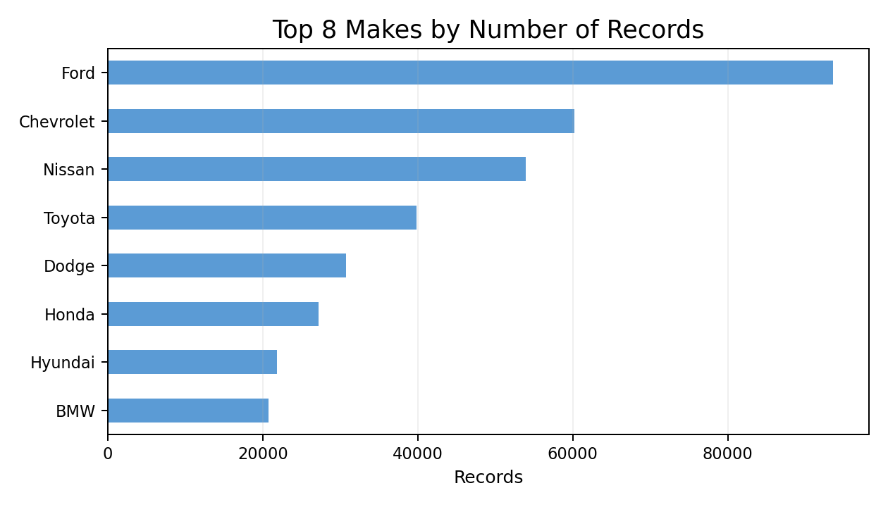
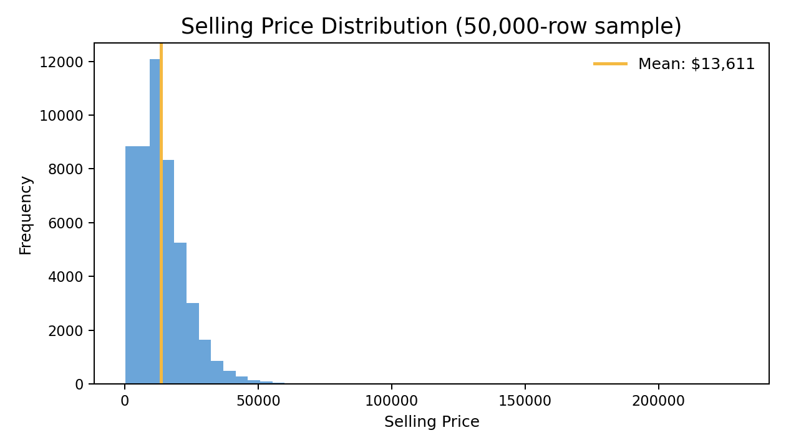
Exploratory Data Analysis
Key distribution patterns from the cleaned dataset
What stands out
• Average Selling Price is $13,611; median is $12,100.
• Average MMR is $13,769; median is $12,250.
• Ford has the largest record count (93,553), followed by Chevrolet (60,197) and Nissan (53,946).
• Automatic transmission represents 85.17% of records (475,904).
Source: cleaned_car_sales.xlsx
4

Slide 5
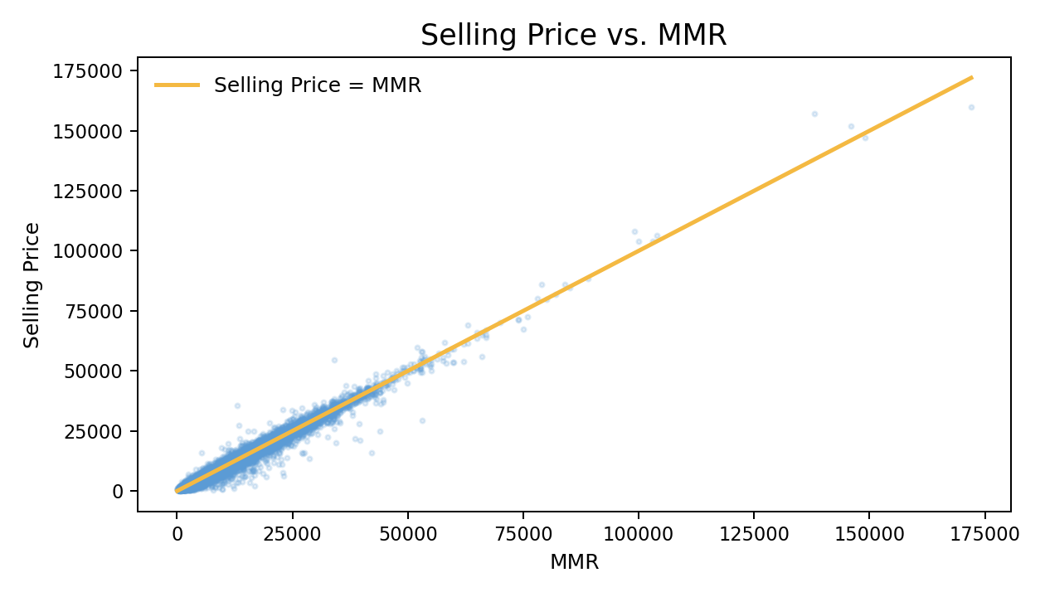
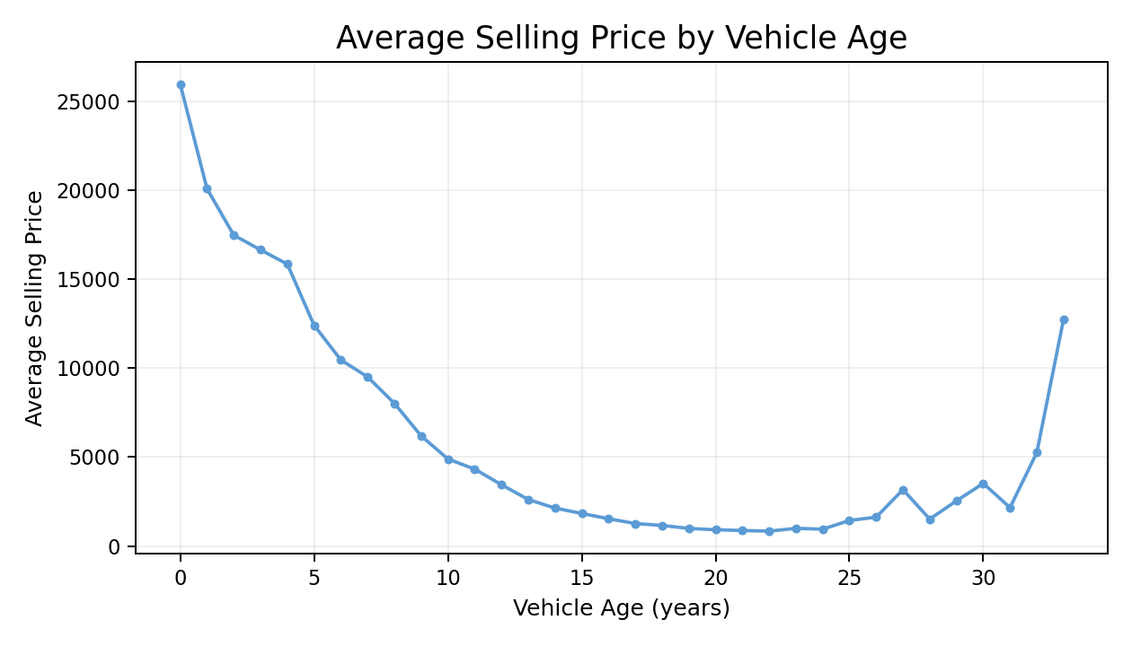
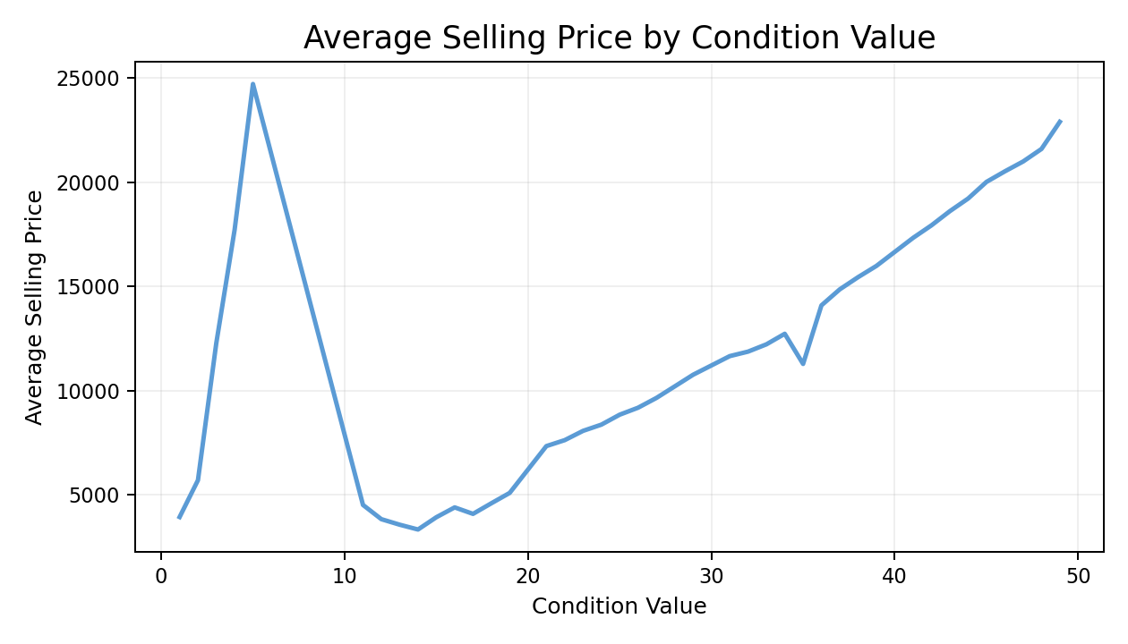
Bivariate Analysis
Relationships directly supported by the cleaned dataset
MMR ↔ Selling Price
Vehicle Age ↔ Selling Price
Condition ↔ Selling Price
r = 0.984
r = -0.587
r = 0.313
Very strong positive association
Negative association
Moderate positive association
Business interpretation: the dataset shows that selling price tracks the MMR reference value closely, while older vehicles tend to have lower selling prices; condition is positively associated with price but less strongly.
Source: cleaned_car_sales.xlsx
5

Slide 6
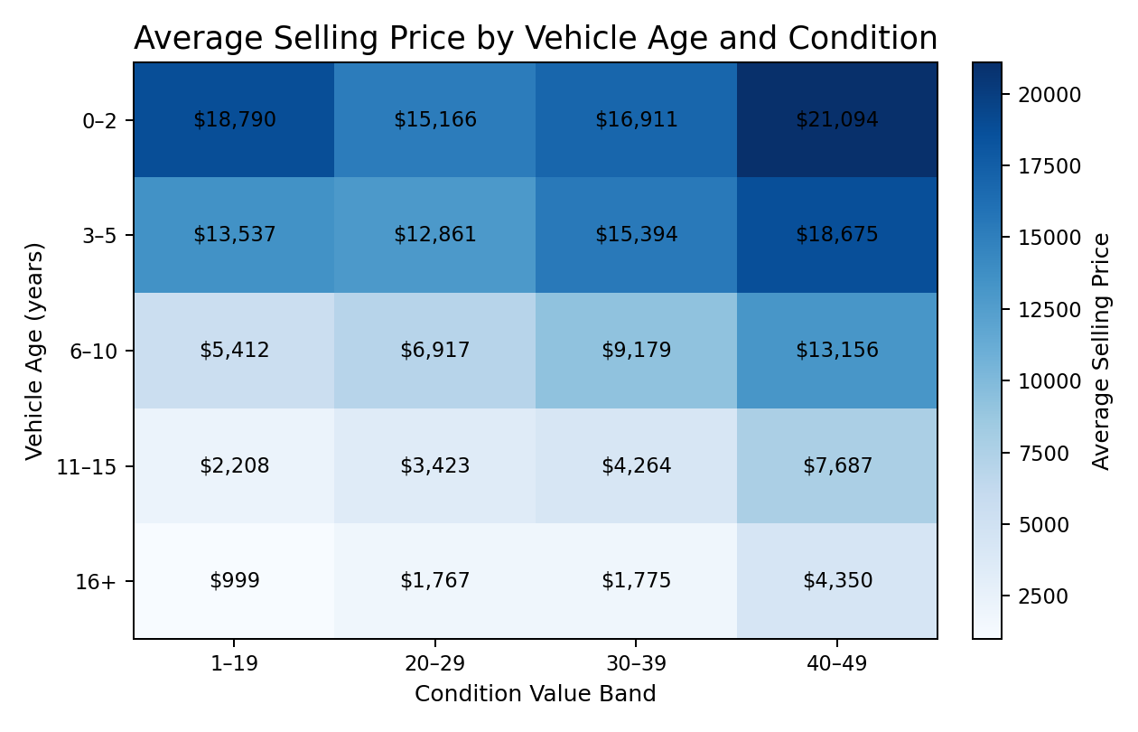
Multivariate Analysis
Combined view of vehicle age and condition
How to read the view
• Each cell shows the average Selling Price for a vehicle-age band and condition-value band.
• Within each age band, higher condition bands generally correspond to higher average selling prices.
• Across age bands, average selling price generally declines as vehicles become older.
Example from the dataset
0–2 years / 40–49 condition
Average Selling Price ≈ $21,094
This is a descriptive multivariate view; it does not establish causation.
Source: cleaned_car_sales.xlsx
6

Slide 7
Data Dashboard — Excel View
Rebuilt directly from the cleaned workbook • 558,799 vehicle-sale records
558,799
$13,611
$13,769
68,201
49
Records
Avg Selling Price
Avg MMR
Avg Odometer
Max Condition
Top Makes by Record Count
Transmission Mix
Automatic
85.17%
475,904 records
Ford
93.6K
Chevrolet
60.2K
Key Relationships with Selling Price
Nissan
53.9K
MMR
+0.984
Vehicle Age
-0.587
Ford has the largest record count in the cleaned dataset.
Odometer
-0.591
Condition
+0.313
Takeaway: price aligns very closely with MMR; age and mileage are negatively associated with price, while condition is positively associated.
Source: cleaned_car_sales.xlsx • descriptive relationships; correlation does not imply causation
7

Slide 8
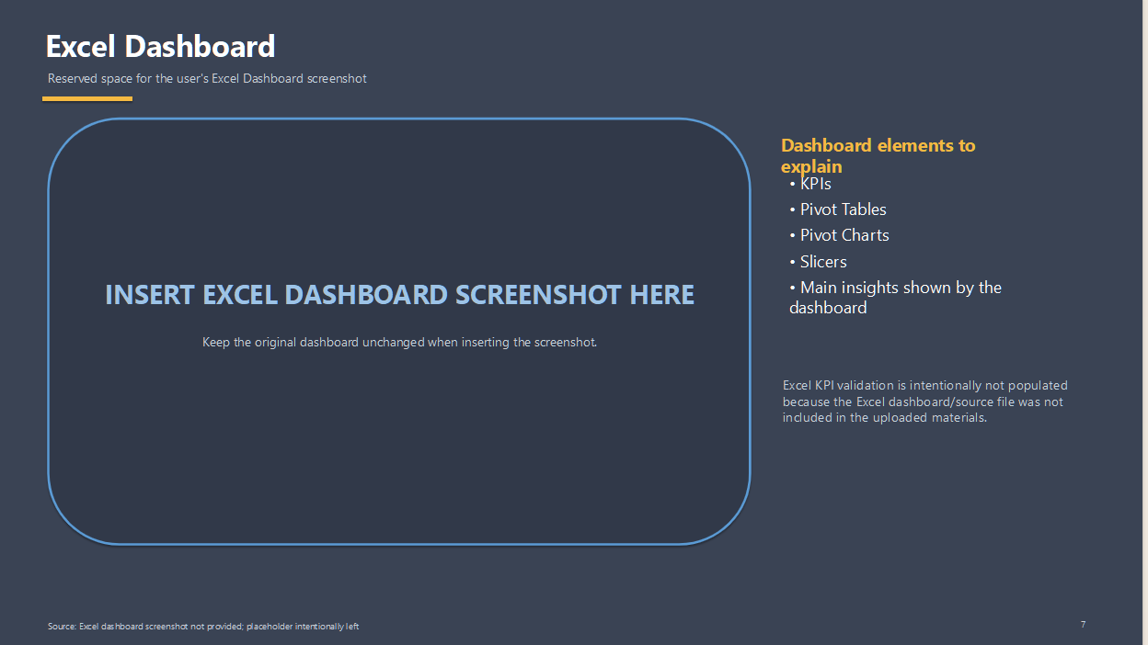
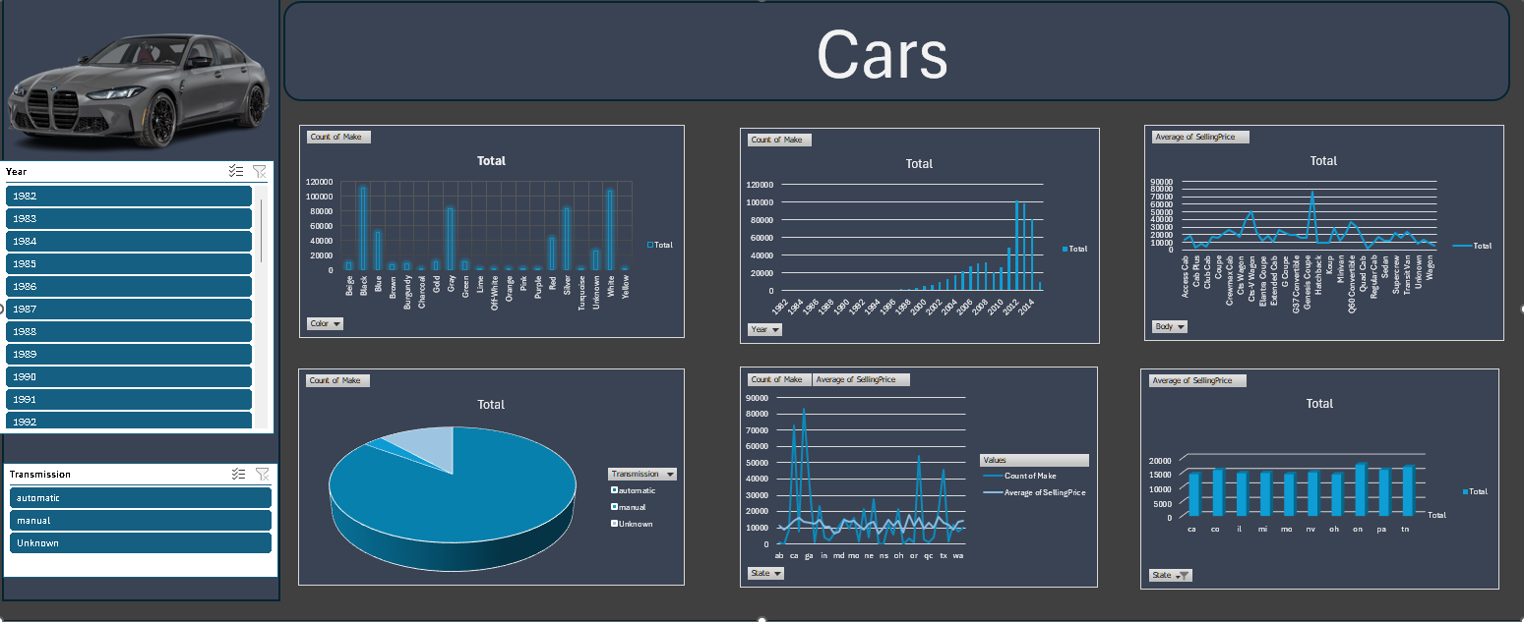

Slide 9
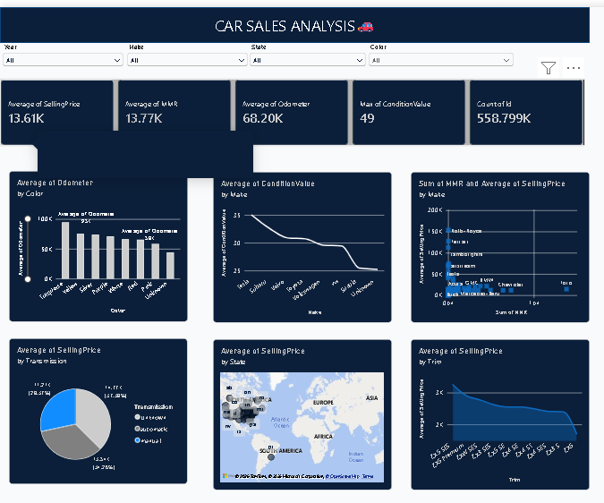
Power BI Dashboard
Uploaded dashboard screenshot — presented as provided
Visible KPIs
• Average Selling Price: 13.61K
• Average MMR: 13.77K
• Average Odometer: 68.20K
• Max ConditionValue: 49
• Record Count: 558.799K
Main visual areas
• Average odometer by color
• Condition value trend by make
• MMR and Selling Price by state
• Selling Price by transmission
• Selling Price by state
• Selling Price by trim
Source: uploaded Power BI dashboard screenshot + cleaned_car_sales.xlsx
8

Slide 10
KPI Validation
Cross-tool validation using only values that can be verified from the uploaded files
KPI | Python | Excel | Power BI
Average Selling Price | $13,611.36 | Not provided | 13.61K
Average MMR | $13,769.38 | Not provided | 13.77K
Average Odometer | 68,201.07 | Not provided | 68.20K
Max ConditionValue | 49 | Not provided | 49
Record Count | 558,799 | Not provided | 558.799K
Validation result
• The Power BI screenshot values match the cleaned dataset after the same display rounding.
• Python and Excel columns cannot be independently verified because their source outputs/files were not uploaded.
• No unsupported explanation for a cross-tool difference has been added.
Source: cleaned_car_sales.xlsx
9

Slide 11
Key Business Insights
Data-driven observations supported by the uploaded cleaned dataset
01
Pricing aligns closely with MMR
MMR has a correlation of 0.984 with Selling Price, indicating a very strong positive association in this dataset.
02
Vehicle age matters
VehicleAge has a correlation of -0.587 with Selling Price; average price generally declines across older age bands.
03
Mileage shows a similar pattern
Odometer has a correlation of -0.591 with Selling Price, a negative association.
04
Condition adds information
ConditionValue has a correlation of 0.313 with Selling Price; higher condition bands generally show higher average prices within age groups.
Source: cleaned_car_sales.xlsx
10

Slide 12
Business Recommendations
Practical actions grounded in the observed relationships
Use MMR as a core pricing reference
Combine age with condition
The very strong MMR–Selling Price relationship supports using MMR as a primary benchmark when reviewing transaction prices.
The age × condition view shows meaningful differences in average price, so both dimensions should be considered together rather than separately.
Segment inventory by vehicle age
Use dashboard filters for targeted review
Because price decreases across older age bands, age should be included in pricing and inventory analysis.
The Power BI dashboard can support focused comparisons by state, make, transmission, color and trim.
These recommendations are limited to patterns visible in the uploaded data; they do not assume business costs, margins, demand or inventory constraints that are not present in the files.
Source: cleaned_car_sales.xlsx
11

Slide 13
Conclusion
End-to-end view from cleaned data to decision-ready dashboards
What was analyzed
What was discovered
How dashboards help
558,799 records
MMR r = 0.984
Interactive
22 variables across vehicle, pricing and sale attributes
Strong price alignment plus age, mileage and condition patterns
KPIs, filters and visuals make comparisons easier
Final takeaway
The project connects data preparation, exploratory analysis, feature engineering and dashboarding into a consistent business analysis. The uploaded Power BI KPIs reconcile with the cleaned dataset at the displayed precision.
Scope note: independent Python-output and Excel-dashboard validation remains pending because those source files were not included in the upload.
Thank you
Source: cleaned_car_sales.xlsx
12

