Slide 1
Question 1: Coffee Sourcing Recommendations
22761926

Slide 2
Dataset Overview: 2095 Coffees, 422 Roasters, 19 Countries
N_Coffees | N_Roasters | N_Countries | Avg_Rating | Avg_Cost | Min_Cost | Max_Cost
2095 | 422 | 19 | 93.11 | 9.32 | 0.12 | 132.28

Slide 3
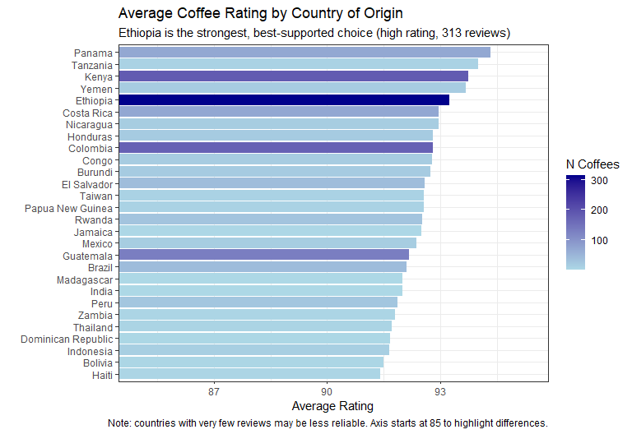
Best Countries by Rating

Slide 4
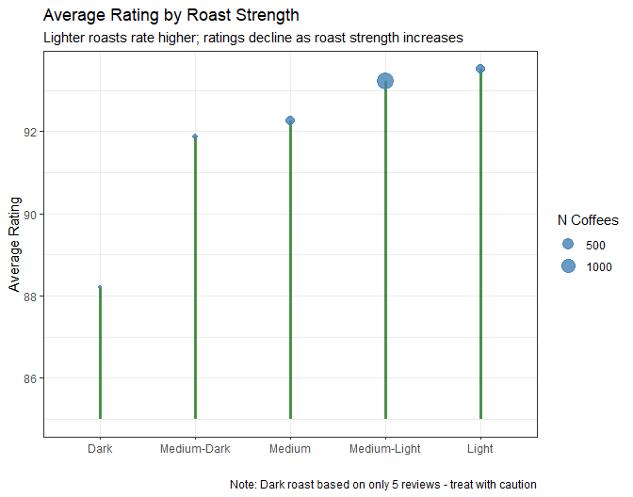
Rating by Roast Strength

Slide 5
Best Value Coffees: Guatemala Leads
Coffee | Roaster | Region | Roast | Rating | Cost/100g ($) | Value Score
Cold Brew | Barefoot Coffee Roasters | Guatemala | NA | 90 | 0.12 | 750.0
100% Guatemalan | Hill’s Bros. Coffee | Guatemala | Medium-Dark | 87 | 0.99 | 87.9
Espresso Blend | Ba Yang Coffee | India | Medium | 92 | 1.13 | 81.4
Asfaw Maru Ethiopia Natural Cold Brew | Collage Coffee | Ethiopia | NA | 93 | 1.32 | 70.5
414 Kenya SL34 | Mr. Chao Coffee | Kenya | Medium-Light | 92 | 1.41 | 65.2

Slide 6
Best Value Coffees: Guatemala Leads (Continued)
Coffee | Roaster | Region | Roast | Rating | Cost/100g ($) | Value Score
5a Sur | El Gran Cafe | Guatemala | Medium | 91 | 1.47 | 61.9
5a Poniente | El Gran Cafe | Guatemala | Medium-Light | 91 | 1.47 | 61.9
Colombia | HT Traders | Colombia | Medium-Dark | 89 | 1.47 | 60.5
5a Sur | El Gran Cafe | Guatemala | Medium | 89 | 1.47 | 60.5
5a Poniente | El Gran Cafe | Guatemala | Medium | 88 | 1.47 | 59.9

Slide 7
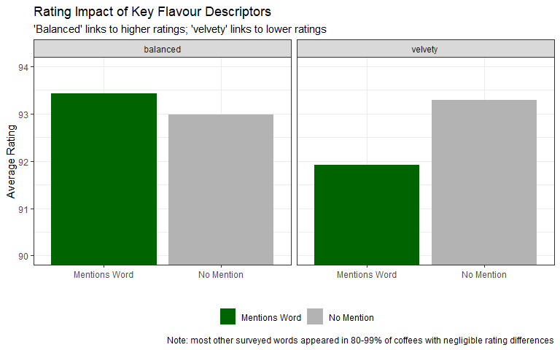
Flavour Descriptor Impact

Slide 8
Recommended Suppliers: Kakalove Cafe Combines Reliability and Value
Roaster | Avg Rating | Avg Cost/100g ($) | N Coffees
Hula Daddy Kona Coffee | 95.1 | 24.8 | 24
SOT Coffee Roaster | 95.0 | 20.7 | 4
Simon Hsieh Aroma Roast Coffees | 94.6 | 22.8 | 11
PT’s Coffee Roasting Co. | 94.4 | 12.1 | 16
Cafe Red Bean Shop | 94.3 | 9.4 | 3
Difference Coffee | 94.3 | 104.1 | 6
Simon Hsieh’s Aroma Roast Coffees | 94.3 | 15.2 | 7
GK Coffee | 94.2 | 11.4 | 36
Dragonfly Coffee Roasters | 94.2 | 16.3 | 37
Kakalove Cafe | 94.2 | 6.5 | 141

Slide 9
Recommendations
Country: Ethiopia is the strongest, best-supported choice (high rating, 313 reviews). Kenya and Colombia are also reliable alternatives.
Roast: Light and Medium-Light roasts rate highest; ratings decline as roast darkens.
Suppliers: Kakalove Cafe offers the best mix of reliability, rating and affordability. Hula Daddy Kona Coffee is a strong premium option if budget allows.

Slide 10
Recommendations (Continued)
Value: Guatemalan coffees repeatedly appear among the best value picks - useful for margin-conscious stocking.
Flavour profile: “Balanced” in reviews is a positive signal; “velvety” is a mild cautionary flag.

