Slide 1
E-COMMERCE DATA PROJECT
What I Did,
Step by Step
From generating the data in Python to a live Power BI dashboard

Slide 2

01
I Chose the Topic and Planned the Tables
Before writing a single line of code, I picked E-commerce as the subject and sketched out six tables around a real online-store workflow — customers, products, orders, order items, payments, and reviews.
STEP 1 OF 9
1
Decided how the tables would connect: an order belongs to a customer, an order has items, items point to products.
Planning
This plan is what everything else in the project was built on.
2
2

Slide 3

02
I Generated the Data With Python
I used the Faker library in Google Colab to generate thousands of realistic rows for all six tables, instead of using a ready-made dataset from Kaggle.
STEP 2 OF 9
1
Ended up with 800 customers, 149 products, 2,757 orders and 8,181 order items.
Python · Colab
I also deliberately injected realistic problems on purpose — missing emails, duplicate rows, inconsistent city names, negative stock, invalid ratings — so I would have real issues to clean.
2
3

Slide 4

03
I Cleaned the Data With pandas
Back in the same notebook, I wrote a cleaning script with pandas to fix every issue I had introduced on purpose.
STEP 3 OF 9
1
Removed duplicate rows, standardized city name formatting, filled in missing values.
Python · pandas
Fixed negative stock quantities, dropped invalid ratings and orphan rows with no matching order.
2
3
The result was a fully clean set of CSV files, ready to load into a database.
4

Slide 5

04
I Analyzed the Data With Python
I went back to Python — pandas, matplotlib and seaborn — to turn the cleaned data into charts and a customer segmentation.
STEP 4 OF 9
1
Charted the monthly sales trend, the top 10 products by revenue, and the sales share by category.
Python Analysis
Segmented customers into High / Medium / Low value tiers based on total spending.
2
5

Slide 6
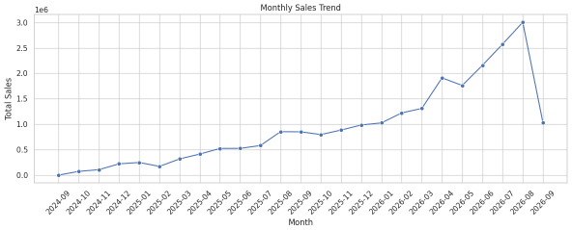
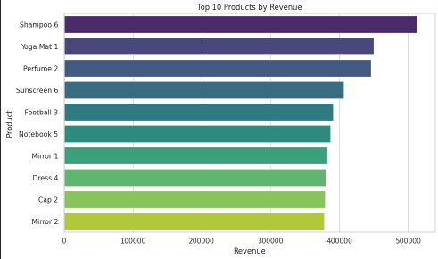
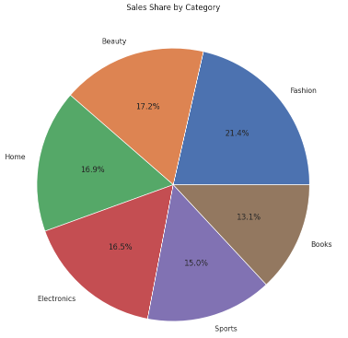
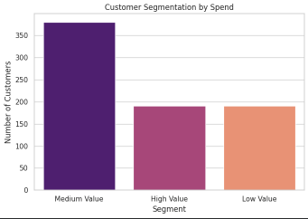
PROOF — PYTHON ANALYSIS
Trends, Products & Customer Segments
Monthly sales trend
Top 10 products by revenue
Sales share by category
Customer segmentation by spend
6

Slide 7

05
I Built the Database in SQL Server
I created the six tables directly in SQL Server with the correct data types from the start, after running into import errors (like tinyint overflowing on larger IDs) the first time around.
STEP 5 OF 9
1
Set a Primary Key on every table.
SQL Server
Linked the tables with Foreign Keys: orders → customers, order_items → orders & products, payments → orders, reviews → customers & products.
2
7

Slide 8

06
I Wrote 10 Business Queries
With the database in place, I wrote ten SQL queries that each answer a real business question, joining across the six tables.
STEP 6 OF 9
1
Top-selling products and categories by revenue, top customers by spending, the monthly sales trend.
SQL
Order status breakdown, average order value by city, most-used payment methods, and more.
2
8

Slide 9

07
I Drew the ERD by Hand
To visualize the structure clearly, I drew the Entity-Relationship Diagram myself in draw.io, using Chen notation — rectangles for tables, ovals for attributes, diamonds for relationships.
STEP 7 OF 9
1
Marked each Primary Key and labeled every relationship as 1:1 or 1:M.
Design
Color-coded the shapes by type so the diagram reads clearly at a glance.
2
9

Slide 10
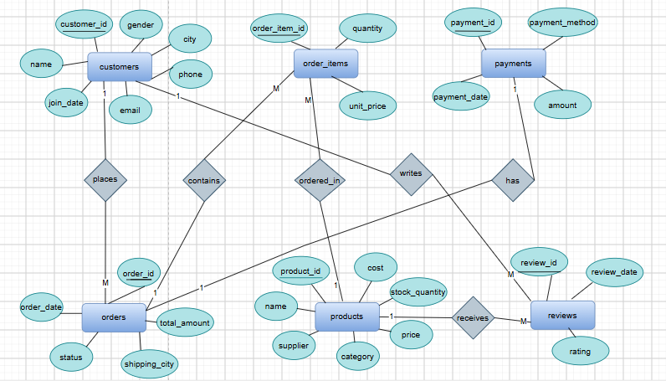
PROOF — DATABASE DESIGN
The Entity-Relationship Diagram
10

Slide 11

08
I Built the Excel Report
I imported all six tables into Excel through Power Query, as separate queries loaded into their own sheets.
STEP 8 OF 9
Built 5 Pivot Tables with matching charts: sales by order status, top products, orders by city, payment method usage, and average price by category.
1
Excel
11

Slide 12
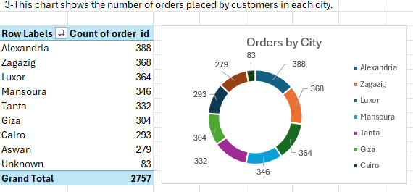
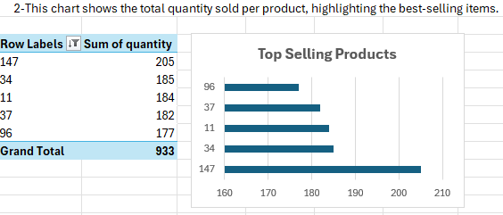
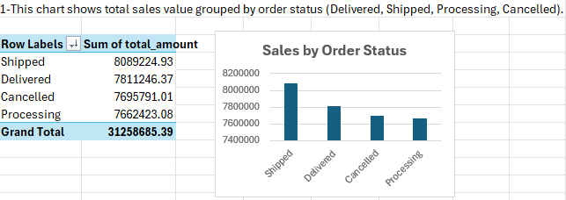
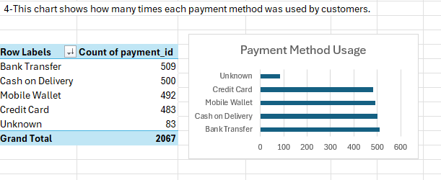
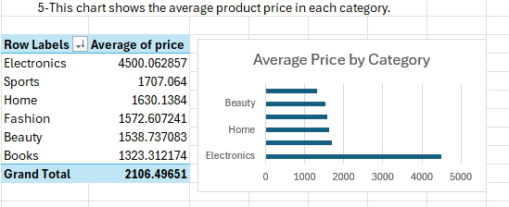
PROOF — EXCEL REPORT
Pivot Tables & Charts
12

Slide 13

09
I Built an Interactive Power BI Dashboard
Finally, I connected Power BI directly to the SQL Server database and built a 3-page dashboard rather than a single static page.
STEP 9 OF 9
1
Wrote DAX measures for every KPI card, instead of relying on default aggregations.
Power BI
Added charts, slicers, and a map, plus custom navigation buttons to move between the Overview, Sales Analysis, and Customer Insights pages.
2
13

Slide 14
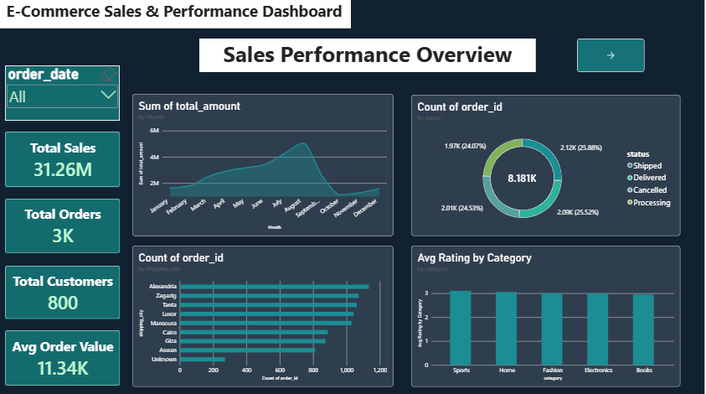
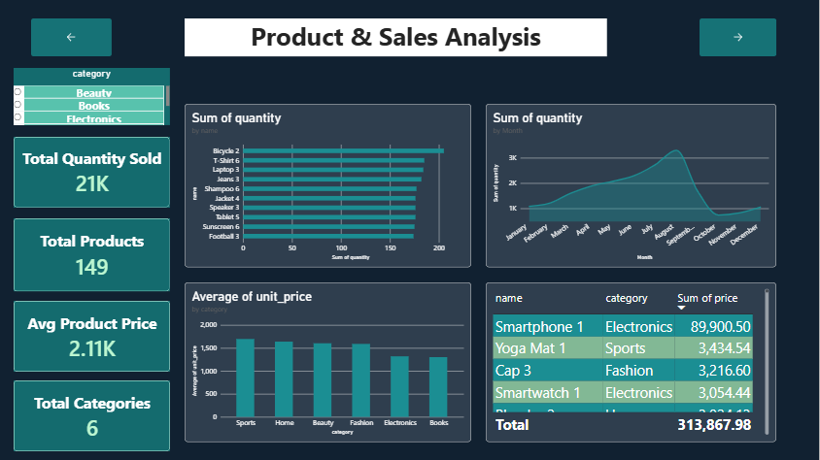
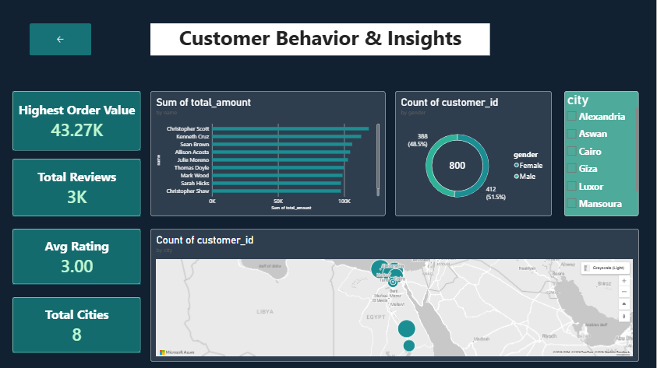
PROOF — POWER BI DASHBOARD
Overview, Sales Analysis, Customer Insights
Overview
Sales Analysis
Customer Insights
14

Slide 15
FROM AN IDEA TO A WORKING PIPELINE
Nine Steps, One Project
Python
pandas
SQL Server
draw.io
Excel
Power BI
Every table, query, chart and dashboard page in this project was built and tested by hand, step by step.

