Slide 1


END-TO-END DATA ANALYTICS PROJECT
SafeRoad
Road Accident Severity
& Risk Intelligence
Understanding where, when, and under what conditions
road collisions are more likely to be severe.
SQL
PYTHON
EXCEL
POWER BI
TABLEAU
2025 UK reported road collisions
Portfolio case study
SAFEROAD • 01

Slide 2
01 • THE QUESTION
One dataset. One clear question.
The project is built around collision severity — not just accident volume.
THE CORE QUESTION
Where, when, and under what conditions
are road collisions more likely to be severe?
DIMENSIONS EXPLORED
TIME
LOCATION
ROAD
WEATHER
DRIVERS
VEHICLES
SAFEROAD • 02

Slide 3
02 • THE DATA
Three related tables — one analytical view.
Official 2025 UK STATS19 road-safety data.
Dataset Link : https://www.gov.uk/government/statistical-data-sets/road-safety-open-data
COLLISIONS
VEHICLES
CASUALTIES
101,525
183,948
127,883
RELATIONSHIP USED IN SQL
• Collisions → one row per collision
• Vehicles → many vehicle records per collision
• Casualties → many casualty records per collision
• Vehicle and casualty tables were summarized first
• Summaries were then joined back using collision_index
This keeps the final analytical dataset at one row per collision.
Source: UK Department for Transport road-safety open data page
SAFEROAD • 03

Slide 4
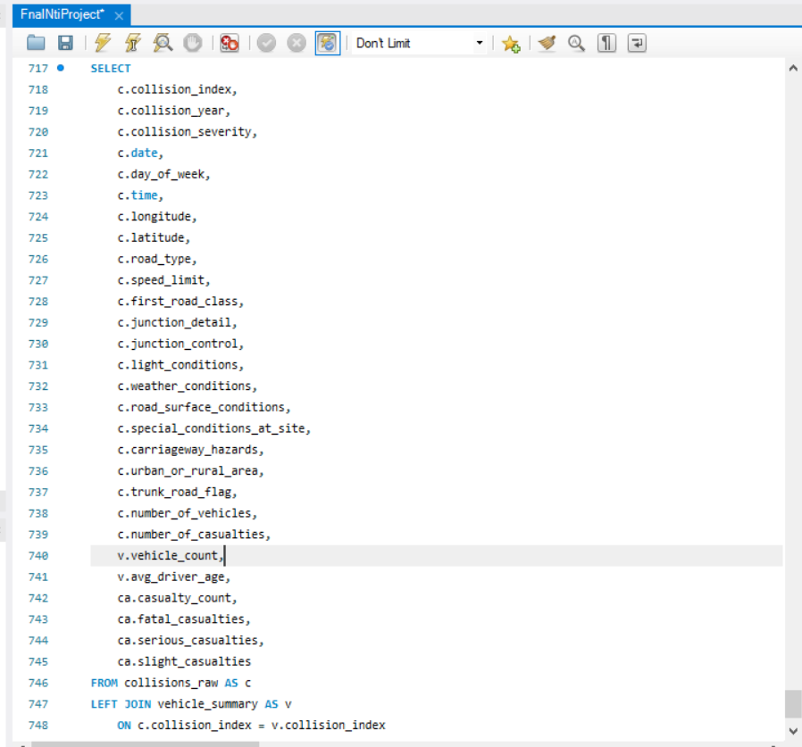
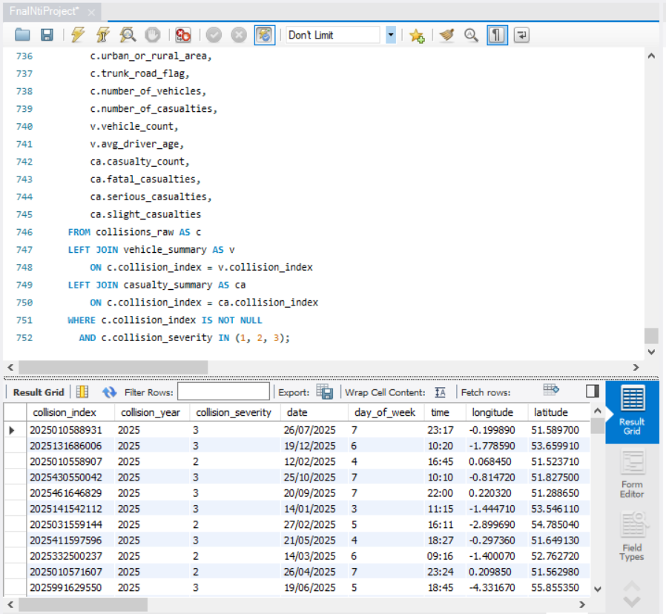
03 • SQL
SQL — Building the Analytical Dataset
I used SQL to structure the raw records before analysis.
WHAT I DID
• Imported 3 related STATS19 tables
• Checked structure and records
• Used JOIN to connect collision, vehicle and casualty data
• Aggregated vehicle and casualty records before joining
• Created a final dataset with one row per collision
MySQL Workbench • table setup, exploration and final query
SAFEROAD • 04

Slide 5
04 • PYTHON
Python — Cleaning & Feature Engineering
The SQL output became the input for the Python analysis.
DATA CLEANING
FEATURE ENGINEERING
What i found:
Some missing latitude and longitude values.
Some missing driver age values.
No duplicate collision records.
Some coded values needed to be converted into readable categories.
How I solved it:
Kept missing locations because the collisions were still valid for other analyses.
Kept missing driver ages instead of guessing or filling them.
Removed duplicate rows.
Converted codes into clear labels such as Fatal, Serious, Slight, Urban, Rural, Dry, Wet, etc.
Result : A clean and analysis-ready dataset was created without unnecessarily removing valid records.
• Extracted month and day
• Created time-of-day groups
• Created driver age groups
• Decoded severity and road-condition codes
Analysis-ready data → severe-collision rates → pattern exploration
Jupyter Notebook • cleaning, feature engineering and analysis
SAFEROAD • 05

Slide 6
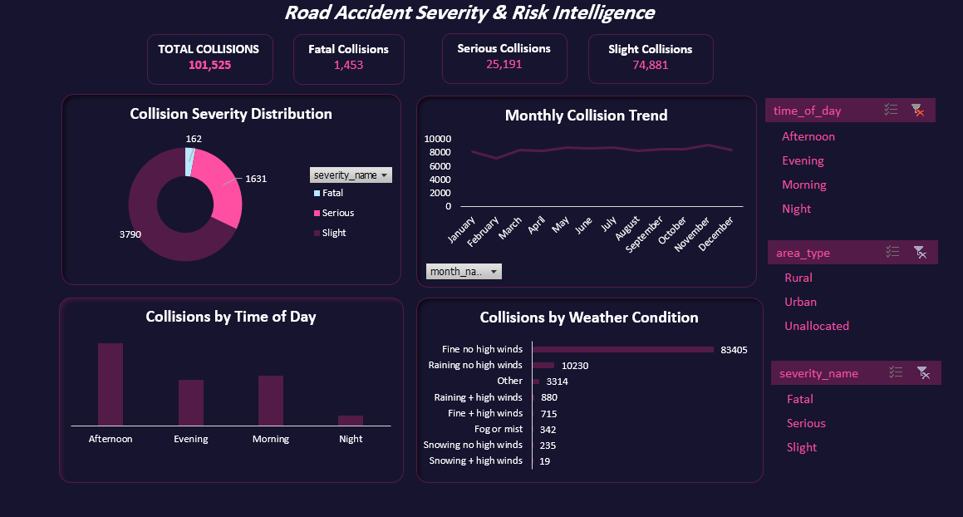
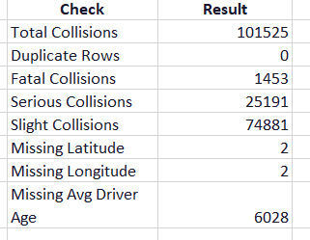
05 • EXCEL
Excel — Validation & First-Level Analysis
Excel was used as a cross-check before the BI dashboards.
WHAT I DID
• Validated the cleaned dataset
• Built PivotTables
• Created KPIs
• Added slicers for filtering
• Compared severity across conditions
Excel validated the numbers before visualization!
Excel Dashboard • PivotTables, KPIs and slicers
SAFEROAD • 06

Slide 7

06 • POWER BI
Power BI — Overview
Interactive risk analysis starts with the overall picture.
KEY INSIGHTS
Over 1 in 4 reported collisions in 2025 were severe, with 1,453 resulting in fatalities, highlighting the need to understand when, where, and under what conditions collision severity increases.
Power BI • Overview dashboard
SAFEROAD • 07

Slide 8
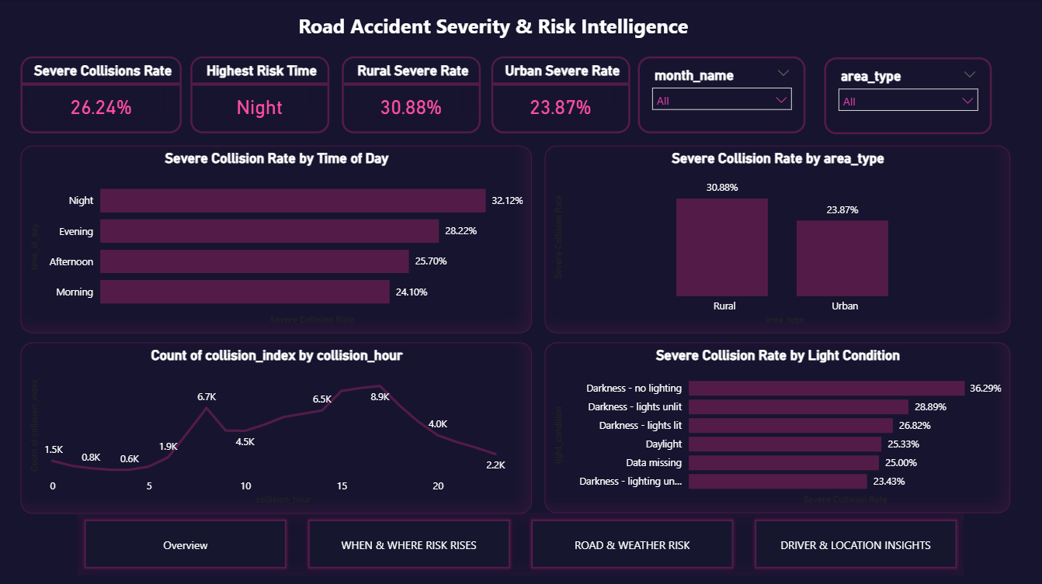
07 • POWER BI
Power BI — When & Where Risk Rises
KEY INSIGHTS
Severe collisions are more common during the night and evening, with rural areas showing a higher severe-collision rate than urban areas.
While the number of collisions increases during the daytime and peaks in the afternoon, darker conditions, especially areas with no lighting, are associated with higher severe-collision rates than daylight conditions.
Power BI • When & Where Risk Rises
SAFEROAD • 08

Slide 9
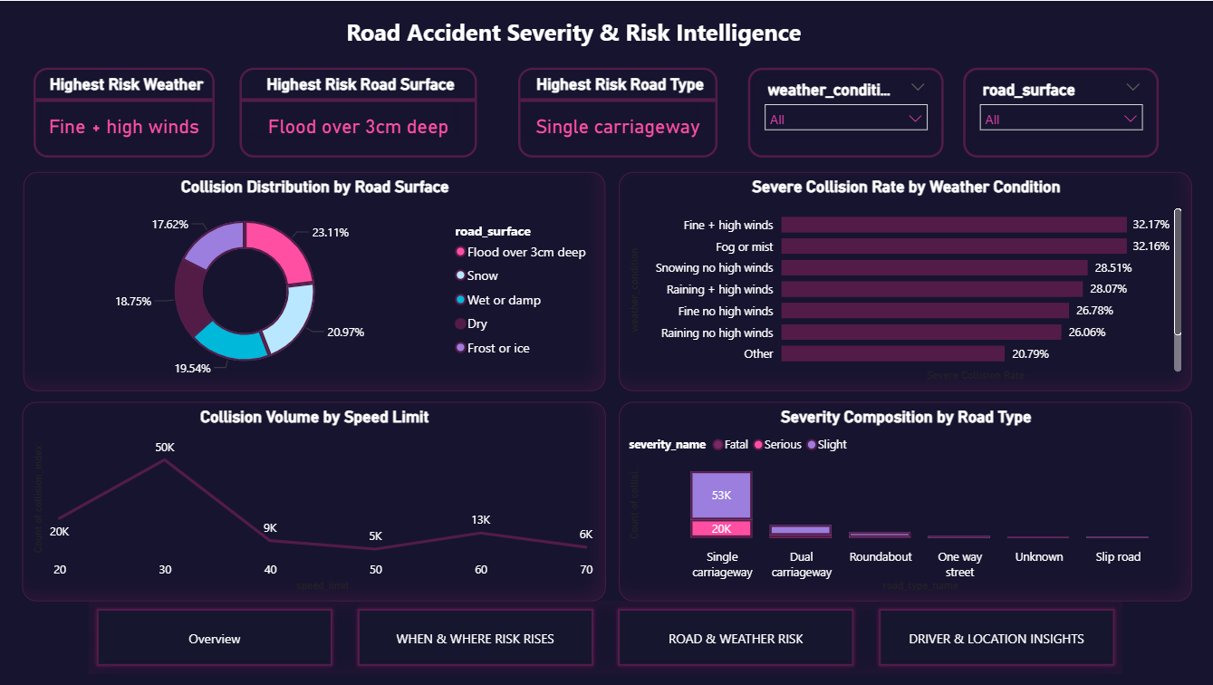
08 • POWER BI
Power BI — Road & Weather Risk
KEY INSIGHTS
Severe collision rates are higher under certain weather and road conditions, with fine weather and high winds showing the highest weather-related rate.
Flooded road surfaces also have a high severe-collision rate, while single carriageways account for the largest number of collisions and show a noticeable share of severe outcomes.
Power BI • Road & Weather Risk
SAFEROAD • 09

Slide 10
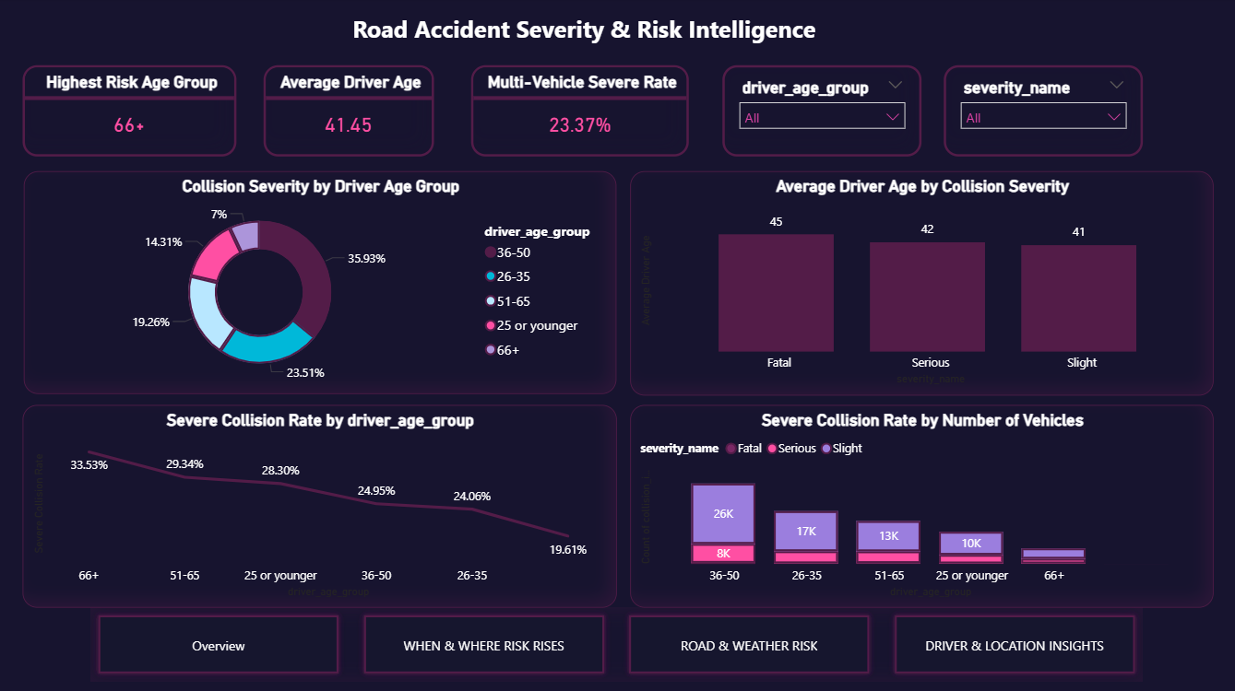
09 • POWER BI
Power BI — Driver & Location Insights
KEY INSIGHTS
Severe collisions show a clear difference across driver age groups, with the 66+ group having the highest severe-collision rate (33.53%), while younger and middle-aged groups have lower rates.
Fatal collisions also have a slightly higher average driver age than serious and slight collisions, and collisions involving multiple vehicles show a 23.37% severe-collision rate.
Power BI • Driver & Location Insights
SAFEROAD • 10

Slide 11
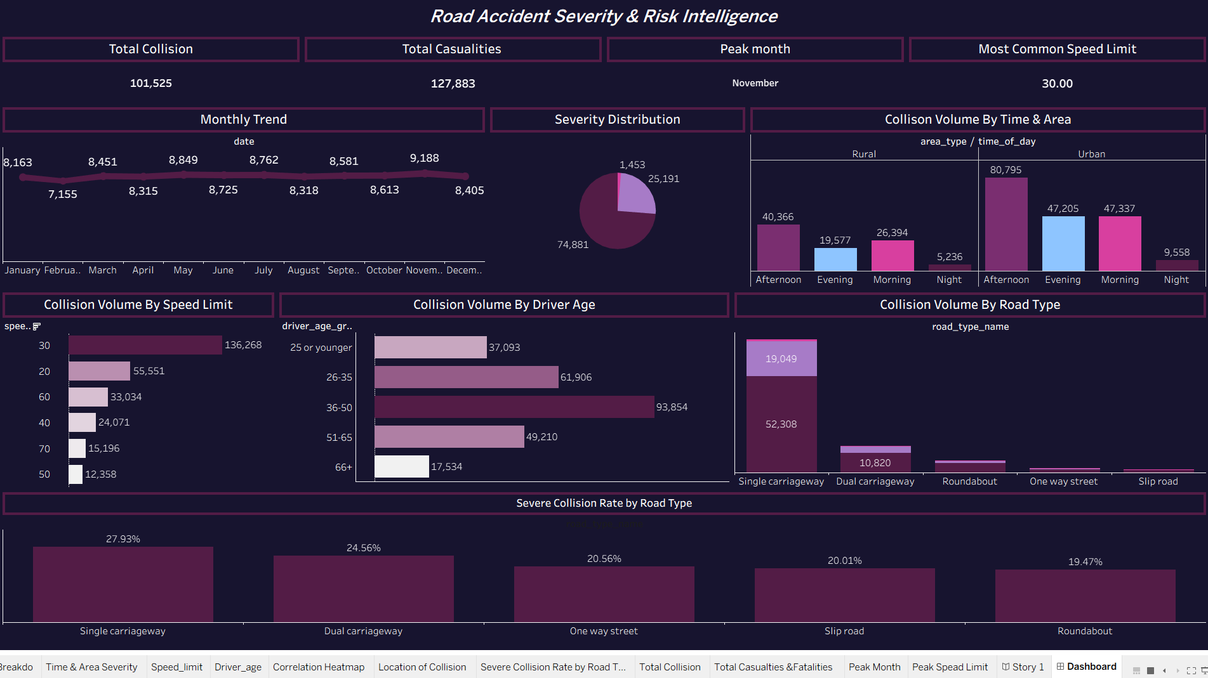
10 • TABLEAU
Tableau — Visual Storytelling
The same cleaned analysis was communicated through a second BI platform.
WHAT TABLEAU ADDED
• Interactive visual exploration
• Comparison of collision patterns
• Clear presentation of severity rates
• Story-focused dashboard design
Power BI + Tableau
made the analysis easier to explore and communicate.
Tableau • presentation-ready dashboard and comparisons
SAFEROAD • 11

Slide 12
Road Safety Recommendations
Focus safety efforts on the conditions associated with higher severe-collision rates.
Night & Lighting
Rural & Single-Carriageway Roads
• Improve lighting in areas with higher severe-collision rates.
• Focus safety measures on poorly lit roads.
• Give extra attention to rural roads and single carriageways.
• Review high-risk locations for possible safety improvements.
Road & Weather Conditions
Driver Safety
• Use clearer warnings during difficult road conditions.
• Pay special attention to flooding and poor visibility.
• Increase awareness and safety programs for older drivers.
• Promote safer driving practices in higher-risk situations.
Takeaway: Target road-safety efforts where, when, and under which conditions severe collisions are more common.
SAFEROAD • 12

Slide 13
11 • FINAL OUTPUT
From Raw Data to Road Safety Insights
One project. Five tools. One coherent analytical story.
01
02
03
04
05
06
RAW DATA
SQL
PYTHON
EXCEL
POWER BI
TABLEAU
→
→
→
→
→
Official 2025
STATS19
Load • explore
• JOIN
Clean • engineer
• analyze
Validate • pivot
• cross-check
KPIs • filters
• risk pages
Storytelling •
comparisons
SAFER ROAD INSIGHTS
Where • When • Road • Weather • Drivers • Vehicles
The handoff remained traceable from raw records to final dashboards.
SAFEROAD • 13

