Slide 1

MONTE CARLO SIMULATION RADIOACTIVE DECAY
Lebanese University
Faculty of Engineering III
Electrical and Electronic Department
CONCURRENT PROGRAMMING PROJECT
Prepared by:
Rokaya Al Harakeh 6441
Jana Jouni 6348
Presented to : DR. MOHAMAD AOUDE

Slide 2
Problem Overview
Simulate radioactive decay using Monte Carlo.
Predict behavior of 1 million atoms over time
Ideal for parallelism: atoms decay independently.

Slide 3
GOALS
Implement sequential & parallel versions.
Speed up the simulation using concurrency.
Measure correctness, speedup, and scalability

Slide 4
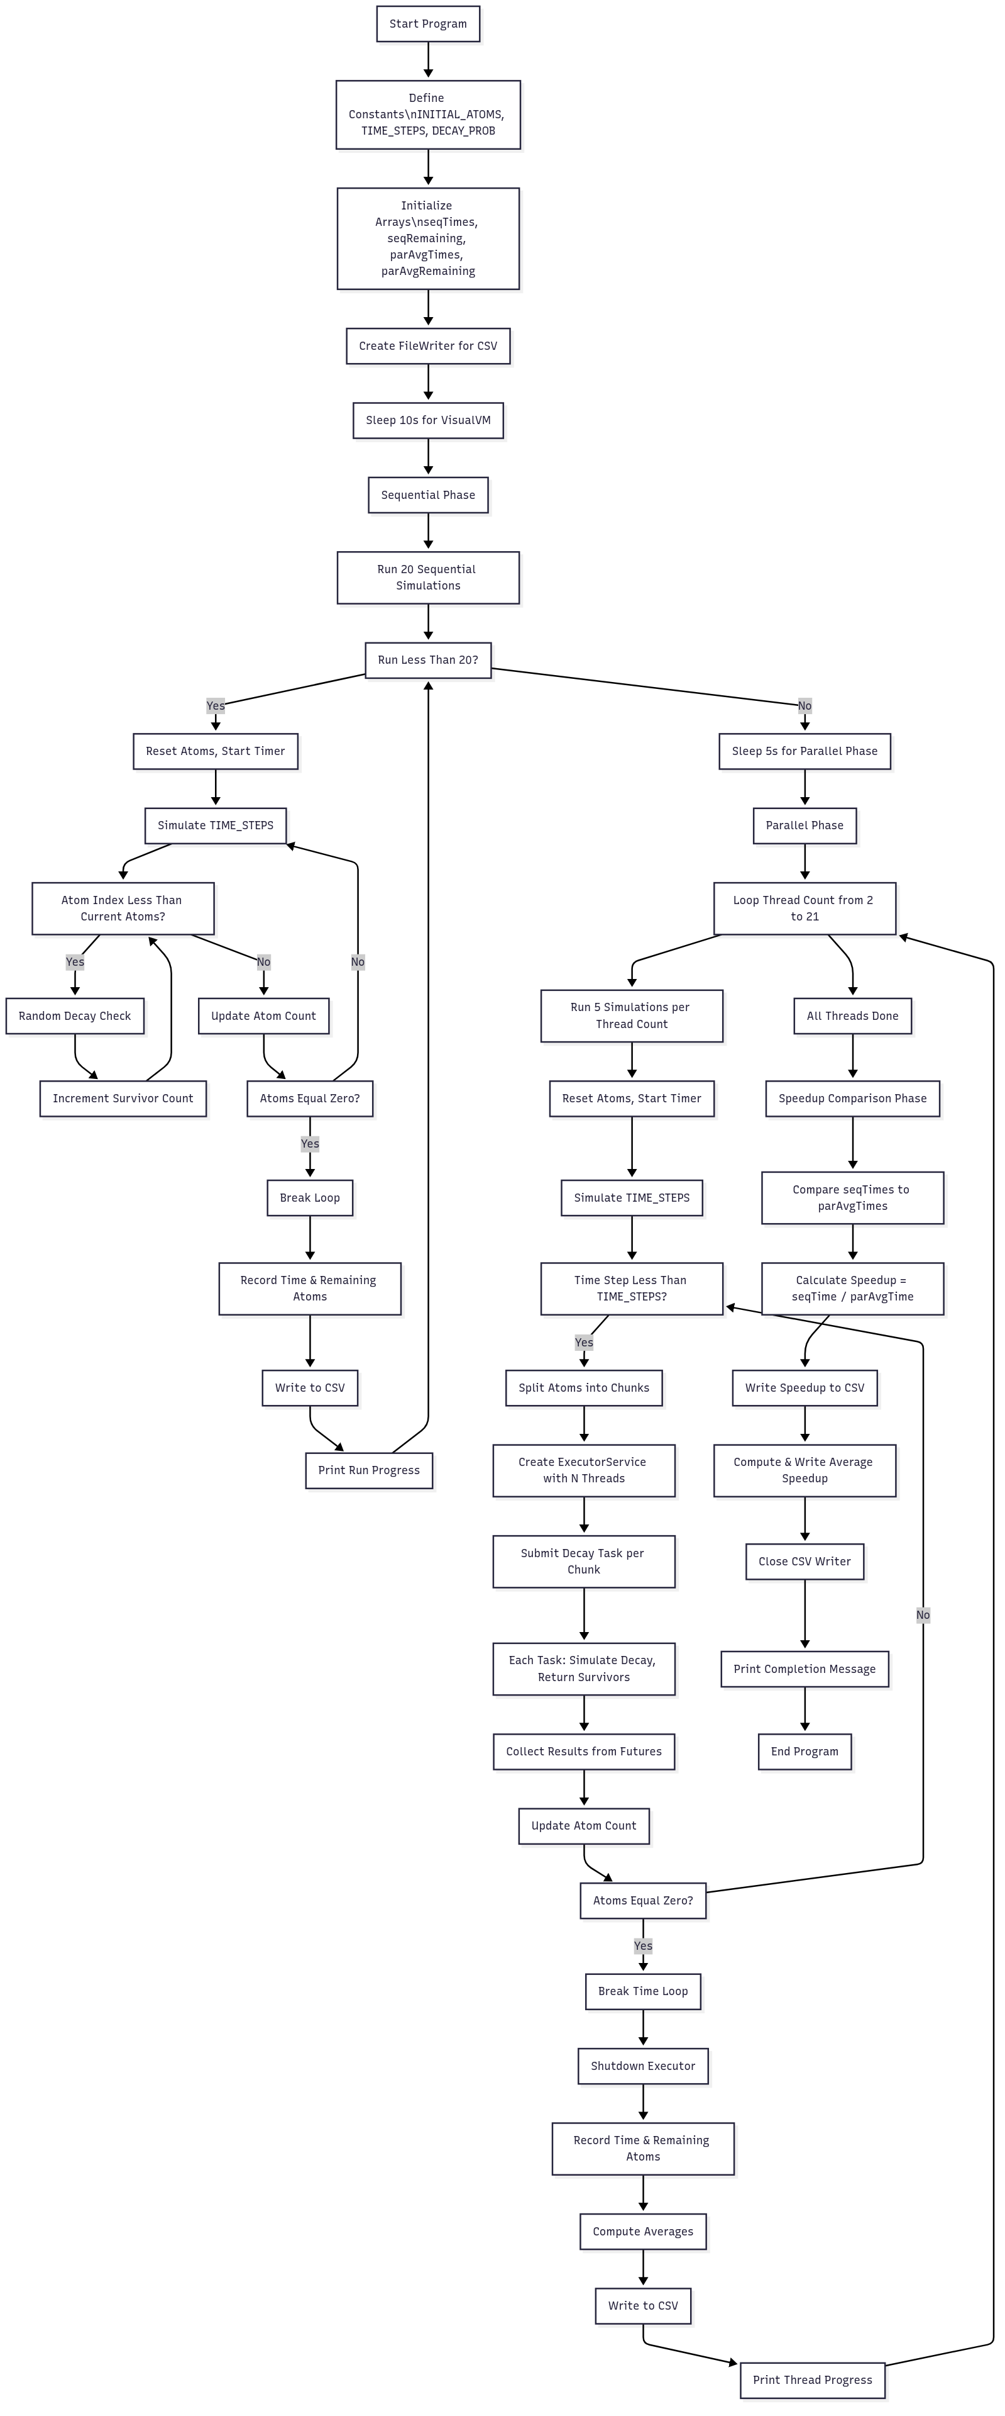
Design and Implementation Flow
Sequential vs. Parallel Atom Decay Simulation and Performance Comparison

Slide 5
Design and Implementation Flow
Initialization

Slide 6
Design and Implementation Flow
Sequential part

Slide 7
Design and Implementation Flow
Parallel part

Slide 8
Sequential vs Parallel
Feature | Sequential | Parallel
Time | ~12 s | ~1.6 s
Cores | 1 | All used
Speedup | 1× | 7–8×

Slide 9
TESTING METHODOLOGY
20 sequential runs, 5 per thread count.
Recorded time, remaining atoms.
Measured speedup:
T_seq / T_par.
We ran the simulation multiple times to get accurate results. We tracked how long each run took and how many atoms survived. Then we calculated the speedup by comparing the sequential and parallel times.

Slide 10
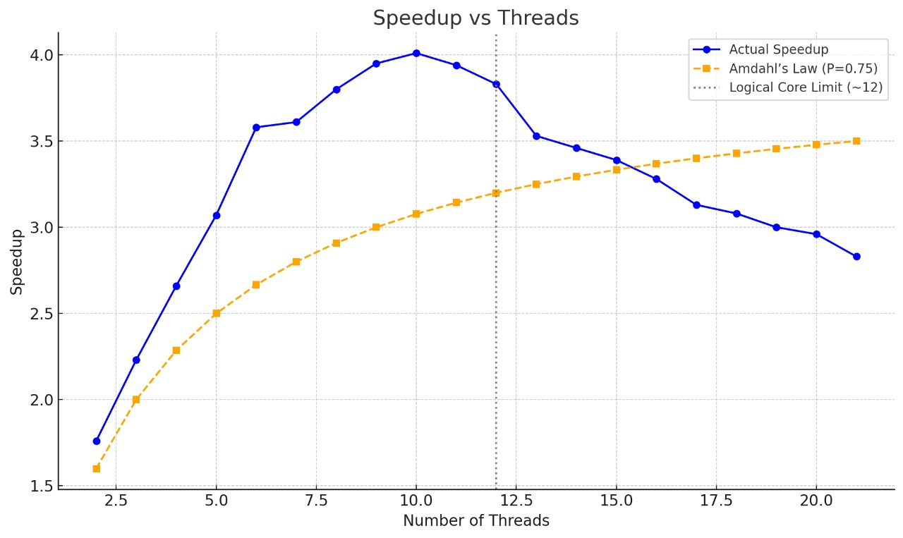

RESULTS
Speedup increases with threads.
Peak at 10–12 threads.
Matches Amdahl’s Law.

Slide 11
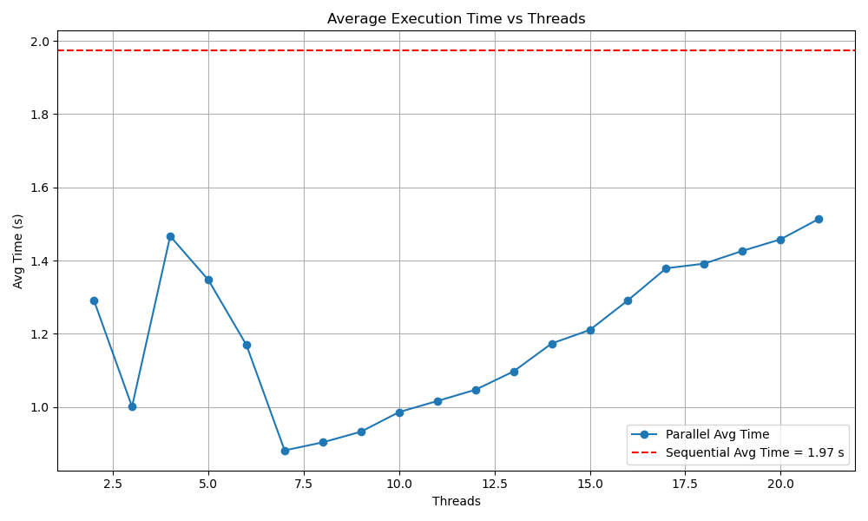
Execution time comparison

Slide 12
CHALLENGES
Issue | Fix
Shared Random | One per thread
Uneven chunks | Last thread handles extra
Overhead | Large task size
Thread shutdown | Used awaitTermination()

Slide 13
CONCLUSION
We successfully implemented a parallel Monte Carlo simulation of radioactive decay using Java’s concurrency APIs. The project demonstrated substantial runtime improvement with multi-threading, achieving up to 4x speedup compared to the sequential version.

