Slide 1
JM COSMETICS
Submitted To:
Supervisor: Dr. Zaher Merhi
Committee Member: Dr. Milia Habib
Submitted By: Jana M. Bakish And Maria S. Tedros

Slide 2
CONTENT
Introduction
Problem Statement
System Design
Implementation Tools
Conclusion
Future Work

Slide 3

INTRODUCTION
Organizations may use technology to make certain that every step of the client journey is simple, quick, and easy.
Nowadays, online buying is becoming more and more commonplace.
Like other businesses, cosmetics must have user-friendly websites that make internet ordering simple.
Cosmetics stores include skincare, personal care, hair care, nails, perfume, makeup, fashion, accessories, and more, which are available at both online and offline stores.

Slide 4
PROBLEM STATMENT
The regular store needs considerable investment, including rent or purchase prices, utility charges, base rates, and startup costs.
A conventional store may have set hours for opening and closing, as well as a possible weekly day off.
Customers must be serviced one at a time in a physical store except there are many cashiers so more registers are open simultaneously, in addition, a client may have to spend a while to buy during rush hour or other busy times, like during holidays, sales, and offers.

Slide 5
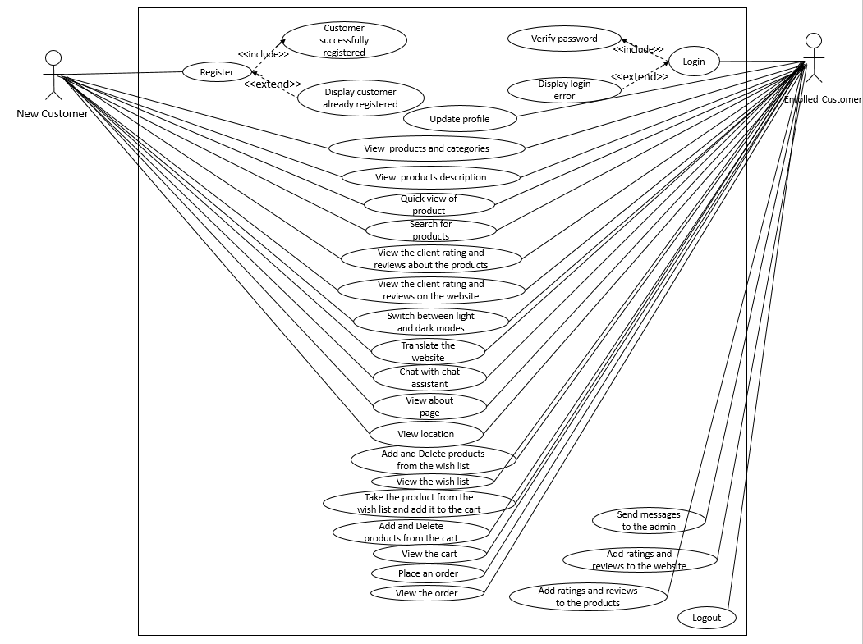
CUSTOMER USE CASE DIAGRAM

Slide 6
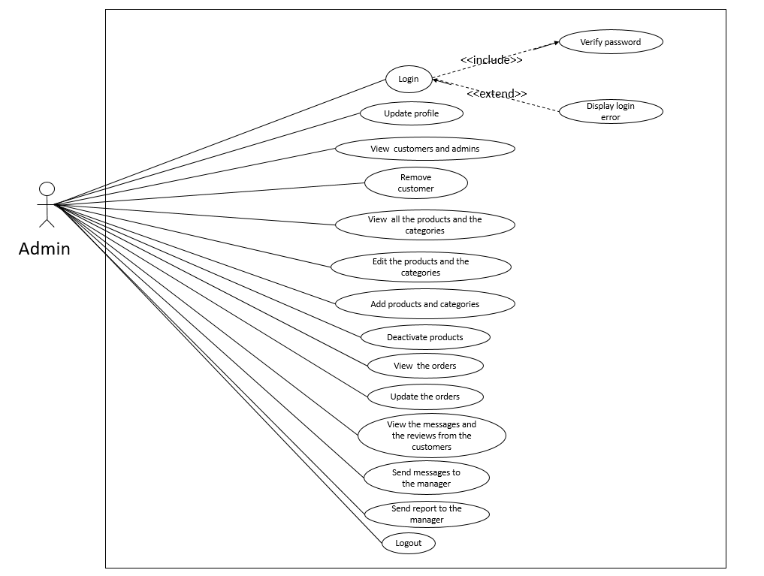
ADMIN USE CASE DIAGRAM

Slide 7
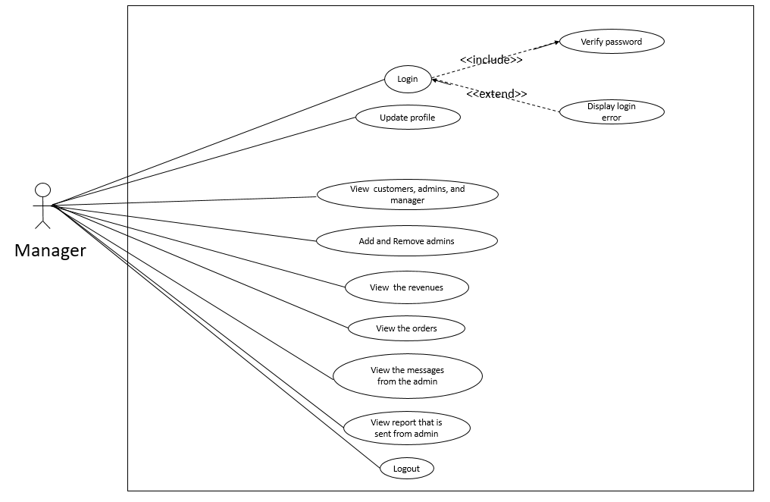
MANAGER USE CASE

Slide 8
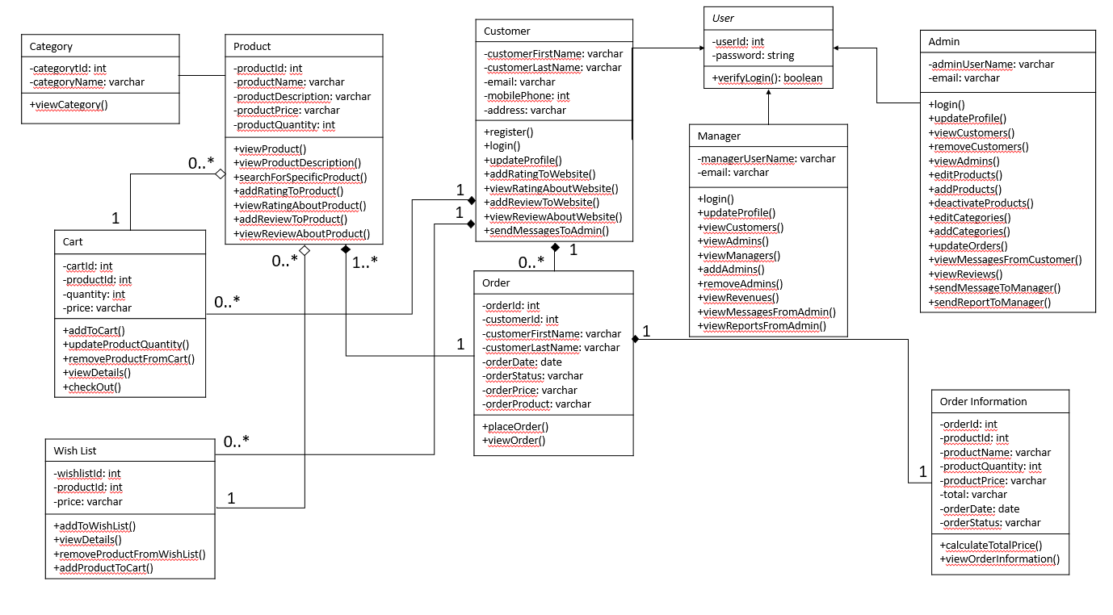
CLASS DIAGRAM

Slide 9
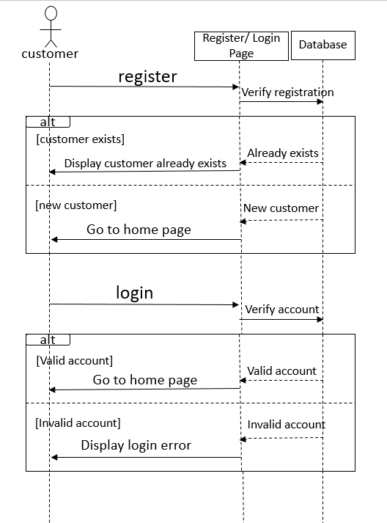
CUSTOMER SEQUENCE DIAGRAM
LOGIN/REGISTER

Slide 10
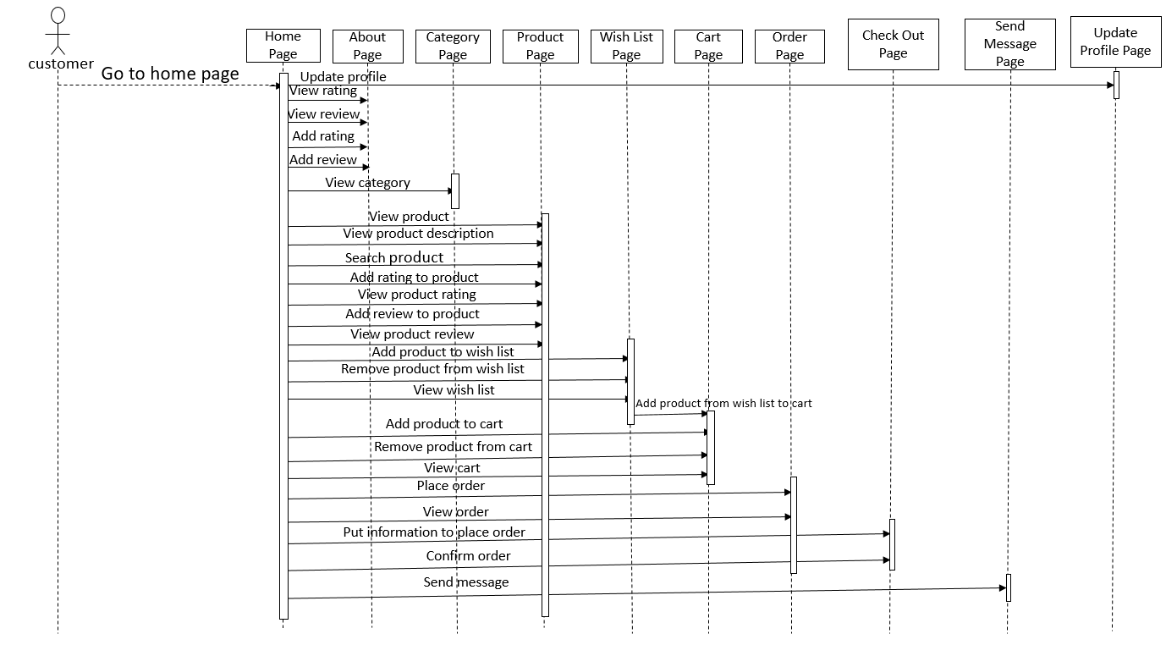
CUSTOMER SEQUENCE DIAGRAM

Slide 11
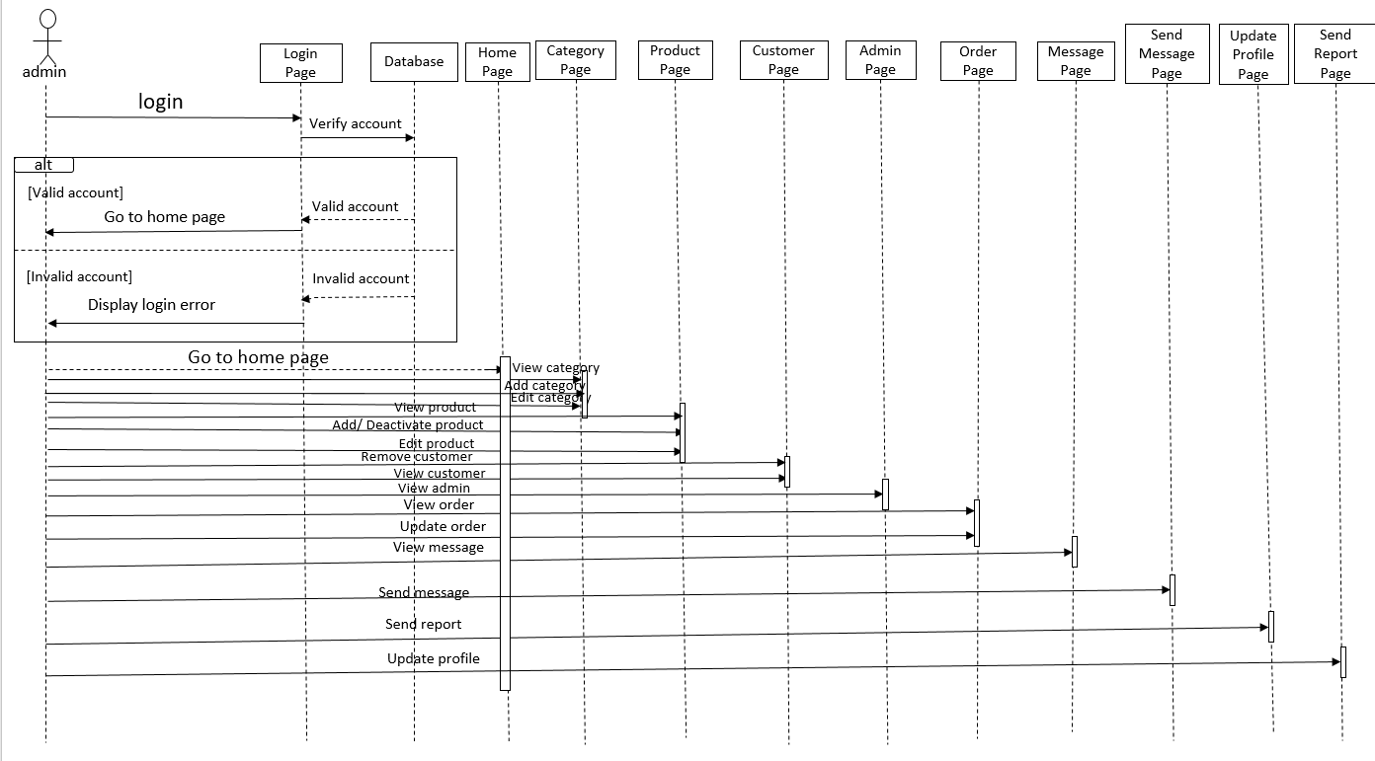
ADMIN SEQUENCE DIAGRAM

Slide 12
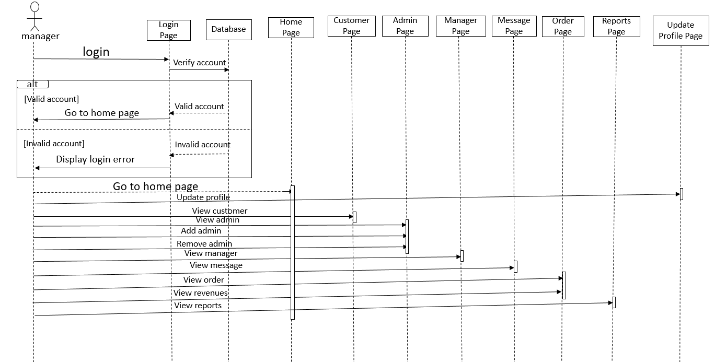
MANAGER SEQUENCE DIAGRAM

Slide 13
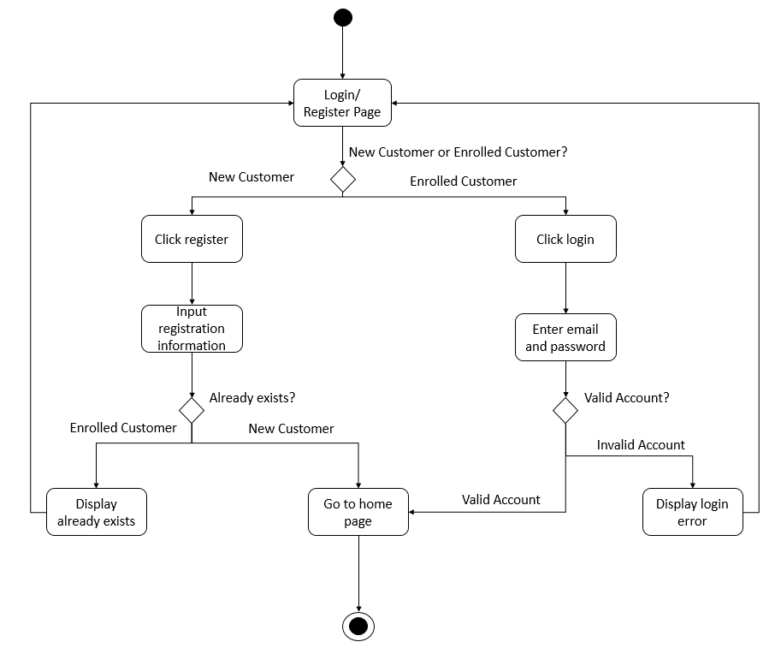
CUSTOMER ACTIVITY DIAGRAM
LOGIN/REGISTER

Slide 14
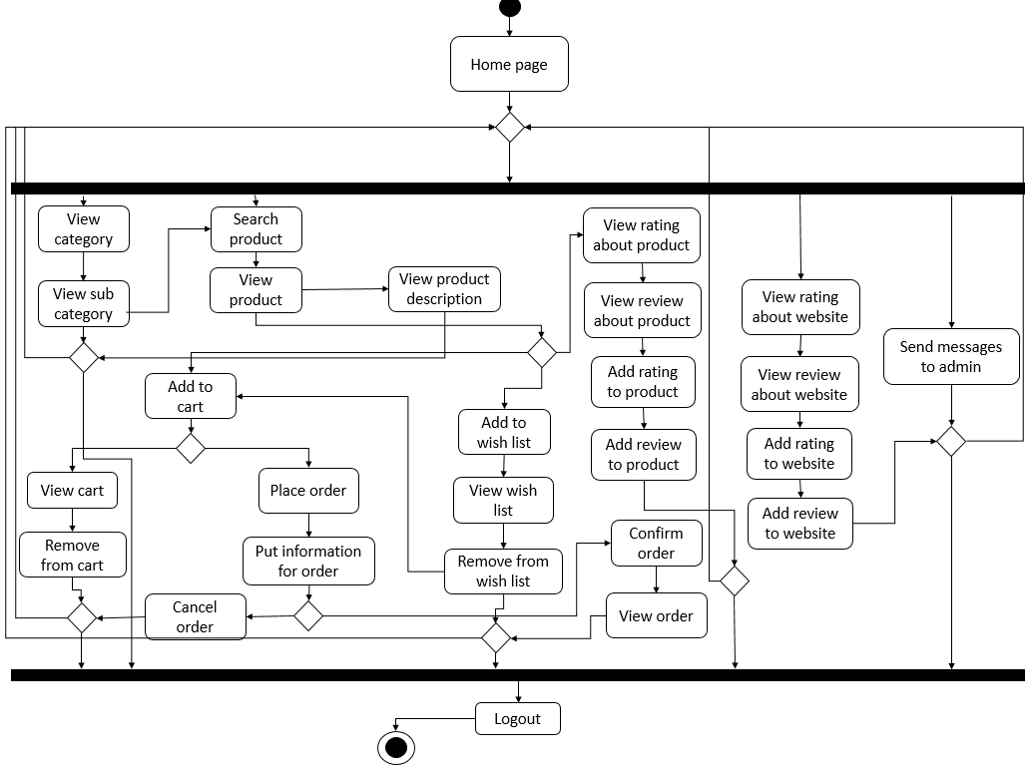
CUSTOMER ACTIVITY DIAGRAM

Slide 15
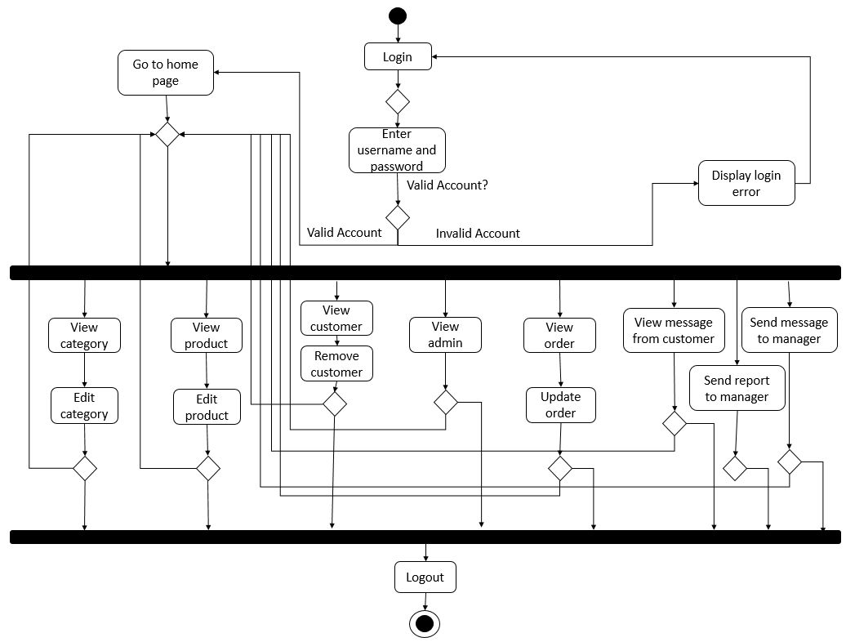
ADMIN ACTIVITY DIAGRAM

Slide 16
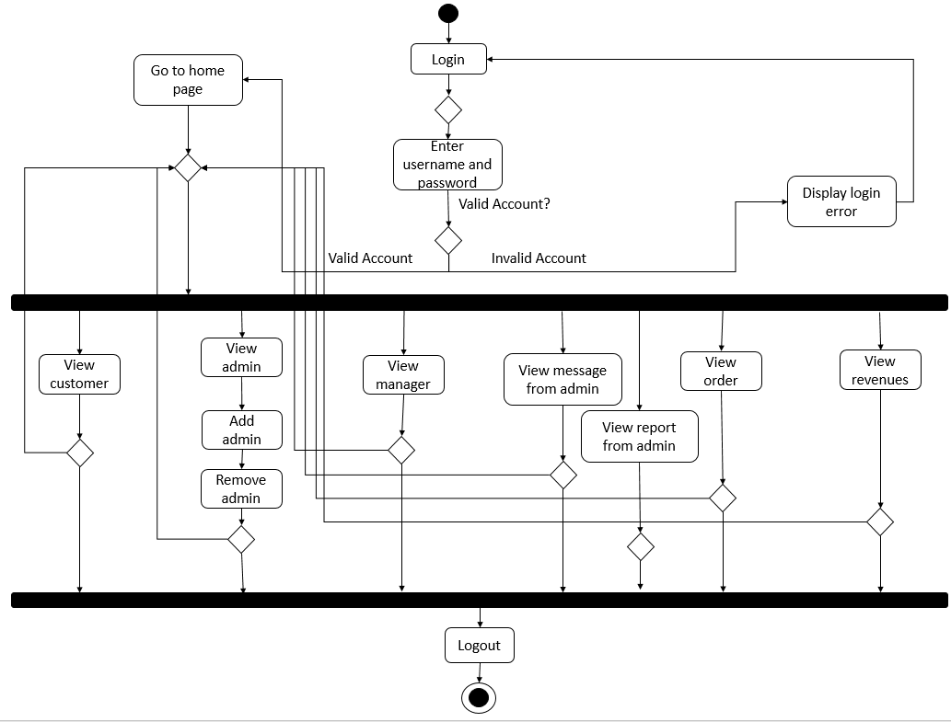
MANAGER ACTIVITY DIAGRAM

Slide 17
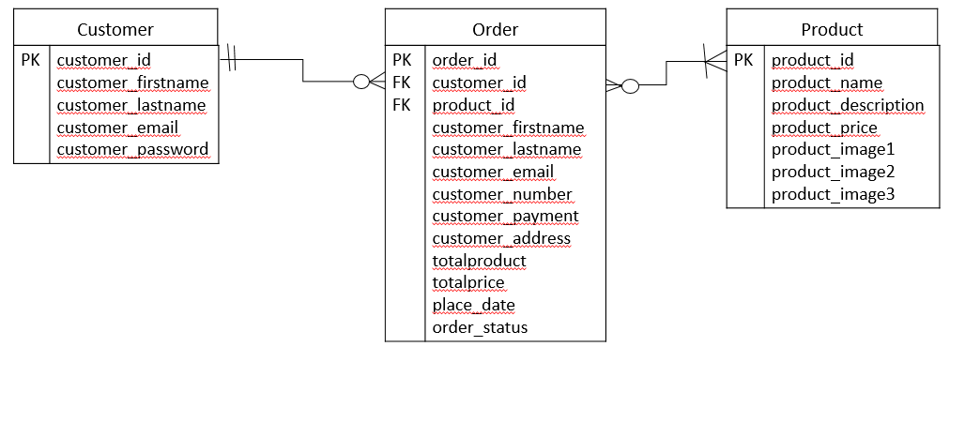
ORDERING ER DIAGRAM

Slide 18
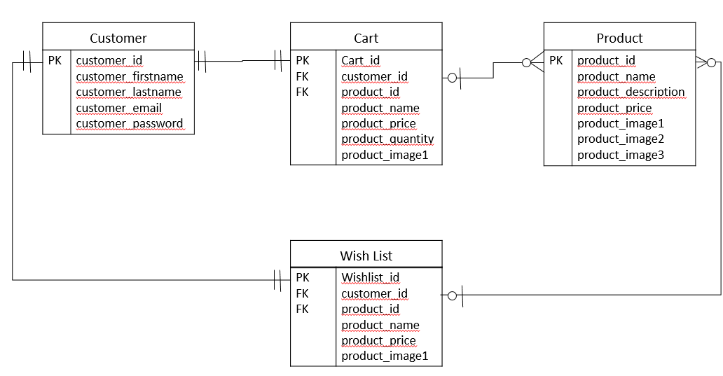
ADD TO CART/WISHLIST ER DIAGRAM

Slide 19
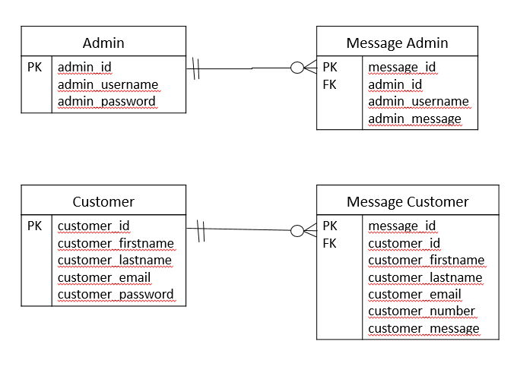
MESSAGING ER DIAGRAM

Slide 20
IMPLEMENTATION TOOLS
Implementation tools for developing the project:
XAMPP
MySQL Database
Visual Studio
HTML
CSS
PHP
JavaScript
PowerPoint for the graphical diagrams presentation

Slide 21

CONCLUSION
A strong page design is required for modern web design and development which is what the JM Cosmetics project aims to accomplish.
Although JM Cosmetics is not a freshly launched online store, using the JM Cosmetics website will make customers’ purchasing experience simpler in accordance with our efforts to create an easy and straightforward website.

Slide 22

FUTURE WORK
Check the product availability in the store.
Since the JM Cosmetics project is a beauty-related project, try products by submitting photos online.
Add a gift card option.
Pick up the order from the store when the order is ready.

Slide 23

THANK YOU FOR YOUR TIME

