Slide 1
Codecademy
Data Visualization with Python
Life Expectancy and GDP Data
BY:
Abdulrahman Al-Janabi
abd0156839@sci.ju.edu.jo

Slide 2
Scope
Introduction
Bar Chart to Compare Average
Violin Plot to Compare Life Expectancy Distributions
Bar Plots of GDP and Life Expectancy Over Time
Scatter Plots of GDP and Life Expectancy Data
Line Plots for Life Expectancy
Line Plots for GDP
Conclusion
References
1

Slide 3
introduction
GDP is refer to Gross Domestic Product, which is an indicator of market value for all services and goods that are produced over a certain time.
Life Expectancy at birth is the number of years since the birth till the expected years that the citizen will live.
The main objective of this project is to check if there is any strong correlation between GDP and the life expectancy at birth for a specific country.
2

Slide 4
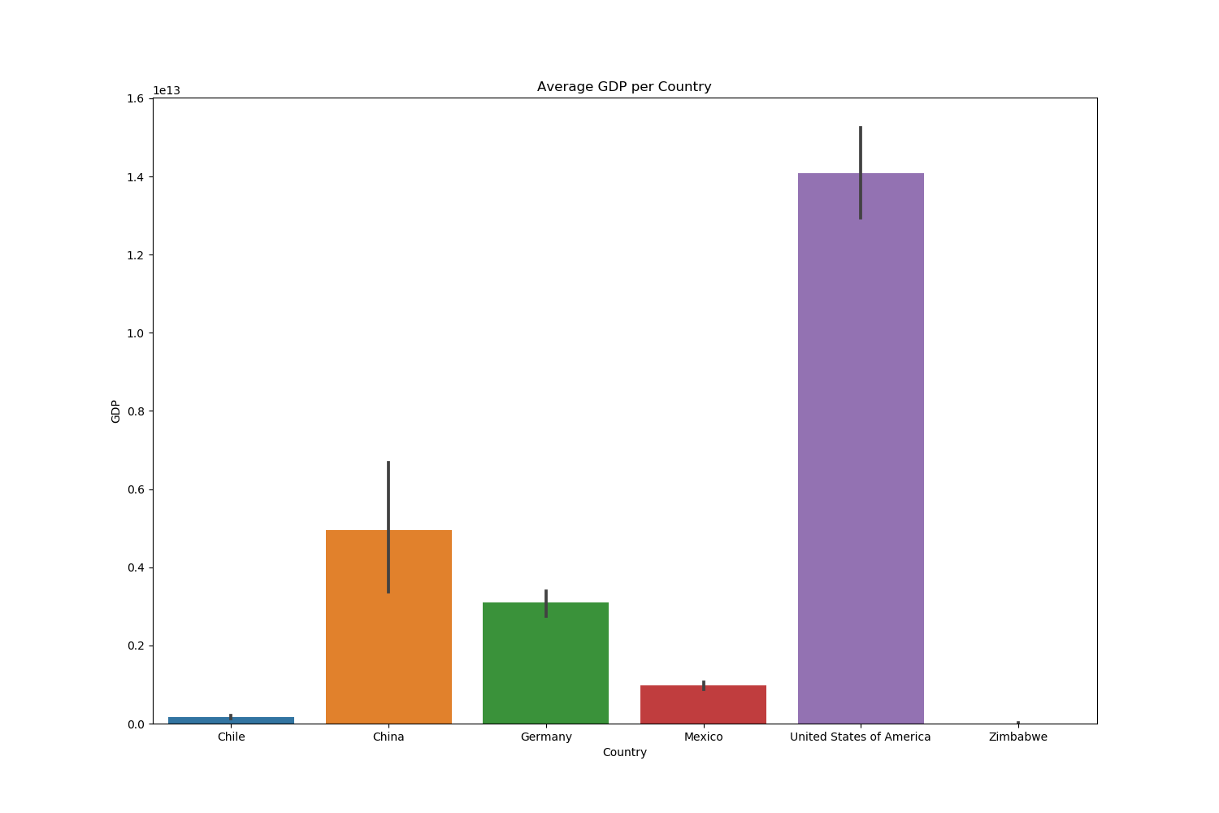
Bar Chart to Compare Average
This bar is shown the average GDP for each country
3

Slide 5
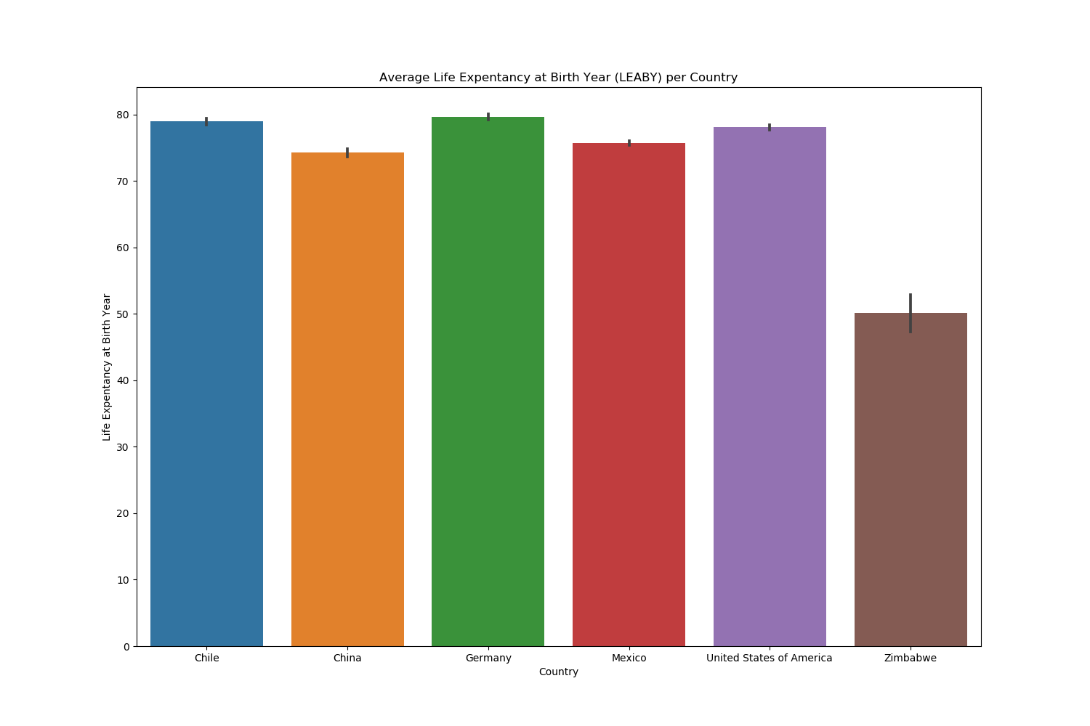
Bar Chart to Compare Average
This bar is shown the average life expectancy at birth for each country
4

Slide 6
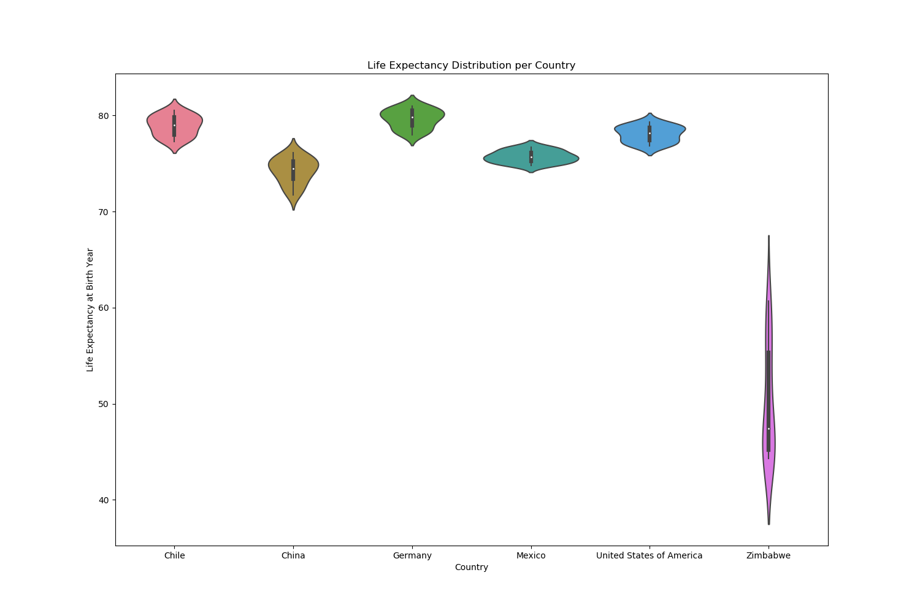
Violin Plot to Compare Life Expectancy Distributions
This violin plot is shown the life expectancy distributions at birth for each country
5

Slide 7
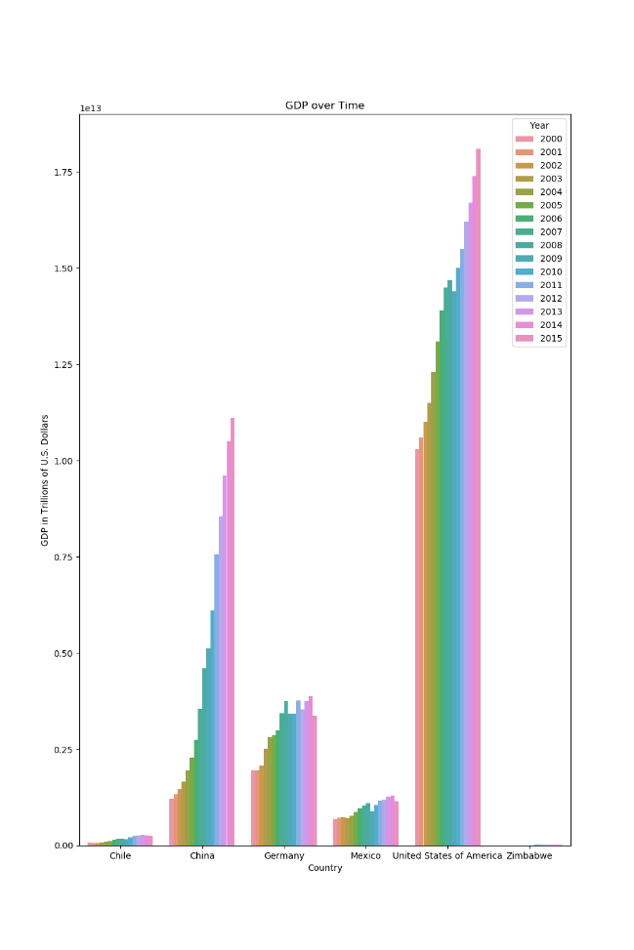
Bar Plots of GDP and Life Expectancy Over Time
This bar plot is shown the GDP over time for each country
6

Slide 8
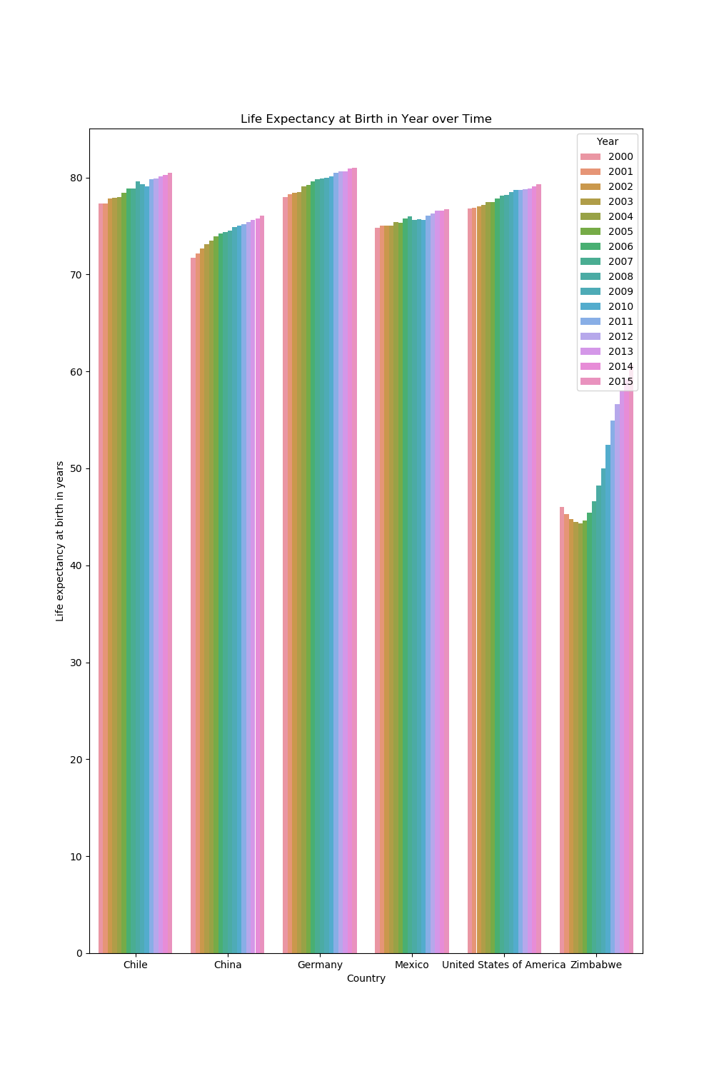
Bar Plots of GDP and Life Expectancy Over Time
This bar plot is shown the life expectancy over time for each country
7

Slide 9
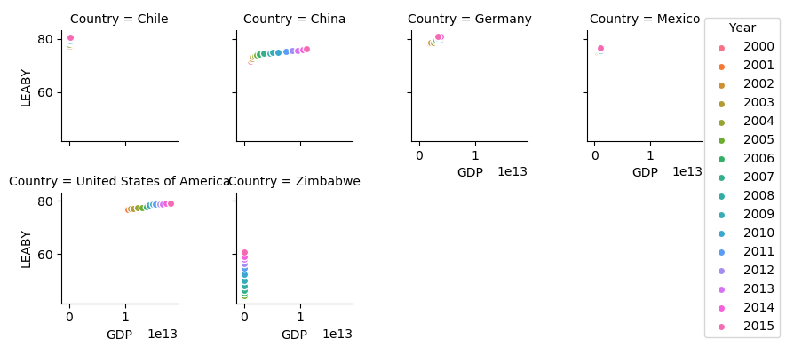
Scatter Plots of GDP and Life Expectancy Data
8

Slide 10
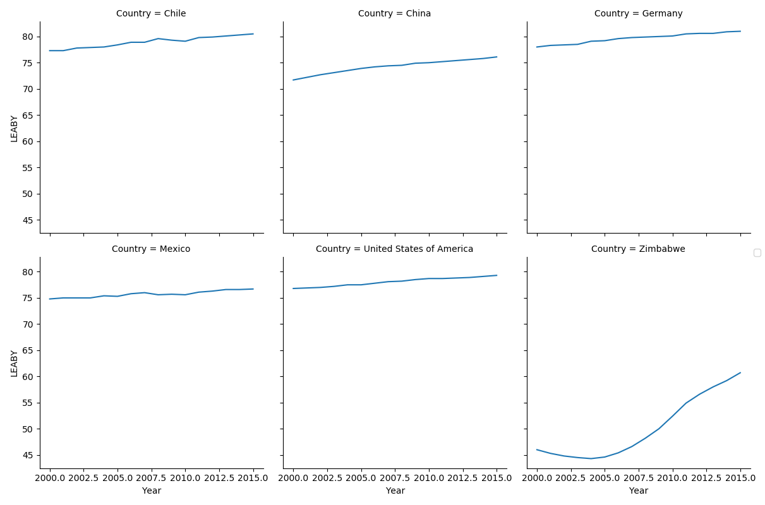
Line Plots for Life Expectancy
9

Slide 11
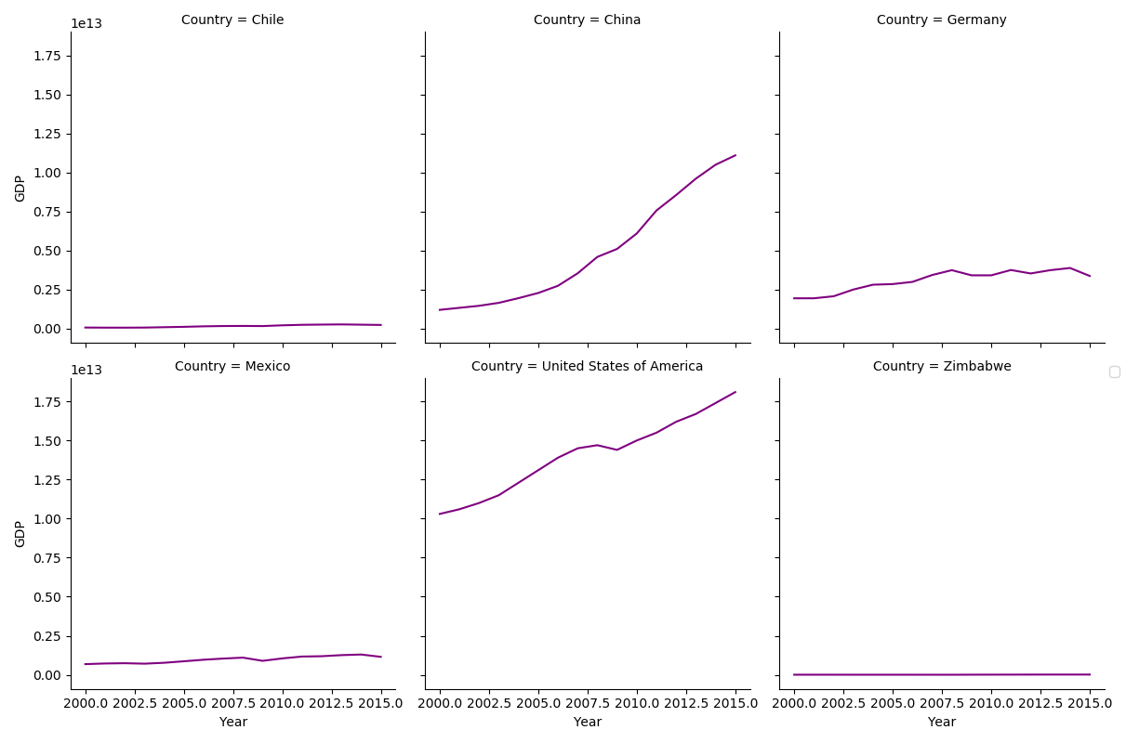
Line Plots for GDP
10

Slide 12
Conclusion
Realized that The USA have the largest values of both factors (GDP and life expectancy), but Zimbabwe has the lowest values for both.
In life expectancy, Zimbabwe has the most significant changes in values which it is stated up to increased since 2004 due to enhancement in health care system.
In GDP, China has increased drastically due to improvement in education and health, largest manufacturing and exporter of product goods.
The data will be more reliable if there was tremendous period of time, it will be better for detecting the changes over time.
11

Slide 13
references
World Bank, 2017, World Bank national accounts data, and OECD National Accounts data files are available at: https://data.worldbank.org/indicator/NY.GDP.MKTP.CD
World Health Organization, 2018, Life expectancy and Healthy life expectancy Data by country are available at: http://apps.who.int/gho/data/node.main.688
12

Slide 14
Thank You for your Listening

