Slide 1
Student spending: where it goes and how to steer it
Findings from a synthetic dataset of 150 students over 24 months.
Synthetic data: results describe the analysis pipeline, not real students.

Slide 2
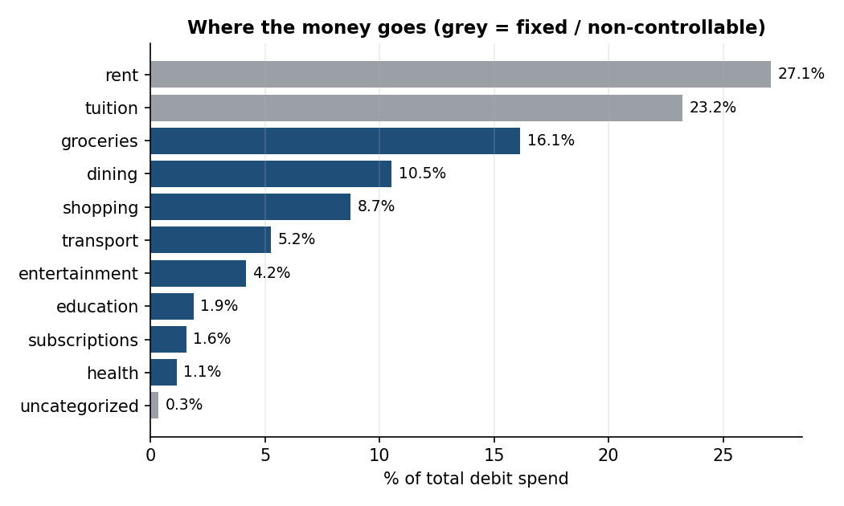
Half of spending is fixed; groceries and dining lead the rest
Rent and tuition are 50% of all spend.
Of the controllable part, groceries and dining make up 60%.
Median student: $922/month variable spend (p10 $691, p90 $1,183).

Slide 3
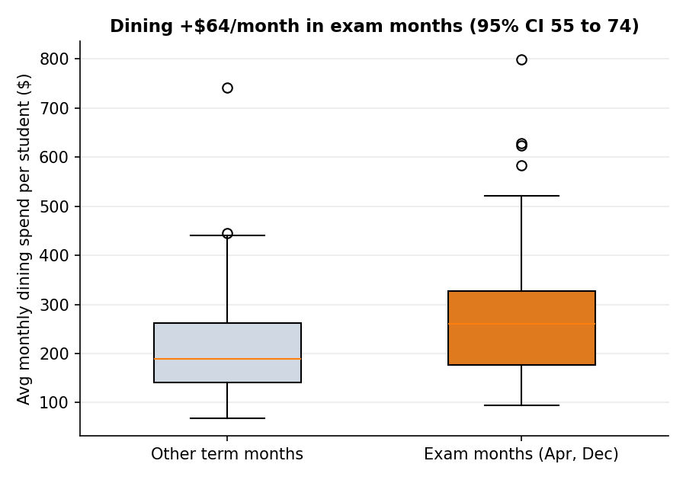
Dining spend rises about 30% in exam months
+$64/month per student (95% CI $55 to $74).
Paired Wilcoxon signed-rank across 150 students, p = 6.1e-22.
Implication: budgets should flex by month rather than stay flat.
The effect is built into the simulator, so this shows the method, not a real-world finding.

Slide 4
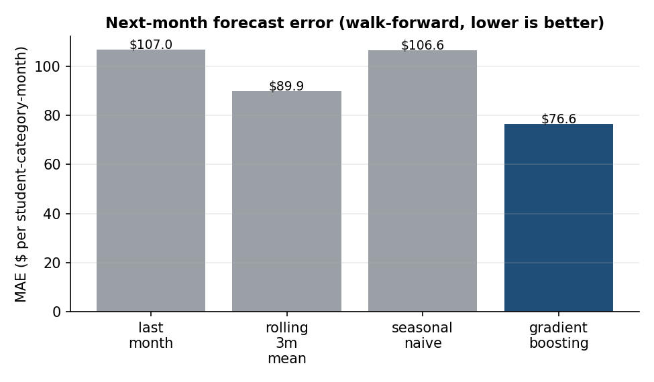
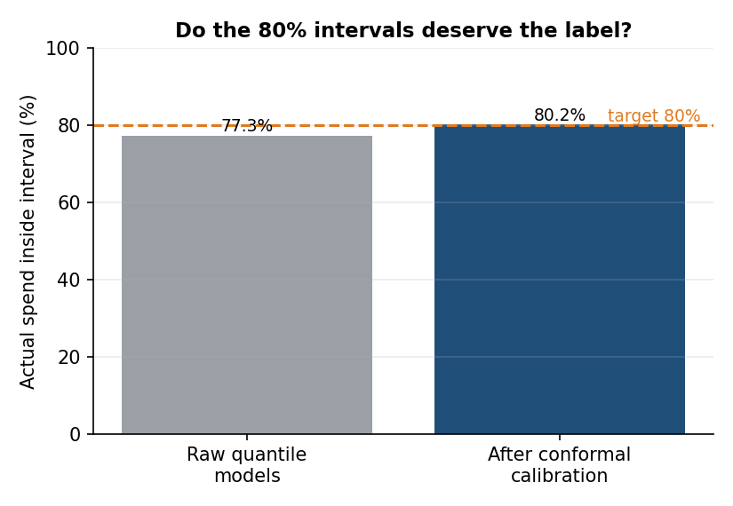
Forecasts beat simple baselines, with intervals that hold up
Gradient boosting MAE $77 vs $90 for the best baseline (15% better), walk-forward, no leakage.
Raw 80% intervals covered 77.3%; after conformal calibration 80.2%.

Slide 5
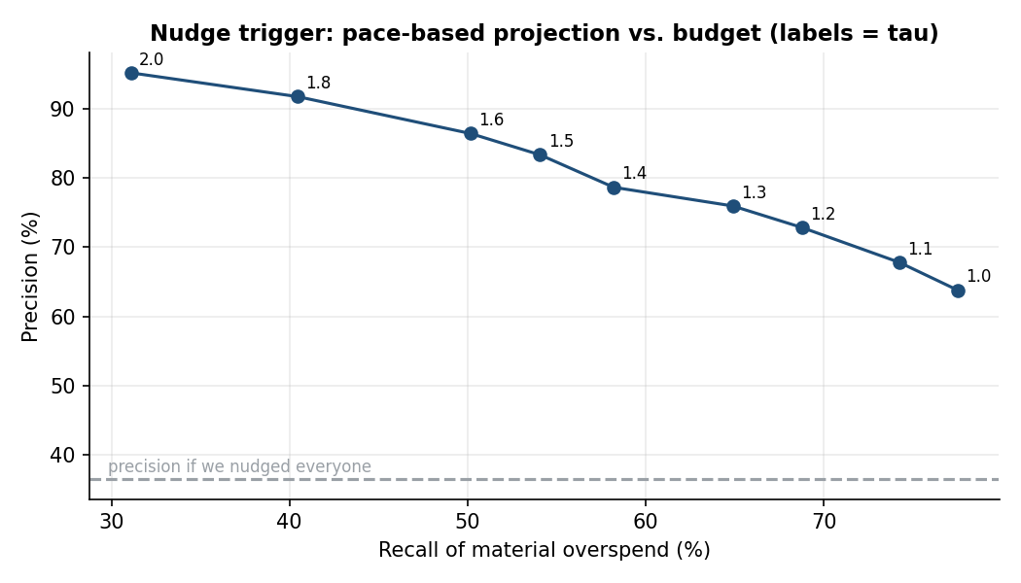
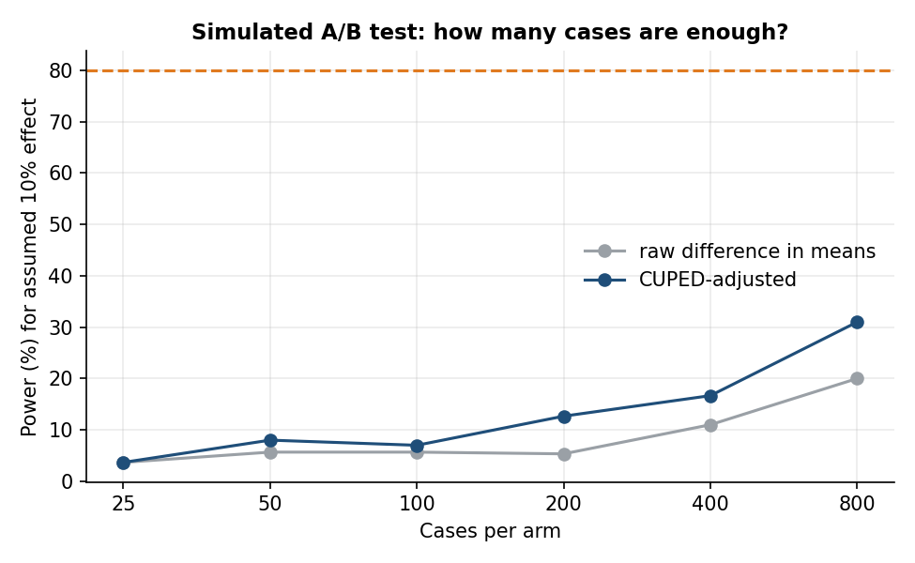
Nudges: a usable trigger, and an honest test design
Day-15 pace trigger (tau 1.1): precision 68% and recall 74% on held-out months, vs 37% if everyone were nudged.
Simulated A/B (assumed 10% effect): needs about 6,509 cases per arm, or 2,763 with CUPED variance reduction.

Slide 6
Limitations and next steps
Data is synthetic; every effect size and rate reflects simulator assumptions.
Categorisation on merchants never seen in training: hybrid covers 73% at 99% accuracy; the rest goes to review.
Anomaly rules catch 93% of injected anomalies but only 31% of flags are real: review queues need triage.
Next: pretrained text embeddings or an LLM for unseen merchants; validate on real, consented data.

