Slide 1

E-Commerce Website Presentation
Introduction to Our E-Commerce Platform

Slide 2
Team Member Details
Name | Roll No | GR NO
Shruti Kamble | 322075 | 22220169
Punam Navale | 323048 | 22110886
Janai Kasle | 323075 | 22220252
Guided By- Prof. Disha S. Wankhede

Slide 3
Introduction
E-commerce, short for electronic commerce, refers to the buying and selling of goods or services over the internet. It encompasses a wide range of transactions, from online retail stores and digital marketplaces to business-to-business exchanges. E-commerce has revolutionized the way businesses operate and consumers shop, offering convenience, accessibility, and a global reach.
With the rise of secure payment gateways, mobile shopping apps, and personalized recommendations, e-commerce continues to reshape the modern economy.

Slide 4
Techstack
MERN Stack
Tailwind CSS
Socket.io

Slide 5
Payment Gateway
PayPal is available for online marketplaces using Stripe Connect
Accepts payments via credit/debit cards, digital wallets (e.g., Apple Pay, Google Pay), and bank transfers.

Slide 6
About Us
We are a leading e-commerce platform dedicated to providing customers with a seamless shopping experience. Our mission is to revolutionize the way people shop online by offering a vast selection of high-quality products, exceptional customer service, and convenient shopping features.
Integrating PayPal as a payment gateway into an e-commerce website is a popular choice due to its widespread acceptance and reputation for security.

Slide 7
Our Products
Our platform offers a wide range of products to suit every need and lifestyle. From electronics and gadgets to fashion, home goods, beauty products, and beyond, we have something for everyone. Our curated selection ensures that customers can find what they're looking for, whether it's the latest tech gadgets, trendy fashion items, or everyday essentials.

Slide 8
Our Services
In addition to our diverse product selection, we provide exceptional services to enhance the shopping experience for our customers. Our dedicated customer support team is available 24/7 to assist with any inquiries or issues. We offer fast and reliable shipping options to ensure prompt delivery of orders. Additionally, our hassle-free return policy allows customers to shop with confidence, knowing that they can easily return or exchange items if needed.
Our goal is to empower individuals to discover and enjoy the best products worldwide. Every interaction with our platform reflects our commitment to integrity, dedication, and continuous improvement.

Slide 9
Contact Us
For any questions, feedback, or assistance, please don't hesitate to contact us. Our customer support team is here to help! email us at support@example.com. We also encourage you to follow us on social media for updates, promotions, and more. We value your feedback and look forward to serving you!

Slide 10
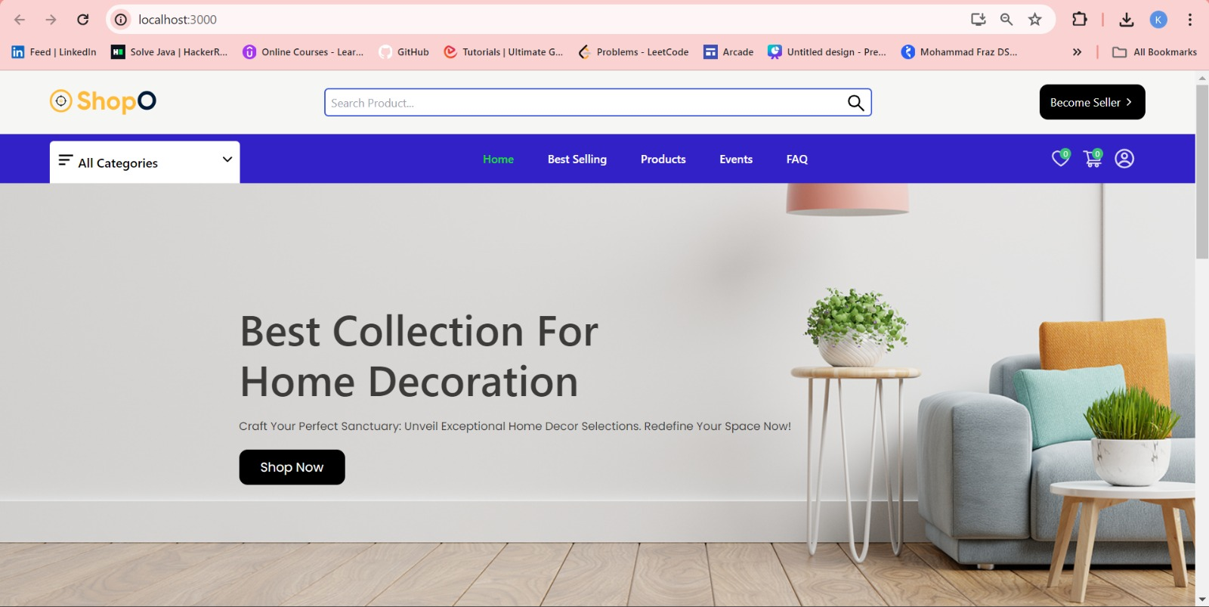
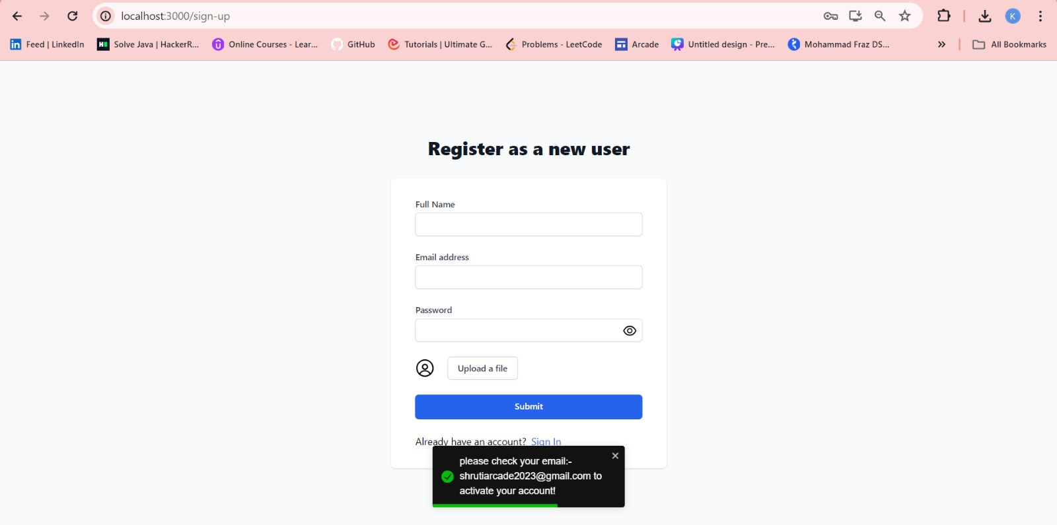
Screenshots
Homepage
Register Page

Slide 11
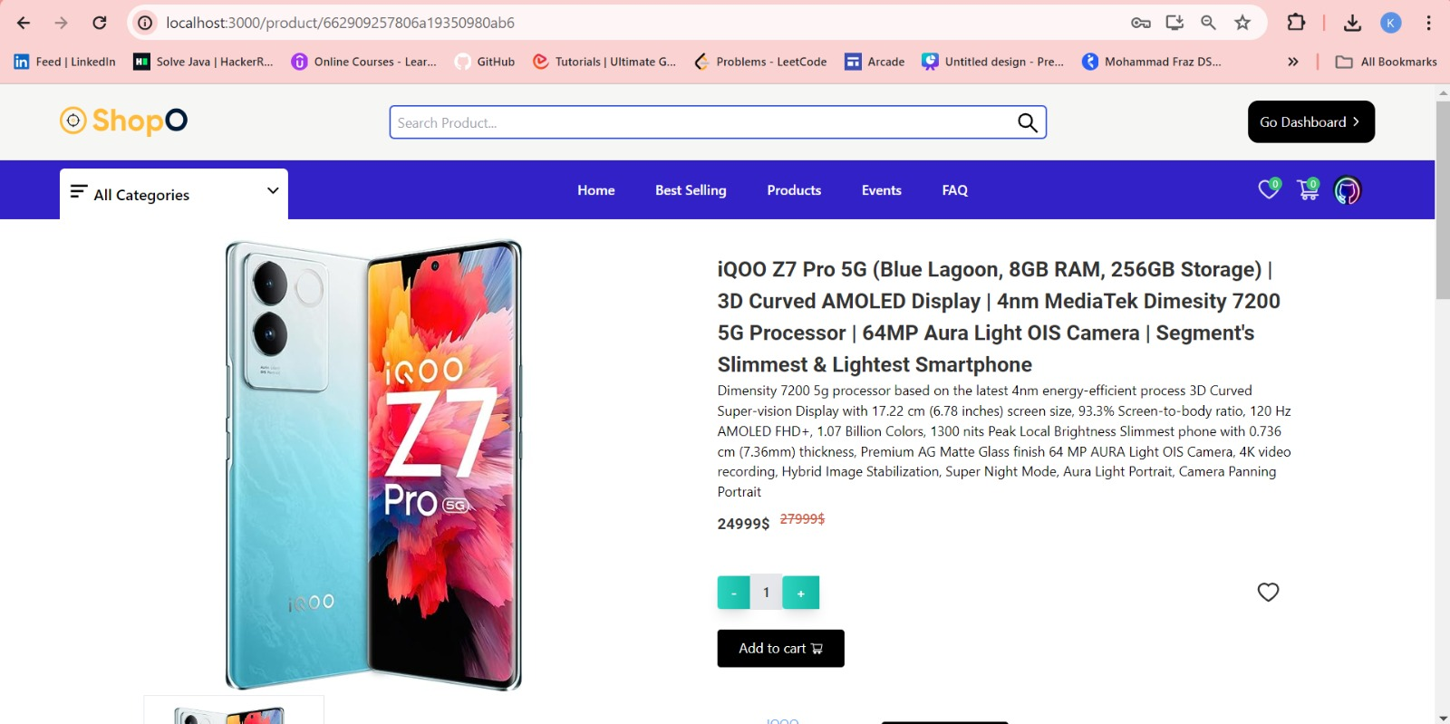
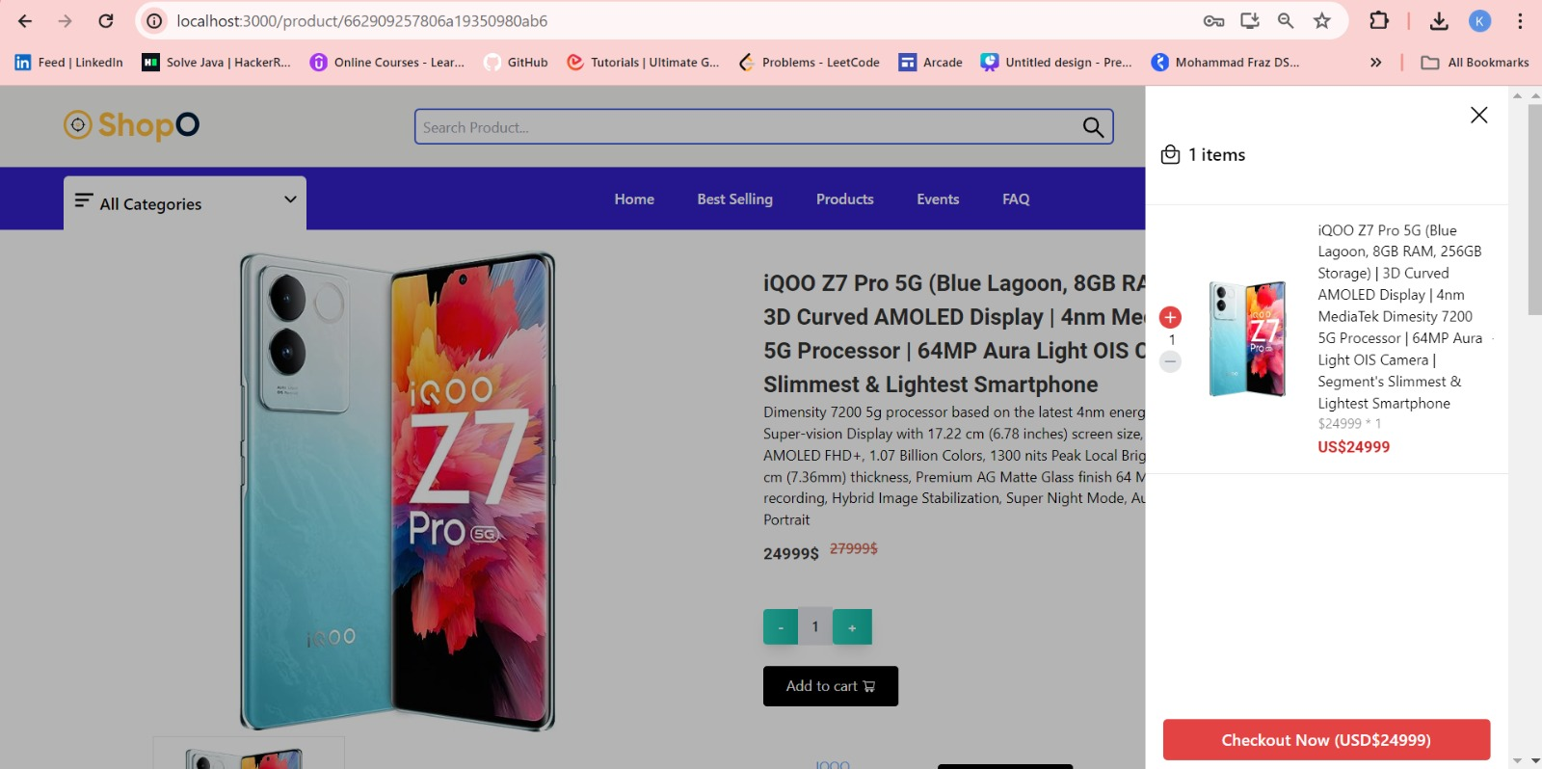

Slide 12
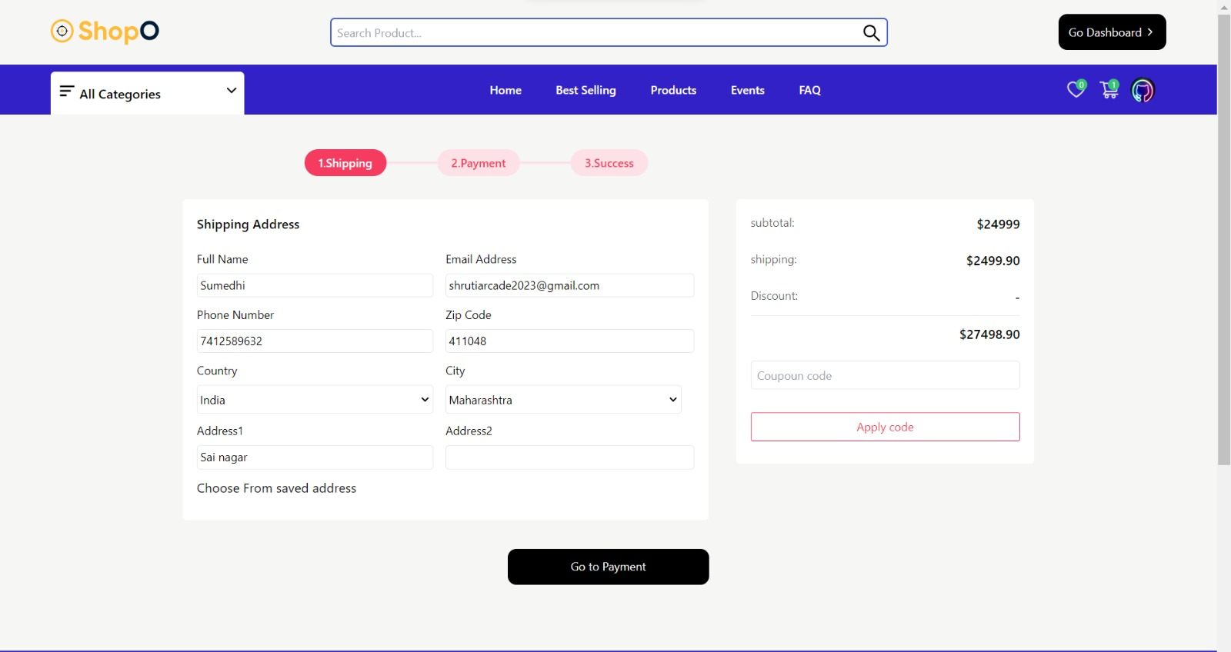
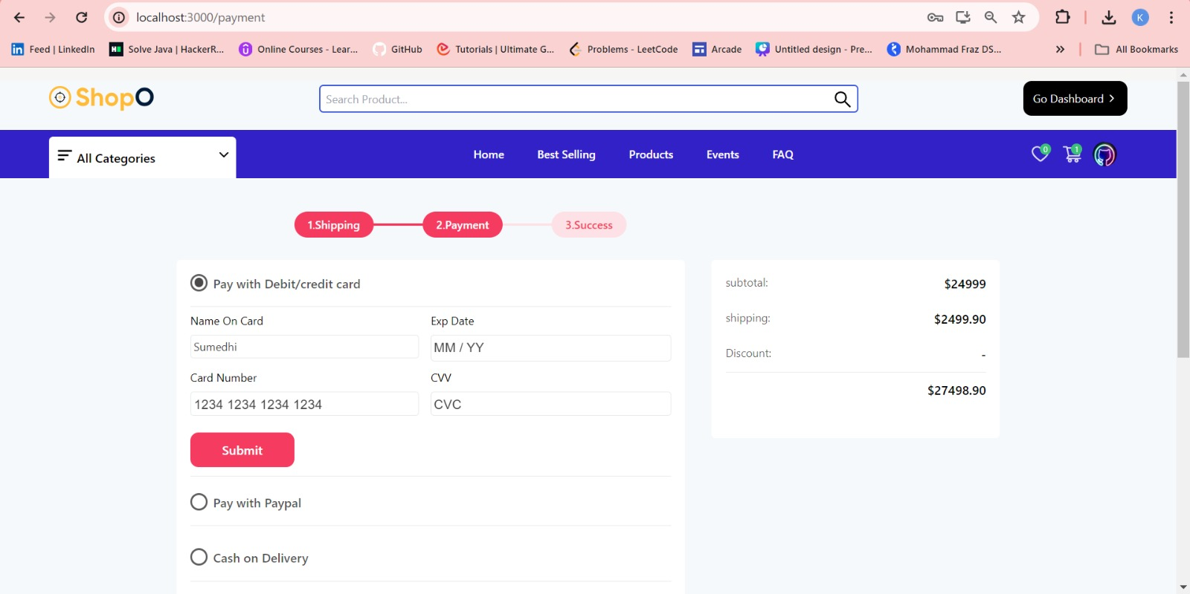

Slide 13
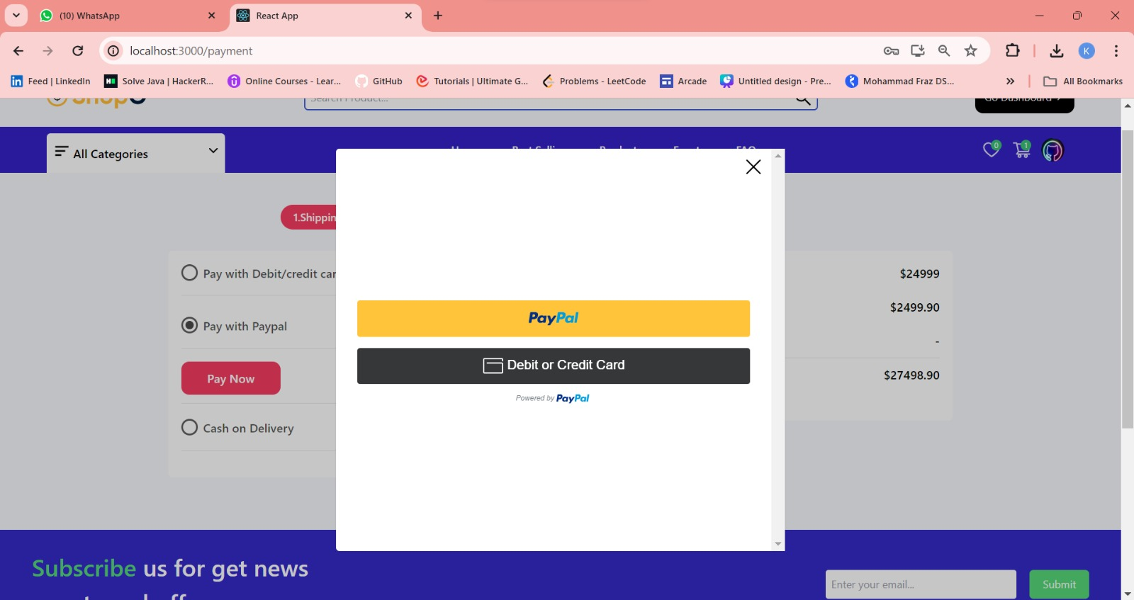
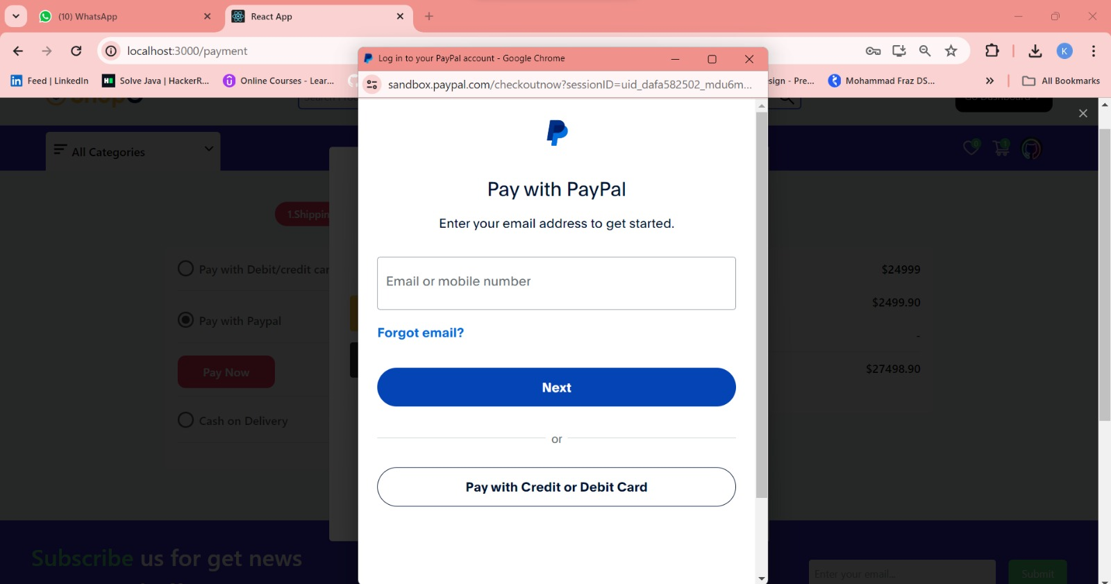

Slide 14
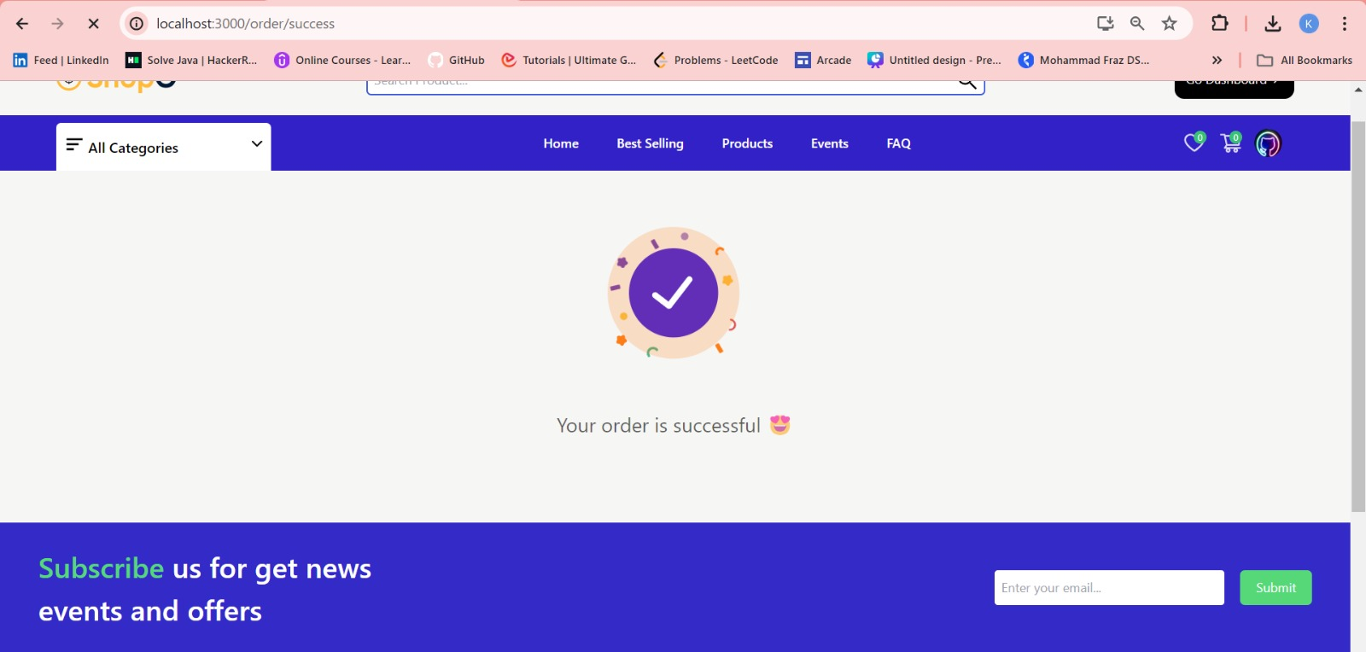

Slide 15
Conclusion
In conclusion, our e-commerce website stands as a testament to seamless user experience, efficient navigation, and a wide array of products tailored to diverse customer needs. With a commitment to excellence in both service and selection, we strive to redefine the online shopping experience. Embracing innovation and customer-centricity, we look forward to continued growth and success in delivering unparalleled satisfaction to our valued clientele. Join us on this journey of convenience, reliability, and endless possibilities in the digital marketplace.

