Slide 1
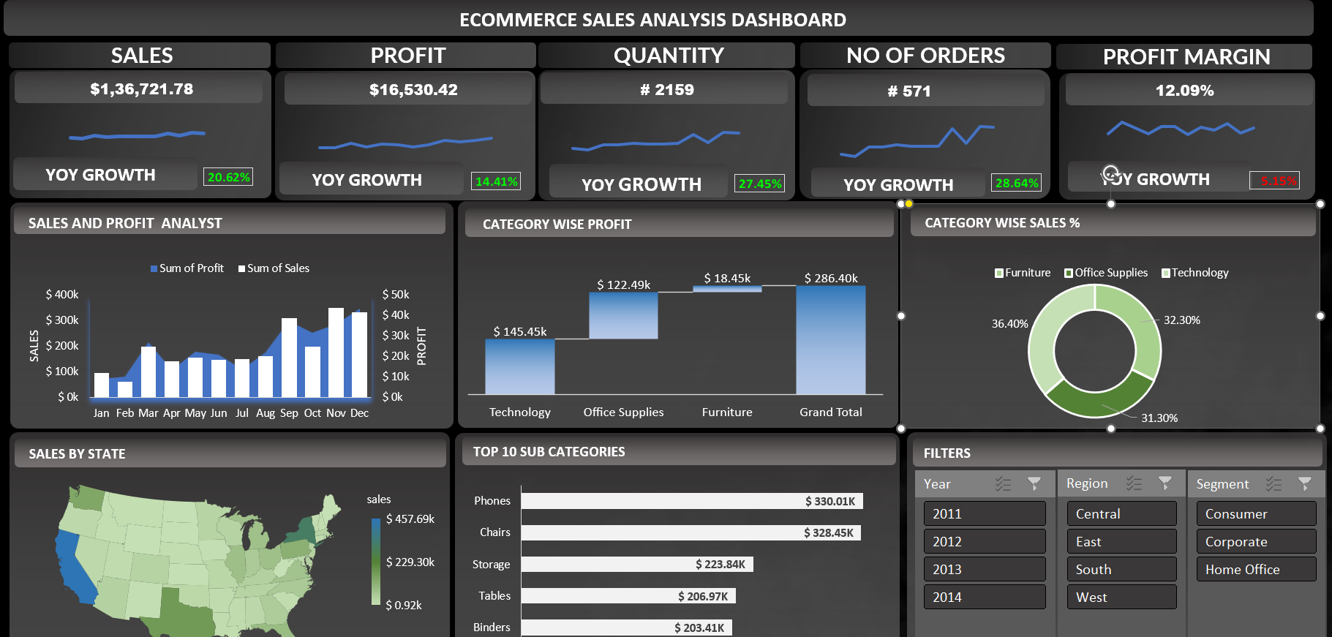
Developed an interactive dashboard using transaction and customer data from a SQL database, to provide real-time insights. Streamlined data processing & analysis to monitor key performance metrics and trends. Shared actionable insights with stakeholders based on dashboard findings to support decision-making processes

