Slide 1

SMART INDIA HACKATHON 2026
TITLE PAGE
Problem Statement ID – SIH26173
Problem Statement Title – iTantra Indian Multilingual TTS & STT Aided Neural Transceiver Radio Access for low bitrate links
Theme - Smart Automation
PS Category - Software
Team ID - 172340
Team Name – Algo Avengers

Slide 2
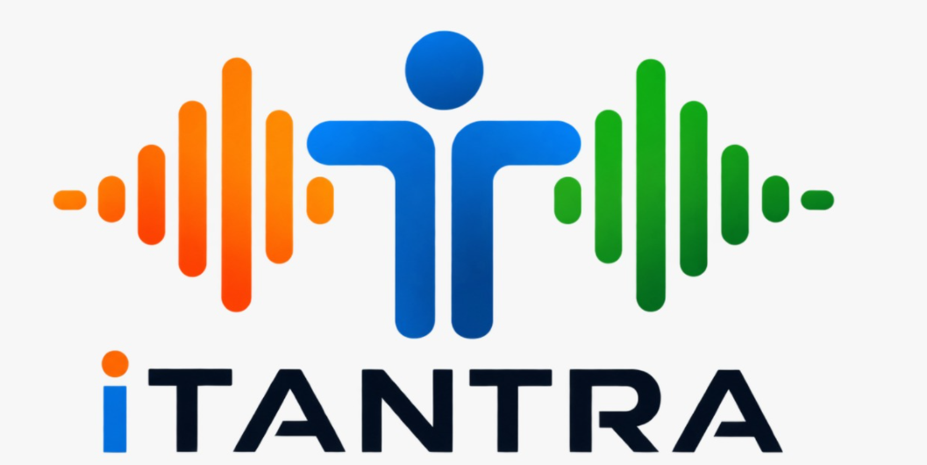
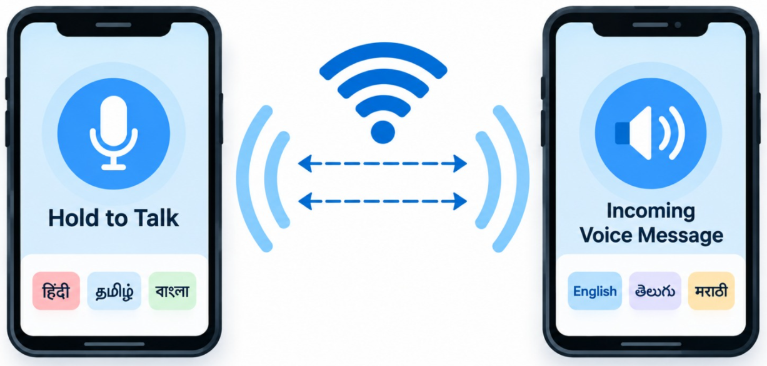
Algo Avengers
IDEA TITLE
Speech
VAD
STT
≤38B Token
Mesh Tx
TTS
Voice
Our Solution
Why different
PROBLEM
≤38B
MIC
STT
MESH
TTS
• Voice notes need internet + MBs; dead in blackouts.
• Radios: one language, no translation, extra hardware.
• Cloud STT: proprietary, needs network, voice leaves device.
• Text-mesh excludes non-literate users.
• Two-engine STT handles language-specific accuracy.
• Voice audio is too data-intensive for low-rate links.
• Text alerts exclude non-literate users.
• STT must trigger on pauses, form sentences, and stream instantly.
• Alerts must be voice: max-volume, non-interruptible.
• 10 Indian languages, offline, on low-power phones.
VAD
• Silero pause-detect → dual-engine STT → sentence formation.
• Speech → ≤38 B token: <300 bps, one UDP packet.
• Wi-Fi Direct / BT mesh; ChaCha20 + RS-FEC repair.
• Receiver TTS in own language; SOS siren override.
• PTT walkie-talkie / phone / SOS; 100% open-source, zero cloud.
Key Value Proposition
• Universal Accessibility: hands-free, voice-first communication for non-literate citizens and rescue workers.
• Tactical Resilience: operates during total telecom blackout.
• Hardware Efficiency: entry-level $80 Android smartphones; <3%/hr battery drain.
P1 shipped → P2 Kathbath 1,700 h + Vaani 7,000 h → P3 synthetic disaster vocabulary

Slide 3
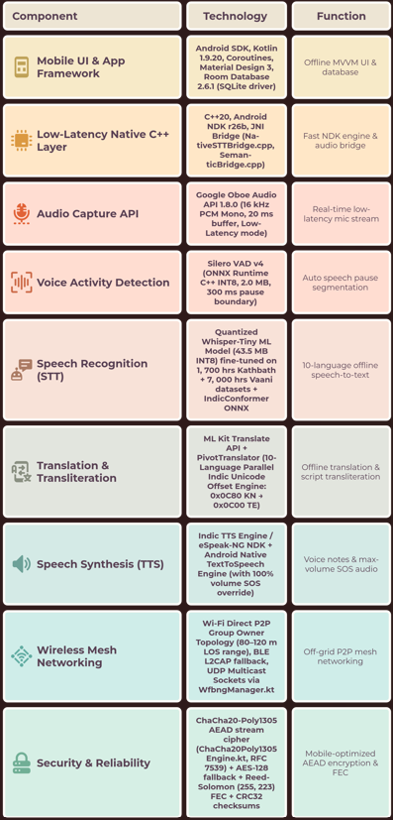
TECHNICAL APPROACH
Algo Avengers
SYSTEM ARCHITECTURE
Tech Stack Used

Slide 4
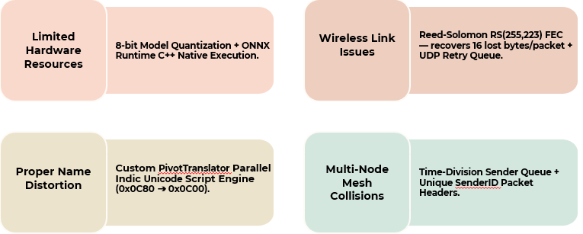
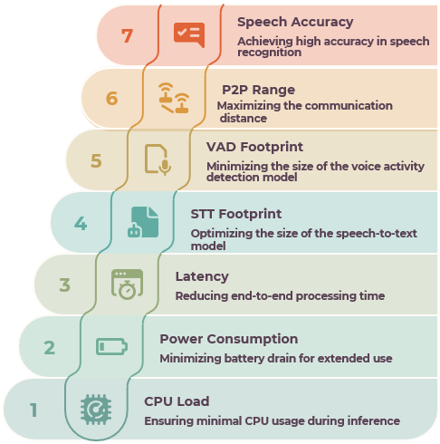
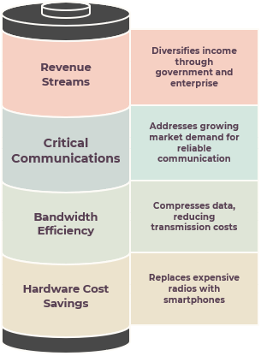
FEASIBILITY AND VIABILITY
Algo Avengers
RISK ASSESSMENT & MITIGATION
OPERATIONAL FEASIBILITY
& HARDWARE OVERHEAD
• Target Hardware: Entry-level Android smartphones (Android 8.0+ / API 26+).
• CPU Utilization: <8% average during active voice processing (INT8 SIMD).
• Power Draw: ~45 mA average current; <3% battery drain/hour.
• RAM Footprint: ~150 MB during active inference on quad-core ARM64.
• Zero Infrastructure: 100% offline — no cell towers, satellite, or cloud.
VALIDATION & FIELD MEASUREMENTS
ECONOMIC APPROACH & VIABILITY
PROVEN DATASETS & FRAMEWORKS
Fine-Tuned Whisper-Tiny ML Model
Kathbath (1,700 hrs) + Vaani (7,000 hrs)
Silero VAD v4 Engine
Android Oboe Low-Latency NDK
ChaCha20-Poly1305 AEAD Encryption
Wi-Fi Direct P2P Protocol

Slide 5
IMPACT AND BENEFITS
Algo Avengers
IMPACTS
FUTURE PROSPECTS
Multi-Hop Mesh Extension
🌐 Social & Accessibility Impact
Extend peer-to-peer transmission range across multi-hop relay nodes to cover 10+ kilometers in mountainous and valley terrains.
Voice-first, hands-free interface empowering non-literate citizens, elderly individuals, and rescue workers. Native support for 10 Indian languages eliminates regional communication barriers during national disasters.
Drone & Airborne Gateway Relay
🛡 Tactical & National Security Impact
Deploy relay payloads on rescue drones to bridge isolated disaster zones directly to state command centers.
100% sovereign Atmanirbhar Indian technology reducing dependence on foreign communication hardware.Encrypted peer-to-peer mesh links operate completely isolated from commercial networks, preventing interception.
Wearable & Tactical Hardware SDK
Port native C++ NDK engine to rugged military smartwatches, helmet communicators, and IoT emergency beacons.
💰 Economic & Administrative Impact
Replaces expensive $1,500 proprietary satellite/VHF radios with existing $80 Android smartphones.100x payload bandwidth compression (32 kB/s raw audio → 0.32 kB/s text payload) enables low-bitrate channel transmission.
Defense-Grade Cryptographic Upgrade
Integrate Hardware Security Module (HSM) key storage and post-quantum encryption for tactical defense forces.
🔒 Ethical & Data Privacy Impact
100% on-device edge AI execution ensures raw audio never leaves the user's handset or streams to cloud servers.
National Emergency Response Standard
Build India's first open offline voice communication standard for NDRF, SDMA, Fire Services, and Border Security Forces.

Slide 6
RESEARCH AND REFERENCES
Algo Avengers

