Slide 1
POWER BI CAPSTONE PROJECT
Company Employee Facilities Utilization & Cost Analysis
Data Cleaning • Data Modeling • Dashboard Development
January – December 2026
Transport
Cafeteria
Parking
Gym
Medical
Arcade
Pool

Slide 2
EXECUTIVE SUMMARY
The problem: no view of facility use and cost
Company provides seven employee facilities but cannot see who uses them, how often, who pays, and whether spending stays within the monthly budget.
7
150
12
3,774
facilities
employees
months, Jan–Dec 2026
clean usage rows
Objectives
Tooling stack
Understand how employees use each facility
Measure how often each is used, month by month
Split what employees pay from what the company pays
Track operating cost and check spending against budget
Power BI Desktop, Power Query for cleaning, and DAX for the Calendar table and measures.
Company | Facilities Utilization & Cost Analysis
2

Slide 3
SCHEMA ARCHITECTURE
Three tables in a simple star model
DIMENSION
DIMENSION
Employees
Facilities
150 rows. One row per employee: department, location, employment type, status.
7 rows. One row per facility: provider, operating cost, monthly budget.
DIMENSION (DAX)
FACT TABLE
Calendar
FacilityUsage
12 months of 2026. Added in the model for monthly cost.
3,774 rows. One row per employee + facility + month: frequency, cost per use, who paid.
Usage Cost = UsageFrequency × CostPerUse, calculated in DAX and never stored.
Company | Facilities Utilization & Cost Analysis
3

Slide 4
DATA CLEANING & TRANSFORMATION
Cleaning: standardize, reject, or flag
1
2
3
4
Import as Text
Standardize
Fix or reject
Flag and load
Every column loads as text, so nothing is silently converted.
Trim spaces, then map spellings with lookup tables.
Repair formats and signs. Reject rows with untrusted keys or dates.
Keep unusual rows with a ReviewFlag. Load three clean tables.
Reject, don't guess
Flag, don't delete
Never invent costs
Rows with a missing or unknown key move to an audit query of 68 rows.
High values and usage by inactive staff may be valid, so they stay with a flag.
The pool operating cost and the arcade budget stay blank until confirmed.
Company | Facilities Utilization & Cost Analysis
4

Slide 5
DATA QUALITY
78 of 3,852 usage rows were removed
3,852
raw usage rows
−78
10 duplicates, 62 rejected, 6 repeats
3,774
clean usage rows
Company | Facilities Utilization & Cost Analysis
5

Slide 6
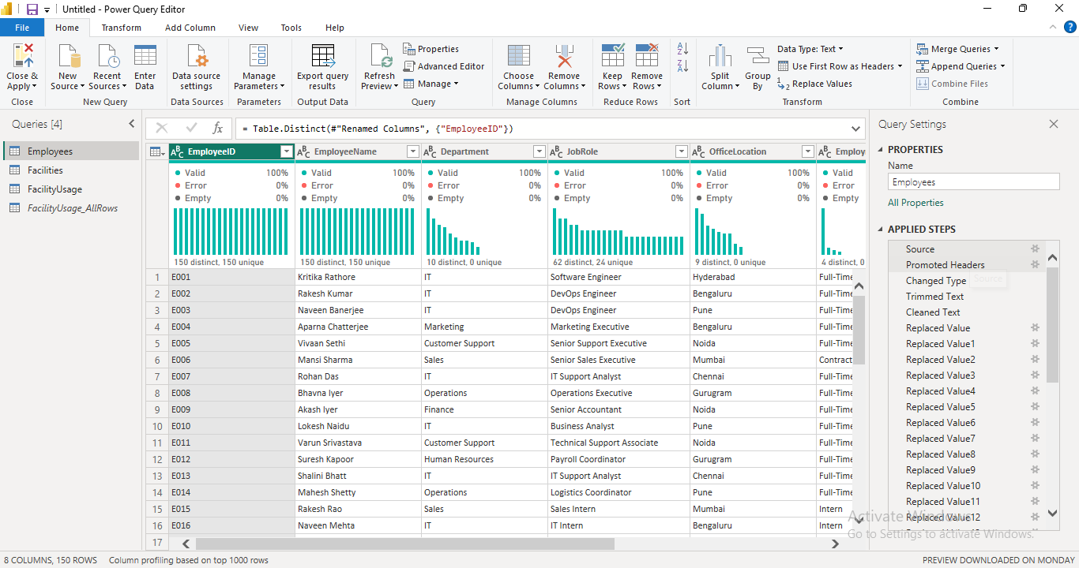
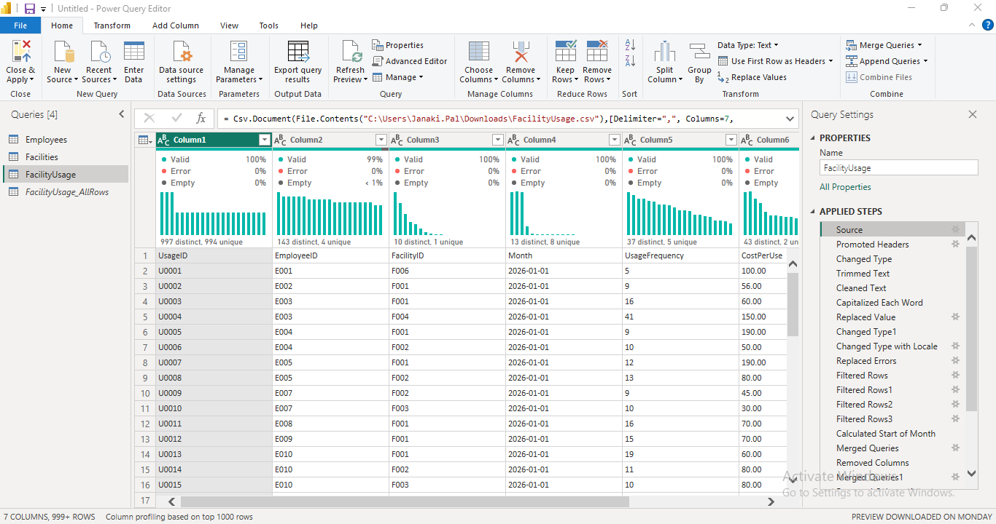
TRANSFORMATION EVIDENCE
Transformation evidence in Power Query
Employees: headers promoted, text trimmed, categories mapped with lookup tables, duplicate EmployeeID rows removed (152 → 150).
FacilityUsage: trim, clean, capitalise, replace values, convert dates with locale, filter invalid rows and calculate start of month.
Company | Facilities Utilization & Cost Analysis
6

Slide 7
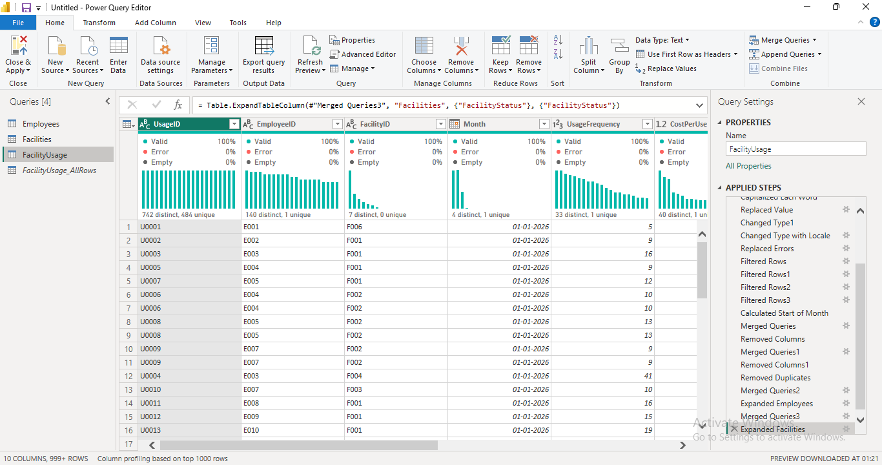
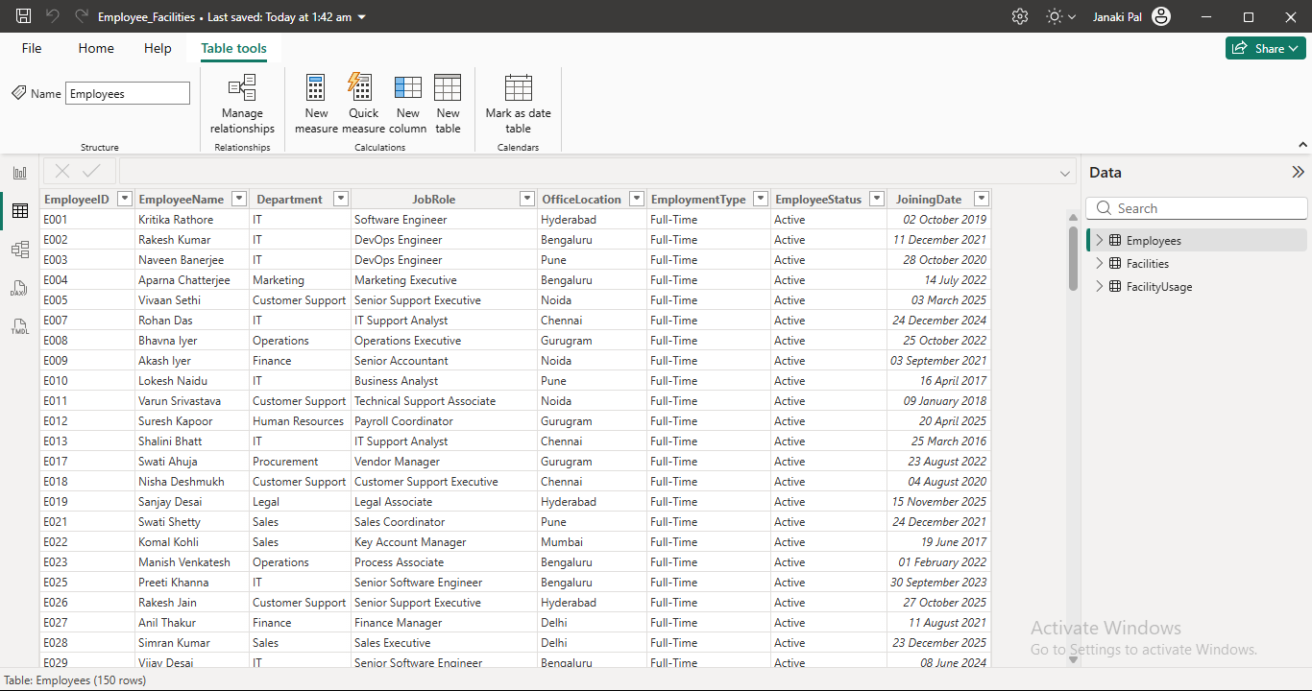
TRANSFORMATION EVIDENCE
From raw data to an analysis-ready dataset
FacilityUsage final steps: merge with Employees and Facilities, remove duplicates and expand the status columns used for ReviewFlag.
Employees table in the model: 150 unique employees with consistent department, type, status and location values.
Company | Facilities Utilization & Cost Analysis
7

Slide 8
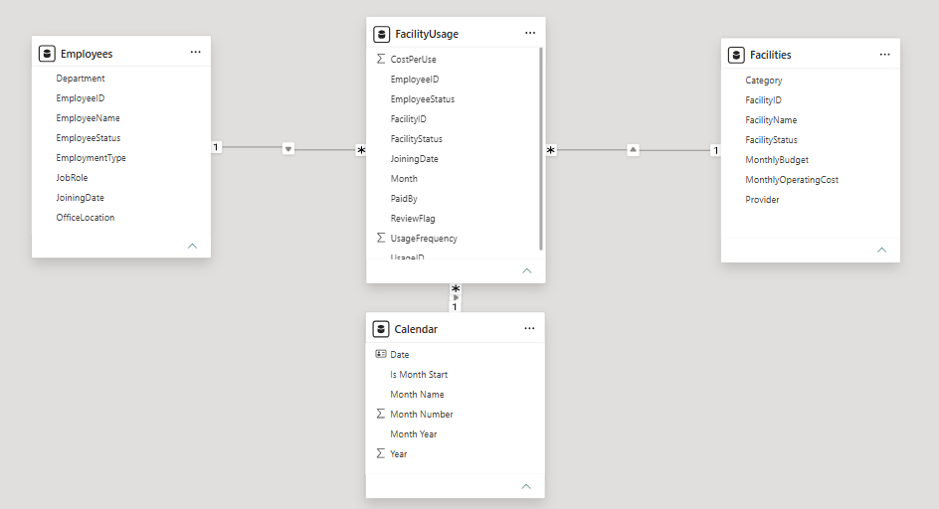
DATA ARCHITECTURE
Data model & relationships
Star schema
FacilityUsage sits at the centre
Employees → FacilityUsage on EmployeeID
Facilities → FacilityUsage on FacilityID
Calendar → FacilityUsage on Month
All one-to-many, single direction
Limitation
Operating cost and budget belong to the facility, so Department and Location slicers do not filter them
Usage Cost = UsageFrequency × CostPerUse, calculated in DAX.
Company | Facilities Utilization & Cost Analysis
8

Slide 9
POWER BI REPORT STRUCTURE
Dashboard: four pages, one visual language
Overview
Utilization
1
2
Cards, cost by month, uses by facility, who pays
Department × facility matrix, top 10 employees
Cost & Budget
Data Review
3
4
Spend vs budget by facility, status colours, months over
Flagged records and a note on rejected rows
Blue: company-paid
Orange: employee-paid
Green, amber, red: budget status
16:9 pages, a page navigator in the header, and synced Month and Facility slicers.
Company | Facilities Utilization & Cost Analysis
9

Slide 10
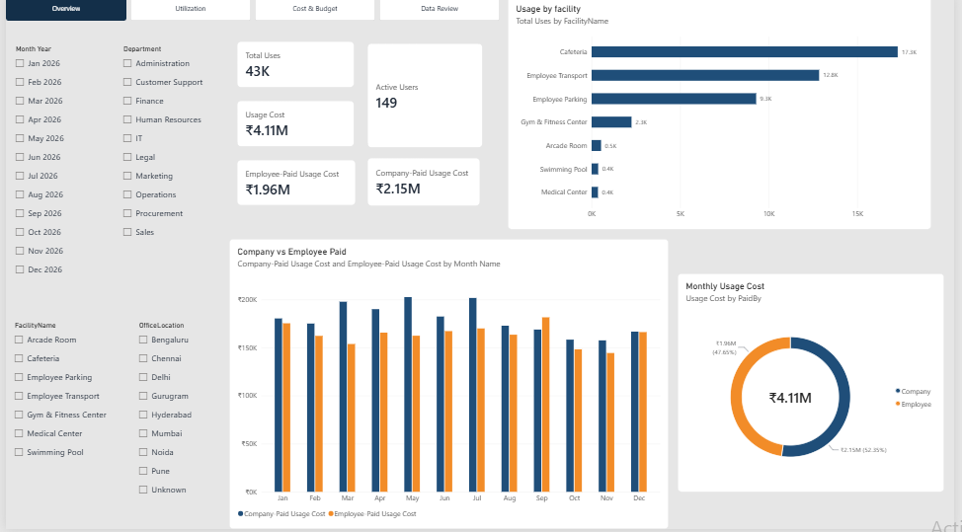
POWER BI REPORT
Page 1: Overview
What this page shows
Total uses 43K, usage cost ₹4.11M, 149 active users
Company pays 52%, employees 48%
Cafeteria and transport lead usage
Slicers: month, department, facility, location
Company | Facilities Utilization & Cost Analysis
10

Slide 11
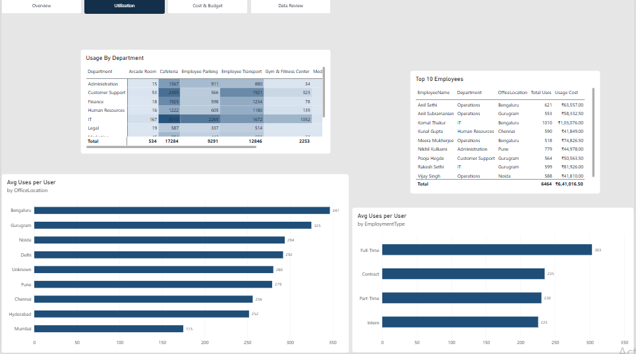
POWER BI REPORT
Page 2: Utilization
What this page shows
Department × facility usage matrix
Top 10 employees by uses and cost
Bengaluru and Gurugram have the highest average use per user
Full-time staff use facilities most
Company | Facilities Utilization & Cost Analysis
11

Slide 12
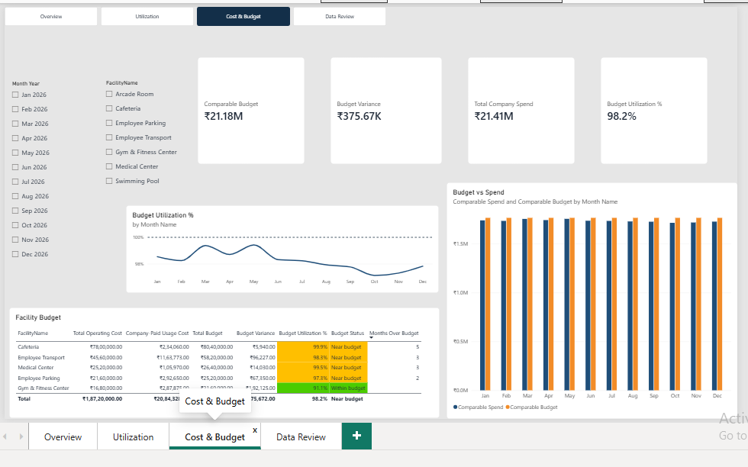
POWER BI REPORT
Page 3: Cost & Budget
What this page shows
Budget utilization 98.2%, variance ₹375.67K
Cafeteria is over budget in 5 months
Status colours: green, amber, red
Arcade and Pool excluded: data missing
Company | Facilities Utilization & Cost Analysis
12

Slide 13
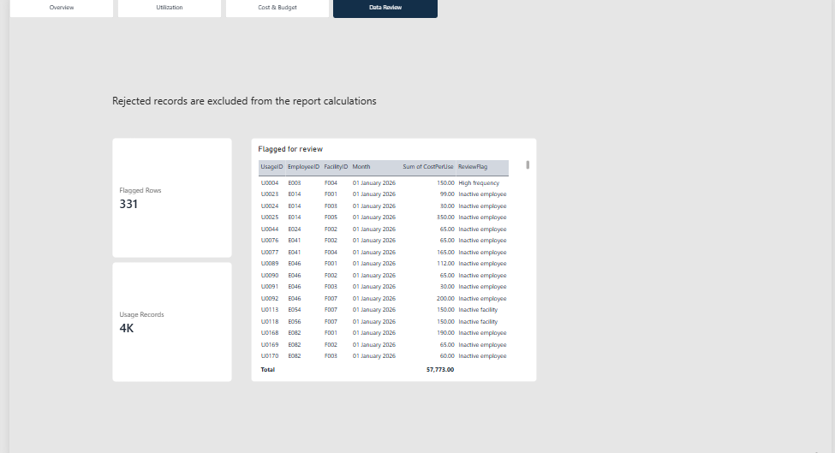
POWER BI REPORT
Page 4: Data Review
What this page shows
Flagged rows listed with their ReviewFlag
Reasons: high frequency, inactive employee, inactive facility
Rejected records are excluded from report calculations
Company | Facilities Utilization & Cost Analysis
13

Slide 14
IMPACT & DELIVERABLES
Findings and next steps
What the data shows
Next steps
Cafeteria and transport account for about 70% of facility use.
Spending sits at 91–100% of budget; the cafeteria was over budget in 5 months.
Company and employees split usage cost about 52 / 48.
Employee E125 has 1,010 uses against an average of 288.
Confirm the pool operating cost and arcade budget.
Review cafeteria budget headroom.
Check usage by inactive staff and the inactive pool.
Review employee E125's usage.
Company | Facilities Utilization & Cost Analysis
14

