Slide 1
An Investigative Analysis of the Association Between Serum Alkaline Phosphatase Levels, Osteoporosis, Periodontitis, and Tooth Loss
Janaki Ramya Namburu

Slide 2
Introduction
Data Description
Objectives
Data Preprocessing
Data Visualization
Conclusion
References
Table
of
Contents

Slide 3
Introduction
Serum Alkaline Phosphatase (ALP) levels, Osteoporosis, Periodontitis, and Tooth Loss: pivotal factors in skeletal and oral health.
Serum Alkaline phosphate can be considered as the initial maker to test BMD and correlate Osteoporosis
The normal range of Serum (ALP) = 44 to 147 international units per liter (IU/L) or 0.73 to 2.45 microkatal per liter (µkat/L).
Activity of serum total ALP >129 U/L is used as an indicator for osteoporosis

Slide 4
The most common bone mineral density test is a central dual-energy x-ray absorptiometry (DXA or DEXA).
DXA is the most widely used technique and the gold standard for osteoporosis diagnosis and management.
Increased ALP can also be correlated to the septal bone loss in the tooth sockets, which in the clinical examination represents as a disease called “periodontitis” that leads to a chronic stage with loss of tooth also.

Slide 5
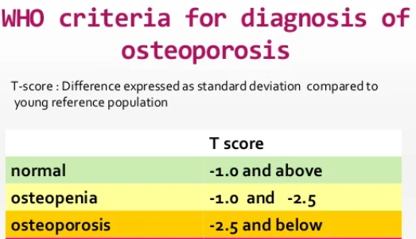
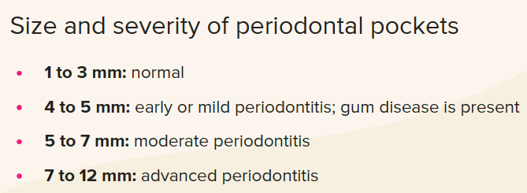

Slide 6
Data description
Data was collected from the NHANES 2013-14 data.
Source: National Health and Nutritional Examination Survey from Centres for Disease Control and Prevention
Variables:
Demographic data- Age, Gender
Examination data-
- Dual-Energy X-ray Absorptiometry - Whole Body: Bone Mineral Density
- Oral Health – Dentition: Missing teeth
- Oral Health – Periodontal: Pocket Depth of Mandibular first molar
c) Laboratory data- Serum Alkaline phosphatase
NHANES Questionnaires, Datasets, and Related Documentation (cdc.gov)

Slide 7
Objectives
Examine the relationship between serum Alkaline Phosphatase (ALP) levels and Bone Mineral Density (BMD) in correlation with age.
Explore the correlation between Missing teeth, Pocket depth, and Age.
Analyze the relation between number of missing teeth and gender.
Analyze the distribution of BMD across various Periodontitis categories.
Determine the prevalence of Periodontitis status among genders (males and females) to assess gender differences in Periodontitis susceptibility.

Slide 8
DATA PREPROCESSING

Slide 9
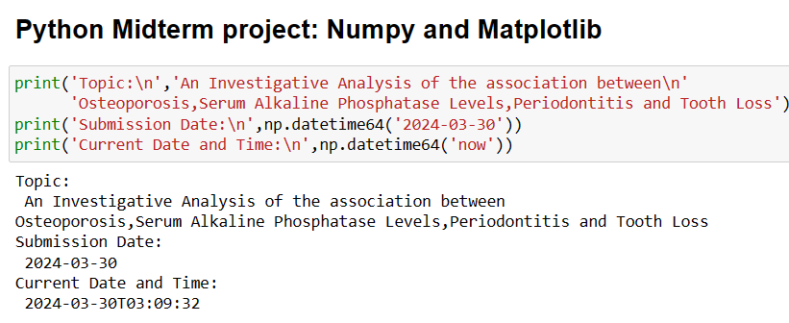

Slide 10
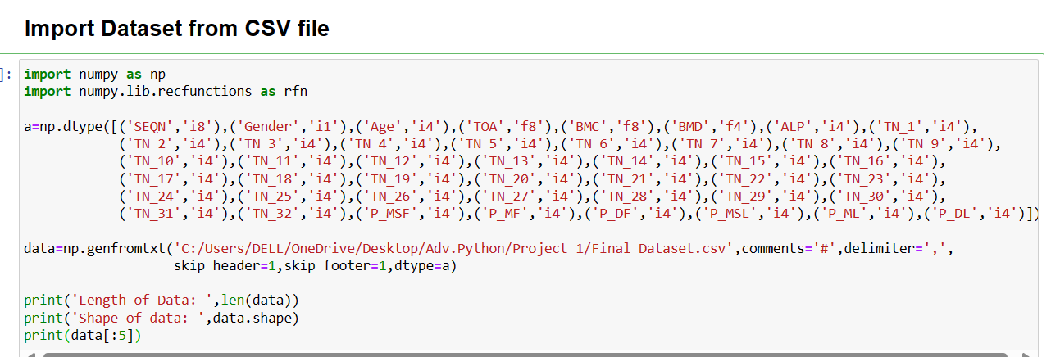
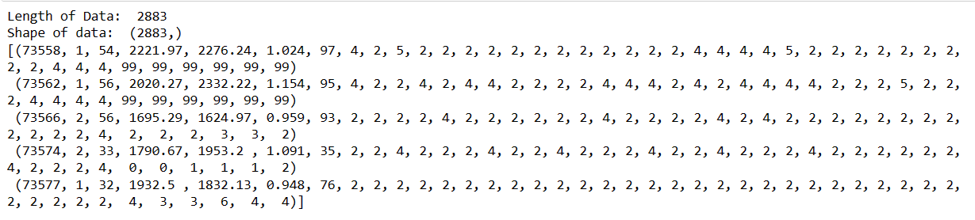

Slide 11
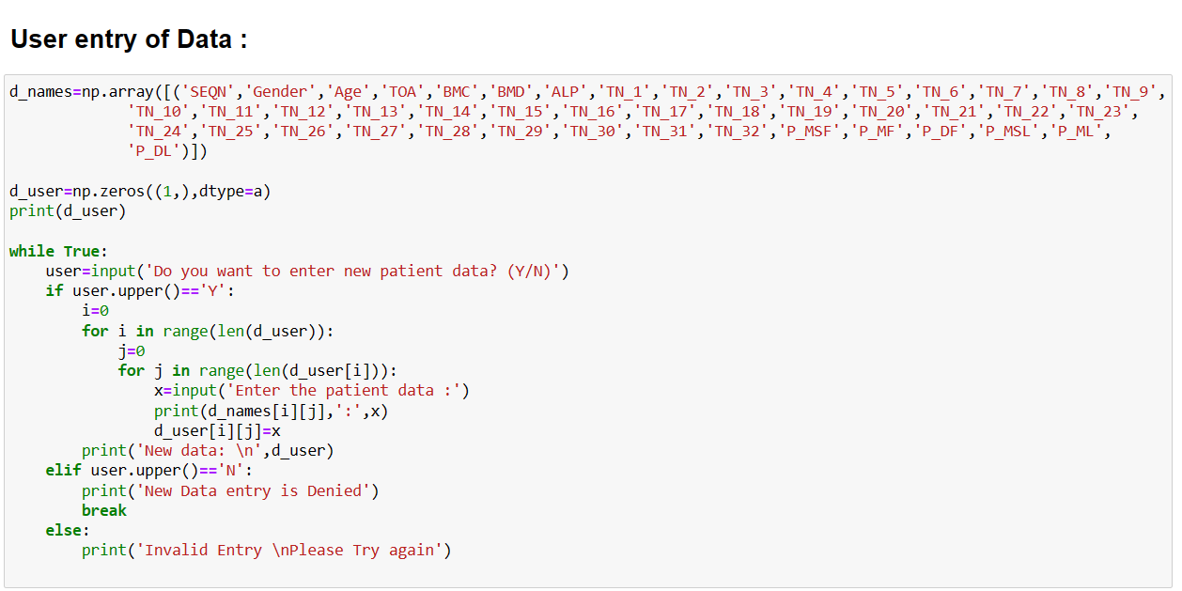

Slide 12
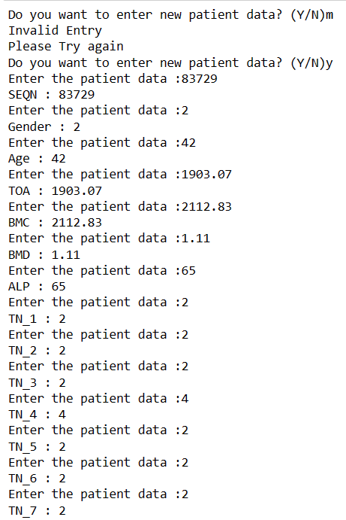
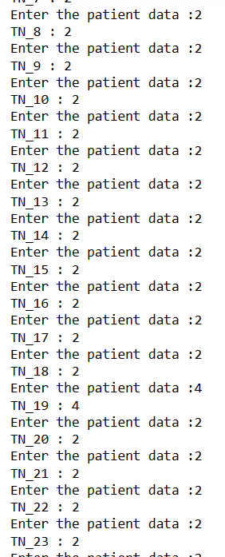
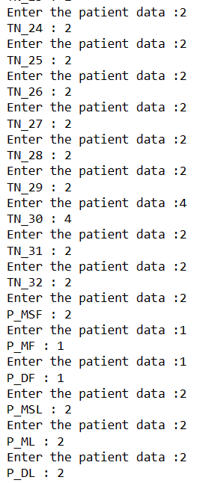
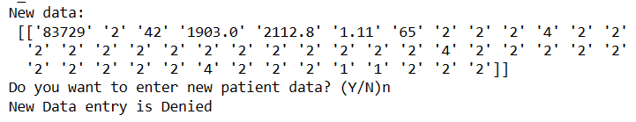

Slide 13
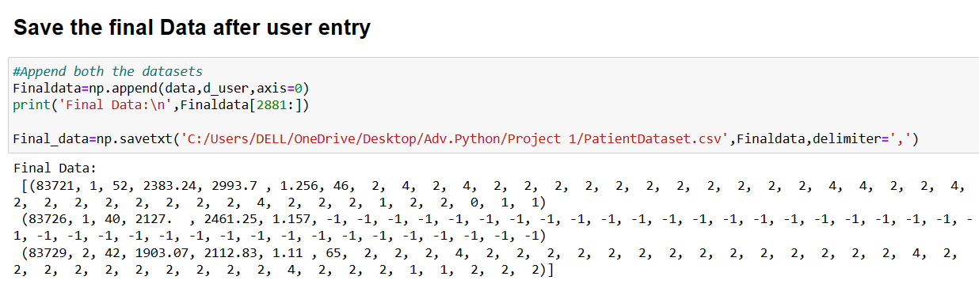

Slide 14
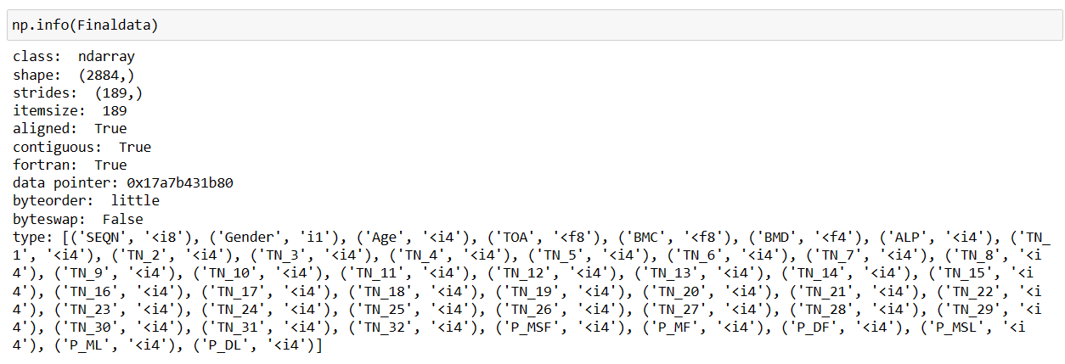
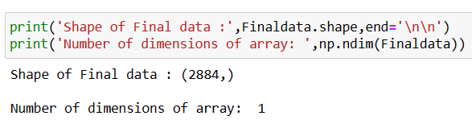
Description of Final data after user entry

Slide 15
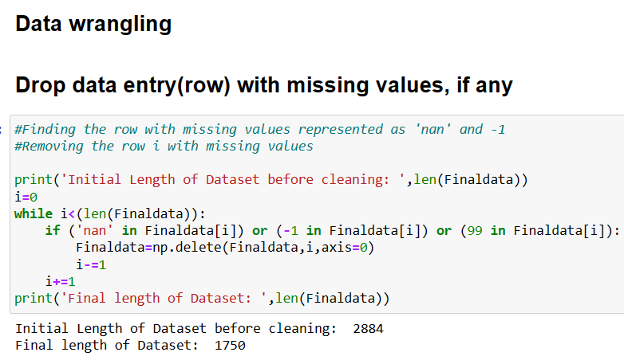
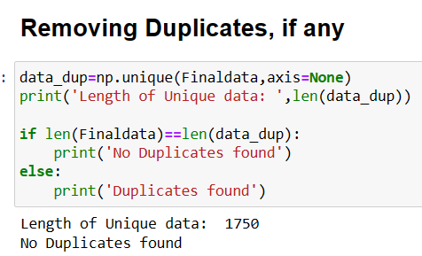
Data Cleaning

Slide 16
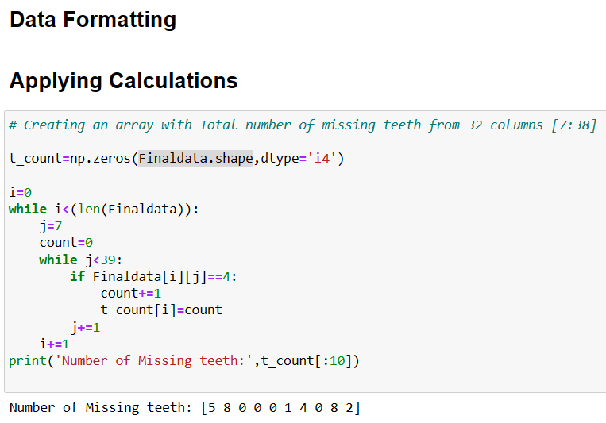

Slide 17
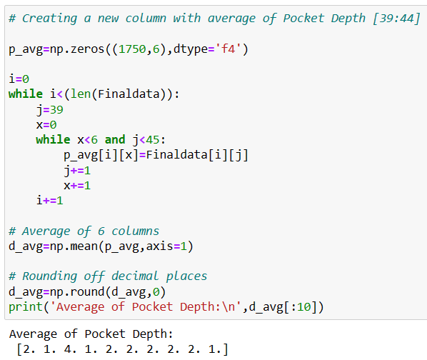
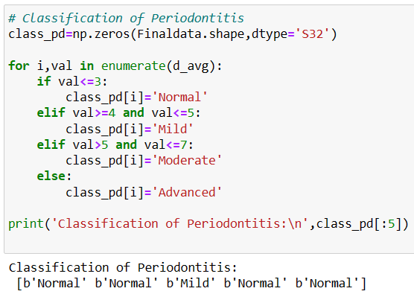

Slide 18
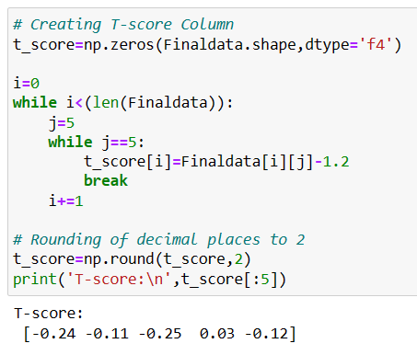
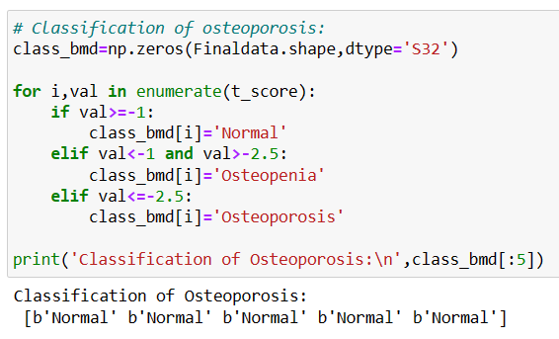
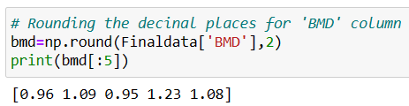

Slide 19
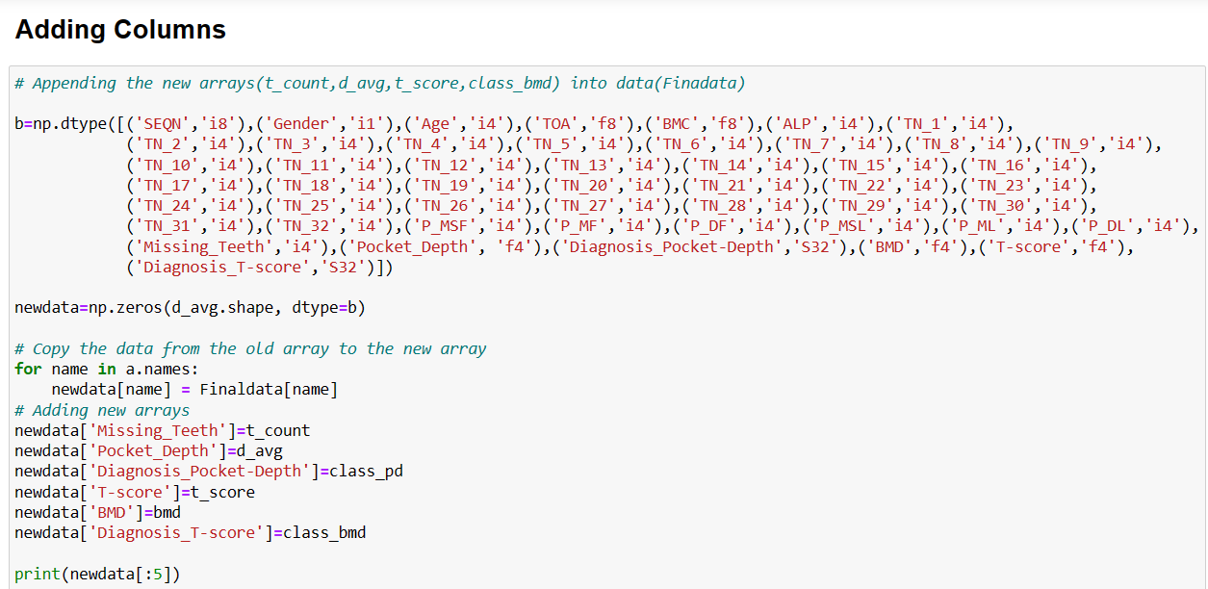

Slide 20
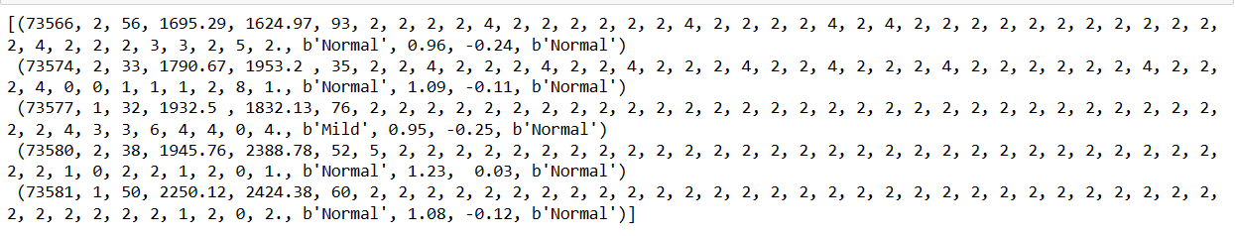
Data after appending columns:

Slide 21
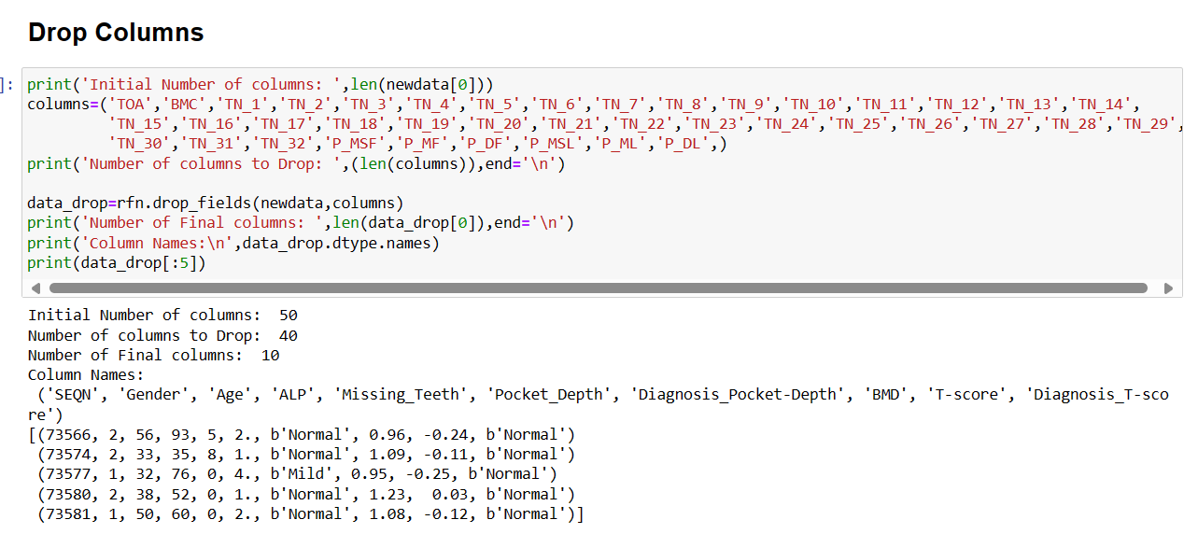

Slide 22
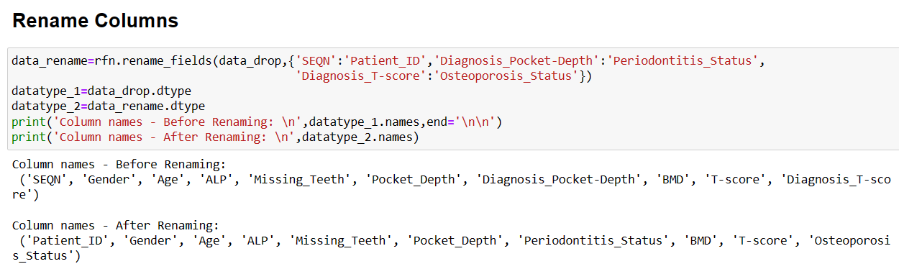

Slide 23
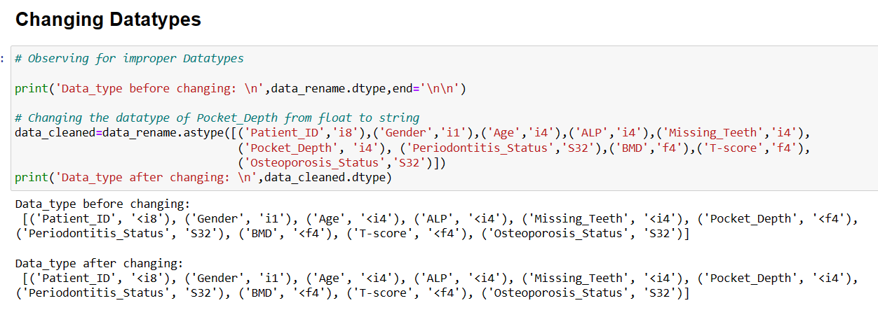

Slide 24
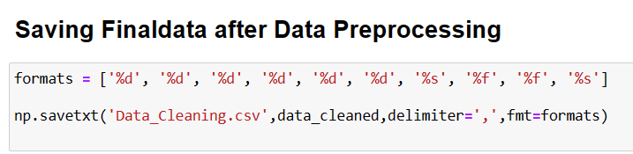
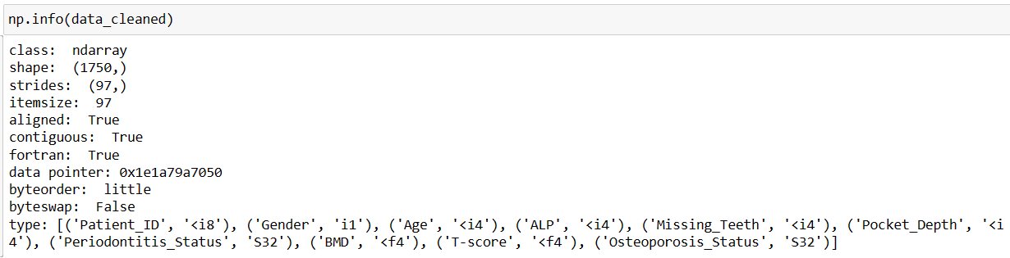
Description of Data after Preprocessing:

Slide 25
FINAL REPORT

Slide 26
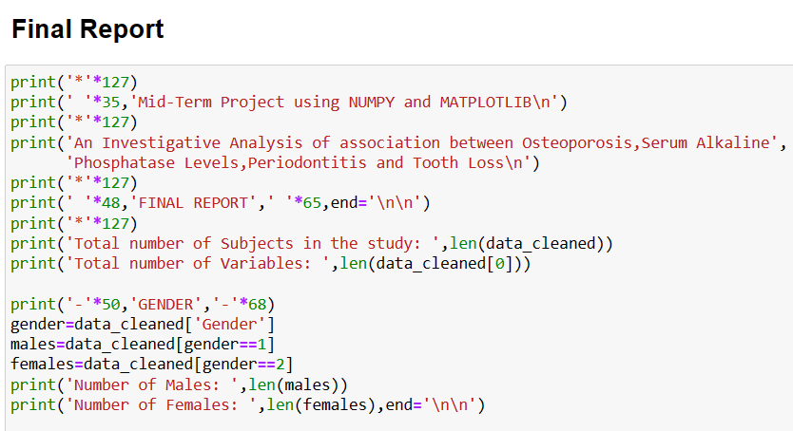
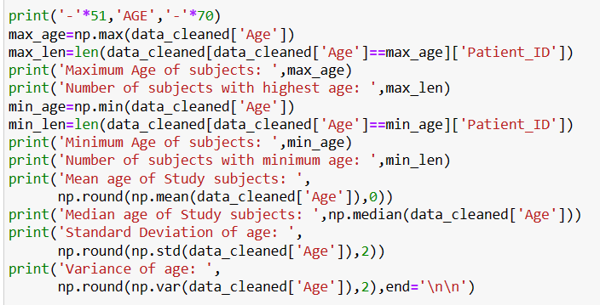

Slide 27
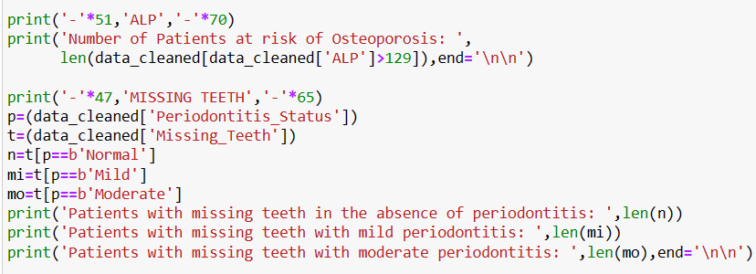
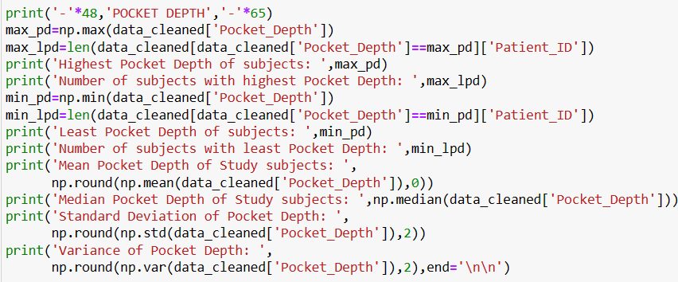
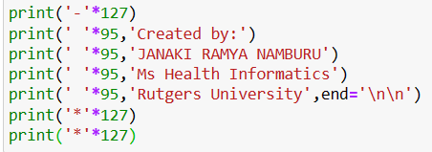

Slide 28
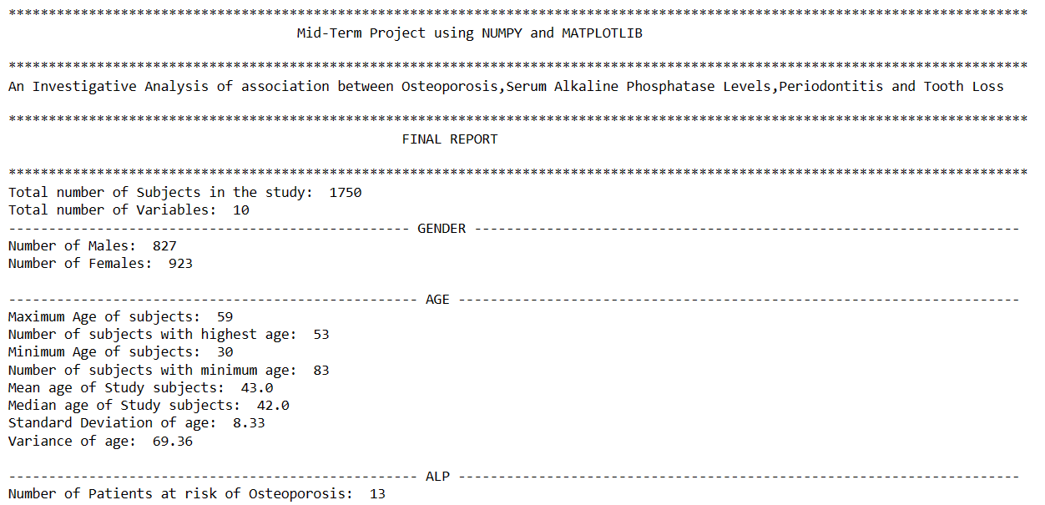

Slide 29
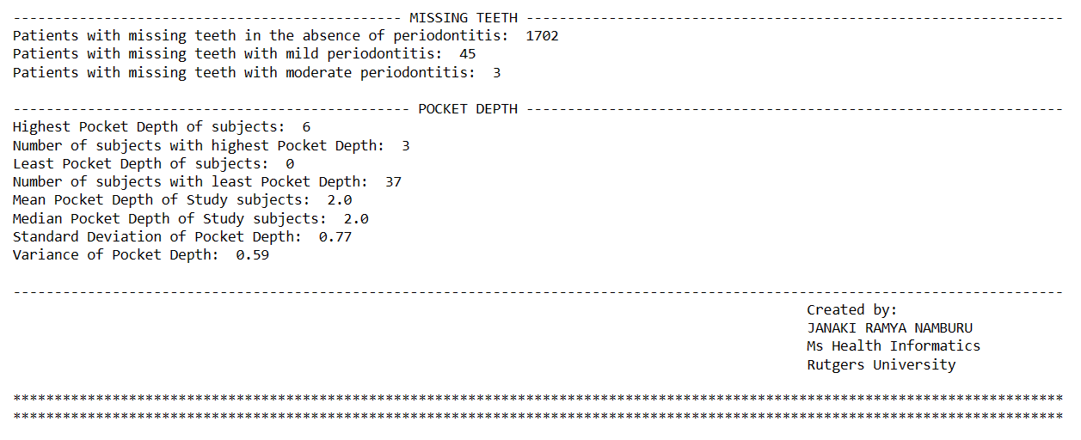

Slide 30
Data Visualization

Slide 31
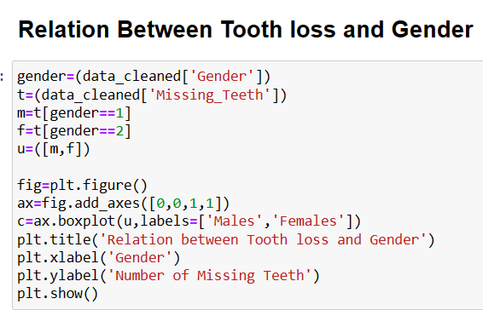

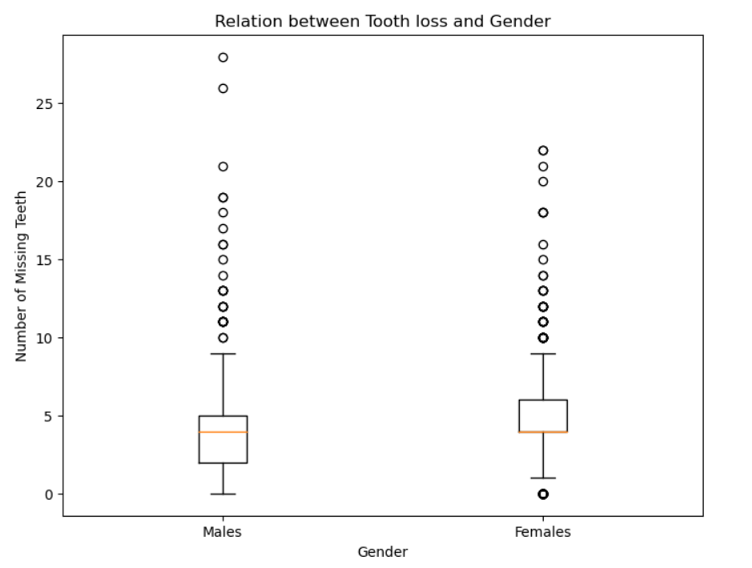
The median, representing the average number of teeth lost, is observed to be around 4 for both males and females. This suggests that, on average, males and females experience a similar degree of tooth loss. However, the extent of outliers appears to be more pronounced in males compared to females, indicating greater variability within the male group.

Slide 32
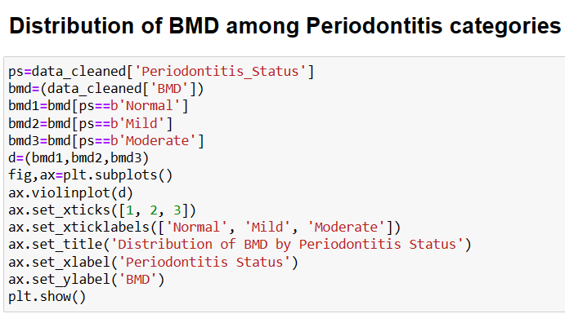
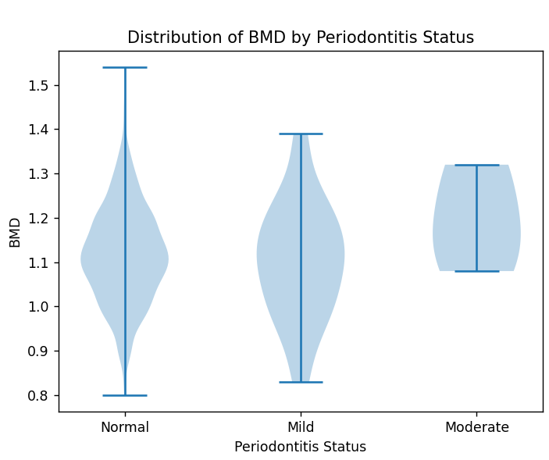
The violin plot shows the distribution of BMD across groups of periodontitis. In the ‘Normal' group, the majority of subjects exhibit a BMD of around 1.1 g/cm². In ‘Mild' periodontitis, the distribution is broader with peaks observed in the range of 1.0 to 1.3 g/cm². In the ‘Moderate' periodontitis group, the predominant BMD values are clustered around 1.1 to 1.3 g/cm². These observations provide insights into how BMD varies across different levels of periodontitis severity.

Slide 33
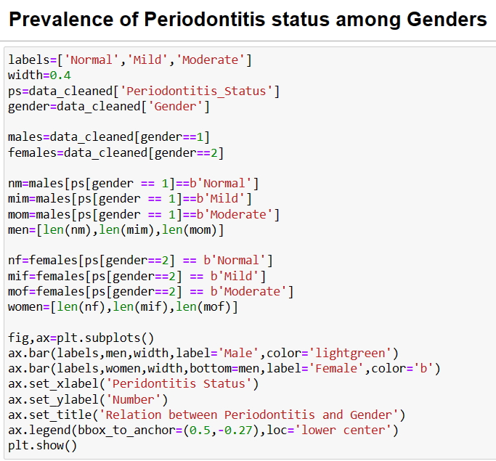
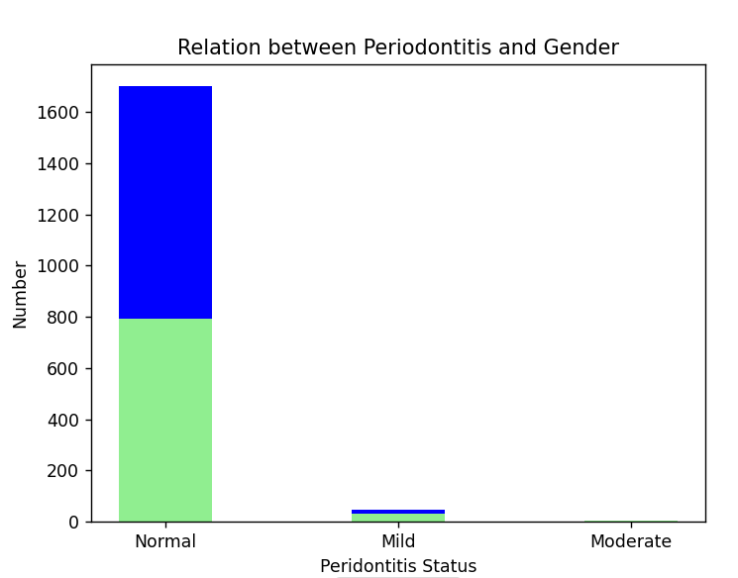

Slide 34
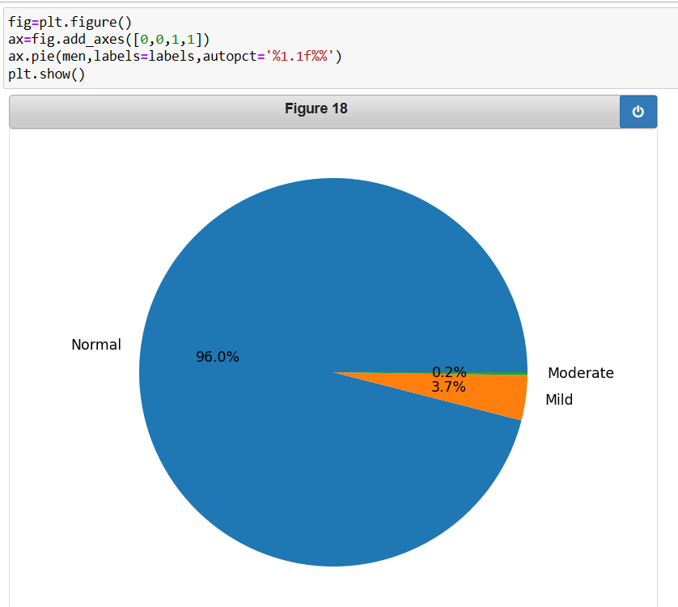
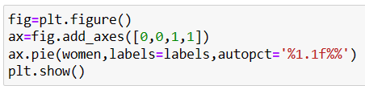
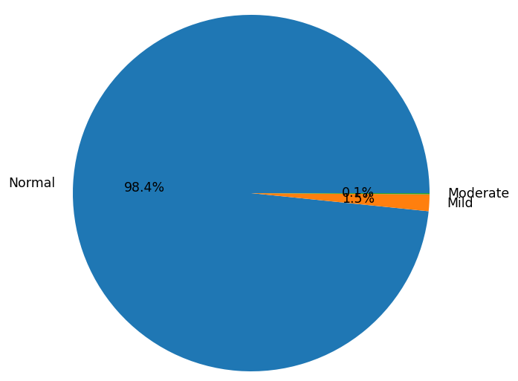
No significant difference is observed in distribution of categories of periodontitis with
regards to age

Slide 35
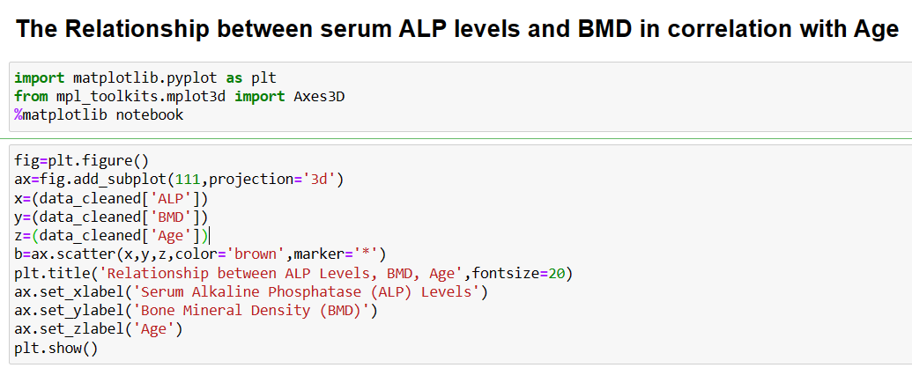
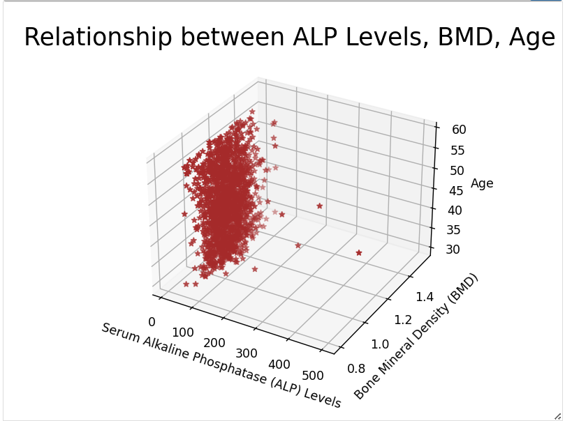
Because of the presence of outliers and large
Sample size, data distribution is concentrated towards one point.
Hence, slicing is done with the first 100 data and plotted again.

Slide 36
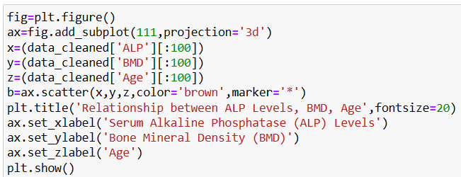
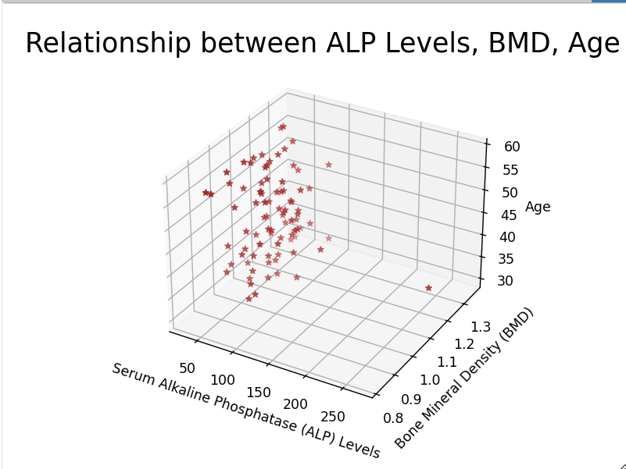
No significant correlation can be observed between serum alkaline phosphatase and BMD in the presence of age

Slide 37
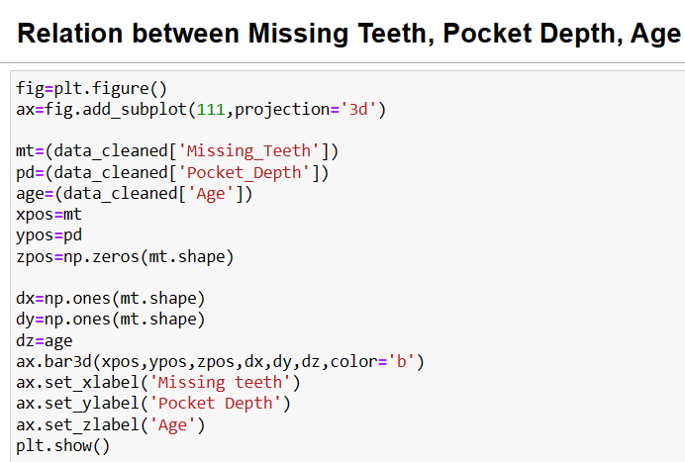
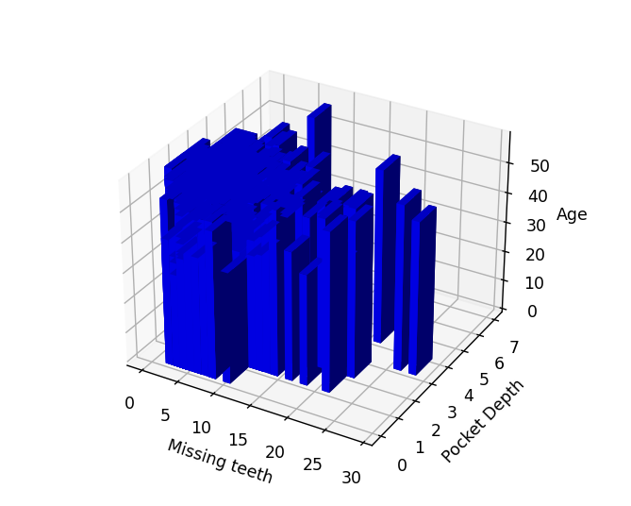
Because of the presence of outliers and large sample size, data distribution is concentrated towards one point.
Hence, slicing is done with the first 10 data and plotted again.

Slide 38



Slide 39
Conclusion
Tooth Loss: The median number of teeth lost is approximately 4 for both males and females, indicating a similar average degree of tooth loss between genders. However, the presence of more pronounced outliers in males suggests greater variability in tooth loss within the male group.
Bone Mineral Density (BMD): The violin plot illustrates BMD distribution across different periodontitis severity groups. In the 'Normal' group, BMD centers around 1.1 g/cm², while 'Mild' and 'Moderate' periodontitis groups exhibit broader distributions with peaks ranging from 1.0 to 1.3 g/cm². These findings highlight variations in BMD across different levels of periodontitis severity.
Age and Periodontitis: No significant difference is observed in the distribution of periodontitis categories concerning age, suggesting that age may not be a significant factor in determining periodontitis severity.
Serum Alkaline Phosphatase and BMD: Despite variations in serum alkaline phosphatase levels, no significant correlation is observed between serum alkaline phosphatase and BMD when considering age, indicating that other factors may influence BMD levels independently of serum alkaline phosphatase.

Slide 40
references
Shevroja, E., Cafarelli, F. P., Guglielmi, G., & Hans, D. (2021). DXA parameters, Trabecular Bone Score (TBS) and Bone Mineral Density (BMD), in fracture risk prediction in endocrine-mediated secondary osteoporosis. Endocrine, 74(1), 20–28. https://doi.org/10.1007/s12020-021-02806-x
Peng, J., Chen, J., Liu, Y., Lyu, J., & Zhang, B. (2023). Association between periodontitis and osteoporosis in United States adults from the National Health and Nutrition Examination Survey: a cross-sectional analysis. BMC Oral Health, 23(1), 254.
Haseltine, K. N., Chukir, T., Smith, P. J., Jacob, J. T., Bilezikian, J. P., & Farooki, A. (2021). Bone Mineral Density: Clinical Relevance and Quantitative Assessment. Journal of nuclear medicine : official publication, Society of Nuclear Medicine, 62(4), 446–454. https://doi.org/10.2967/jnumed.120.256180

