Slide 1

Enhancing Clinical Analysis through NLP Integration
By
Janaki Ramya Namburu

Slide 2
Table of Contents
Introduction
Objectives
Methodology
Results
Discussion
Conclusion
References

Slide 3
Introduction:
A large amount of valuable data is available in the medical domain such as diagnosis records, discharge summaries, online health discussions and medical publications.
With the rapid growth of information technology, the necessity for processing health data using advanced information technologies is increasing.
Despite the significant progress made in finding new treatments and prevention strategies for some of the chronic diseases like cancer, diabetes, and hypertension, the incidence of these diseases is still increasing.
One promising novel approach would be the utilization of medical health records to analyze patient data, conduct medical research, and improve clinical decision-making.

Slide 4
NLP is the widely used analytical technique in the healthcare industry, particularly for "big data" analysis.
Natural language processing (NLP) is “Any computer-based algorithm that handles, augments, and transforms natural language so that it can be represented for computation.”
Although the medical language is often ambiguous and complex, NLP has been successfully applied in healthcare for different purposes-
Recognizing risk factors of medical conditions,
Evaluating the efficiency of care and costs,
Extracting insights from the unstructured text of medical records.
Koleck, T. A., Dreisbach, C., Bourne, P. E., & Bakken, S. (2019). Natural language processing of symptoms documented in free-text narratives of electronic health records: a systematic review. Journal of the American Medical Informatics Association, 26(4), 364-379. https://doi.org/10.1093/jamia/ocy173

Slide 5
In the health and medical domain, NLP techniques have been shown to be useful in dealing with information overload with
Aggregation and summarization of patient notes
Treatment analysis
Information extraction from massive discharge summaries
Semantic understanding of patient queries.
NLP may also be applied to assist medical decision-making by automatically analyzing the commonalities and differences of a large amount of text data and recommending appropriate actions on behalf of domain experts
Hao, T., Huang, Z., Liang, L., Weng, H., & Tang, B. (2021). Health Natural Language Processing: Methodology Development and Applications. JMIR medical informatics, 9(10), e23898. https://doi.org/10.2196/23898

Slide 6
Smoking is the leading preventable cause of death.
In the United States, almost 500,000 deaths each year are caused by smoking.
Effective preventive strategies depend on the identification of tobacco-dependent individuals.
It is the responsibility of healthcare professionals to help patients quit smoking, as it is a crucial aspect of treating many diseases such as lung cancer and coronary heart disease.
Rajendran, S., & Topaloglu, U. (2020). Extracting Smoking Status from Electronic Health Records Using NLP and Deep Learning. AMIA Joint Summits on Translational Science proceedings. AMIA Joint Summits on Translational Science, 2020, 507–516.

Slide 7
Alkaline phosphatase plays a crucial role in the process of bone formation and mineralization.
Elevated levels of ALP in the blood indicate increased bone turnover, which can be a sign of various bone disorders such as osteoporosis, Paget's disease, or bone metastases.
By checking the association between alkaline phosphatase (ALP) and bone, we can:
Assess Bone Health
Diagnose Bone Disorders
Monitor Treatment Response
Guide Clinical Decision-Making
Chen, H., Li, J., & Wang, Q. (2018). Associations between bone-alkaline phosphatase and bone mineral density in adults with and without diabetes. Medicine, 97(17), e0432. DOI: 10.1097/MD.0000000000010432

Slide 8
Objectives:
To utilize a Naïve Bayes (NB) classifier trained on different n-gram models(unigram, bigram, and trigram) to ascertain smoking status in discharge summaries, followed by an evaluation of the system's performance.
To develop and evaluate a Spacy-based system for automatically extracting instances of alkaline phosphatase (ALP) and bone from medical text and analyzing the association between them using information retrieval and relation extraction techniques.

Slide 9
Methodology:
Dataset:
Source: “n2c2 NLP Research Data Sets of Unstructured notes from the Research Patient Data Registry at Partners Healthcare” from the DBMI data portal of Harvard Medical School.
Content: 398 observations/ discharge summaries with patient ID, smoking status, and free text of discharge summary.
Patients are classified based on smoking status into 5 categories: smoker, current smoker, past smoker, nonsmoker, and unknown
n2c2 NLP Research Data Sets. (n.d.). Portal.dbmi.hms.harvard.edu. https://portal.dbmi.hms.harvard.edu/projects/n2c2-nlp/

Slide 10
Text preprocessing steps like removal of null values, duplicates, punctuations, special characters, stop words, lower casing of text, and lemmatization and POS tagging were done to improve the outcome.
Performing stemming on the processed texts was avoided since it might change the meaning of words.
The dataset was split for the training and testing phase (0.80, 0.20).
For Text classification, A Naïve Bayes classifier was used which is trained on features extracted from unigrams, bigrams, and trigrams.

Slide 11
For Named Entity Recognition (NER) and relation extraction between alkaline phosphatase (ALP) and bone, a Spacy-based system was devised.
The system utilized the PhraseMatcher for information retrieval of ALP and bone mentions in the medical text and DependencyMatcher for relation extraction.
Furthermore, a rule-based function was applied to each text to verify the existence of a relation between ALP and bone, serving as a complementary method to the automated extraction process.
Additionally, another rule-based function was implemented to extract the values of ALP mentioned in the context, providing quantitative information for further analysis.
Lastly, context windows surrounding occurrences of ALP and bone were extracted.

Slide 12
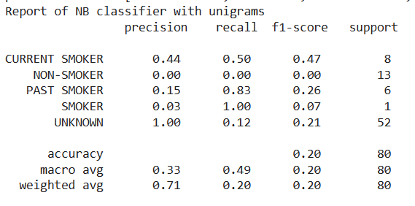
Results:
TEXT CLASSIFICATION
Unigram-based Classifier:
This classifier yielded an overall accuracy of 20%.
Despite its relatively low accuracy, it demonstrated notable recall for the "Past Smoker" category (83%).
However, precision and recall for other categories, such as "Current Smoker" and "Unknown," were suboptimal, suggesting challenges in accurately identifying these groups based on individual words.
However, the low recall indicates that many instances of "Unknown" smoking status were missed by the classifier.

Slide 13
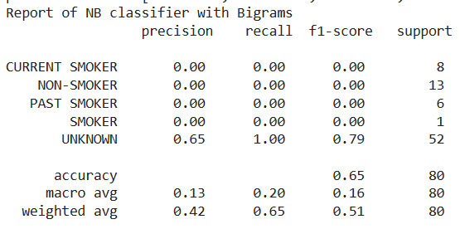
Bigram-based Classifier
The bigram-based classifier achieved an accuracy of 65%, representing a notable improvement compared to the unigram-based approach.
The precision and recall for the "Unknown" category notably improved, indicating better performance in identifying this group.
The bigram-based classifier failed to correctly classify any instances for the categories Current Smoker, Non-Smoker, Past Smoker, Smoker resulting in zero precision and recall for each.

Slide 14
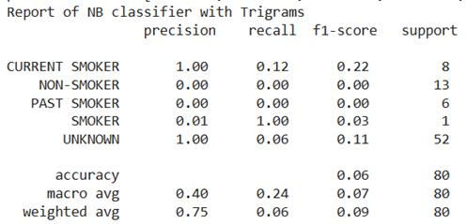
Trigram-based Classifier
The trigram-based classifier demonstrated the lowest accuracy among the three approaches, with an accuracy of 6%. While the precision for the “Unknown” and “Current smoker” categories was perfect, the overall performance was severely limited

Slide 15
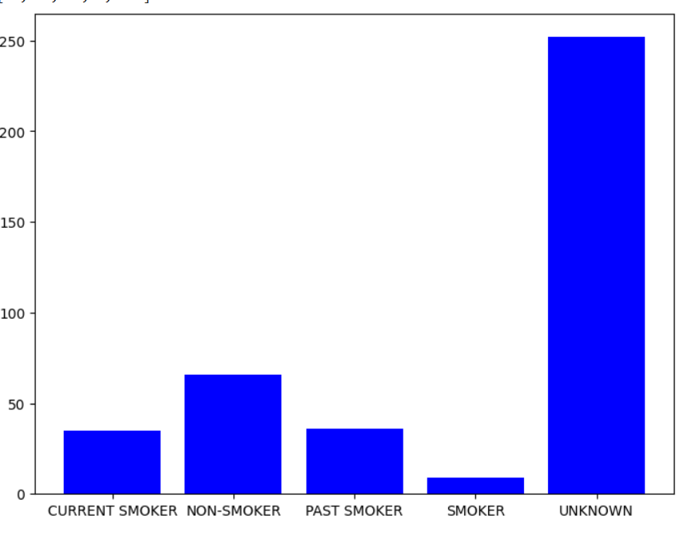
A notable disparity in the distribution of smoking labels, with the "unknown" category substantially outnumbering other labels can be seen. This skewed distribution suggests a prevalence of missing or unclassified smoking statuses within the dataset, likely influencing the text classification model's performance and contributing to the observed lower precision scores.

Slide 16
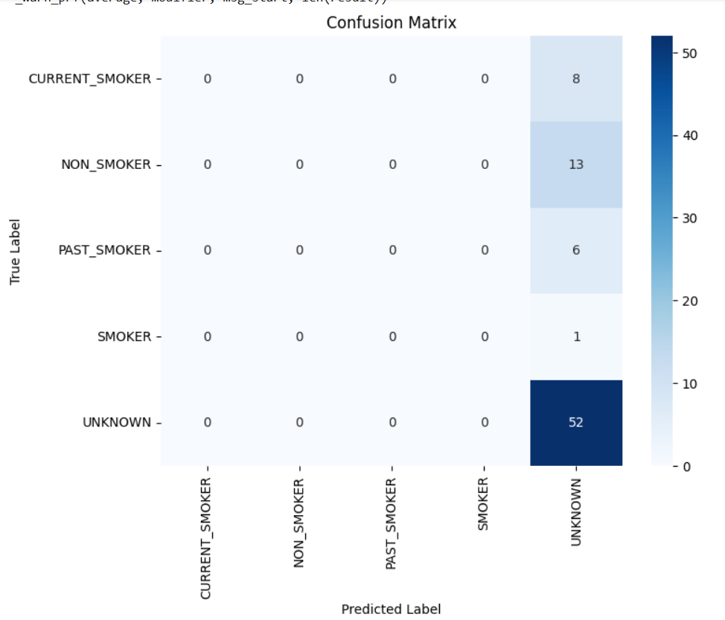
The predominance of "unknown" predictions in the confusion matrix indicates the model's difficulty in confidently classifying instances into specific smoking categories, possibly due to imbalanced data and the complexity of language in medical records.

Slide 17
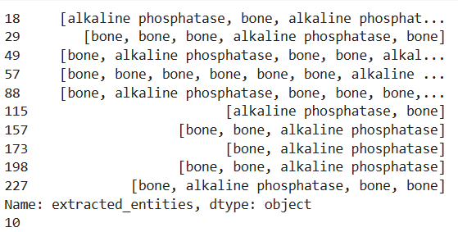
NAMED ENTITY RECOGNITION AND RELATION EXTRACTION
The NER process successfully extracted entities of alkaline phosphatase and bone from the medical text data without encountering significant challenges.

Slide 18
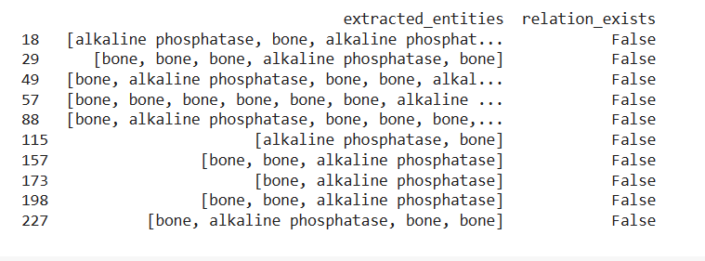
The system faced difficulties in identifying relations between "alkaline phosphatase" and "bone" mentions, with all extracted relations being false.
This might be due to the complexities in syntactic structures, contextual nuances, and variations in language usage across medical records.

Slide 19
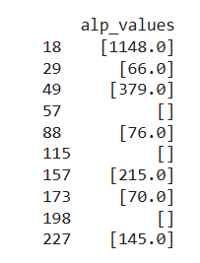
While attempting to extract ALP values, the system achieved a correct extraction rate of 70% (7 out of 10 instances).
The challenges in value extraction primarily stemmed from inconsistencies in formatting, variations in numerical representation, and the presence of noise or irrelevant text surrounding ALP mentions.

Slide 20
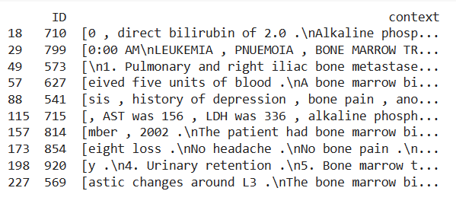
Context windows surrounding the occurrences of ALP and bone were extracted for comprehensive analysis.

Slide 21
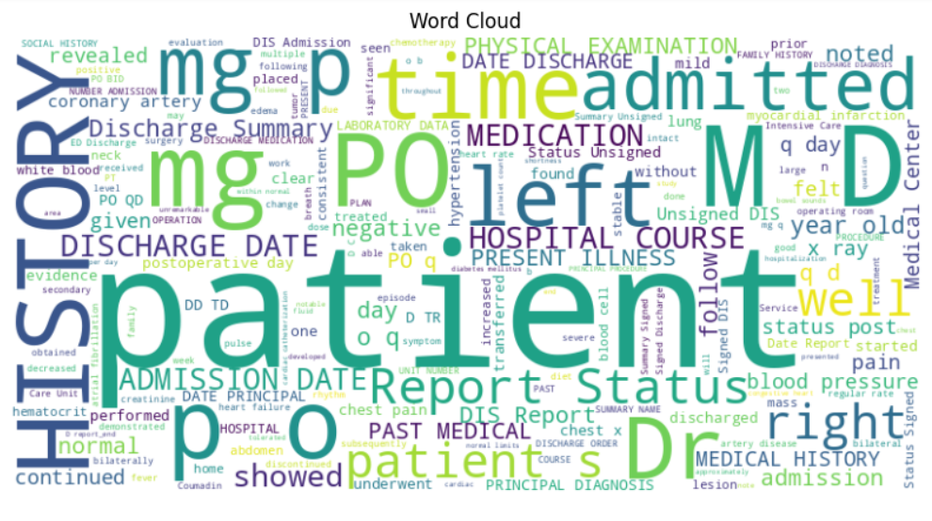
Each word's size in the cloud correlates with its occurrence frequency in the text, with larger words denoting higher frequencies.
Notably, we observe pivotal terms recurrent in medical records, such as “patient”, “history”, “mg”, “time”, “admitted”, “Discharge” and “Dr”.
This visualization makes it easy to spot the most important words in the dataset, facilitating a quick grasp of key themes and topics in the dataset.

Slide 22
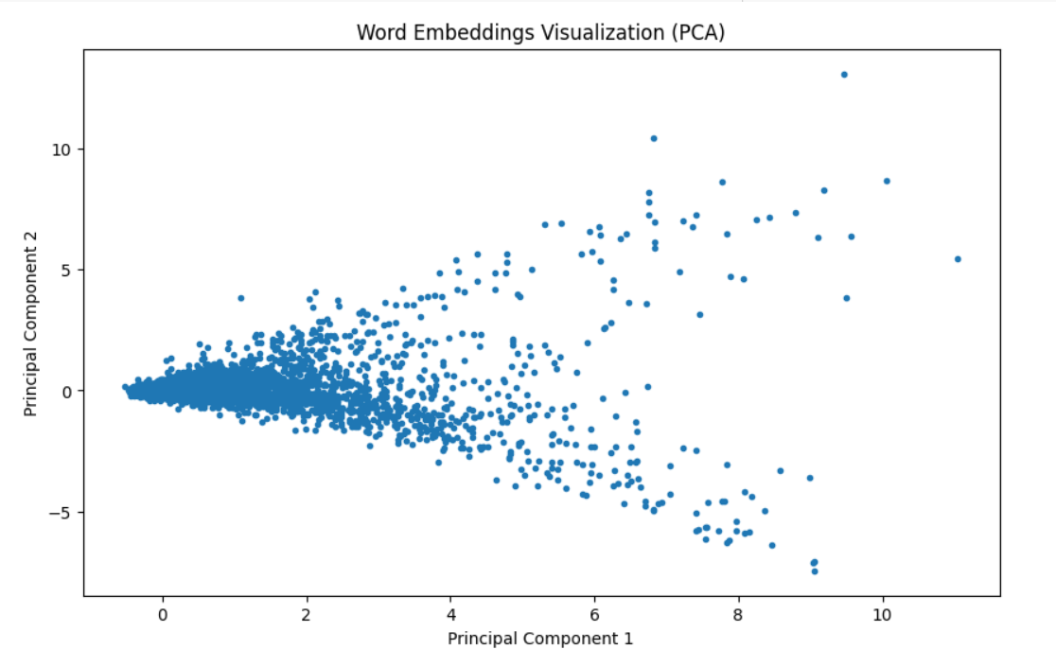
The spatial arrangement of words indicates their semantic relationships. The clustering of most data points suggests that a significant portion of words share similar meanings or contexts. However, there are a few outliers scattered across the plot, representing rare words or terms with unique semantic attributes. This distribution pattern underscores the richness and diversity of language use within the dataset, with common themes dominating while rare or specialized terms exist as exceptions.

Slide 23
Discussion:
By utilizing bigrams as features for the Naive Bayes classifier, we observed a significant increase in accuracy, achieving an overall accuracy rate of 65%.
This observation is consistent with the research of Carrero et al.,⁶, who similarly identified bigrams and trigrams as the most effective features for classification, outperforming unigrams.

Slide 24
Another study that supports our findings is by Wicentowski et al.,⁷, who found that a basic NB model trained on word bigrams performs comparably to expert human annotators, but less effectively when smoking cues are absent.
In the study done by Uzuner et al.,⁸ 12 systems were run with micro-averaged F-measures above 0.84 utilizing different classifiers.

Slide 25
Our study on Named Entity Recognition and relation extraction showed successes and challenges.
While we could effectively extract entities from medical text data, establishing relations between them was difficult due to the intricate nature of syntactic structures and contextual nuances in medical records.
Further refinement of relation extraction techniques is necessary to capture semantic associations between entities.
Our findings show the potential of NLP in clinical analysis and the ongoing need for methodological advancements in processing medical text data.

Slide 26
Conclusion:
This study underscores the potential of NLP in augmenting clinical analysis by extracting actionable insights from unstructured medical text data.
While advancements in smoking status classification demonstrate promising results, further research is warranted to address challenges in relation extraction, particularly regarding ALP and bone associations.
By leveraging NLP techniques, healthcare professionals can unlock new avenues for understanding patient data, conducting medical research, and ultimately improving clinical decision-making processes in the era of big data analytics.

Slide 27
References:
Koleck, T. A., Dreisbach, C., Bourne, P. E., & Bakken, S. (2019). Natural language processing of symptoms documented in
free-text narratives of electronic health records: a systematic review. Journal of the American Medical Informatics
association, 26(4), 364-379. https://doi.org/10.1093/jamia/ocy173
Sheikhalishahi, S., Miotto, R., Dudley, J. T., Lavelli, A.,Rinaldi, F., & Osmani, V. (2019). Natural language processing of clinical
notes on chronic diseases: systematic review. JMIR medical informatics, 7(2), e12239. https://doi.org/10.2196/12239
Hao, T., Huang, Z., Liang, L., Weng, H., & Tang, B. (2021). Health Natural Language Processing:
Methodology Development and Applications. JMIR medical informatics, 9(10), e23898. https://doi.org/10.2196/23898
Ong, K. C., Cheong, G. N., Prabhakaran, L., & Earnest, A. (2005). Predictors of success in smoking cessation
among hospitalized patients. Respirology, 10(1), 63-69. https://doi.org/10.1111/j.1440-1843.2005.00656.x
Rajendran, S., & Topaloglu, U. (2020). Extracting Smoking Status from Electronic Health Records Using
NLP and Deep Learning. AMIA Joint Summits on Translational Science proceedings. AMIA Joint Summits on Translational
Science, 2020, 507–516.
Chen, H., Li, J., & Wang, Q. (2018). Associations between bone-alkaline phosphatase and bone mineral density in
adults with and without diabetes. Medicine, 97(17), e0432. DOI: 10.1097/MD.0000000000010432
n2c2 NLP Research Data Sets. (n.d.). Portal.dbmi.hms.harvard.edu. https://portal.dbmi.hms.harvard.edu/projects/n2c2-nlp/
Carrero, F., Hidalgo, J. G., Puertas, E., Maña, M., & Mata, J. (2006). Quick prototyping of high performance text
classifiers. In i2b2 Workshop on Challenges in Natural Language Processing for Clinical Data.
Wicentowski, R., & Sydes, M. R. (2008). Using implicit information to identify smoking status in smoke-blind
medical discharge summaries. Journal of the American Medical Informatics Association, 15(1), 29-31.
https://doi.org/10.1197/jamia.M2440
Uzuner, O., Goldstein, I., Luo, Y., & Kohane, I. (2008). Identifying patient smoking status from medical discharge
records. Journal of the American Medical Informatics Association: JAMIA, 15(1), 14–24.
https://doi.org/10.1197/jamia.M2408
‌

Slide 28


