Slide 1
Exploring the Interactive Effects of Mental Health Conditions and Sleep Disorders on Diabetes
JANAKI RAMYA NAMBURU

Slide 2
Introduction:
Diabetes, a chronic metabolic disorder, is influenced by various factors, including mental health conditions and sleep disorders.
Understanding the interactive effects of these factors is crucial for effective management and prevention of diabetes complications.

Slide 3
Objectives:
I aim to explore correlations and patterns between mental health conditions, sleep disorders, and diabetes.

Slide 4
Data Description:
Source: National Health and Nutrition Examination Survey (2017–2020)
Joined four datasets from NHANES with 8,000 to 15,000 observations each
Final dataset after cleaning: 3,574 observations
Variables:
Demographic Data: Age, Gender, Race, Income
Mental Health & Sleep Data: Depression symptoms, Sleep duration
Laboratory Data: HbA1c levels (Diabetes Indicator)

Slide 5
Importing the Data

Slide 6
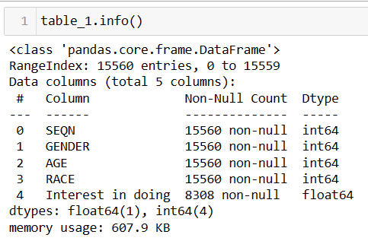
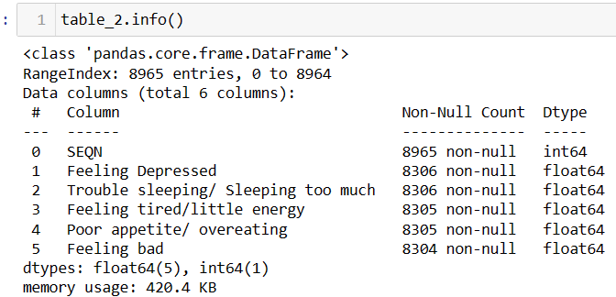
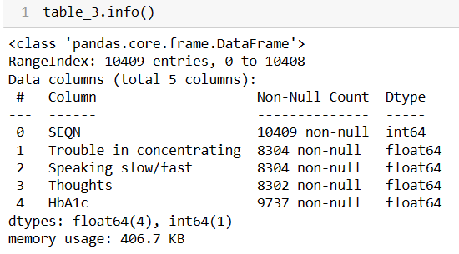
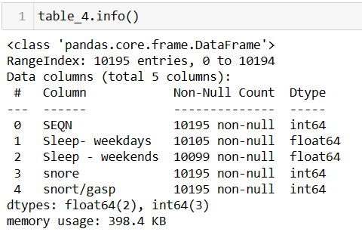

Slide 7
Data Preprocessing

Slide 8
Handling Null values
Removing duplicates
Data Cleaning
Data Formatting & Standardization
Data type conversion
Reversing One-Hot Encoding
Binning Continuous Variables
Dropping irrelevant columns
Joined all 4 tables
Final data
3574 rows and 19 columns

Slide 9
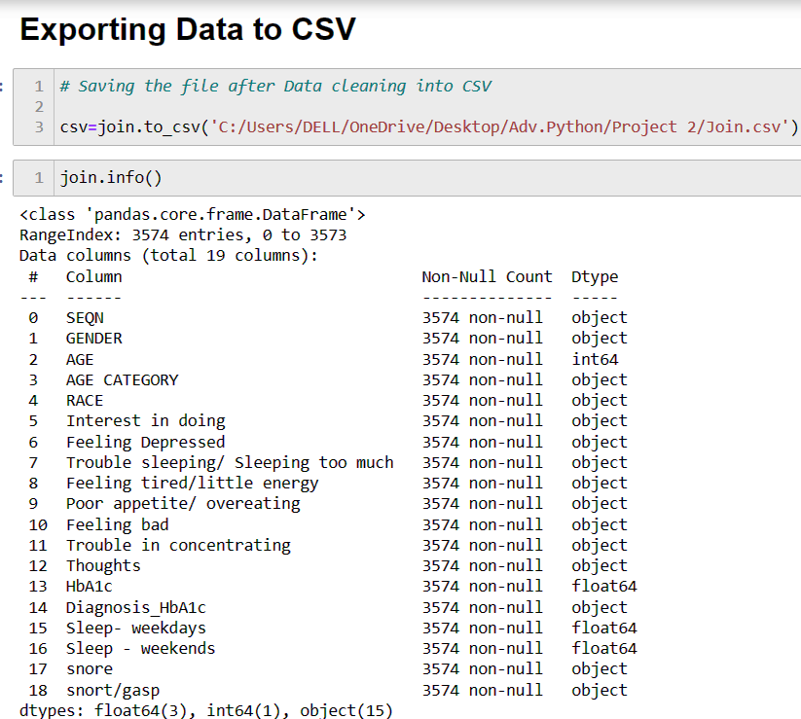

Slide 10
Exploratory Data Analysis

Slide 11
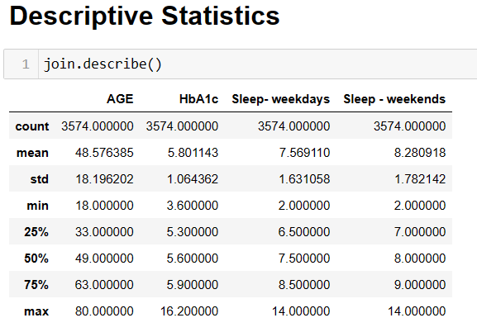

Slide 12

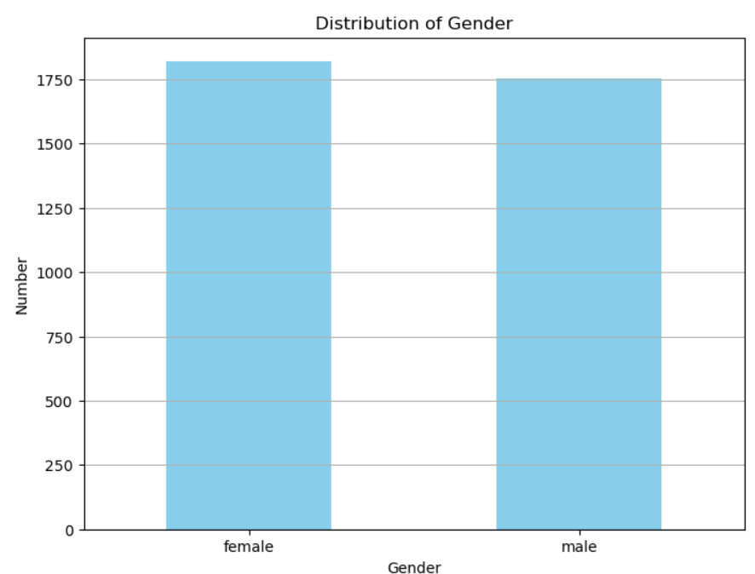
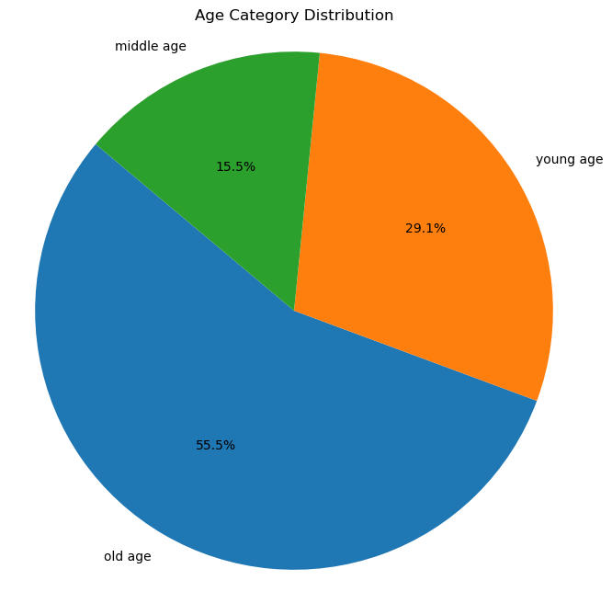

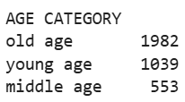

Slide 13
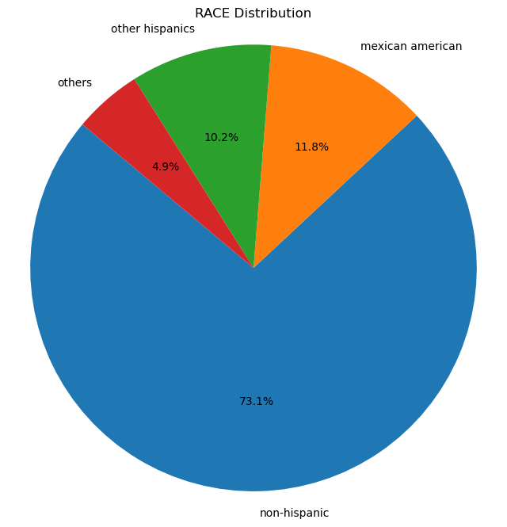
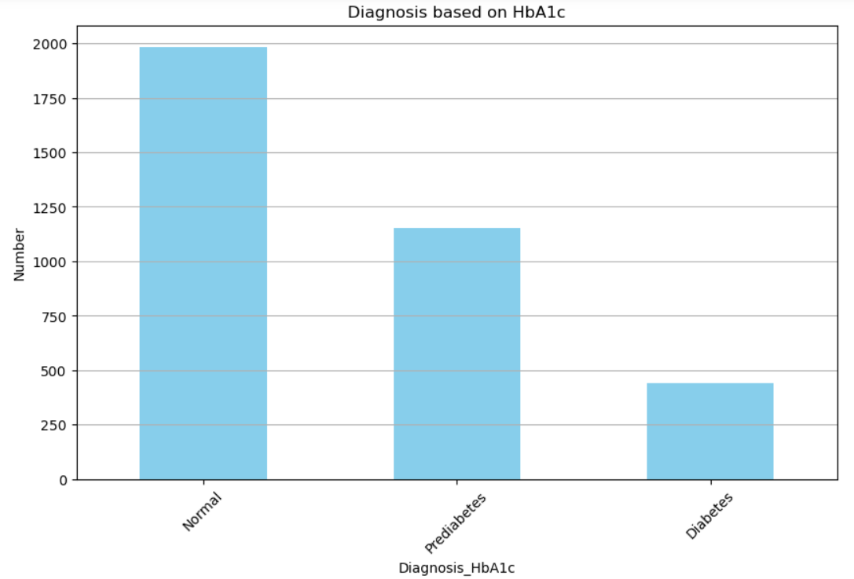
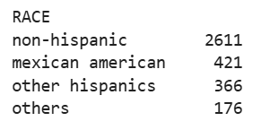
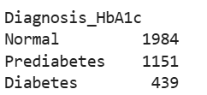

Slide 14
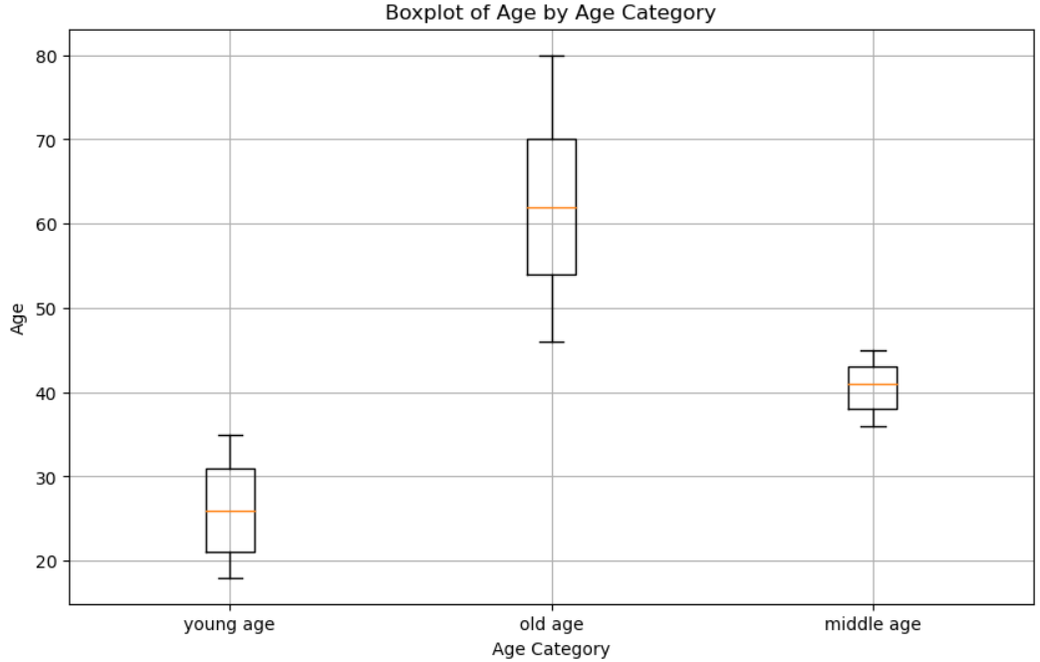
The median age is lowest for young age whereas higher for the old age category.
The spread of ages is widest for the old age category, indicating greater variability, whereas the middle age category has the least spread.

Slide 15
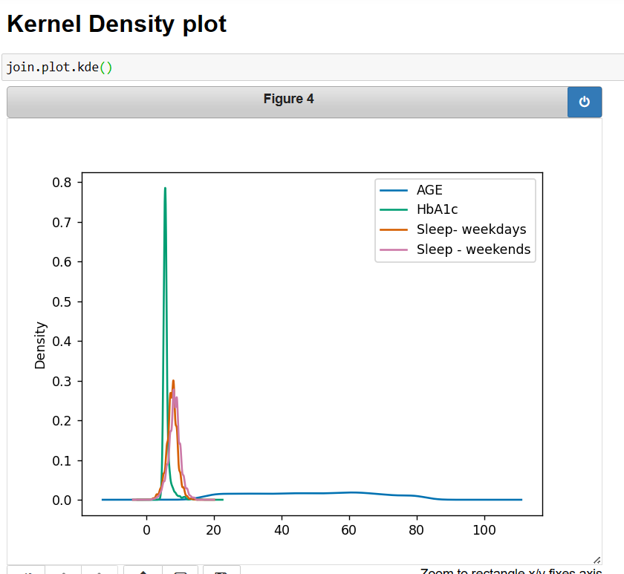
Age has a wider spread, while HbA1c and sleep variables are more concentrated around lower values. The peaks indicate that most values cluster within a narrow range, suggesting skewness in the data distribution.

Slide 16
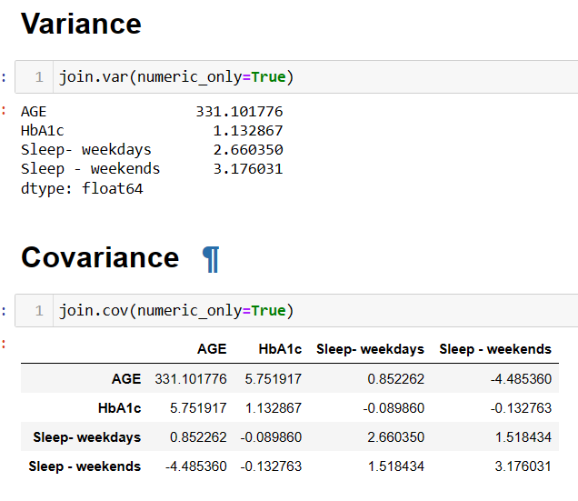
Bivariate Analysis
The high variance in age suggests a diverse age range in the dataset, which may influence other variables.
The higher variance in weekend sleep compared to weekday sleep indicates more irregular sleep patterns on weekends.

Slide 17
The negative covariance between age and sleep suggests that their sleep duration on weekends decreases as people age.
Moreover, the weak negative covariance between HbA1c and sleep variables may indicate a slight tendency for individuals with higher HbA1c levels to have irregular sleep patterns.

Slide 18
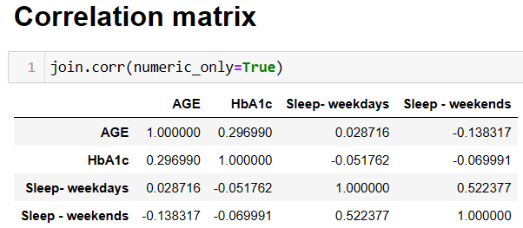
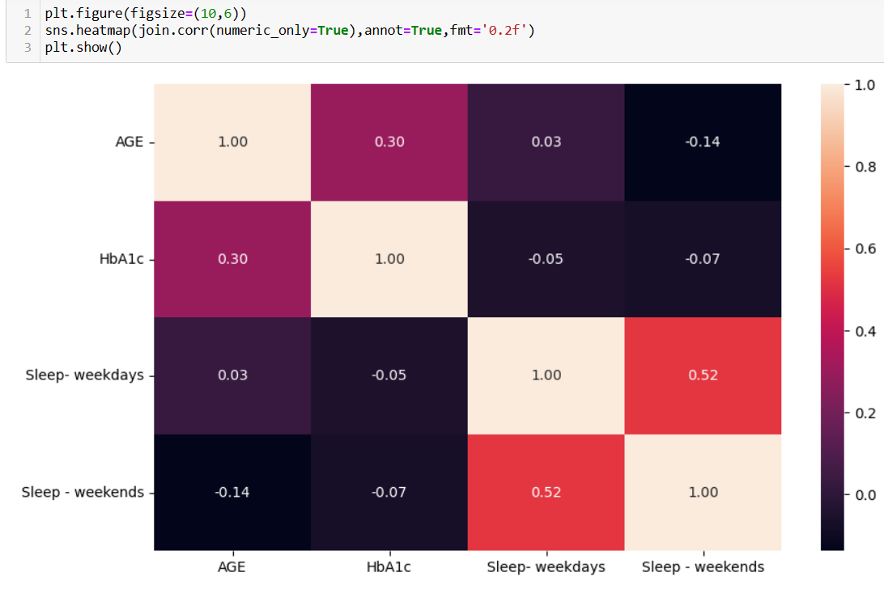

Slide 19
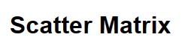
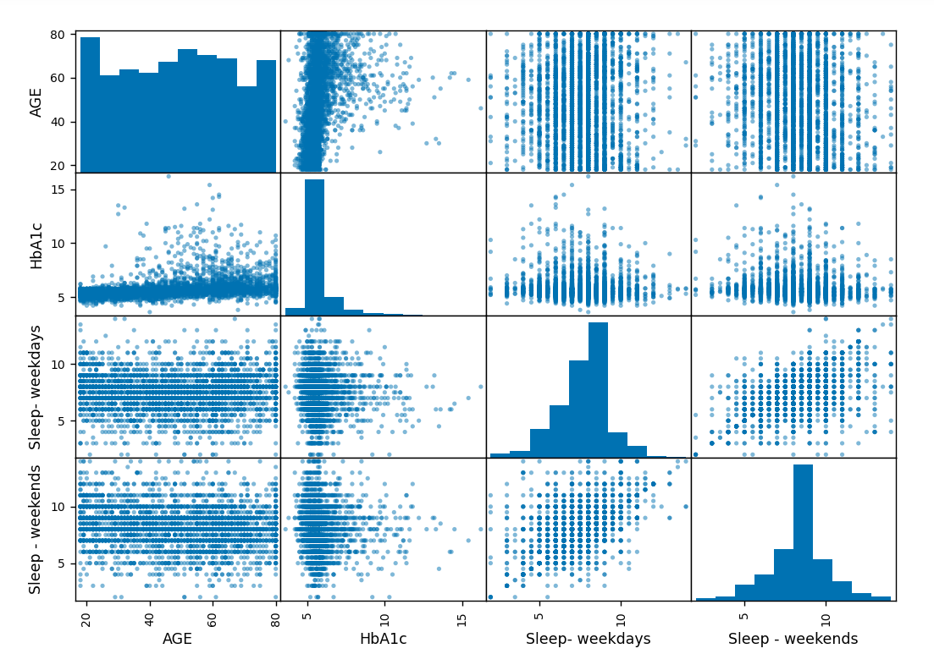

Slide 20

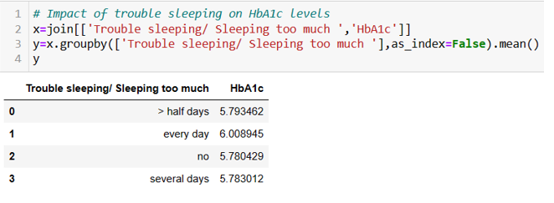
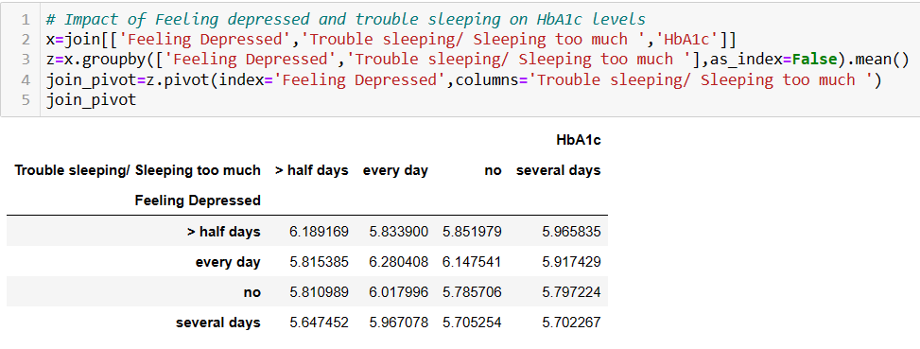
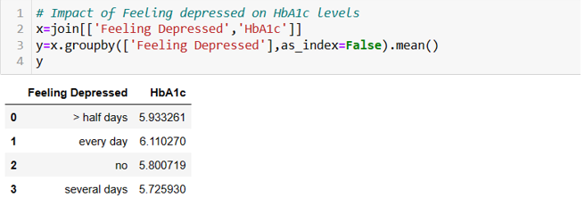

Slide 21
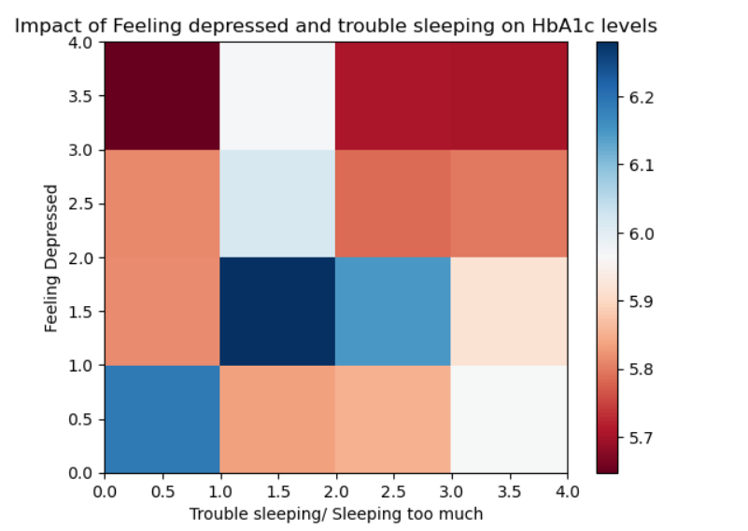
The interaction effect between depression and sleep on HbA1c appears non-linear, suggesting complex relationships rather than a simple additive effect.

Slide 22
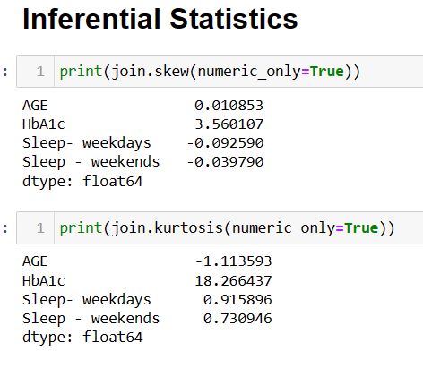
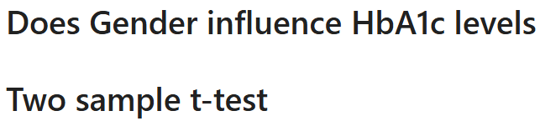
t-statistic = -2.08, p-value < 0.05 == Statistically significant difference, with females having lower HbA1c levels compared to males.

Slide 23
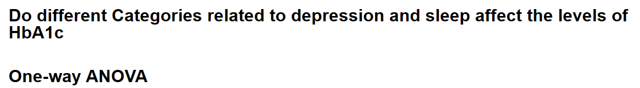
F=4.37, p-value < 0.05 == Statistically significant effect of frequency of feeling depressed on HbA1c levels
F=4.18, p-value <0.05 == Significant effect of sleep disturbances on HbA1c levels
F=4.44, p-value <0.05 == Significant difference in HbA1c levels among groups with different appetite levels
F=2.90, p-value <0.05 == variations in having little energy levels could significantly influence HbA1c levels.

Slide 24
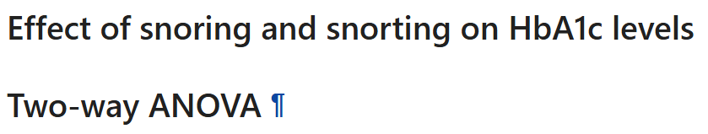
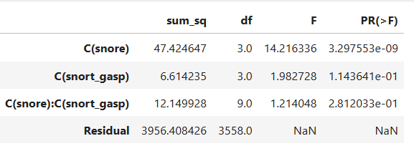
All the p-values are < 0.05 indicating snoring and snorting both have an individual effect on HbA1c levels. The interaction effect is also significant.

Slide 25
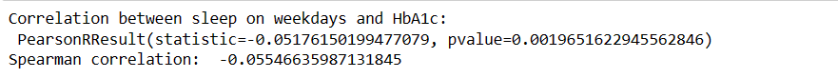
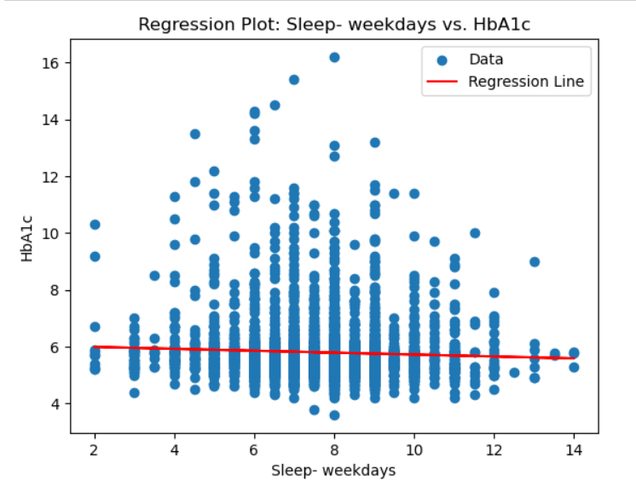
As the correlation statistic is close to 0, it indicates that there is no correlation between HbA1c and sleep on weekdays.
As the p-value is <0.05, the result has only moderate certainty.

Slide 26
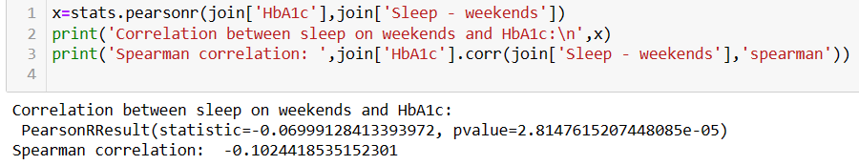
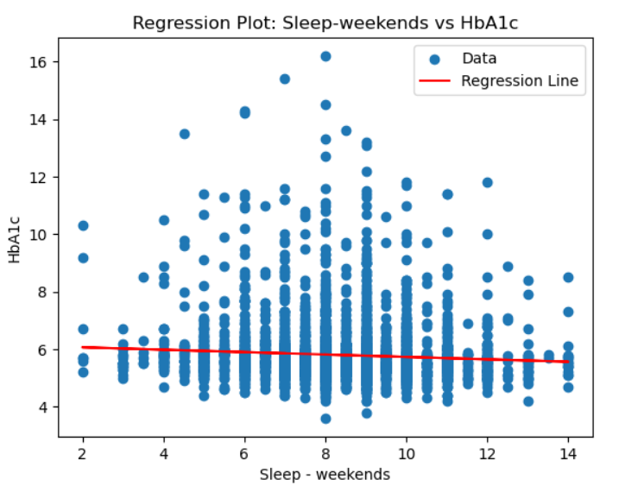
As the correlation statistic is close to 0, it indicates no correlation between HbA1c and sleep on weekdays.
As the p-value is < 0.001, the result is highly significant

Slide 27
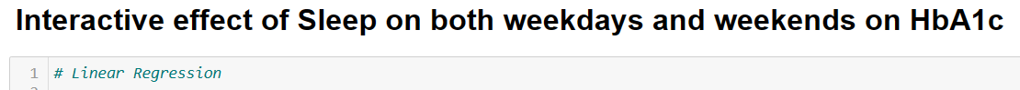
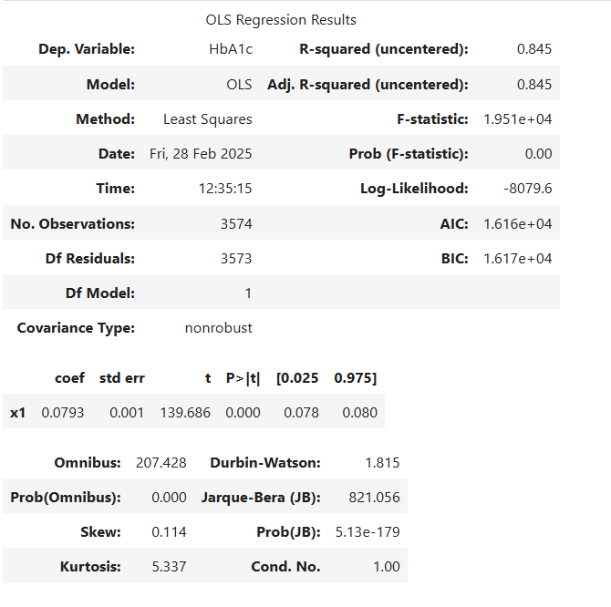
R-square = 0.845 ==
The model explains 84.5% of the variance in HbA1c, indicating a strong relationship between sleep patterns and HbA1c levels.

Slide 28
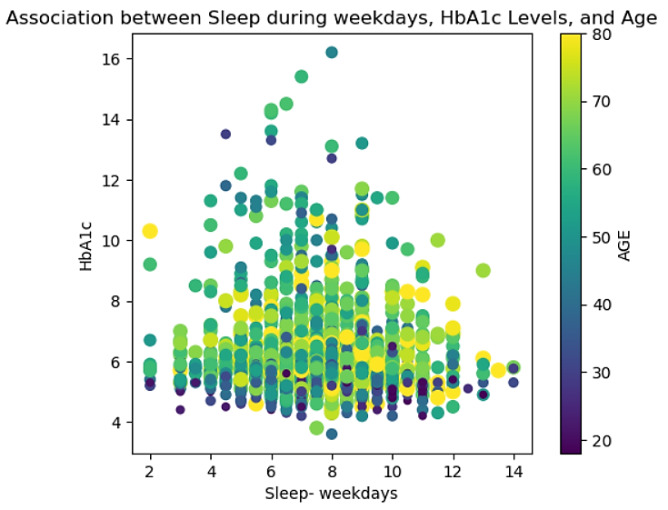
We can see the relationship between HbA1c and sleep on weekdays, with an increase and decrease in age with the change of colour and size.
The distribution suggests that older individuals tend to have higher HbA1c levels, but younger individuals also exhibit variability in their HbA1c levels.

Slide 29
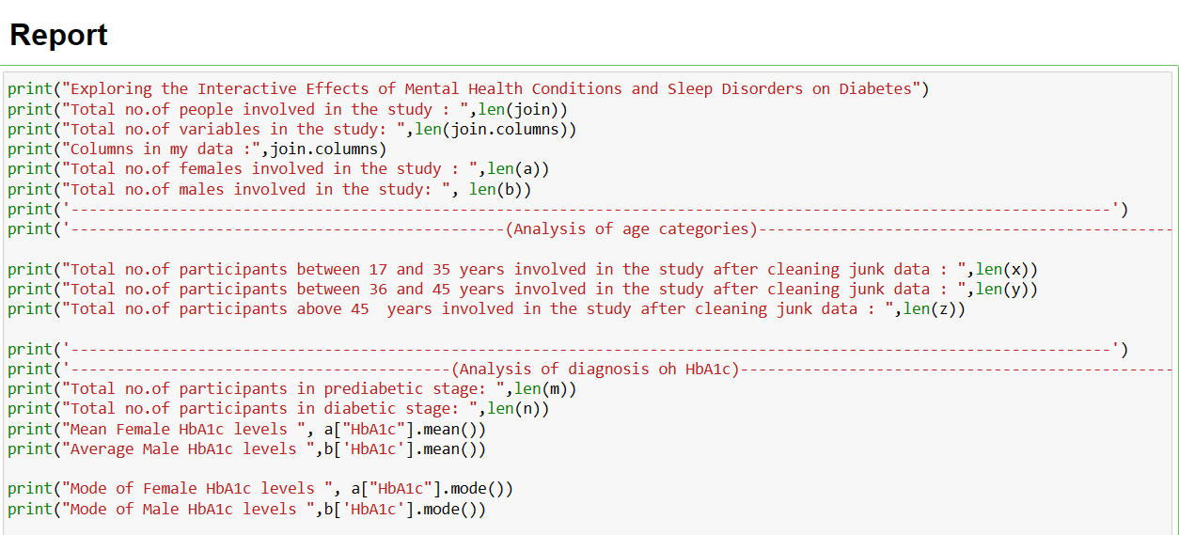

Slide 30
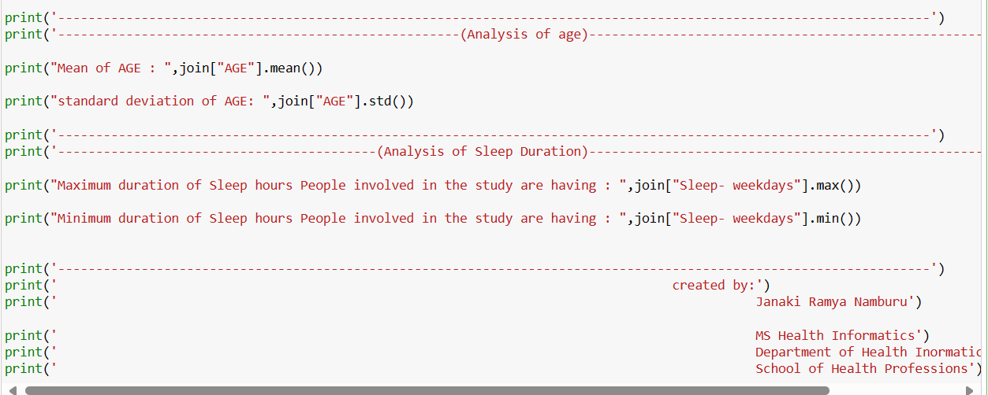

Slide 31
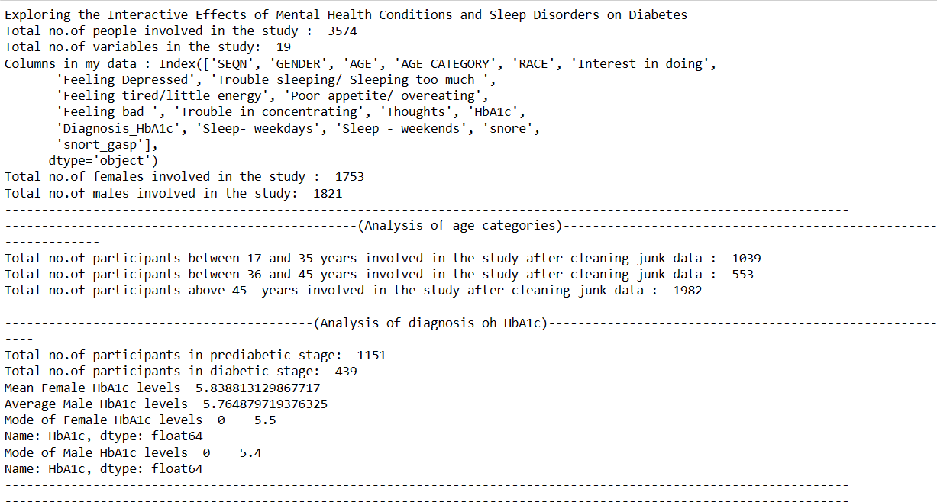

Slide 32
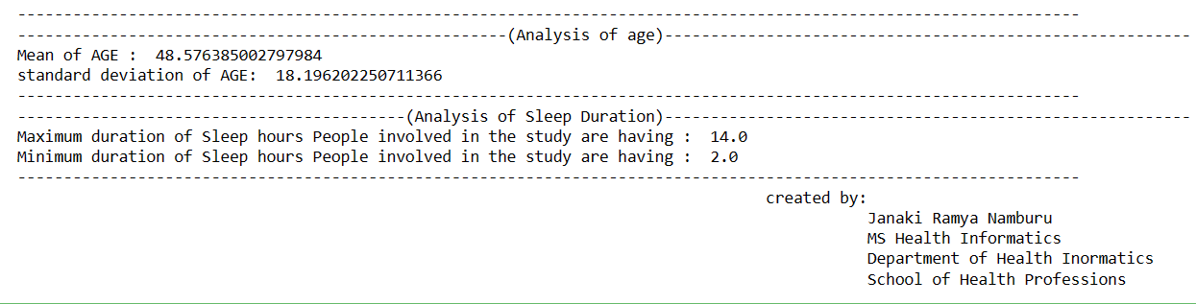

Slide 33
CONCLUSION:
This analysis highlights the strong correlation between mental health, sleep patterns, and diabetes. Depression and sleep disturbances significantly impact HbA1c levels, emphasizing the need for a holistic approach to diabetes management.
Older individuals generally have higher HbA1c levels, but irregular sleep patterns, especially on weekends, suggest that maintaining consistent sleep schedules may help regulate metabolic health.
Snoring and snorting show individual and combined effects on HbA1c, indicating that sleep-disordered breathing may affect blood glucose regulation.
Depression significantly affects HbA1c levels, as individuals experiencing frequent depressive symptoms tend to have higher HbA1c levels, reinforcing the link between mental health and metabolic health.
These insights highlight the importance of integrating mental health support and sleep hygiene into diabetes prevention and management strategies.

Slide 34

THANK YOU

