Slide 1
APPLE ITUNES MUSIC ANALYSIS
NAME : JANAKI R
DATE : 12/07/2025

Slide 2
🎯 PROJECT OBJECTIVES
Analyze Customer Behavior Understand how customers interact with the platform and their spending patterns.
2. Identify Popular and Unpopular Content Determine which genres, tracks, and playlists are most or least purchased.
3. Evaluate Sales Performance Measure total sales by employees and regions to assess business performance.
4. Analyze Revenue Trends Track how revenue changes over time and across different media types.
5. Find Growth Opportunities Identify underperforming artists, tracks, and inactive customers for improvement.

Slide 3
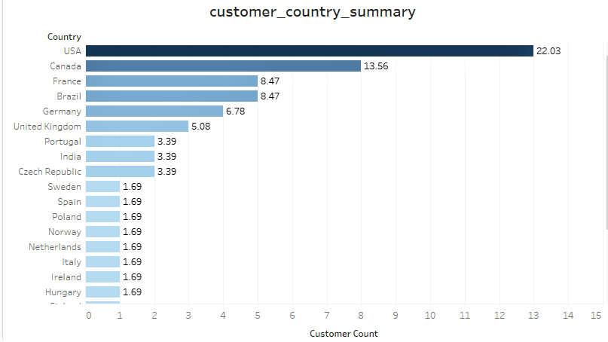
1. Analyze Customer Behavior
COUNTRIES HAVING HIGHEST NUMBER OF CUSTOMER
The United States holds the largest share of customers at 22.03%, indicating it as the primary market.
Canada follows with 13.56%, while France and Brazil are tied at 8.47% each.
These top four countries collectively account for a significant portion of the customer base, highlighting key regions for engagement.

Slide 4
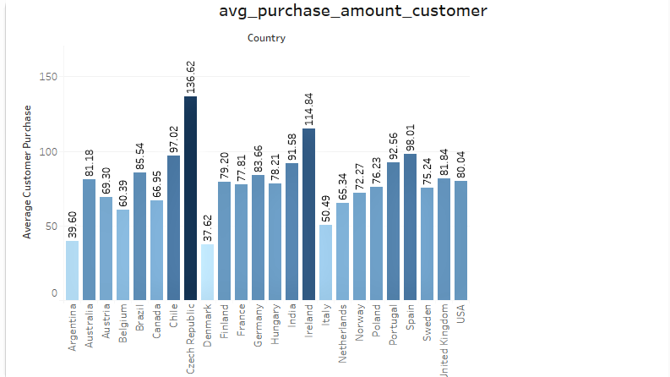
CUSTOMER AVERAGE PURCHASE AMOUNT BY COUNTRY
The Czech Republic has the highest average purchase amount at $136.62, followed by Ireland with $114.84.
Interestingly, the USA, despite having the most customers, shows a comparatively lower average purchase value of $80.04.
This suggests that countries with fewer customers may contribute higher value per transaction.

Slide 5
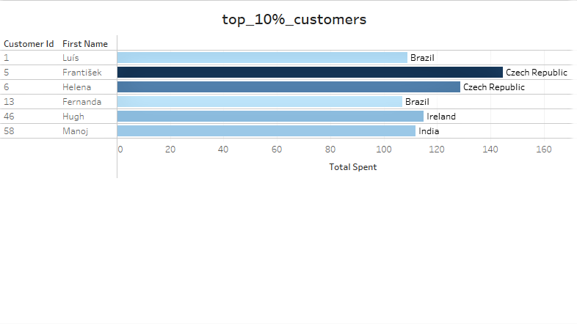
TOP 10% CUSTOMERS WITH COUNTRY
The highest-spending customer is Frantisek from the Czech Republic, with a total spend of $144.54, followed by Helena from the same country at $128.70.
Ireland ranks next with Hugh, who spent $114.84.
Following these, top spenders are also seen from Brazil and India, indicating notable high-value customers in these regions despite overall lower customer counts.

Slide 6
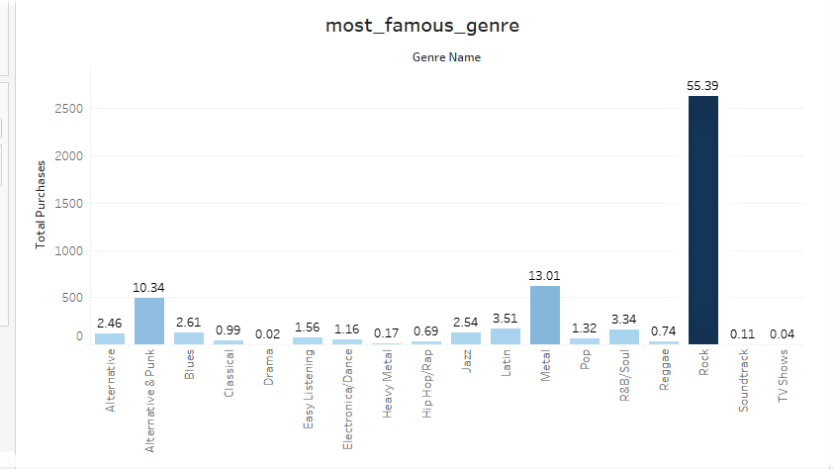
2. Identify Popular and Unpopular Content
MOST FAMOUS MUSIC GENRES BY PURCHASE%
Rock is the most purchased music genre, making up 55.39% of total purchases.
It is followed by Metal at 13.01% and Alternative & Punk at 10.34%.
On the other end, Drama and TV Shows are the least popular, with only 0.02% and 0.04% of purchases, respectively.
This highlights a strong preference for Rock-related genres, while non-music content has minimal demand.

Slide 7
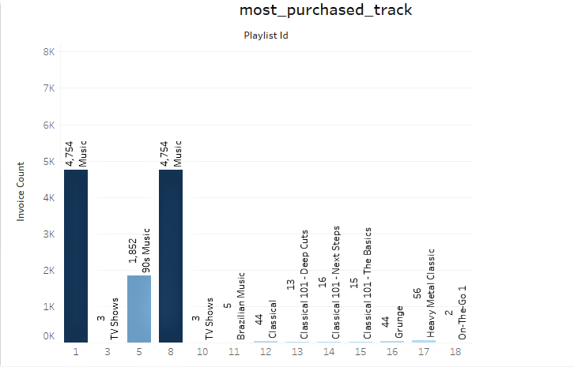
PLAYLISTS WITH MOST PURCHASED TRACKS
The “Music” playlist is the most purchased, appearing twice in the data with an invoice count of 4,754 each. This may be due to different internal categorizations, and further analysis is needed to confirm.
“90’s Music” follows as the next most popular playlist with 1,852 invoices, highlighting strong interest in nostalgic music collections.

Slide 8
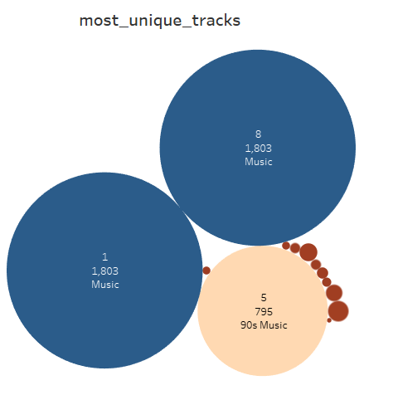
PLAYLISTS WITH MOST UNIQUE TRACKS
The “Music” playlist appears twice again, each showing 1,803 unique tracks purchased, indicating a likely internal categorization difference.
“90’s Music” ranks next with 795 unique tracks purchased, reflecting strong variety and interest in nostalgic content.
This pattern aligns with previous findings, where both playlists also led in total purchases.

Slide 9
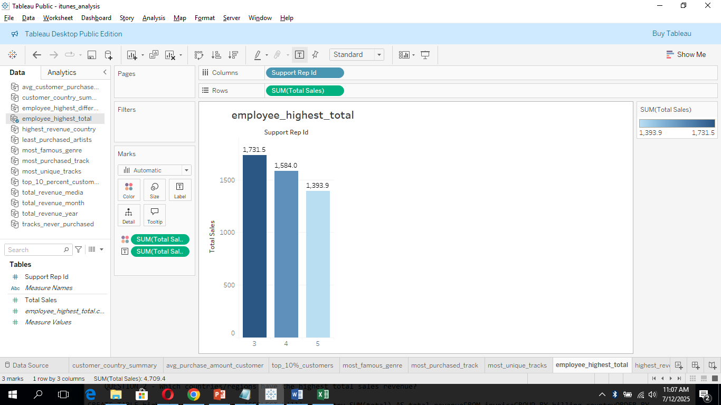
3. Evaluate Sales Performance
SUPPORT REP WITH HIGHEST TOTAL SALES
Support Representative ID 3 recorded the highest total sales at $1,731.50.
This is followed by ID 4 with $1,584.00 and ID 5 with $1,393.90.
These top-performing representatives significantly contribute to overall revenue through customer interactions and support.

Slide 10
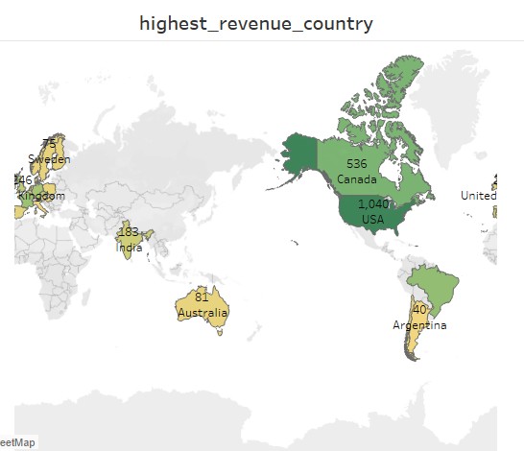
COUNTRIES WITH HIGHEST TOTAL SALES
The United States leads in total sales with $1,040, making it the top revenue-generating country.
Canada follows with $536, and Brazil ranks third with $428.
This highlights North and South America as key markets contributing significantly to overall revenue.

Slide 11
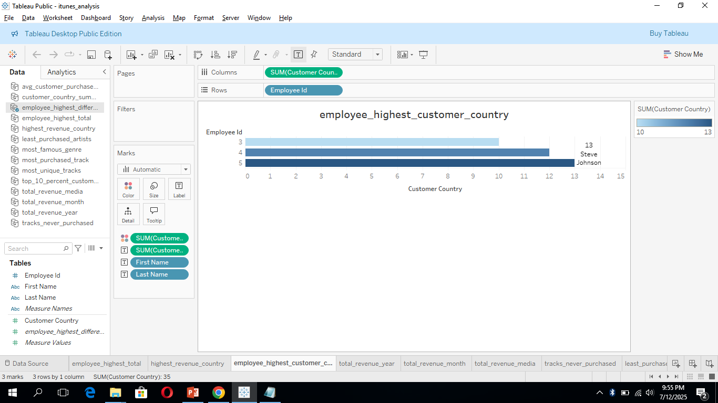
EMPLOYEE MANAGES CUSTOMER FROM HIGHEST NUMBER OF COUNTRIES
Employee ID 5, Steve Johnson, manages the highest number of countries — a total of 13.
He is followed by Margret Park (ID 4) with 12 countries, and Jane Peacock (ID 3) with 10 countries.
This shows that these employees play a key role in international customer management and regional coverage.

Slide 12
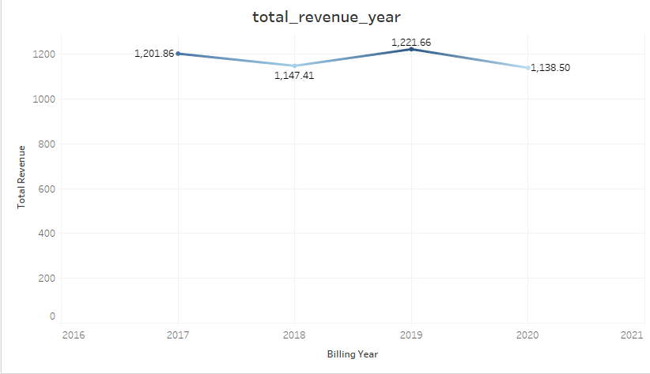
4. Analyze Revenue Trends
TOTAL REVENUE BY YEAR
2019 recorded the highest total revenue at $1,221.66, slightly ahead of 2017, which generated $1,201.86.
This suggests a strong upward trend or peak in customer spending during these years.

Slide 13
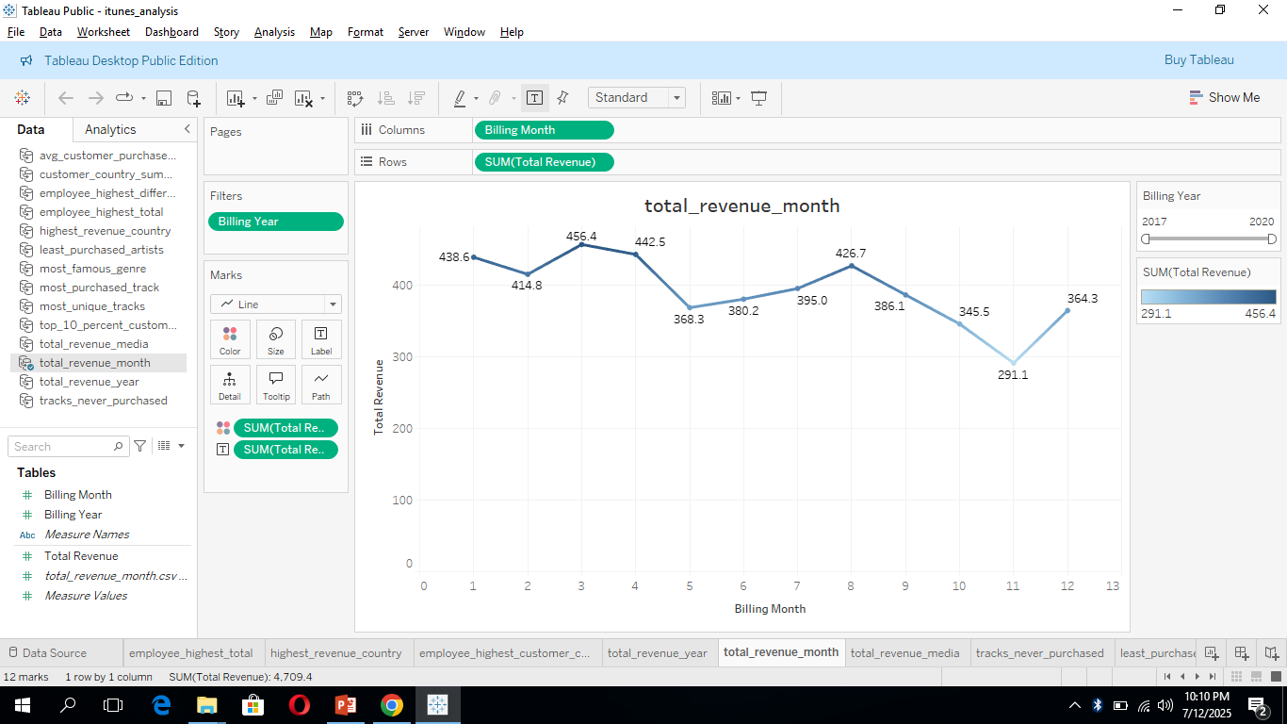
TOTAL REVENUE BY MONTH
Month 3 (March) has the highest revenue at $456.40, followed closely by Month 4 (April) with $442.50.
The lowest revenue is seen in Month 11 (November) with $291.10, indicating possible seasonal variation in customer spending.

Slide 14
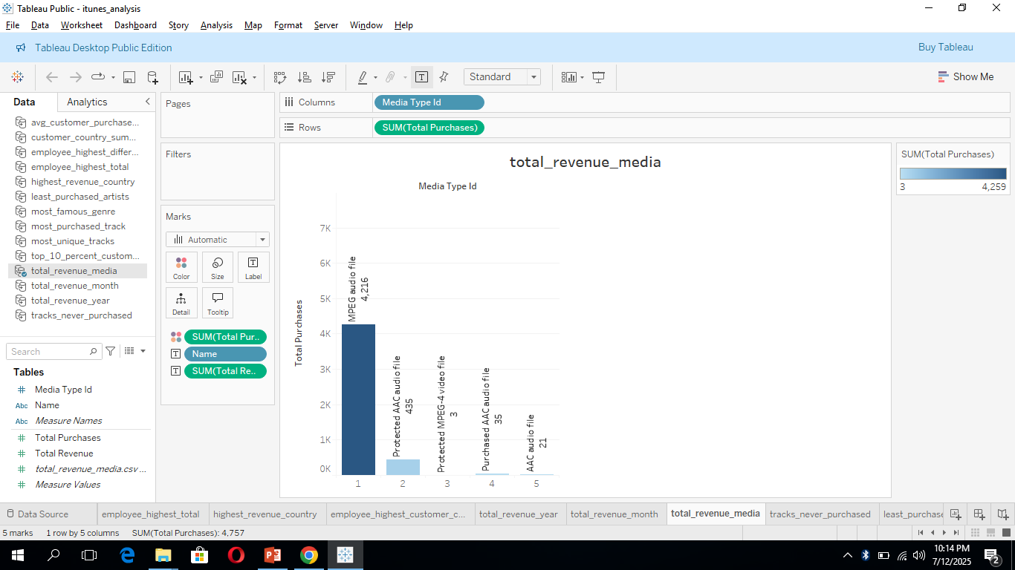
TOTAL REVENUE BY MEDIA TYPE
MPEG audio files generated the highest revenue by far, totaling $4,216.
MPEG audio file usually refers to MP3 files, the most common and widely supported audio format.
This is followed by Protected AAC audio files with a much lower revenue of $435.
This indicates that MPEG format is the most preferred and purchased media type among customers.

Slide 15
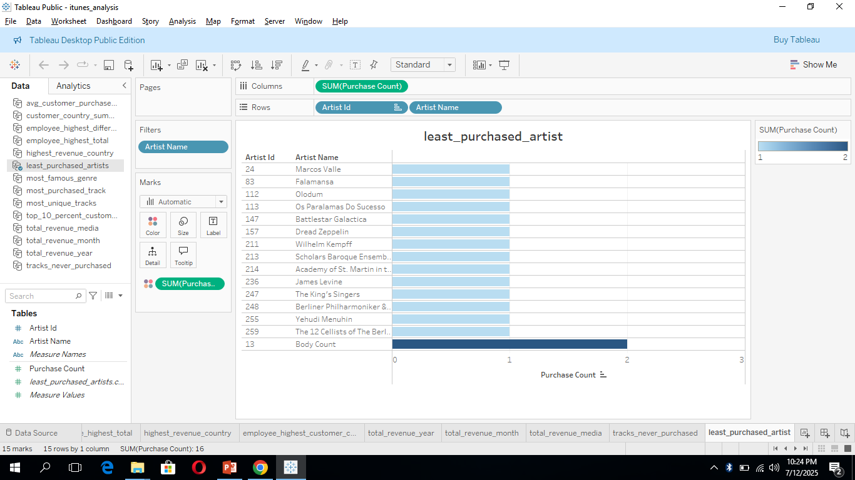
5. Find Growth Opportunities
LEAST PURCHASED ARTIST
A total of 14 artists have tracks that were purchased only once, and 1 artist has tracks with just two purchases.
This indicates a group of low-performing artists whose music has minimal reach or demand among customers.
These could be reviewed for potential removal, promotion, or replacement in the store catalog.

Slide 16
TRACKS NEVER PURCHASED
RATE OF INACTIVE CUSTOMERS
A significant number of tracks in the dataset were never purchased, indicating unused inventory or low customer interest in certain songs.
This could suggest a need to review and optimize the music catalog, promote underperforming tracks, or focus more on popular genres and artists.
The chart for inactive customers is empty, which suggests that all customers in the dataset have made at least one purchase.
However, this may be due to the dataset only including active customers, as those who never purchased may not have been recorded.
Further data would be needed to confirm the true rate of customer inactivity.

Slide 17
CONCLUSION
The USA has the highest number of customers and total revenue, while Czech Republic shows the highest average spend per customer.
Top-spending customers are from Czech Republic, Ireland, and Brazil.
Rock is the most popular genre; Drama and TV Shows are the least purchased.
The “Music” playlist appears twice with the highest purchases and track count, suggesting internal categorization differences.
“90’s Music” ranks second in both purchase volume and track variety.
2019 was the top revenue year, and March the highest revenue month.
MPEG audio files generated the most revenue among media types.
Some tracks and artists had very low or no purchases, and all customers in the dataset were active (likely due to how data was filtered).

Slide 18
RECOMMENDATIONS
Promote high-spending regions like Czech Republic and Ireland, where customers spend more per purchase.
Leverage popular genres such as Rock, Metal, and Alternative & Punk through featured placements and promotions.
Introduce more nostalgic playlists like “90’s Music” to tap into strong listener interest.
Reevaluate low-performing content, including Drama, TV Shows, and tracks/artists with minimal or no purchases.
Encourage higher spending in large markets like the USA by offering bundles, discounts, or loyalty programs.
Analyze seasonal trends (e.g., strong revenue in March) to time promotions and campaigns effectively.

Slide 19
THANK YOU!!

