Slide 1

Smart Krishi
By-
Gargeya Singh
And
Janakinath Verma

Slide 2
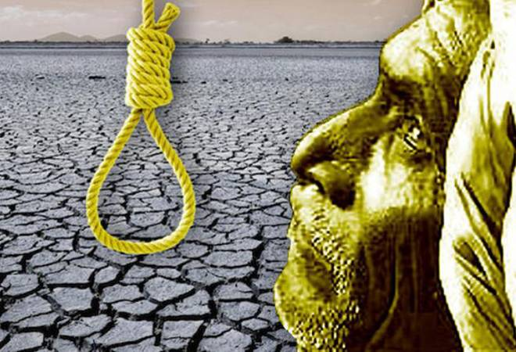
Farmer suicides account for 11.2% of all suicides in India.

Slide 3
Problems that Indian farmers face Every Year
Agriculture is an important sector of Indian economy as it contributes about 17% to the total GDP and provides employment to over 60% of the population.
Extreme weather increases the risk of large-scale crop failure.
India is an agrarian country with around 70% of its people depending directly or indirectly upon agriculture With the crop failure most of the people lives are in danger.
Around 41.49% of total labor are associated with agriculture in year 2020.
Farmer suicides account for 11.2% of all suicides in India. 85 % farmers have low financial resilience.

Slide 4
Problems that Indian farmers face Every Year
India’s growing economy is totally dependent on Agriculture and India’s ambition of ‘Made In India’ can only be fulfilled if its agricultural industries flourish.
So, it becomes important that initiatives must be taken towards its growth.
CROPS ARE DESTROYED DUE TO UNEVEN WEATHER Conditions. Due to which farmers suicide every year.
Basically many farmers don’t get accurate information about weather conditions and which ideal crop they should produce.
Many of the farmers don’t get correct fertilizers and seed. This also affects the production.

Slide 5
How our project will help the farmers
We will not only show the weather variables like temperature, humidity and wind etc. but also predict crop as per data, which is most suitable for the upcoming weather conditions.

Slide 6
Software Requirements
Frontend: Using Html and CSS , we will make client side interface.
Weather app: Using weather prediction API and Express JS for fetching details from API.
Crop Prediction: Data is saved in Excel sheet and we will make ml predictor on python that will be part of backend.

Slide 7
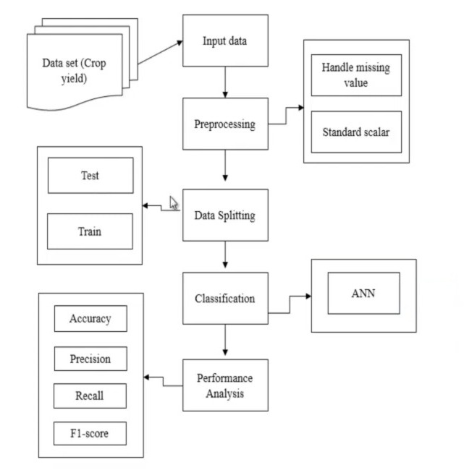
Working model Flowchart

Slide 8
Working
The Data set is taken from Github and other online resources.
We have taken input data from the Data set and we preprocess the data.
We have to detect the missing values from the data set and replace with correct values.
We have to perform Data Splitting, in this process we have to split the data into ratios most of the data is stored in train part and the smaller portion is stored in test part.

Slide 9
Working
Test data is used for predicting the model and train data is used for evaluate the model.
After data splitting we have to implement the classification algorithm in this step we have to implement the deep learning algorithm such as artificial neural network.
With the help of ANN we have the experimental result that shows that the accuracy precision recall and score.

Slide 10
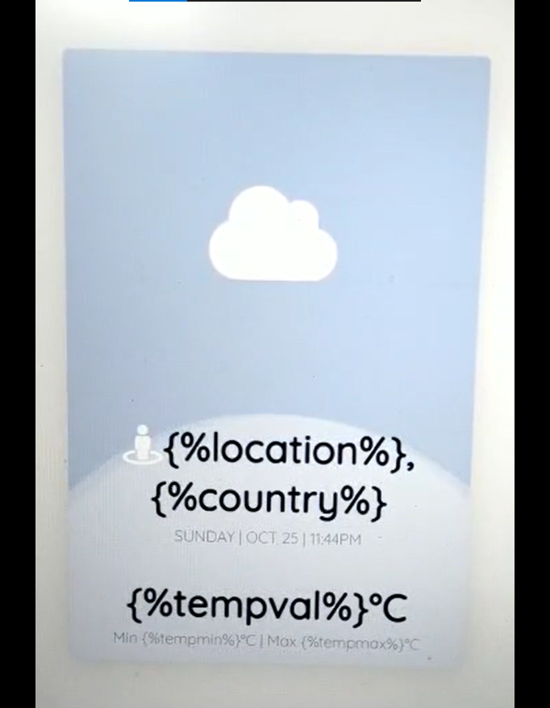
Weather App looks Like this

Slide 11
What we aspire in future !
We would add retailers globally to our interface to sell seeds and fertilizers.
Farmers will also get information about which fertilizer and insecticide to be used along with crop prediction.
Farmers can buy seeds, manure and fertilizers online with our portal
We would turn our project from web version to progressive web app (pda) version.
We would extend our portals to other regional languages for easier understanding to farmers.

Slide 12
That’s IT. Thank you!

