Slide 1
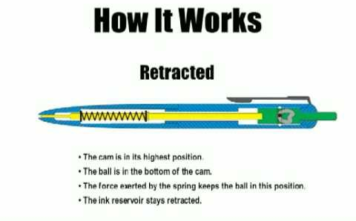
MECHANISM BEHIND THE WORKING OF A BALLPOINT PEN
The mechanism is made up of a plunger and a simple rotating device, also known as a cam body. When you're ready to use the pen and the button is pushed, it tells the plunger to move down. This also pushes the cam body down allowing it to rotate.

