Slide 1
Project Health Synthesis
RED
Monthly portfolio review | Status: RED | Score: 59.4
Projects reviewed: Zycus - UniSan S2P Implementation, Zycus - Titan S2P Implementation
Generated 08 Jul 2026

Slide 2
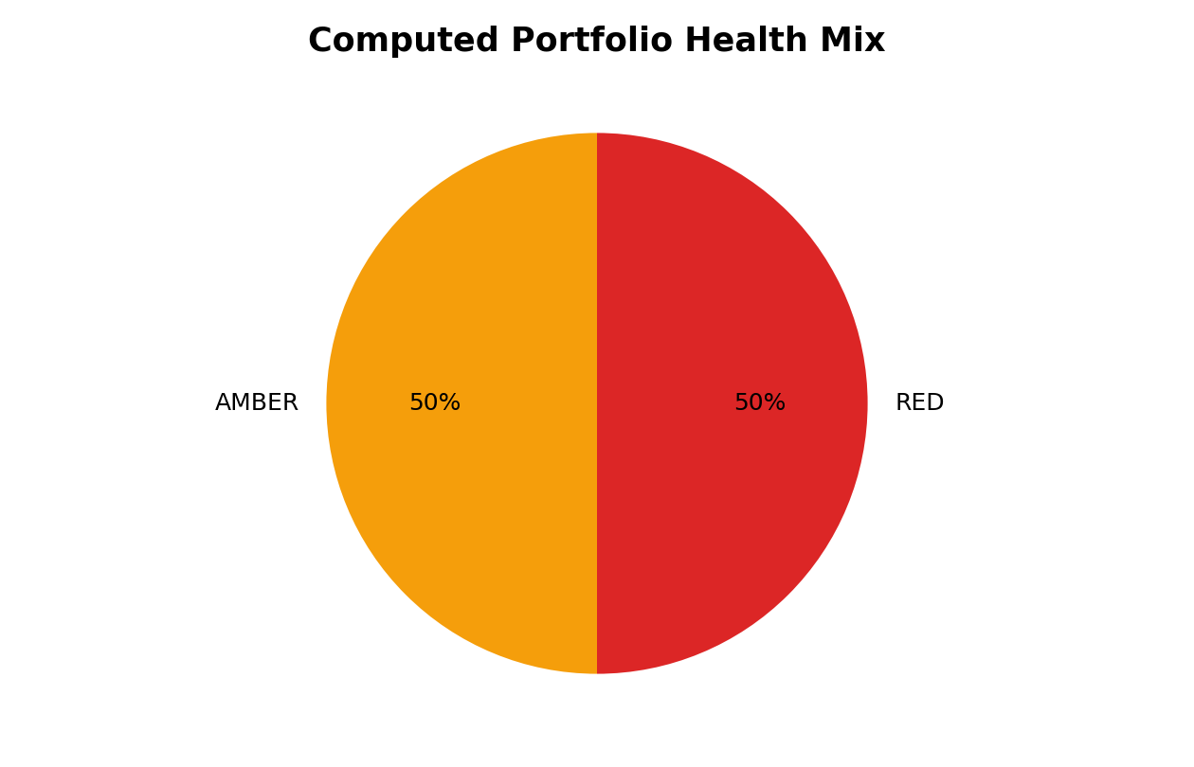
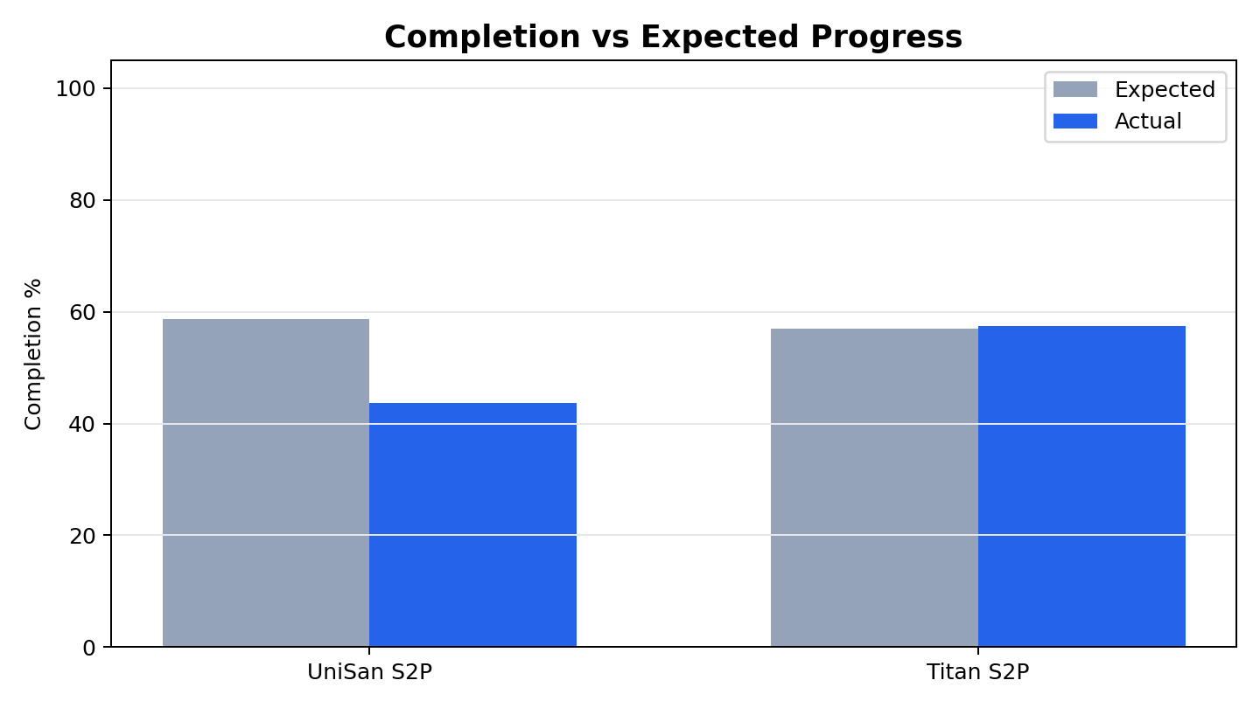
Portfolio health needs targeted governance focus
The portfolio is rated RED with an average health score of 59.4 across 2 projects. Completion is 51% across 876 tasks. Leadership attention should focus on 44 overdue incomplete tasks, 46 incomplete critical tasks, and 6 blocker-like stakeholder comments.
876 total tasks
51% weighted completion
44 overdue incomplete tasks
46 incomplete critical tasks
Portfolio Health
Project Health Reporting Agent

Slide 3
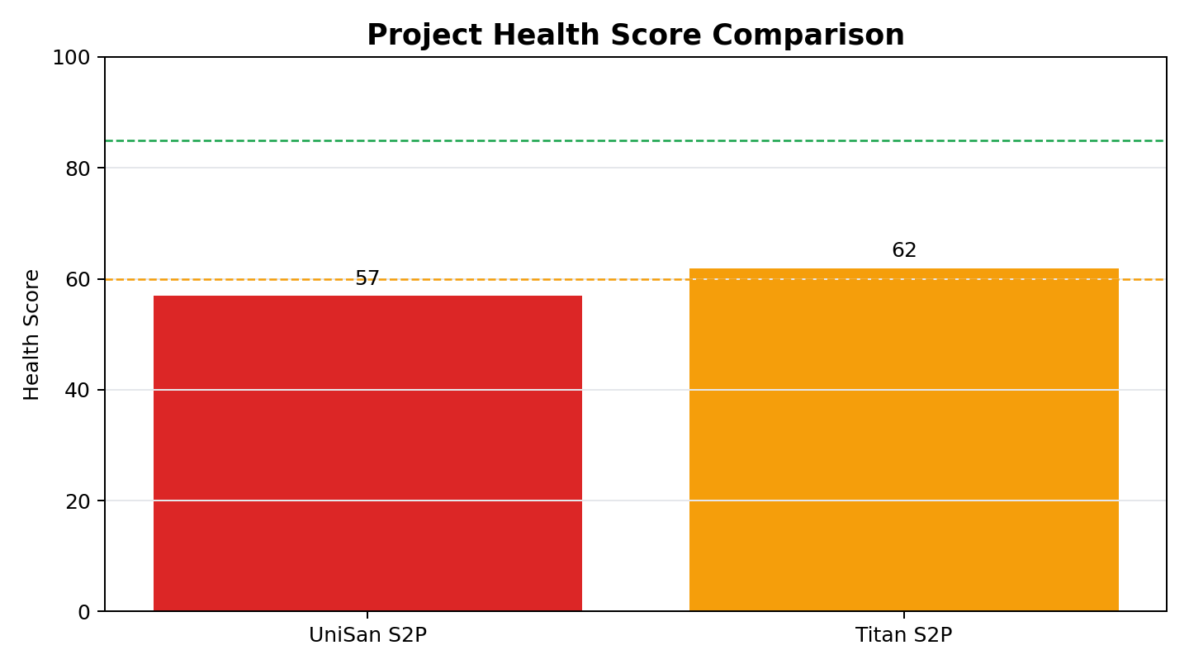
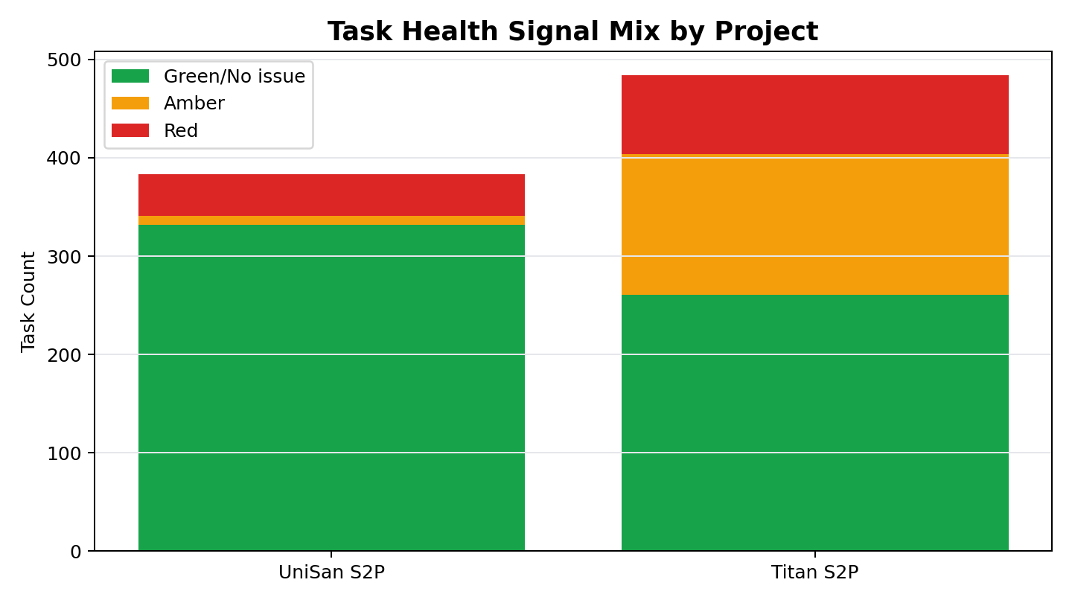
Project comparison shows different risk profiles
Zycus - UniSan S2P Implementation: RED, score 57.0, 25 overdue tasks.
Zycus - Titan S2P Implementation: AMBER, score 61.9, 19 overdue tasks.
Project Comparison
Project Health Reporting Agent

Slide 4
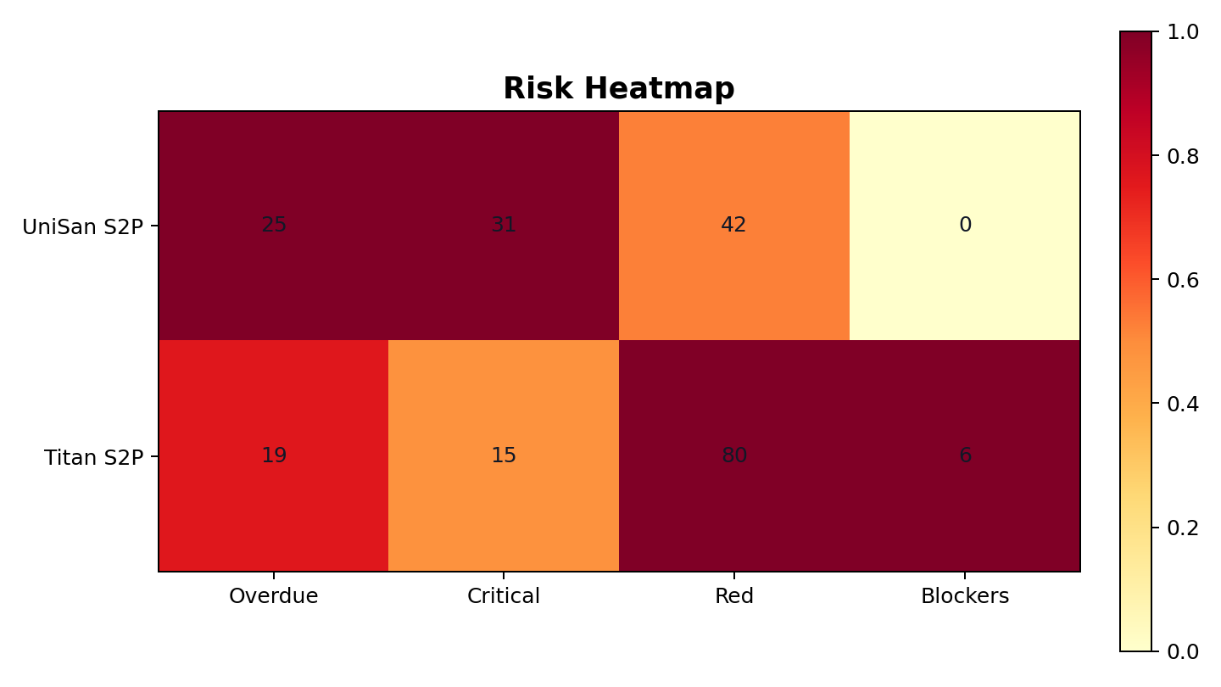
Emerging risks are concentrated in schedule execution
Highest priority risks
2 of 2 projects are not computed Green.
44 overdue incomplete tasks exist across the portfolio.
46 incomplete critical tasks may constrain delivery.
Stakeholder comments show unresolved mapping, workshop, and calendar coordination issues.
Trend signal
Zycus - UniSan S2P Implementation: 44% complete, 15% behind expected progress.
Zycus - Titan S2P Implementation: 57% complete, 1% ahead of expected progress.
Emerging Risks
Project Health Reporting Agent

Slide 5
Recommendations drive management action
1
Create a weekly exception review for overdue, critical, and zero-float tasks.
2
Normalize workbook hygiene across projects, especially owner, milestone, budget, and comment fields.
3
Separate self-reported workbook health from independently computed health in leadership reporting.
4
Add budget burn data to the standard project plan export so health is not schedule-only.
Management intent: move from descriptive status reporting to exception-based governance.
Recommendations
Project Health Reporting Agent

Slide 6
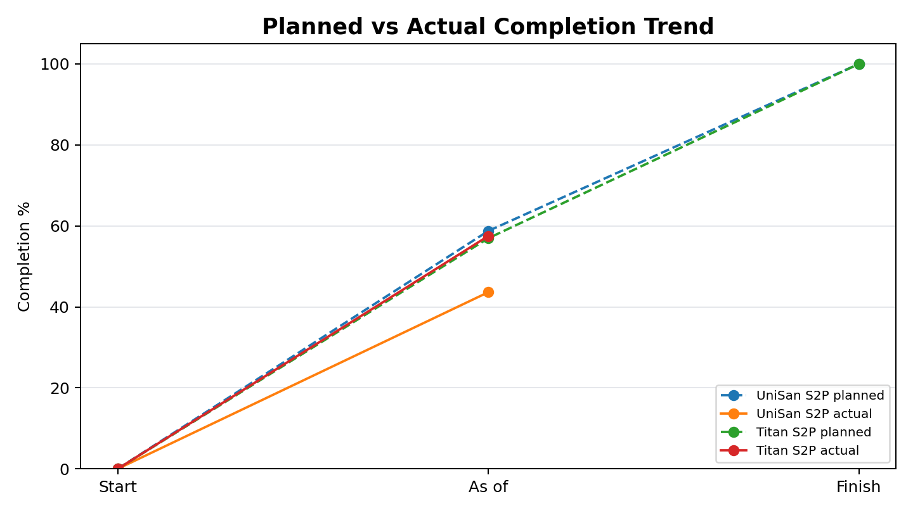
The evidence base combines completion, trend, and risk views
These views are generated from task-level data and can be refreshed automatically from updated workbooks.
Charts
Project Health Reporting Agent

Slide 7
Next steps tighten cadence, ownership, and data quality
Run the weekly agent refresh after project plan updates.
Review Red, overdue, critical, and blocker items with project owners.
Update budget and owner fields so future scoring has higher confidence.
Use workbook discrepancy findings to calibrate PM status reporting.
Leadership decision
Adopt independent computed health as the standard exception signal, while keeping PM-entered workbook status as supporting context.
Primary outcome: faster escalation on schedule risk with less manual follow-up.
Next Steps
Project Health Reporting Agent

