Slide 1

ANIMCODE
GUIDE:
MRS.C.SANGEETHA (AP/CSE)
TEAM MEMBERS:
JANAKI S 920222104017
NASIKA K 920222104036
SARMILA B 920222104048
ANIMCODE
Page 1
Notes:
1

Slide 2

ABSTRACT
AnimCode uses animations and a built-in compiler to teach programming interactively.
Users solve coding challenges, progress through a ranking system, and receive instant feedback.
Upon solving 50 challenges, they earn a certificate and access extra learning resources.
CRIME RATE PREDICTION
Page 3
ANIMCODE
Notes:
2

Slide 3
OBJECTIVE
Objective:
Create an engaging platform that simplifies learning programming through interactive tasks.
Offer instant feedback to enhance users’ coding skills effectively.
Reward users with certificates to motivate and recognize their achievements.
Scope:
Develop an interactive site for beginners with user registration, question selection, and animated code execution.
Track user progress, assign ranks, and issue certificates upon completing challenges.
Focus on basic programming, excluding advanced topics and mobile apps.
CRIME RATE PREDICTION
Page 2
ANIMCODE
Notes:
3

Slide 4


EXISTING SYSTEM AND DISADVANTAGE
Lack of Visual Learning: Few use animations or visual aids for concept explanation.
Insufficient Hands-on Practice: Limited interactive environments for practical coding.
Intimidating Environment: Competitive platforms discourage beginners.
Monetization Barriers: Subscription fees restrict access to resources.No Gamification: Lack of motivation through ranks or rewards.
ANIMCODE
Page 4
CRIME RATE PREDICTION
Notes:
4

Slide 5

PROPOSED SYSTEM
Code User-Friendly Interface: Easy registration and navigation.
Animation Integration: Visual explanations of coding concepts.
Interactive Coding Environment: Real-time coding and concept videos.
Gamification Elements: Ranking system and certificates for completed programs.
Extra Concept Links: Additional resources for deeper understanding.
ANIMCODE
Page 5
CRIME RATE PREDICTION
Notes:
5

Slide 6

MODULES
User Registration Module: Collect user details.
Question and Language Selection Module: Let the user choose a question and language.
Code Compiler and Execution Module: Provide an interface to run code with concept explanations and animations.
Ranking and Progress Tracking Module: Keep track of user progress and rank.
Certificate Generation Module: Generate a certificate after successfully completing 50 programs.
Extra Concepts and Learning Resources Module: Provide additional learning materials.
ANIMCODE
Page 5
CRIME RATE PREDICTION
Notes:
6

Slide 7
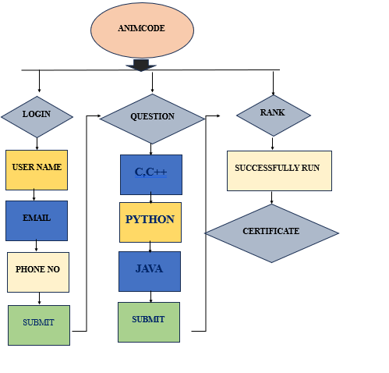
FlOW CHART
CRIME RATE PREDICTION
Page 16
ANIMCODE
Notes:
7

Slide 8

SOFTWARE REQUIREMENTS
Frontend Development:
HTML5, CSS, JavaScript
Database:
PHP
MySQL
Xampp
Language, Frameworks And API’s:
Python
ChatGPT API
ANIMCODE
Page 18
CRIME RATE PREDICTION
Notes:
8

Slide 9

CONCLUSION
AnimCode revolutionizes programming education by offering interactive learning, engaging animations, and real-time code execution. By personalizing the learning experience and incorporating gamification, it empowers users to master coding skills effectively. Ultimately, AnimCode aims to make programming accessible and enjoyable for everyone.
ANIMCODE
Page 19
CRIME RATE PREDICTION
32
Notes:
9

Slide 10
THANK YOU
Notes:
10

