Slide 1


Heart Disease Prediction
Fall 2020, ALY6150
Healthcare/Pharmaceutical Data and Applications
CRN: 71699
INSTRUCTOR – Zhi He
Hemanth
Janaki sajja
Shrutika
Tejaswini Somasundar

Slide 2
Contents
Goals of the Project
Questions addressed from Dataset
Dataset Information
Exploratory data Analysis
Models Built
Conclusion

Slide 3
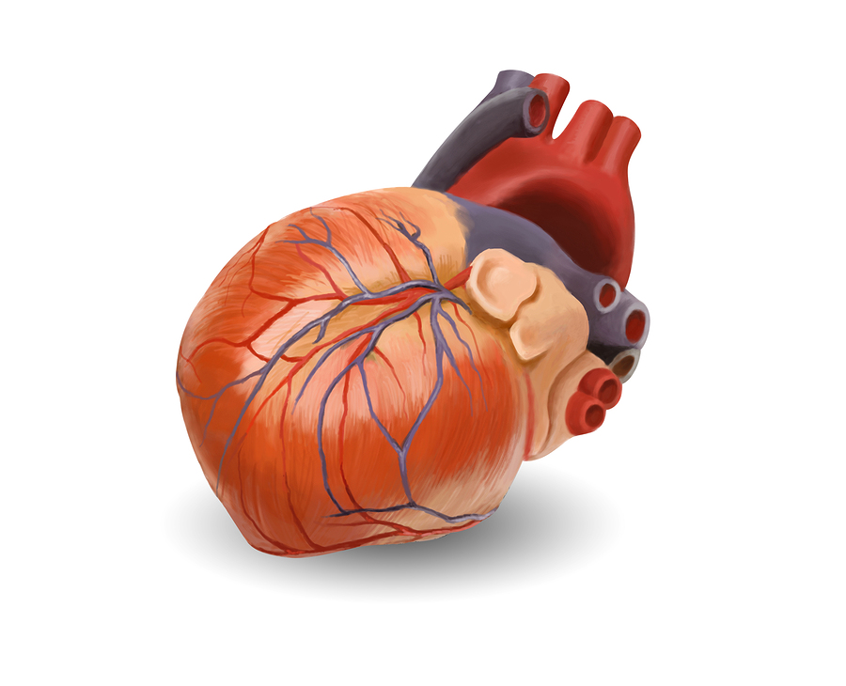
Goal of the Project
Want to see top reason for heart failures
Prevent CVDs by addressing behavioral risk factors
Early detection & Management of CVDs

Slide 4
Questions addressed from Dataset
Understand if gender has to do anything with heart disease?
Understand if age has to do anything with heart disease?
Understand what preexisting conditions has to do with heart disease?
Predict ways to avoid heart disease

Slide 5
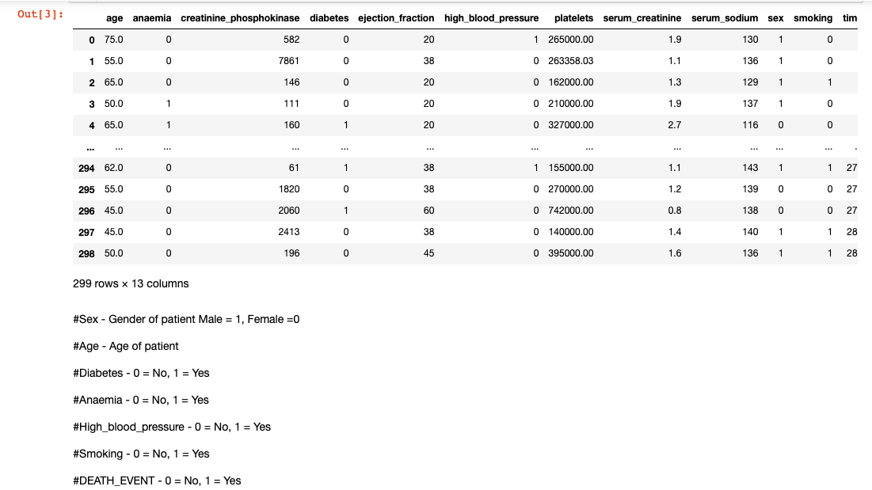
Dataset Information
The Data set we have taken is “Heart failure clinical records Data Set” taken it from UCI machine learning Repository.
Link to the dataset: https://archive.ics.uci.edu/ml/datasets/Heart+failure+clinical+records
The Dataset consists of 299 records and 13 features out of which 7 numerical and 6 categorical.
Cardiovascular diseases (CVDs) are the number 1 cause of death globally, taking an estimated 17.9 million lives each year, which accounts for 31% of all deaths worldwide.

Slide 6
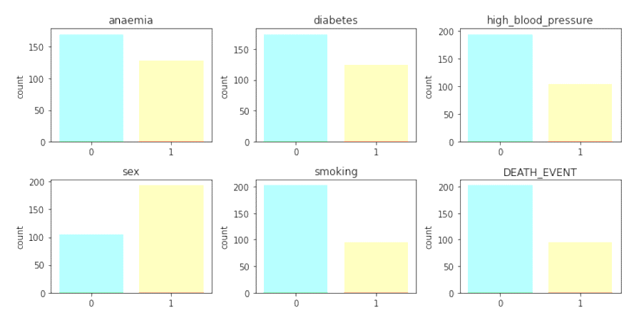

Exploratory Data Analysis
These small graphs describe the distribution of data in the dataset.
Out of all 299 records, we have observed over 96 deaths.
There are some variables, which are clearly seem responsible for the death or CVDs.
They are smoking, high blood pressure, diabetes, anemia.
More that 100 patients seems anemic and diabetic.

Slide 7

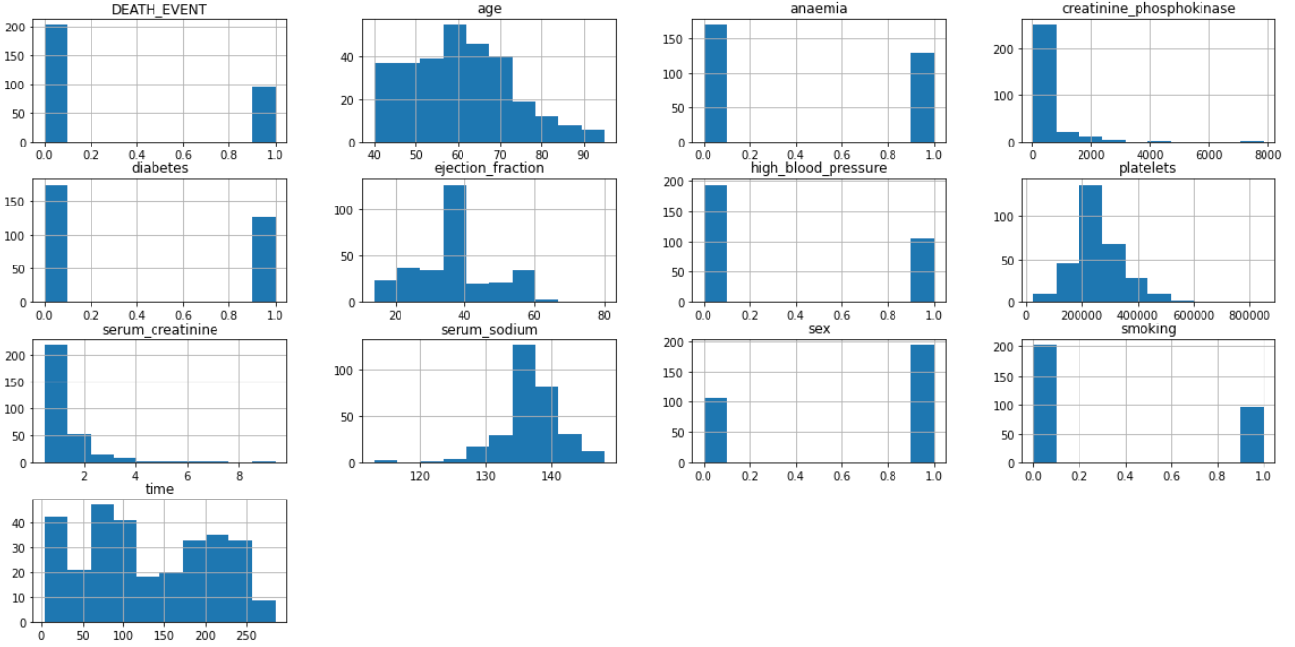

Frequency of Parameters.

Slide 8
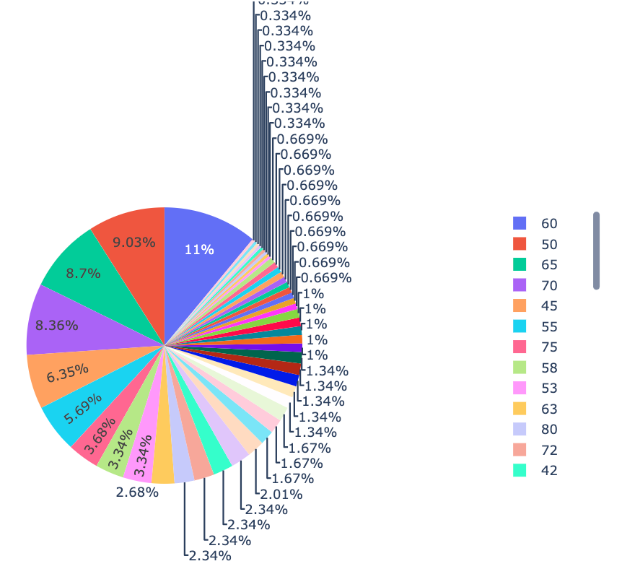
Age Distribution:
As per the pie chart, 11% percent of the population is of 60 years old, 9.03% are 50 years old, 8.7% are 65 years old and 8.36% are 70 years old.
Rest of the age group population accounts to less percentage in the dataset.

Slide 9
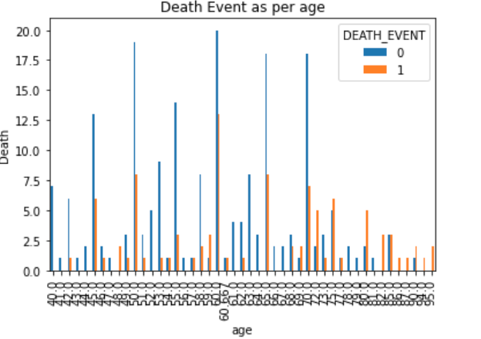
Death Event as per Age:
As per the bar graph deaths are high among for the population of age 60 years.

Slide 10
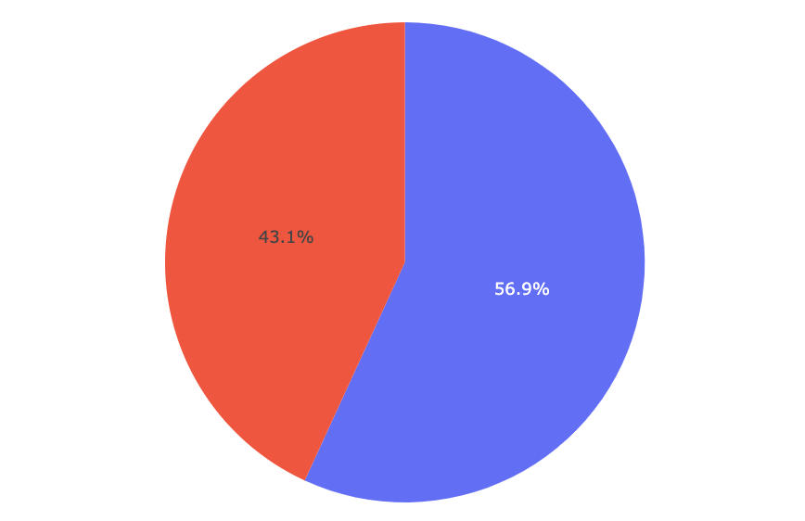
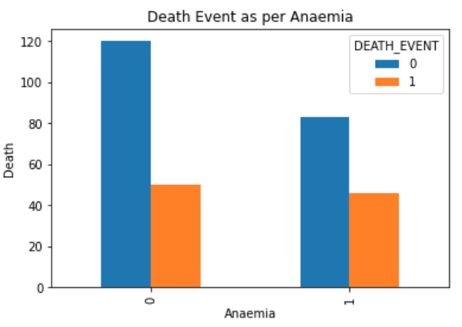
Anemia Distribution
43.1% of the dataset has anemia.
56.9% of the doesn’t have anemia.
DEATH EVENT AS PER ANEMIA
Death percentage is high among the people with anemia.

Slide 11
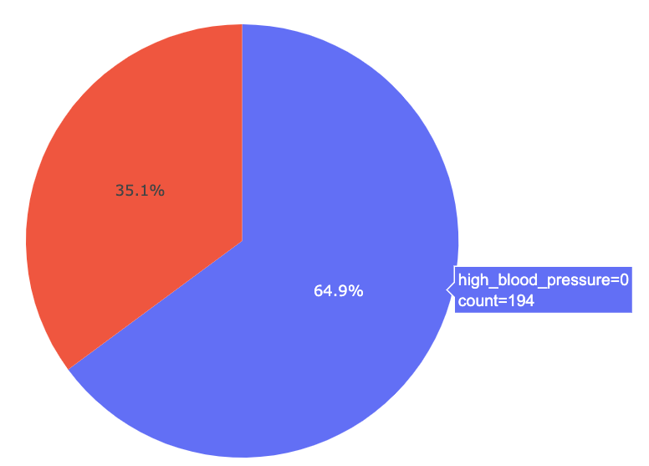
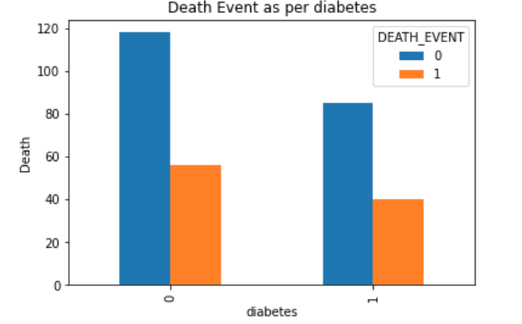
HIGH BLOOD PRESSURE DISTRIBUTION
64.9% of the people in the dataset have no high blood pressure.
35.1% has high blood pressure
DEATH EVENT AS PER DIABETES
Death percentage is high among those who doesn’t have diabetes.

Slide 12
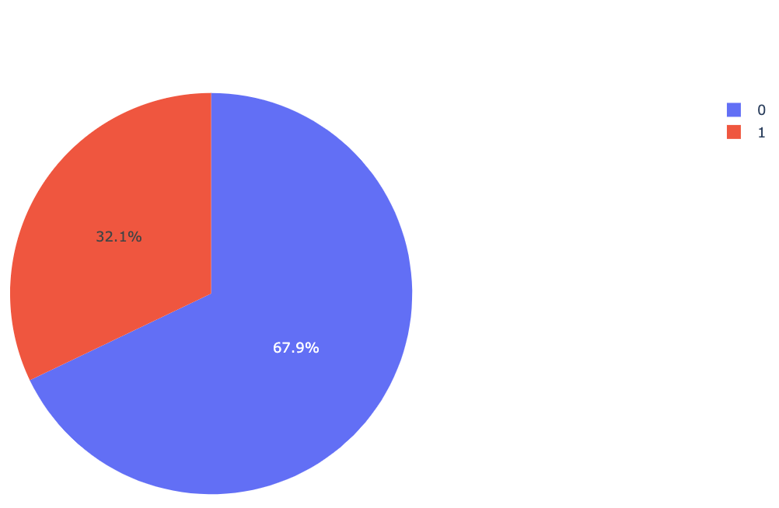
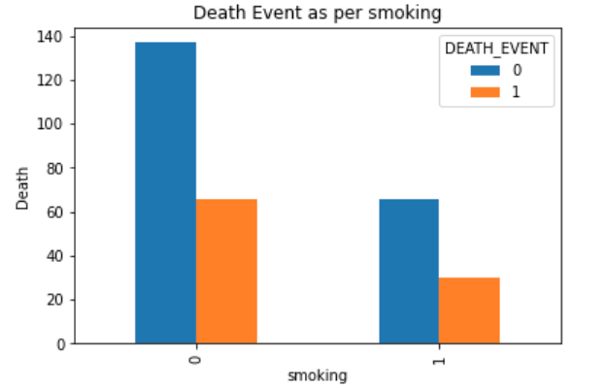
SMOKING DISTRIBUTION
67.9% of the dataset has people who doesn’t smoke.
32.1% of the dataset has people who smoke.
DEATH EVENT AS PER SMOKING
Death percentage is high among the people who smoke.

Slide 13
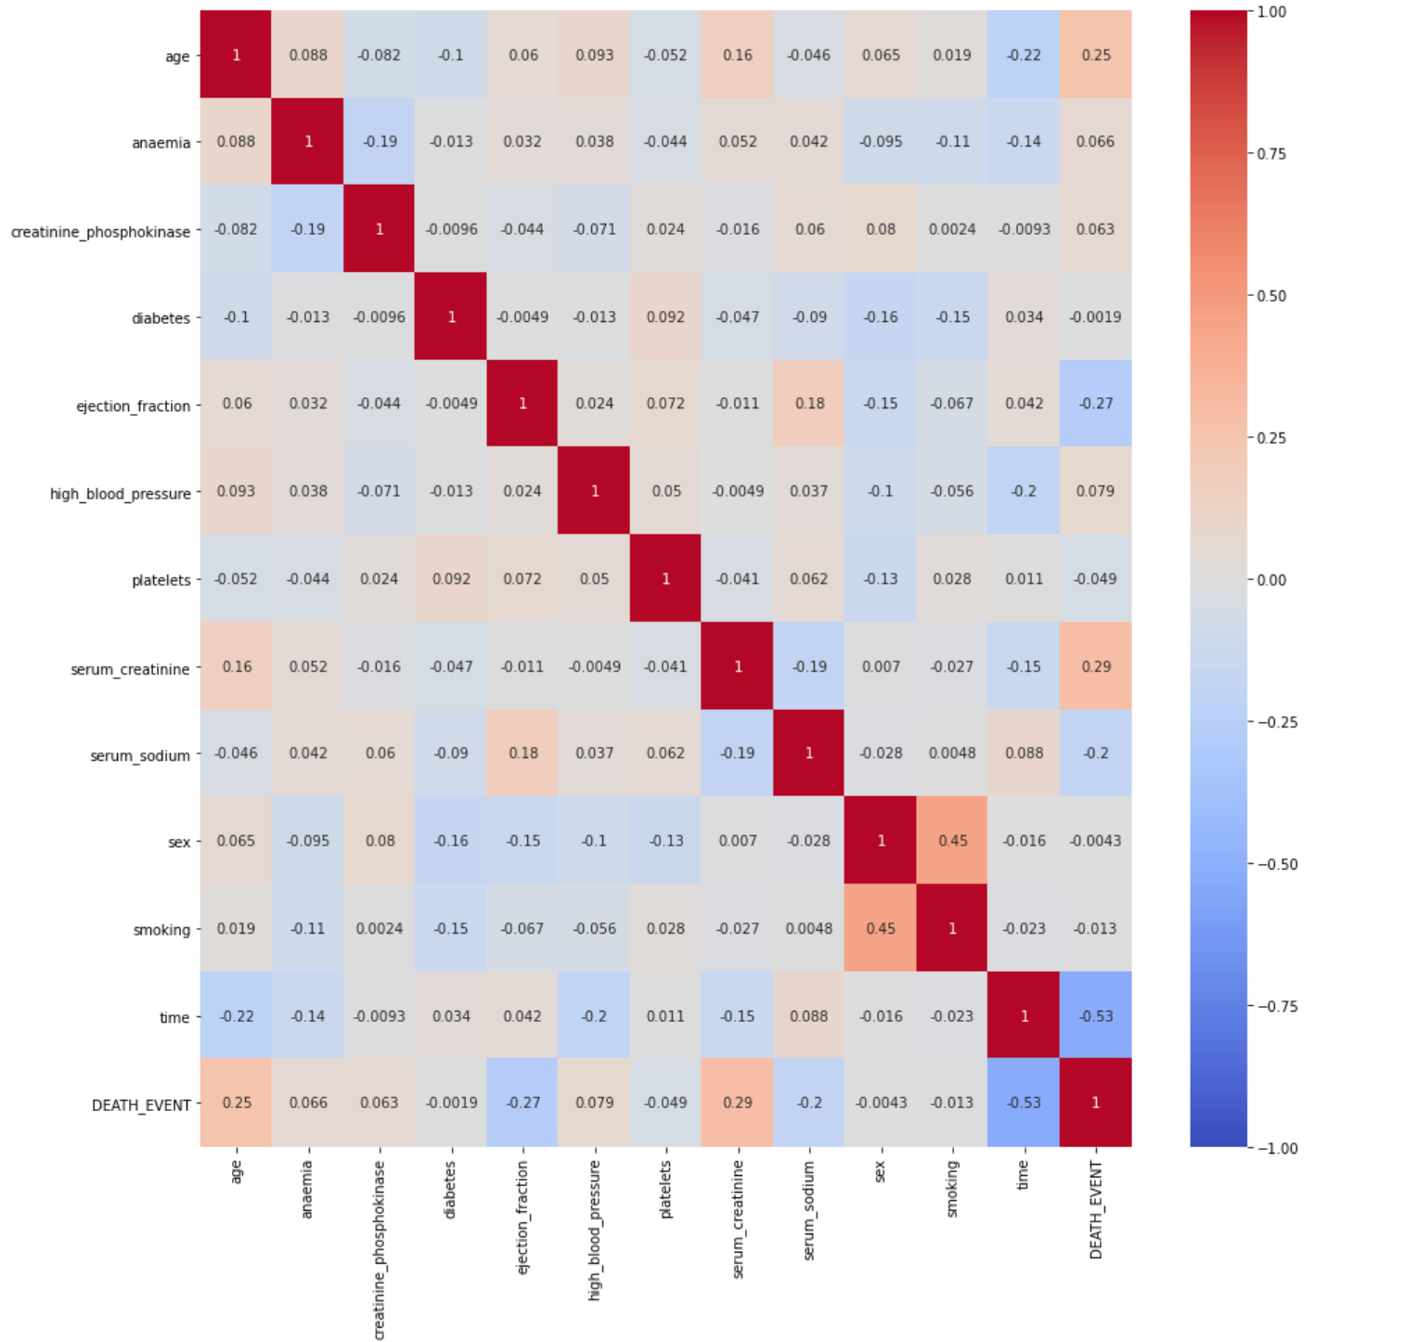
Correlation Matrix
Variables age, ejection fraction, serum creatinine, serum sodium, time has high correlation with death event which is > 0.1.
Hence, we can consider these variables while predicting the DEATH_EVENT.

Slide 14
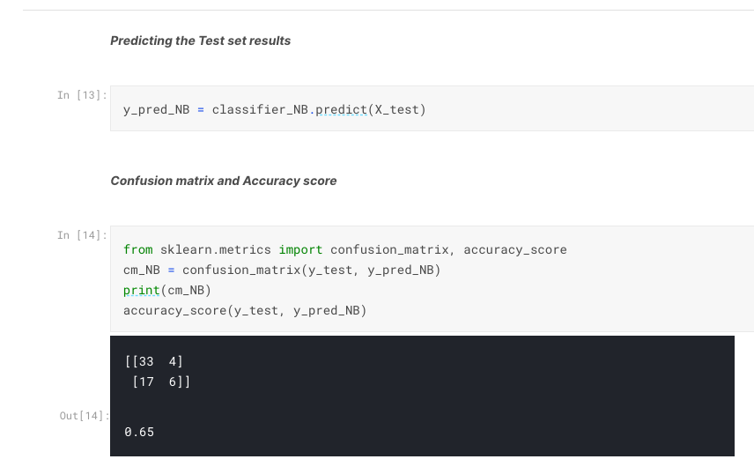
Models Built
Naïve Bayes
Features used for this model are time, ejection fraction, Serum creatinine, age.
Achieved 65% accuracy with Decision Tree model.

Slide 15
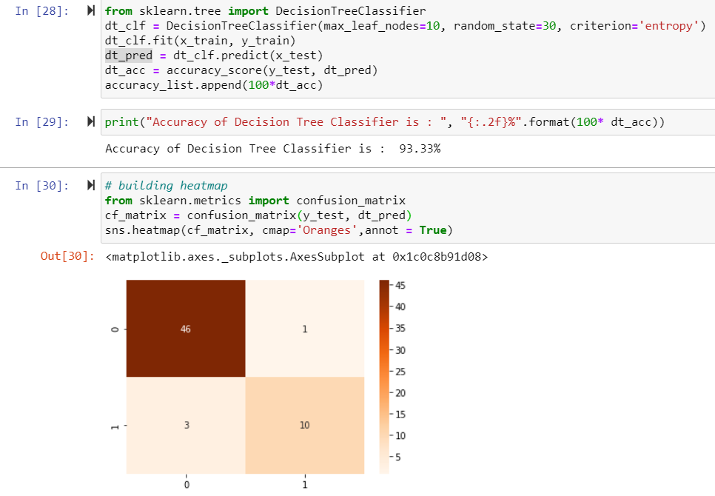
Models Built
Decision Tree
Features used for this model are time, ejection fraction, Serum creatinine, age.
Achieved 93.33% accuracy with Decision Tree model.
As most of the variables are categorical, this model works well with this dataset.

Slide 16
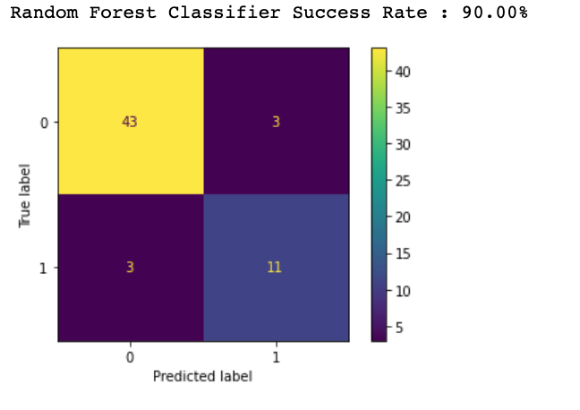
Models Built
Random Forest Classifier
Used age, ejection fraction, serum creatinine, serum sodium, time as features to the model.
The accuracy rate is 90% with random forest classifier.

Slide 17
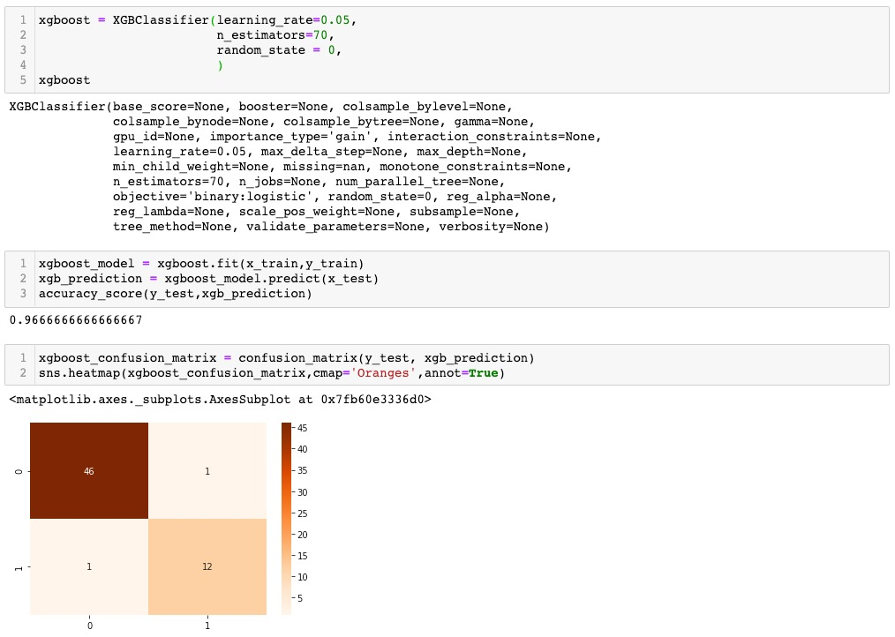
Models Built
XGBoost
Since we have seen high accuracy with Decision Tree model the ensemble models work well with decision methods.
The False Negative rate of Decision Trees is further reduced with XG boost algorithm.
The accuracy rate is 97% with XG classifier.
Hyperparameter tuning has helped us increase the accuracy upto 97%.

Slide 18
Models Built
Model | Accuracy
Naïve Bayes | 65
Decision Tree | 93.33
Random Forest Classifier | 90
XGBOOST | 97

Slide 19
Conclusion
We can see that Age and smoking has a significant impact on heart disease.
We have observed from our exploratory analysis that, anaemia and diabetes along with high blood pressure has great impact on death events.
After comparing all the models we created XG boost model performed well with 97% accuracy
we can use deep neural networks to make this model more efficient
In order to make this an end to end project we are planning to deploy this model in web platform like, pythonanywhere.com or heroku.com

Slide 20
Reference
https://en.wikipedia.org/wiki/Gradient_boosting
https://archive.ics.uci.edu/ml/datasets/Heart+failure+clinical+records

Slide 21
Thank You

