Slide 1


CarConnect - Car Rental Platform
- JANALYN MAROULA L

Slide 2
INTRODUCTION
What is CarConnect?
CarConnect is a Car Rental Management System built using Python and MySQL. It simplifies car rentals by allowing users to register, book cars and admins to manage vehicles and reservations.
It’s designed using:
Database connectivity
Unit Testing
Exception handling

Slide 3
PROBLEM STATEMENT
Manual car rental processes are time consuming and error-prone.
There is a lack of:
Real-time reservation tracking
Centralized vehicle management
Secure user authentication
Automated reporting

Slide 4
OBJECTIVES
The goals for this project:
Provide secure user & admin login
Allow customers to browse and book available vehicles
Enable admins to add, update or remove vehicles
Track reservation details and calculate rental cost
Generate reports for analysis
Write unit tests for key functions

Slide 5
TECHNOLOGY/TOOLS USED
Category Tools/Technologies
Language | Python 3.13.5
Database | MySQL Workbench
Connector | mysql-connector-python
IDE | Visual Studio Code (VS Code)
Testing | unittest (Python built-in)
Version Control | Git + GitHub

Slide 6
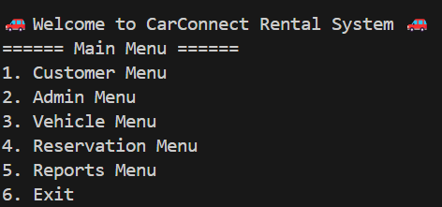
Project Overview
1. Customer Menu
Register Customer
Get Customer by ID
Get Customer by Username
Update Customer
Delete Customer
2. Admin Menu
Register Admin
Get Admin by ID
Get Admin by Username
Update Admin
Delete Admin
3. Vehicle Menu
Add Vehicle
View Vehicle by ID
View Available Vehicles
Update Vehicle
Remove Vehicle
4. Reservation Menu
Create Reservation
View Reservation by ID
View Reservations by Customer ID
Update Reservation
Cancel Reservation
5. Reports Menu
Reservation History
Vehicle Utilazation
6. Exit

Slide 7
KEY FUNCTIONALITIES
CUSTOMER MENU
Register customer-This feature allows a new user to register into the system by providing personal details such as name, email, phone number, address, username, and password. The registration date is also recorded.It checks for unique usernames and valid input data.
Get Customer by ID-This function retrieves a customer's full details using their Customer ID (a unique identifier).
Get Customer by Username-This option allows fetching a customer’s profile based on their username instead of their numeric ID.
Update Customer-This function is used when a customer wants to change or update their personal information, such as phone number, address, or email.
Delete Customer-This allows a user (or admin) to permanently remove a customer’s record from the system.

Slide 8
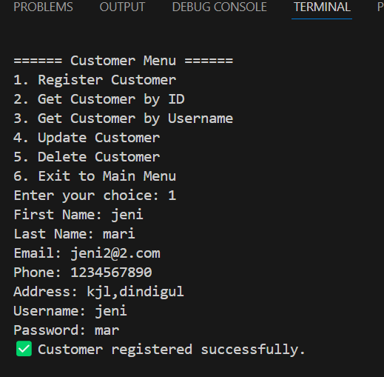
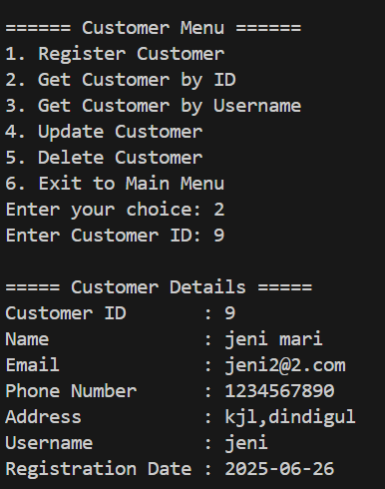
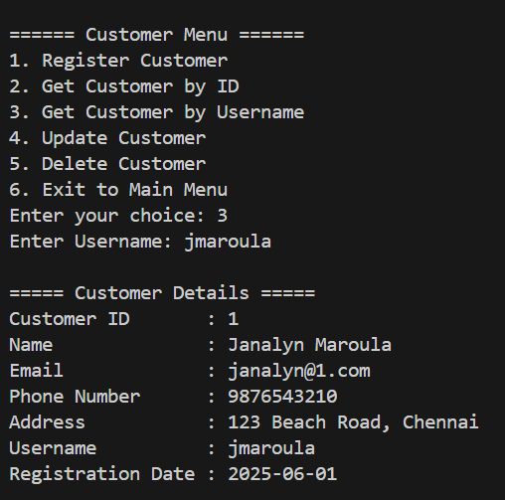
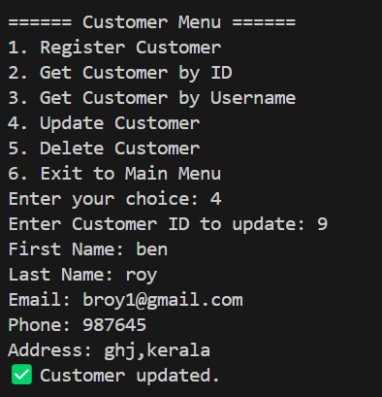


Slide 9
KEY FUNCTIONALITIES
ADMIN MENU
Register Admin-This feature is used to create a new admin account in the system by entering details like first name, last name, email, phone number, username, password, role (e.g., Super Admin, Fleet Manager).
Get Admin by ID-This function retrieves an admin’s complete profile using their unique Admin ID
Get Admin by Username-This fetches the admin's data based on the username instead of numeric ID.
Update Admin-Allows updating the admin’s personal details or role. For example, if the admin changes their contact number or needs to be promoted to a different role.
Delete Admin-This feature permanently removes an admin record from the database using their Admin ID or username.

Slide 10
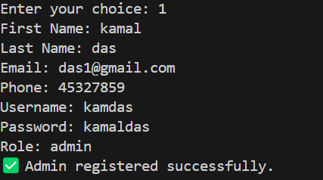
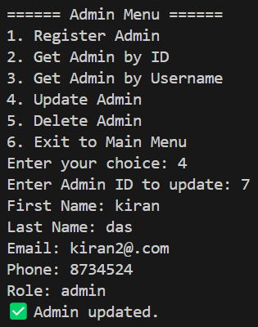
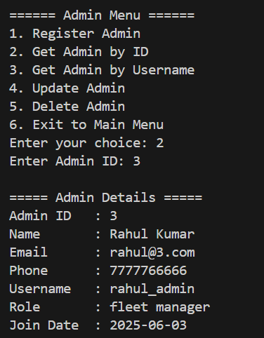
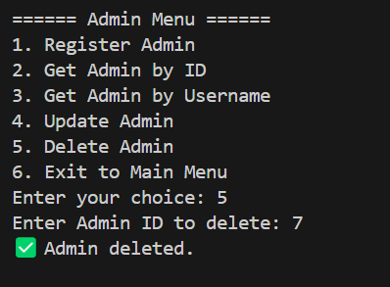
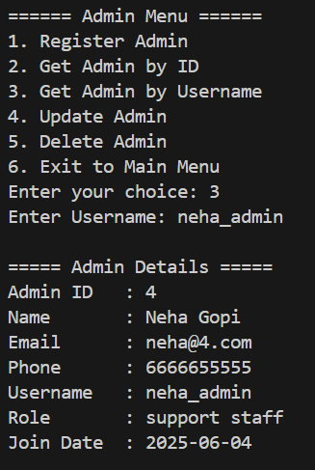

Slide 11
KEY FUNCTIONALITIES
VEHICLE MENU
Add Vehicle-This option allows an admin to add a new vehicle to the fleet by entering details such as model, make, year, color, registration number, availability status and daily rental rate.
View Vehicle By ID-Retrieves the full details of a specific vehicle using its unique Vehicle ID.
View available vehicle -Displays a list of all vehicles currently available for rent.
Update Vehicle-Enables modification of vehicle details such as color, availability, rental price, or any other property.
Remove Vehicle-Deletes a vehicle from the database using its Vehicle ID.

Slide 12
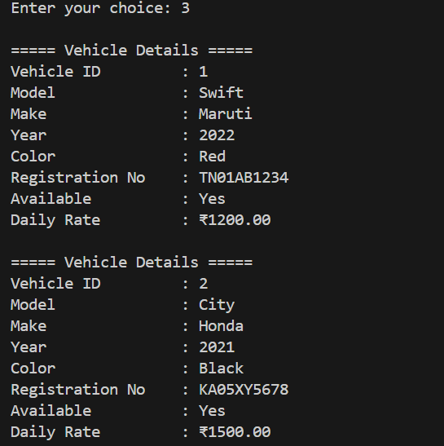
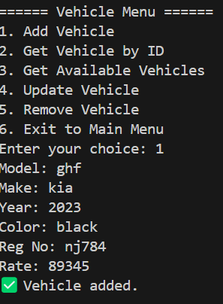
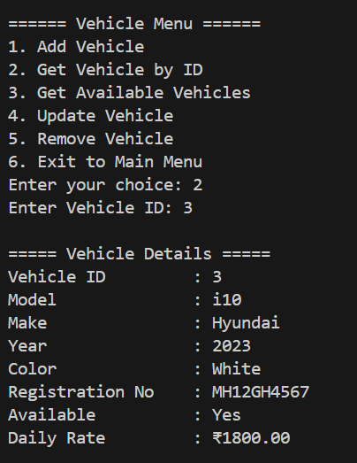
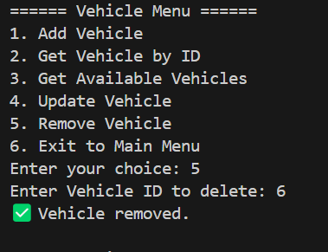

Slide 13
KEY FUNCTIONALITIES
RESERVATION MENU
Create Reservation-Allows a customer to book a vehicle for a specific start and end date.Before booking, the system checks:If the vehicle is available in the selected time range.
View Reservation by ID-Retrieves reservation details using a unique Reservation ID.
View Reservations by Customer ID-Displays all reservations made by a specific customer using their Customer ID.
Update Reservation-Allows changing reservation details like start date, end date, or vehicle, provided the vehicle is available in the new date range.
Cancel Reservation-Cancels an active reservation using its Reservation ID.

Slide 14
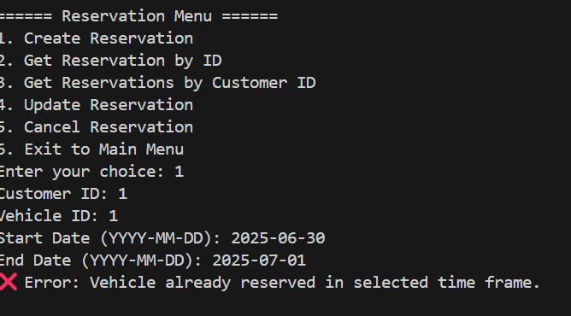
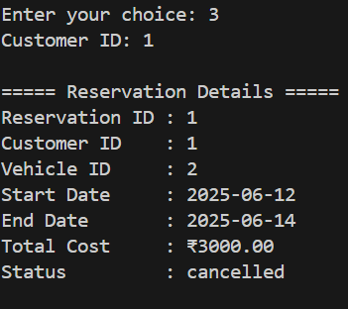
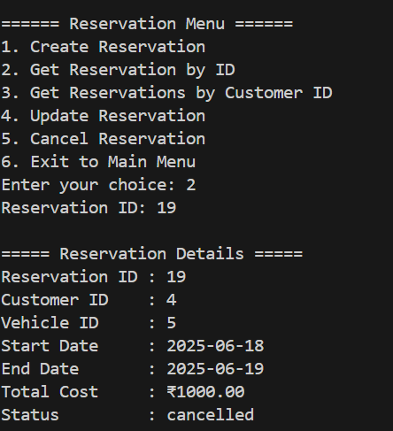
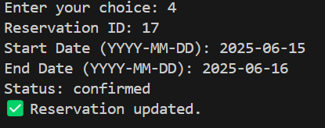
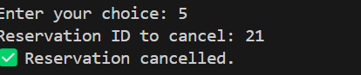

Slide 15
KEY FUNCTIONALITIES
REPORTS MENU
Reservation History-Generates a detailed report of all past reservations, including:
Reservation ID,Customer name,Vehicle details,Start & end dates,Total cost,Status (Completed/Cancelled)and Helps admins monitor booking trends and customer activity.
Vehicle Utilization-Displays a report showing how often each vehicle is used, i.e., how many days it has been reserved versus available.Useful for:Tracking fleet performance,Identifying popular vehicles,Deciding which vehicles need maintenance or replacement

Slide 16
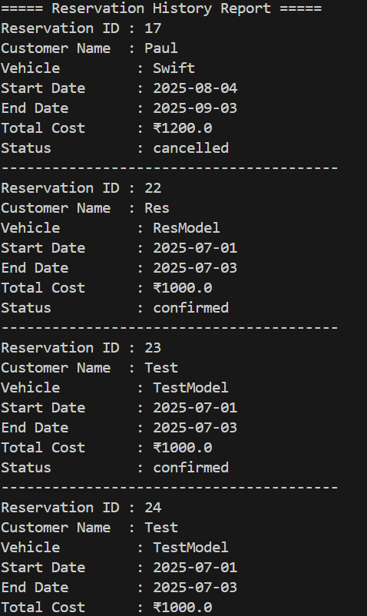
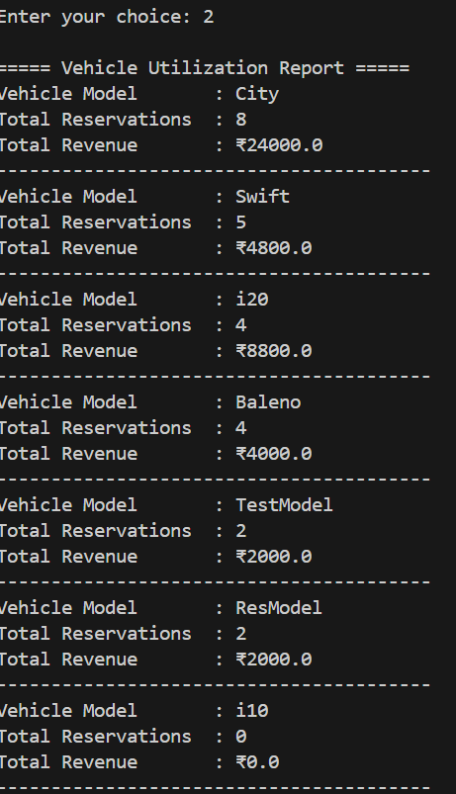

Slide 17
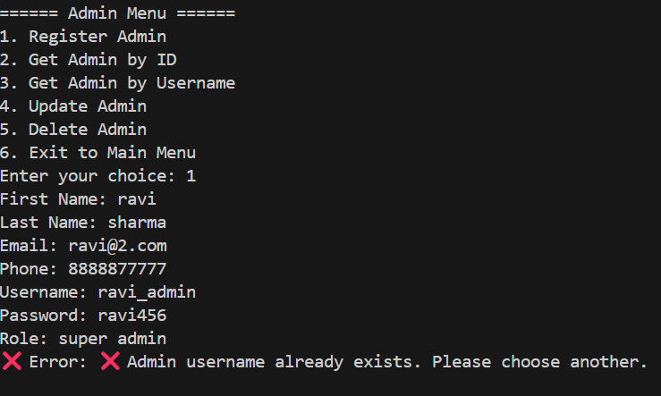
EXCEPTION HANDLING
Exception handling in the CarConnect project ensures that the application behaves predictably even in error situations.
By using custom user-defined exceptions, the system provides clear, actionable feedback without crashing the program.
1. InvalidInputException
→ Thrown when user inputs are missing or formatted incorrectly.
2. AuthenticationException
→ Raised when login credentials are incorrect.Example: Wrong password entered by customer or admin.
3. ReservationException
→ Thrown when reservation conflicts occur.Example:Booking a vehicle that's already reserved in the selected time frame.
4. VehicleNotFoundException
→ Raised when a requested vehicle does not exist.Example: Viewing details of a deleted or non-existent vehicle.
5. AdminNotFoundException
→ Raised when an admin account is not found in the system.Example:*Searching by admin ID that doesn't exist.
6. DatabaseConnectionException
→ Raised when there are issues connecting or interacting with the database.

Slide 18
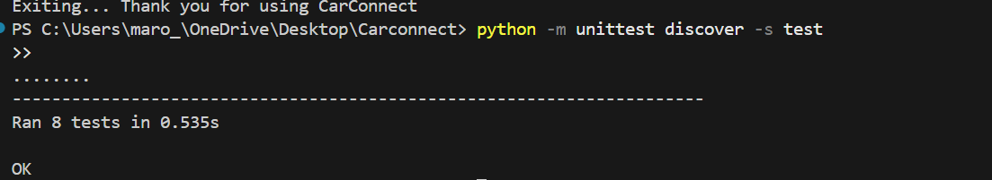
UNIT TESTING
Unit testing was conducted using Python’s unittest module to validate the core business logic of the CarConnect application.
1. Customer Service Tests
test_get_customer_by_username-Ensures customer data can be fetched using a unique username.
test_update_customer- Verifies successful update of customer’s details.
test_delete_customer-Confirms a customer can be deleted correctly.
2. Vehicle Service Tests
test_add_vehicle-Tests insertion of a new vehicle record into the database.
test_update_vehicle-Validates update of vehicle attributes like color or availability.
test_get_available_vehicles-Checks whether available (not reserved) vehicles are listed correctly
3. Reservation Service Tests
test_create_reservation-Ensures reservation can be made successfully between valid dates.
test_update_reservation-Confirms a reservation’s status or dates can be updated.
Result:Application logic is verified and stable for these critical use cases

Slide 19
CONCLUSION
The CarConnect Car Rental System is a robust and modular application developed using Python and MySQL, designed to manage car rentals efficiently.
It includes fully functional modules for Customers, Admins, Vehicles, Reservations, and Reports with real-time operations. The system adheres to object-oriented principles and clean architecture, ensuring maintainability and scalability.
Custom exceptions were implemented for better error handling, and database connections were efficiently managed through utility classes.
Comprehensive unit testing was done to validate key operations like customer management, vehicle updates, and reservation creation.
Overall, the project reflects a real-world solution, combining backend logic, database integration and test-driven development.

Slide 20
THANK YOU

