Slide 1
Using Machine Learning to find location to open an Indian Restaurant in Melbourne, Austraiya
J.Ganesapiragas

Slide 2
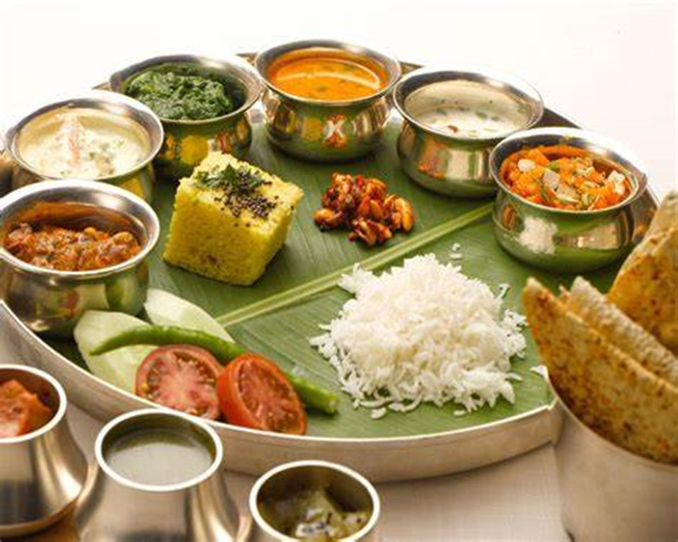
Contents
Introduction and Problem Statement
Study Area
Clustering
Suitability Analysis
Conclusion

Slide 3
Introduction and Problem Statement
Melbourne has a vibrant Indian community with Indian-born migrants making up 3 per cent of Melbourne’s total population.
Since 2001 the number of Indian-born migrants in Melbourne has more than tripled.
There may not be enough Indian restaurants in Melbourne and it might present a great opportunity for an entrepreneur who is wants to open an Indian restaurant in Melbourne.

Slide 4
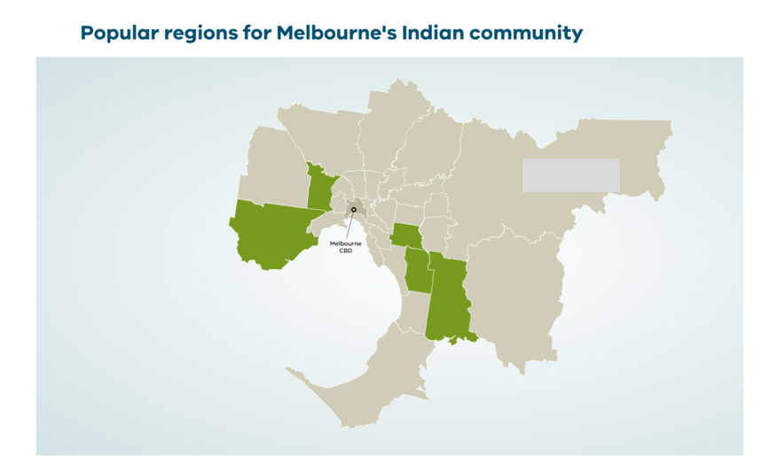
Study Area
Cassy, Greater Dandenong, Monash, Brimbank and Wyndham are the major cities where Indian population is high.
Melbourne’s Indian community available at https://liveinmelbourne.vic.gov.au/discover/multicultural-communities/indian

Slide 5
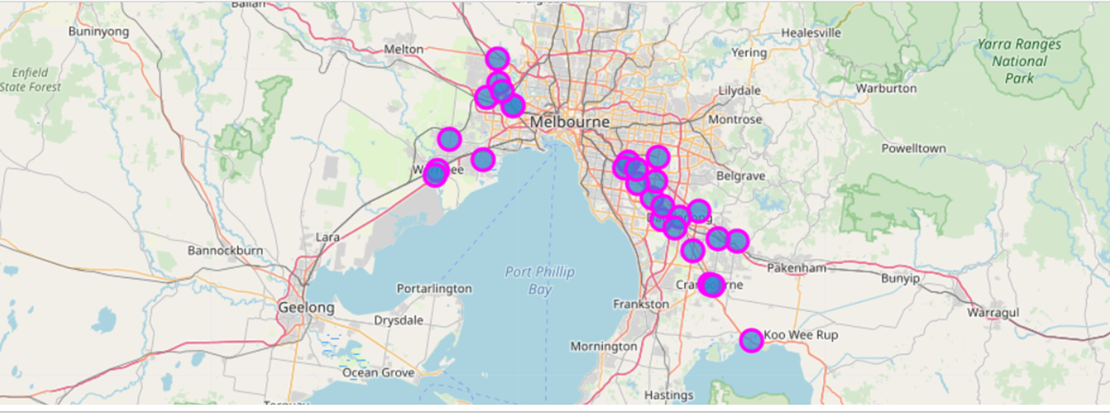
Cities considered in the analysis
Endeavour Hills, Cranbourne, Berwick, Narre Warren, Tooradin, Springvale, Keysborough, Noble Park, Dandenong, Lyndhurst, Chadstone, Oakleigh, Glen Waverley, Mulgrave,Clayton, Point Cook, Werribee, Tarneit, Taylors Lakes, Deer Park, St Albans, Sunshine, and Keilor

Slide 6
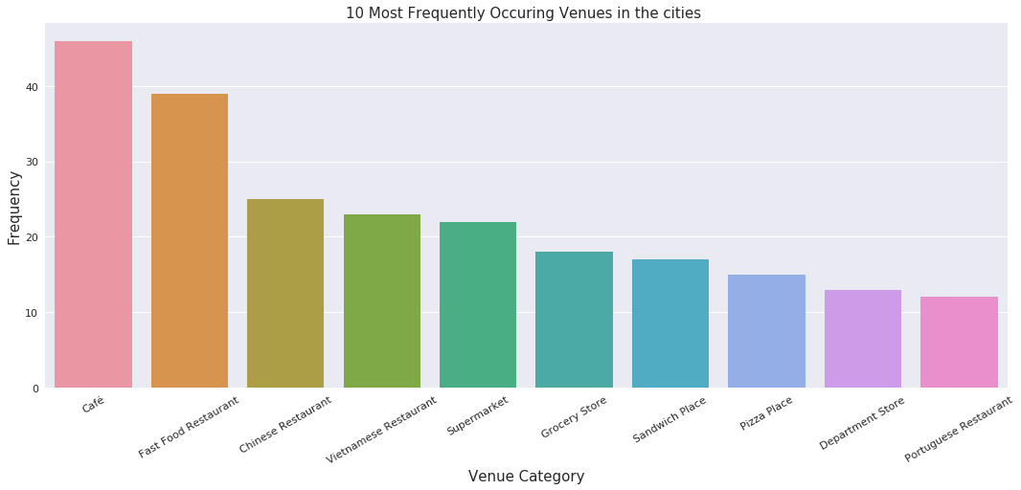
10 Most Frequently Occuring Venues in the study area

Slide 7
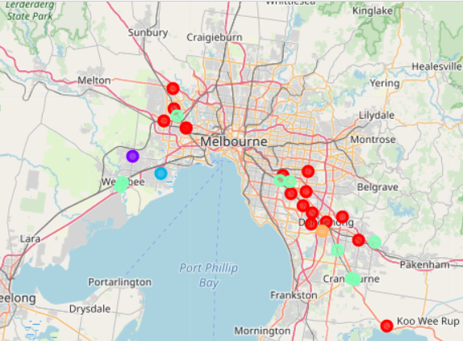
Clustering of study area
Cluster 1: Cities in this cluster exhibits highly urbanized areas where there are lots of food restaurant, café, supermarkets and shoping malls. 16 cities falls into this cluster namely Endeavour Hills, Narre Warren, Tooradin, Springvale, Keysborough, Noble Park, Dandenong, Chadstone, Glen Waverley, Mulgrave, Clayton, Taylors Lakes, Deer Park, St Albans, Sunshine, Keilor.
Cluster 2: Tarneit falls in category 2 with features of electronic stores, gas station.
Cluster 1 in red color, Cluster 2 in light green color and Cluster 3 in yellow color Cluster 4 in blue and Cluster 5 in purple color.

Slide 8
Clustering of study area
Cluster 3: Point hook falls in category 3 with unique features of plaza and flea market
Cluster 4: Cities in this cluster exhibits less urbanized areas with café,fast food restaurents, grocery stalls. Threre are 9 cities in this cluster namely,Cranbourne,Berwick,Lyndhust,Oakleigh,Werribee,Casey,Monash,Brimbank,Wyndham
Cluster 5: Greater Dandenong falls in catergorey 5 with features of flea market, Farmers,post office, café.
Cluster 1 in red color, Cluster 2 in light green color and Cluster 3 in yellow color Cluster 4 in blue and Cluster 5 in purple color.

Slide 9
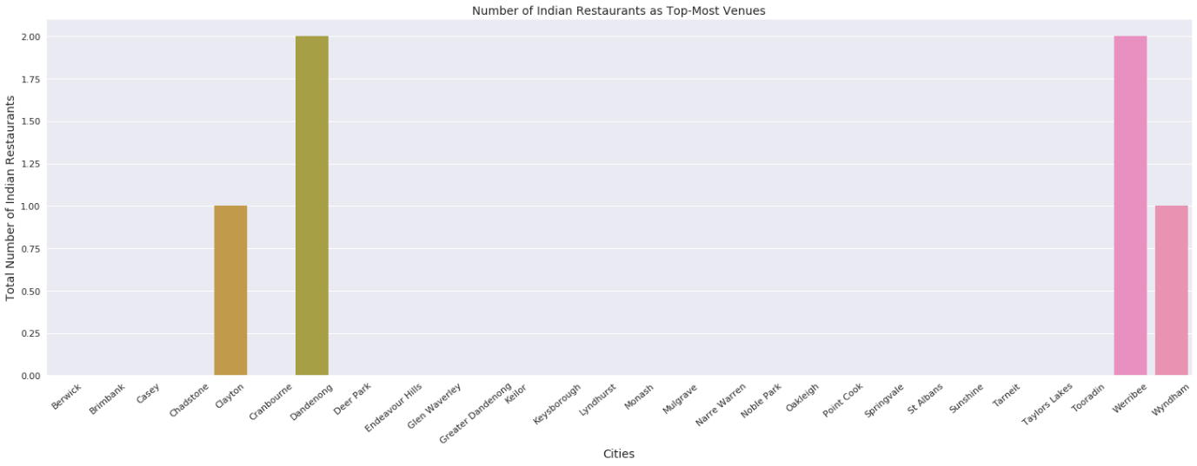
Number of Indian Restaurant in the study area

Slide 10
Suitability Analysis
Cluster 1 contains many restaurants and café, this is unsuitable as there are highly urbanized and high competition 5 Indian restaurant out of 6 exist in this cluster therefore less likely to attract new customers.
Cluster 4 contain one Indian restaurant and urbanized area therefore high land price therefore difficult to open a restaurent
Cluster 2 and 3 are not urbanized therefore less profitable.
Cluster 5 (Greater Dandenong) is moderately urbanized and land prices are affordable have potential to attract new customers,
Therefore, this project recommends the entrepreneur to open an authentic Indian restaurant in Greater Dandenong.

Slide 11
Limitations and Suggestions for Future Research
In this project, I considered the suitability of opening a restaurant based on the venues popular in the area and clustered them. And then used the existent of Indian Restaurant to assess the competition. But other factors like population desity,income level and land prices also should be considered.
Conclusion
In this project, I learned how solve a real world problem and gained skills on data preparation analysis and machine learning tool like clustering.
References
Melbourne’s Indian community available at https://liveinmelbourne.vic.gov.au/discover/multicultural-communities/indian

