Slide 1
WELCOME

Slide 2
Salary Data Analysis Using Excel
Student Name: Janani E
Register Number: 312200847
Department: III B.com (general)
College: Pachaiyappas college For women

Slide 3
Project Title
Salary and compensation Analysis
Through Excel Data Modeling

Slide 4
AGENDA
Problem statement
Project overview

Slide 5
Problem Statment
Salary and compensation analysis through excel data modelling involves using excel tools and techniques to analyze and interpret compensation data. Here’s a general outline of the steps involves :

Slide 6

SALARY PROCESS

Slide 7
Project Overview
Employees salary statement analysis to review though employers must issue salary slips to their employees, it is not mandatory to provide printed slips. For employees, a salary slip works as proof of income it provide the detail statements of expenses on management.

Slide 8
Our Solution And Its Value Proposition
CONDITIONAL FORMATING-MISSING VALUES
FILTER-FILTER OUT MISSING VALUES
PIVOT TABLE-SUMMARY OF DATA
GRAPH DATA VISUALISATION

Slide 9
DATA SET DESCRIPTION
Employee data set –kaggle
Features-21
Considered-7
Name-Text
Provident Fund-Numerical
D.A-Numerical
Gross salary-Numerical
Net salary-Numerical

Slide 10
THE “WOW” IN OUR SOLUTION
=SALARY IFS(G15>=29182,”VERY HIGH”,G15>,”HIGH”G15>13,”Low”)

Slide 11
Modelling
1. Data Collection
2. Download Kaggle
3. Edunet Dashboard-File download FEATURES COLLECTION
4. Employees name
5. Department
6. Salary
7. Position
8. location
9. Employees Number
10. PF UAN
11. PF Number
12. ESI Number
13. Joining Date
14. Leaving Date
Using Bar Diagram For Summary

Slide 12
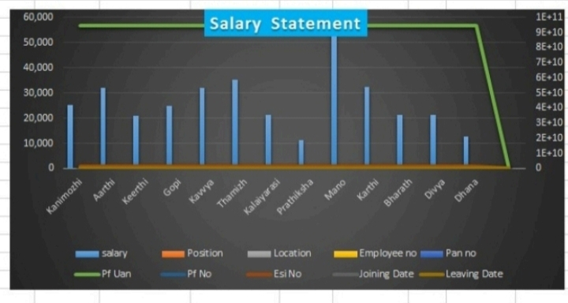
RESULTS

Slide 13
CONCLUSION
The salary statement provides a clear breakdowns of the employee ‘s total earnings, including basic pay, allowances and bonuses, along side statutory and other deduction.
The net salary payable is calculated after on applicable deductions.
This statement ensures transparency and accuracy in salary disbursement supporting both the employee and employer in financial planning.

Slide 14
THANK YOU

