Slide 1
Presentation on "IPHONE SALES ANALYSIS”
PRESENTED BY-
JANANI S

Slide 2
iPhone Sales Analysis iPhone Sales Analysis, This analysis looks at iPhone sales data to understand trends and regional sales patterns. The goal is to gain insights that can inform business decisions.

Slide 3
PROGRAMMING LANGUAGE PYTHON Python is a high-level, interpreted programming language known for its simplicity and versatility. It's widely used for web development, data analysis, machine learning, and automation. Python's syntax is easy to learn, making it a great language for beginners.

Slide 4
LIBRARIES PANDAS Pandas is a powerful Python library for data manipulation and analysis. It provides data structures like Series and Data Frame to efficiently handle structured data. Pandas is widely used in data science and analytics. Matplotlib Matplotlib is a popular Python library for creating static, animated, and interactive visualizations. It provides a wide range of visualization tools, including line plots, scatter plots, histograms, and more. Matplotlib is widely used in data science, research, and education.

Slide 5
Seaborn Seaborn is a Python data visualization library built on top of Matplotlib. It provides a high-level interface for creating informative and attractive statistical graphics. Seaborn offers various visualization tools, including heatmaps, scatterplots, and bar plots, with a focus on aesthetics and clarity.

Slide 6
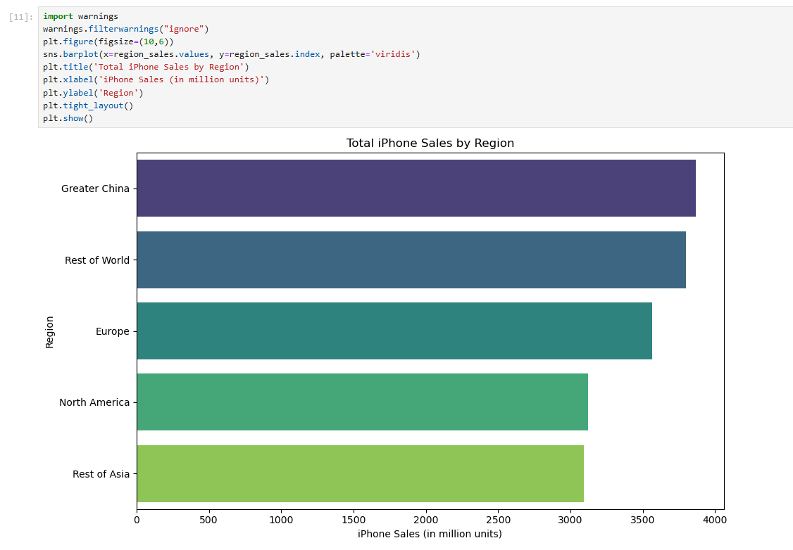

Slide 7
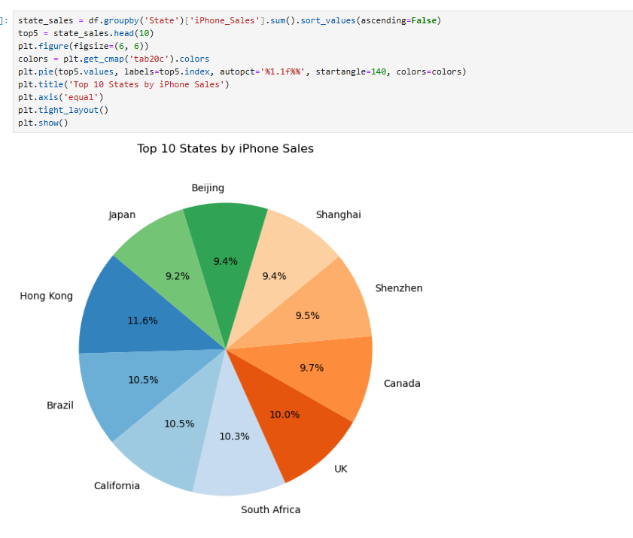

Slide 8
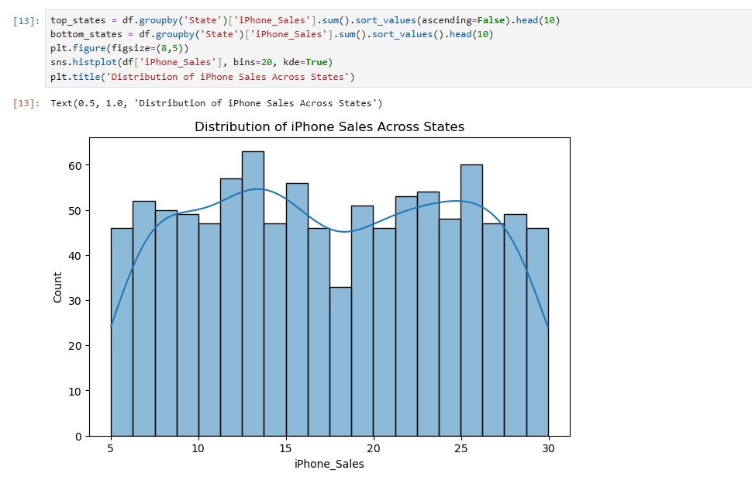

Slide 9
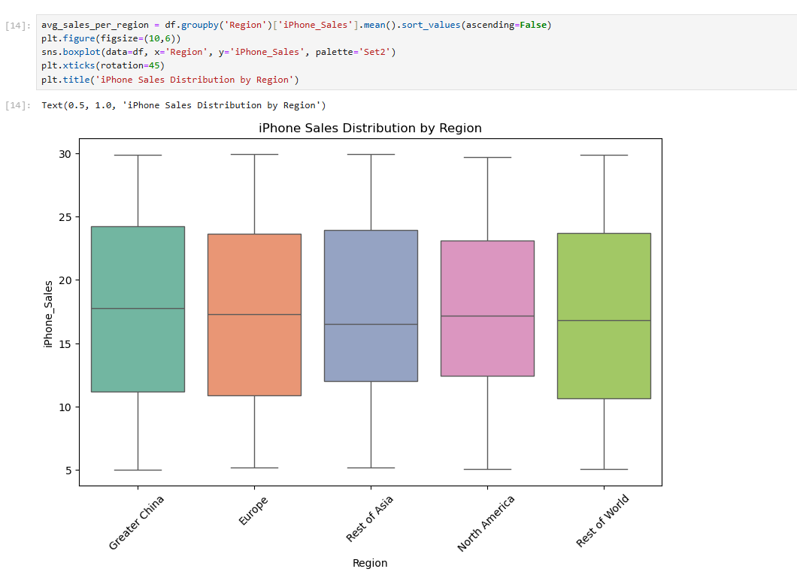

Slide 10
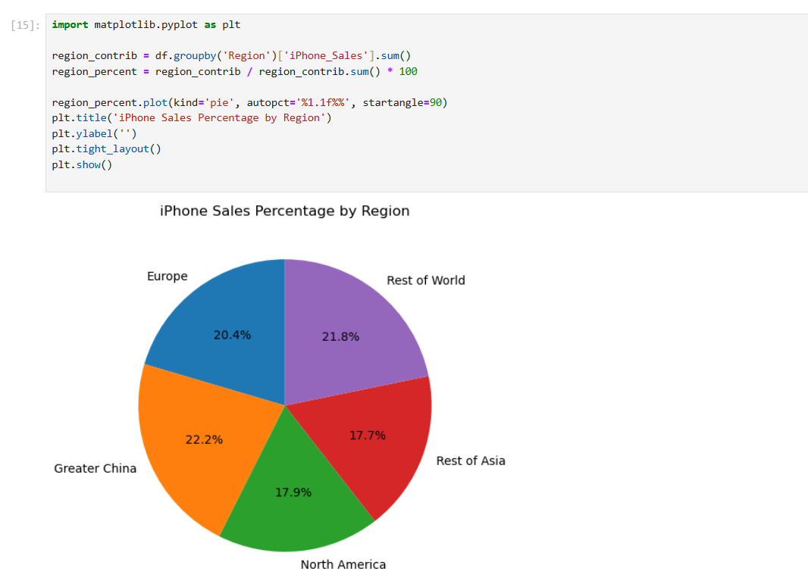

Slide 11
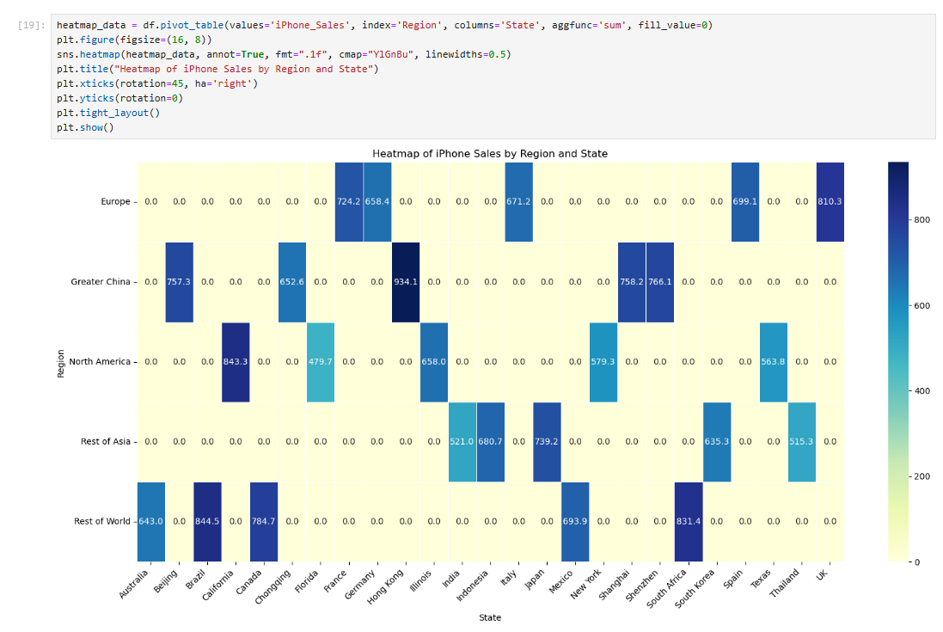

Slide 12
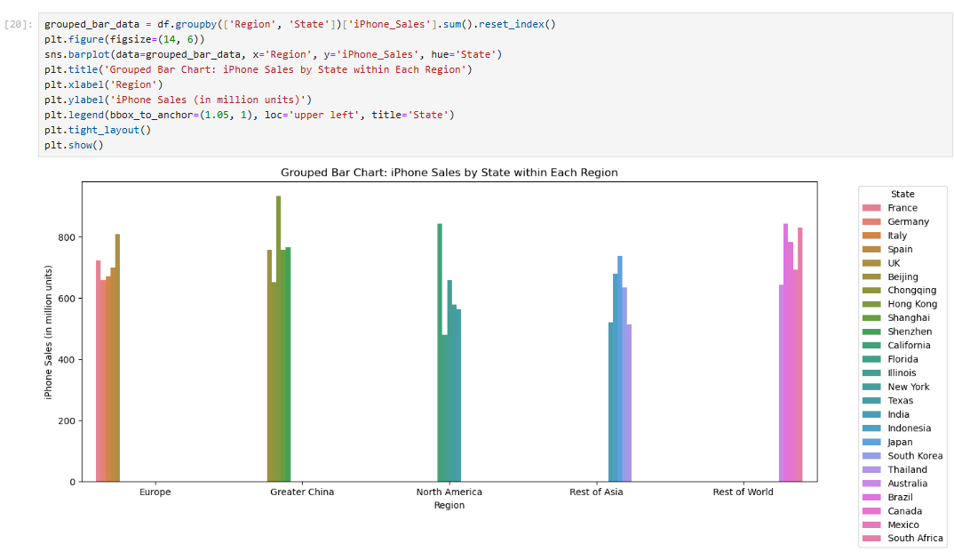

Slide 13
CONCLUSION
In 2024, iPhone sales continued to perform strongly, with noticeable growth driven
by the launch of the iPhone 15 series. The United States and China remained the top markets, contributing the highest share of sales, while Europe followed closely behind. Although sales in emerging markets like India and Brazil grew at a slower pace, there are clear signs of increasing demand, suggesting potential for future expansion.
Overall, 2024 was a successful year for iPhone sales, marked by strong performance in developed markets and growing interest in developing regions.

Slide 14
THANK YOU

