Slide 1
YES BANK • EQUITY RESEARCH PROJECT
Stock Closing Price
Prediction
From ₹367.90 peak to single digits — decoding a decade of Yes Bank's stock behaviour through Exploratory Data Analysis and Machine Learning Regression.
Janani M
Individual Contribution | EDA + ML Regression
github.com/Janani23092/YES-BANK-STOCK-PRICE-PREDICTION

Slide 2
ROADMAP
What We'll Cover
01
02
03
Business Context
The Dataset
Exploratory Analysis
Why Yes Bank, and what problem we're solving
185 months of OHLC prices, 2005–2020
20 charts uncovering trend, risk & relationships
04
05
06
Hypothesis Testing
Feature Engineering
ML Models & Results
Statistically validating what we observed
Preparing data the right way for modelling
3 models compared, 1 clear winner
07
Business Recommendations
What this means for investors & the bank
02

Slide 3
WHY THIS MATTERS
The Yes Bank Story
Yes Bank is one of India's most closely watched private banks — not for growth, but for its collapse. The 2018 fraud case involving founder Rana Kapoor triggered one of the sharpest stock declines in Indian banking history.
THE CRISIS IN NUMBERS
₹367.90
1
Given monthly OHLC prices (Jul 2005 – Nov 2020), build a model to predict monthly Close price
Peak close price — July 2018
2018
2
Understand and quantify the effect of the 2018 governance crisis on stock behaviour
Fraud disclosure & governance crisis
3
Deliver a model simple and transparent enough for analysts to trust and deploy
Mar 2020
RBI-led moratorium & reconstruction
~97%
Peak-to-trough decline in stock value
03

Slide 4
KNOW YOUR DATA
The Dataset at a Glance
185
5
0
0
Monthly Records
Columns
Missing Values
Duplicate Rows
Jul 2005 → Nov 2020
Date, Open, High, Low, Close
Fully clean — no imputation needed
Every record is unique
VARIABLE DEFINITIONS
Open Opening stock price (₹) for the month
High Highest price (₹) touched during the month
Low Lowest price (₹) touched during the month
Close Target variable — closing price (₹) to predict
04

Slide 5
PREPARING THE DATA
Data Wrangling
Before any analysis, the raw dataset needed a few essential transformations to become fully analysis-ready.
1
2
3
4
Datetime Conversion
Year & Month Extraction
Monthly_Range Feature
Pct_Change Feature
'Jul-05' style strings converted into proper datetime objects, then sorted chronologically
Derived for time-based grouping and seasonality checks
Engineered as High − Low, a proxy for intra-month volatility
Month-over-month % change in Close, to spot the sharpest swings
Key insight: Monthly_Range spikes dramatically during 2018–2020, foreshadowing the volatility that would later define the crisis period and shape our train/test split strategy.
05

Slide 6
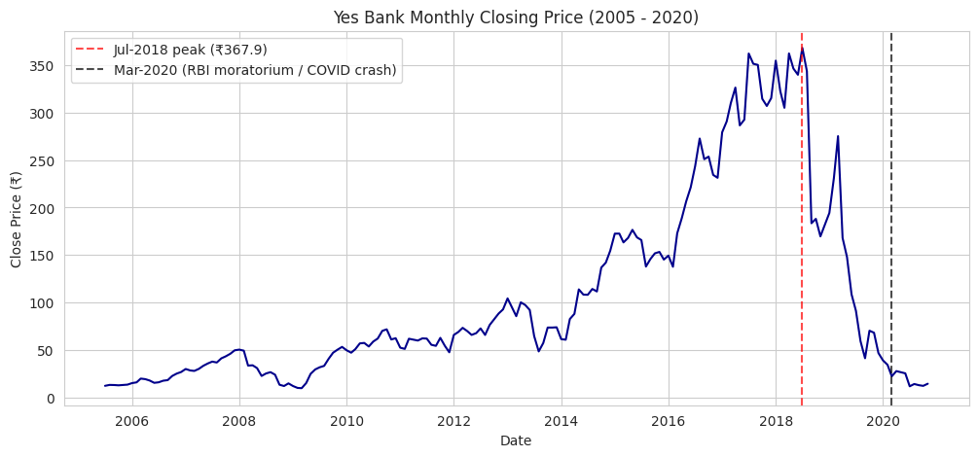
THE BIG PICTURE
Three Acts of a Stock's Journey
Steady Climb
2005 – 2016
Slow, consistent growth after listing
Explosive Rally
2017 – Jul 2018
Peak of ₹367.90, driven by bull optimism
Sustained Crash
Late 2018 – 2020
Fraud crisis, RBI moratorium, COVID-19
06

Slide 7
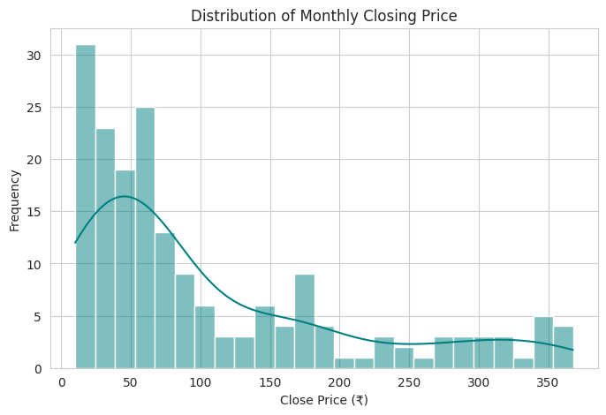
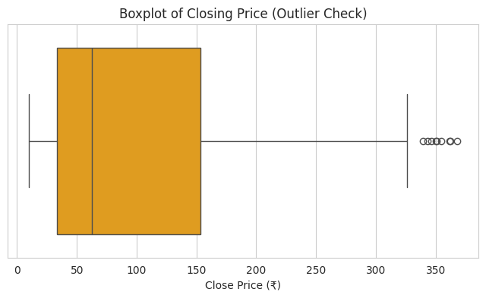
UNIVARIATE ANALYSIS
Understanding the Price Distribution
Insight: Close price is heavily right-skewed — most months stayed under ₹100, with a long tail up to ₹368. Boxplot 'outliers' beyond ₹200 are genuine bull-run prices, not data errors, and must be kept in modelling.
07

Slide 8
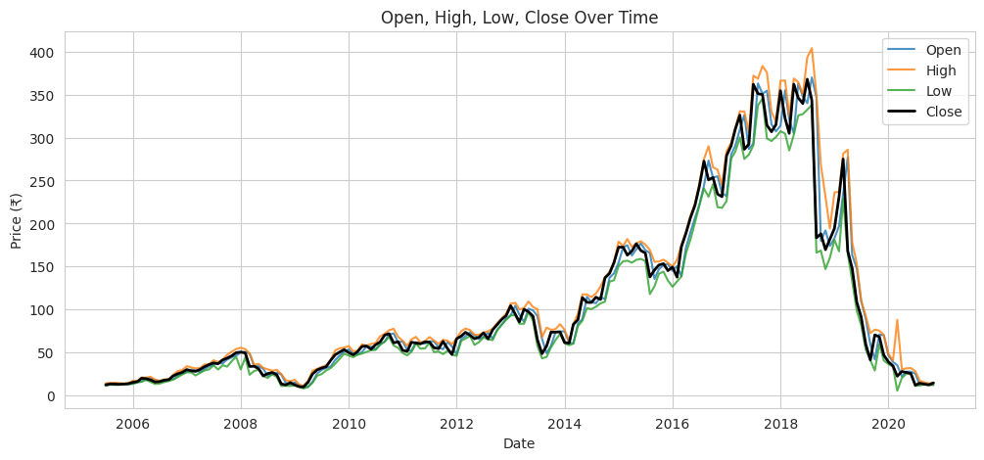
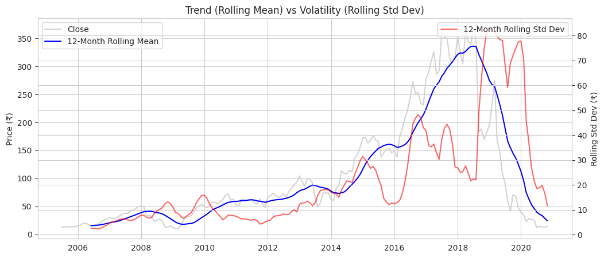
MULTIVARIATE TIME-SERIES VIEW
How OHLC Prices Move Together
WHY THIS MATTERS
All four series — Open, High, Low, Close — move almost in lock-step across the entire 15-year history.
The gap between High and Low only widens visibly during 2018–2020 — a direct visual signal of rising volatility during the crisis.
This strongly signals Open, High, and Low will be excellent predictors of Close.
12-month rolling mean & volatility — variance clearly rises post-2018
08

Slide 9
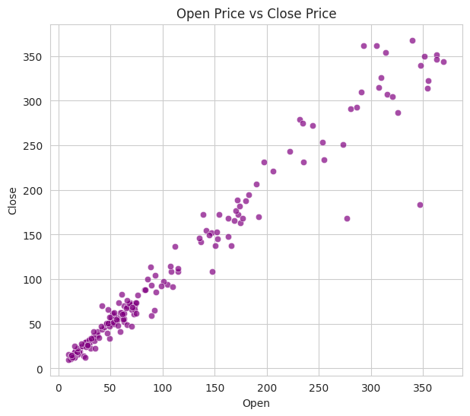
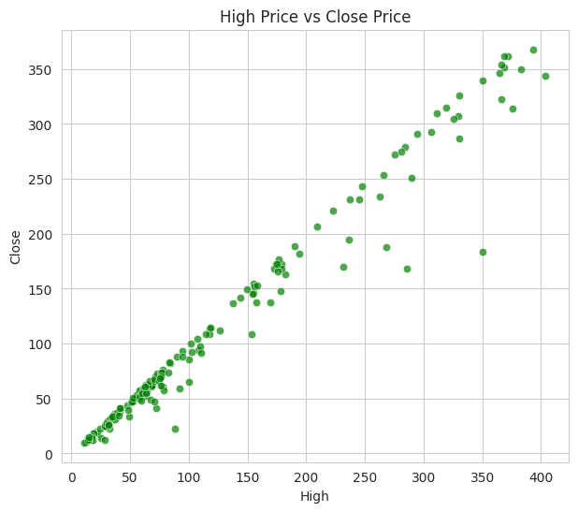
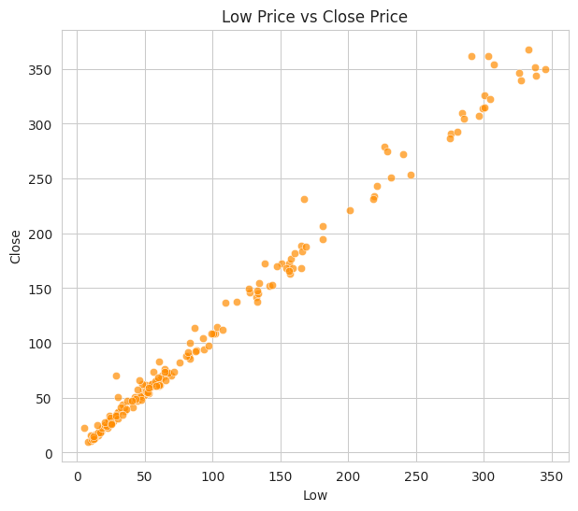
BIVARIATE ANALYSIS
Feature vs. Target: Near-Perfect Linearity
Open → Close r ≈ 0.98
High → Close r ≈ 0.985
Low → Close r ≈ 0.995
Insight: Low has the tightest relationship with Close of all three predictors — meaning even a single-feature model using Low alone would already be a strong baseline.
09

Slide 10
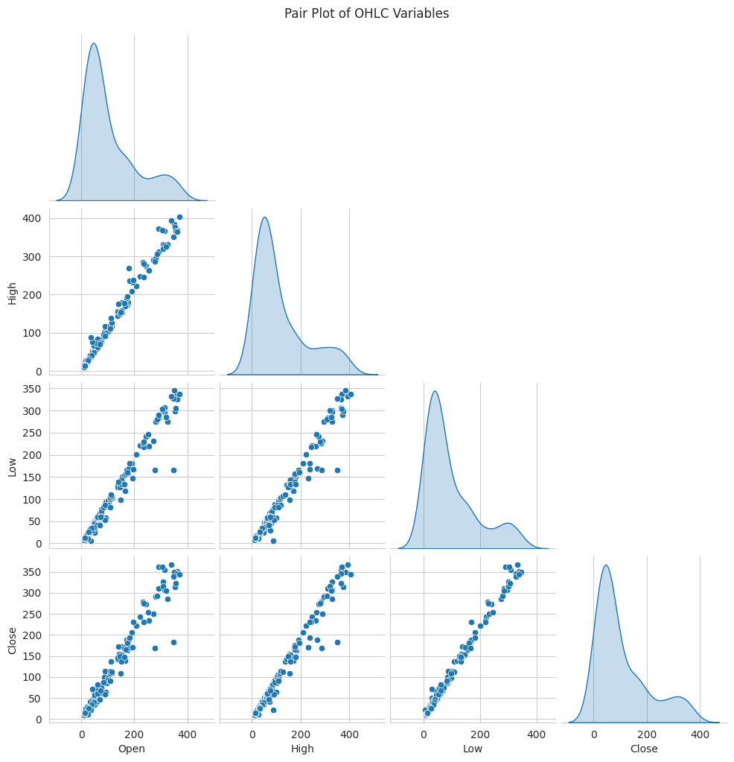
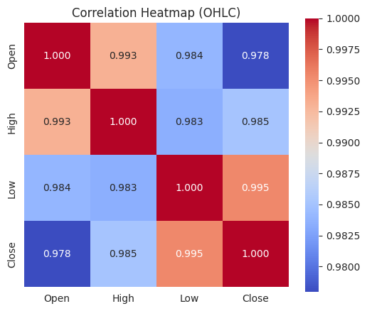
MULTIVARIATE ANALYSIS
Correlation Heatmap & Pair Plot
ALL PAIRWISE
CORRELATIONS
> 0.97
Low–Close is tightest at ~0.995
Confirms strong multicollinearity — expected, and manageable via Ridge regularization
10

Slide 11
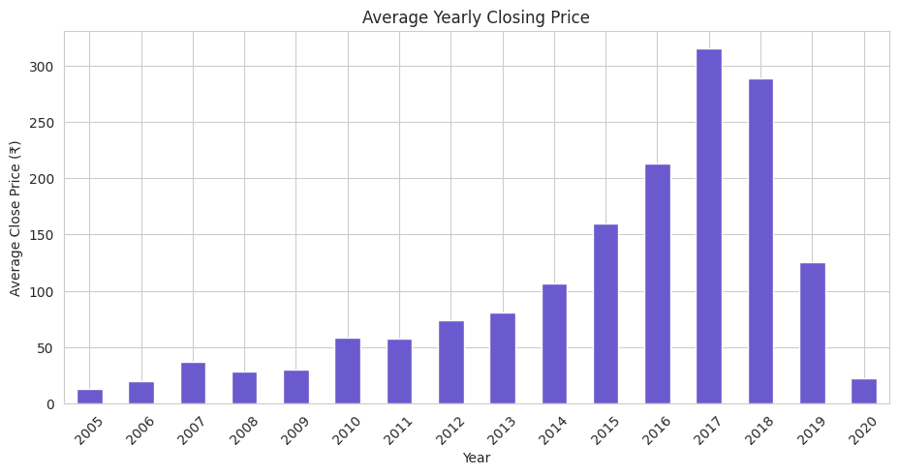
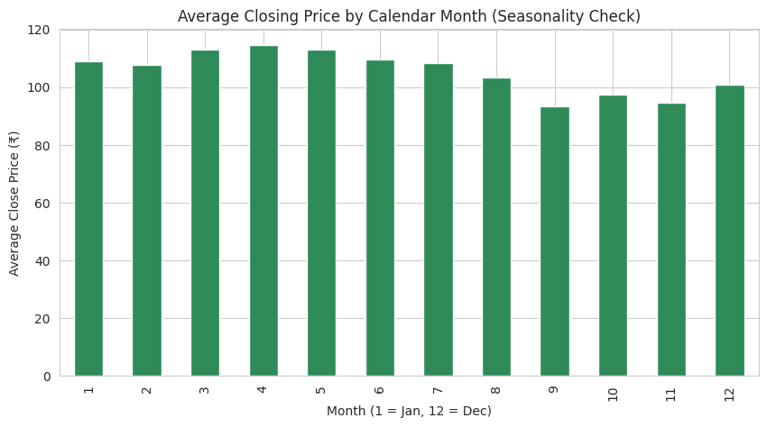
TIME-BASED PATTERNS
Yearly Trend vs. Calendar Seasonality
Yearly view: Steady rise 2005–2017, a 2018 spike, then steep 2019–20 decline — the entire story condensed into one chart.
Seasonality: No consistent calendar-month pattern found — useful negative finding that saves effort on unneeded seasonal features.
11

Slide 12
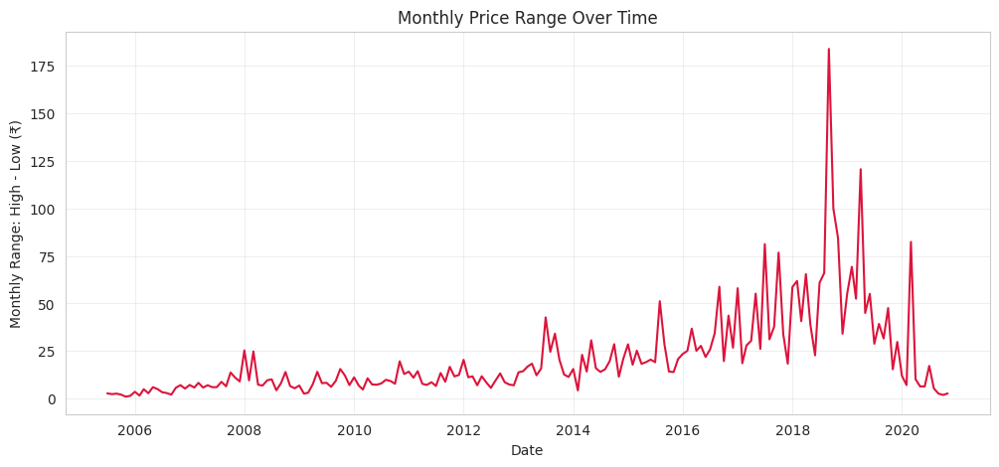
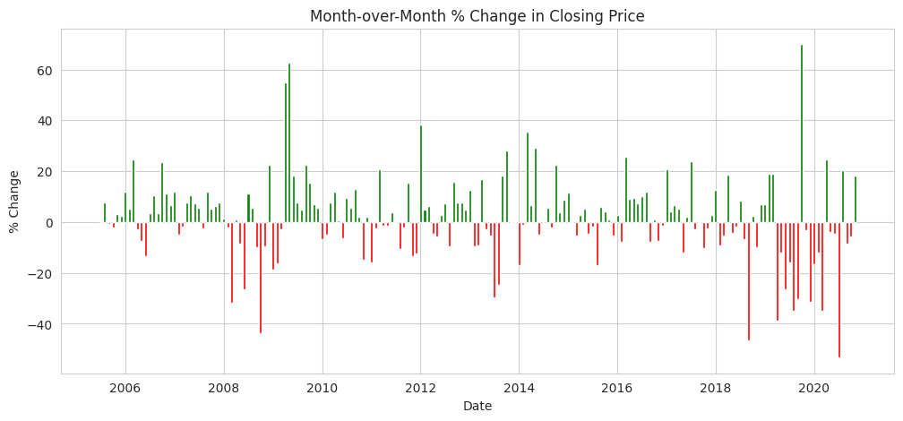
RISK SIGNALS
Volatility Tells Its Own Story
Monthly High–Low Range Over Time
Month-over-Month % Change (green = gain, red = loss)
Multiple 30–50%+ single-month crashes cluster in 2018–2020
far larger and more frequent than anything seen from 2005–2017. These line up directly with news events: the fraud disclosure, RBI action, reconstruction scheme, and COVID-19 — confirming the crisis was a series of repeated shocks, not one event.
12

Slide 13
STATISTICAL VALIDATION
Hypothesis Testing
Three data-driven hypotheses were tested to statistically confirm what the charts suggested.
H1
H2
H3
High vs. Close Correlation
Pre- vs Post-Crisis Mean Close
Post-Crisis Volatility Higher
Pearson correlation test
Welch's two-sample t-test
One-sided Welch's t-test
r = 0.9851
t = -2.36
t = 4.39
p = 9.97e-142
p = 0.0230
p = 4.73e-05
Significant — strongly reject H₀
Significant — means differ
Significant — volatility rose
13

Slide 14
GETTING MODEL-READY
Feature Engineering & Pre-processing
Missing Values
None found — zero imputation needed
Outlier Treatment
IQR-flagged 2018 peaks kept — they're real market data, not errors
Categorical Encoding
Not required — no categorical columns in this dataset
Feature Selection
Open, High, Low retained (all r > 0.97 with Close); Year/Month/Monthly_Range dropped as redundant or non-generalizing
Data Scaling
StandardScaler applied — required for Ridge Regression's scale-sensitive penalty
Dimensionality Reduction
Not needed — only 3 features, no PCA required
14

Slide 15
CRITICAL MODELLING DECISION
Why a Chronological Split?
A random train/test split would let the model 'see the future' — training on data from both before and after the 2018 crash. We used a strict time-ordered 80/20 split instead.
TRAINING SET — 148 months (80%)
TEST (20%)
Jul-2005 to Oct-2017
37 months
↑ Split point: Oct 2017 — deliberately includes part of the volatile crisis period in the test set for an honest, hard evaluation
This ensures the model is always tested on data that comes strictly after its training window — a realistic, leakage-free simulation of real-world deployment.
15

Slide 16
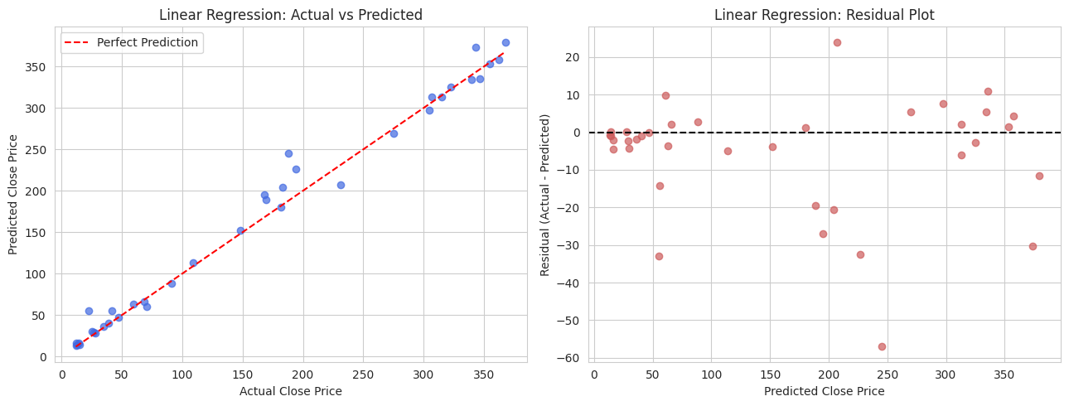
MODEL 1 OF 3
Linear Regression
TEST SET PERFORMANCE
R²
0.9848
MAE
₹9.78
RMSE
₹15.82
Ordinary Least Squares regression using Open, High, Low as features.
No hyperparameters to tune — instead validated using 5-fold TimeSeriesSplit cross-validation for stability, achieving a mean CV R² of 0.899, confirming the strong test performance isn't a lucky single split.
16

Slide 17
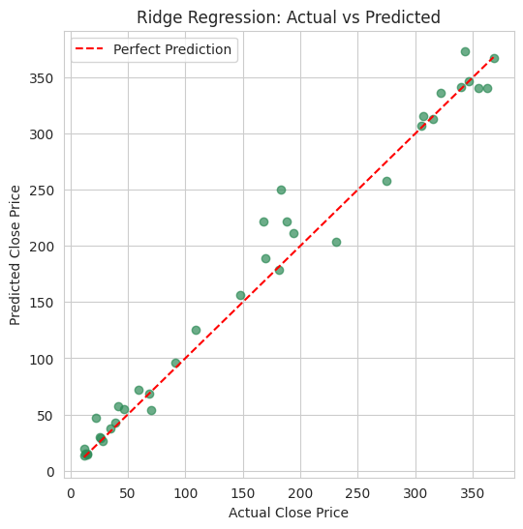
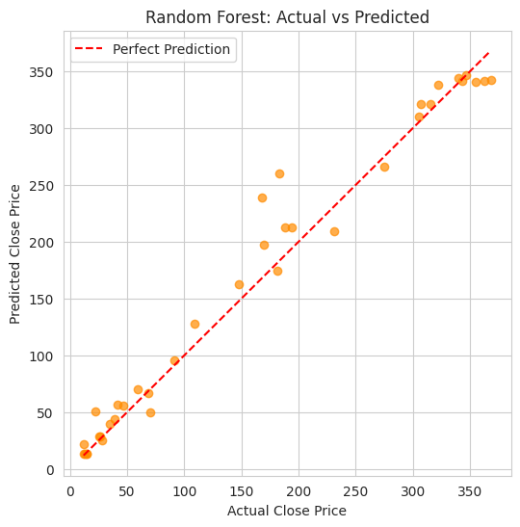
MODEL 2 & 3 OF 3
Ridge Regression & Random Forest
TUNED RESULTS
Ridge (α=0.001)
R² 0.9848 • MAE ₹9.79 • RMSE ₹15.82
Random Forest (depth=8, n=200)
R² 0.9709 • MAE ₹13.96 • RMSE ₹21.85
Ridge ≈ Linear.
RF falls short.
Grid search picked minimal Ridge regularization — confirming Linear Regression was already close to optimal. Random Forest, despite tuning, has too little data (148 rows) to beat a clean linear relationship.
17

Slide 18
HEAD-TO-HEAD
Model Comparison
Model | R² (Test) | MAE (₹) | RMSE (₹) | Verdict
Linear Regression | 0.9848 | 9.78 | 15.82 | ★ Best & Simplest
Ridge Regression (tuned) | 0.9848 | 9.79 | 15.82 | Near-identical
Random Forest (tuned) | 0.9709 | 13.96 | 21.85 | Falls short
FINAL MODEL SELECTED
Linear Regression
was chosen as the final model — best test R² (0.985), fully interpretable coefficients, instant training, and no overfitting risk on this small 185-row dataset. Random Forest's added complexity brings no accuracy benefit here.
18

Slide 19
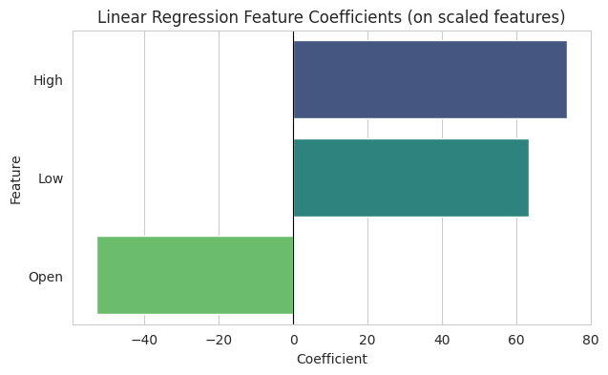
INTERPRETABILITY
What Drives the Prediction?
Close = 92.10 + (coef × Open, High, Low)
High
Dominant positive driver
+73.70
Low
Second strongest contributor
+63.39
Open
Slightly negative once High/Low are known — expected due to multicollinearity
−52.97
Sanity check: predicting Nov-2020 from Open ₹12.41, High ₹14.90, Low ₹12.21 → Predicted Close ₹14.64 vs. Actual ₹14.67
19

Slide 20
WRAPPING UP
Conclusion & Recommendations
1
Use Open, High, Low as core features
Correlations above 0.97 with Close support a simple, interpretable regression — no need for complex non-linear models.
2
Treat 2018 onward as a structurally different regime
A model trained only on 2005–2017 data would be dangerously misleading post-crisis. Always evaluate with a chronological split.
3
Deploy Linear Regression as the production model
R² 0.985, MAE ~₹9.78 — accurate, fast, transparent, and easy for stakeholders to trust and audit.
This model should be used as a decision-support tool alongside human judgement — not a guaranteed market forecast.
Thank You
Janani M | github.com/Janani23092/YES-BANK-STOCK-PRICE-PREDICTION
20

