Slide 1

Employee Data Analysis using Excel
STUDENT NAME: S.JANANI
REGISTER NO: 312200766/ FFBCD5929F5878996924539D832E41D3
DEPARTMENT: B.COM ( G ) COMMERCE
COLLEGE: PACHAIYAPPAS COLLEGE FOR WOMEN KANCHIPURAM
1
Notes:
1

Slide 2

PROJECT TITLE
Employee Performance Analysis using Excel
2

Slide 3



AGENDA
Problem Statement
Project Overview
End Users
Our Solution and Proposition
Dataset Description
Modelling Approach
Results and Discussion
Conclusion
3/21/2024 Annual Review
3

Slide 4

PROBLEM STATEMENT
The performance of employees plays a crucial role in driving the organization's growth. To foster a positive environment, it is important to appreciate and recognize employees' contributions, which can be achieved through promotions, increments, and continuous motivation. By investing in their development, the organization not only boosts employee morale but also ensures sustained progress and success for all.
4

Slide 5

PROJECT OVERVIEW
Employee Data Analysis focuses on collecting and interpreting data to improve workforce decision-making.
Key areas include tracking performance, employee growth, and retention.
It helps assess compensation, engagement, and satisfaction levels.
This analysis supports better workforce planning and enhances employee motivation.
Ultimately, it aligns individual progress with overall organizational growth.
.
5

Slide 6

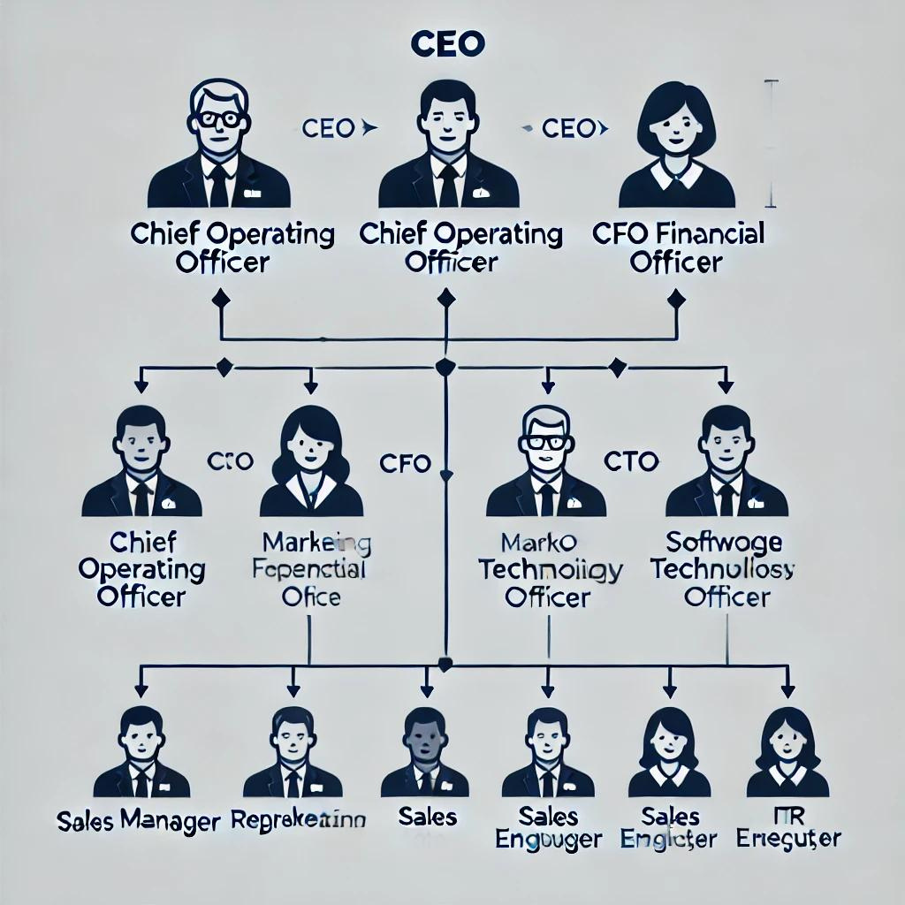

WHO ARE THE END USERS?
6

Slide 7

OUR SOLUTION AND ITS VALUE PROPOSITION
Conditional formatting - Missing values Filter - Filter out missing values
Pivot table - summary of date
Graph - Data visualization
7

Slide 8
Dataset Description
Employee dataset - Kaggle
Features - 26
Considered - 9
Employee I'D - Numerical
First Name - Text
Employee Type
Performance level
Gender - male and female
Employee rating - Numerical

Slide 9

THE "WOW" IN OUR SOLUTION
=IFS(Z8>=5,"VERY HIGH",Z8>=4,"HIGH", Z8>=3,"MED", TRUE,"LOW")
3/21/2024 Annual Review
9

Slide 10
MODELLING
Data collection
1) Download - gaggle
2) Edunet dashboard - File download
Features collection
1) Employee I'D
2) First Name
3) Employee Type
4) Performance level
5) Gender - Male and female
6) Employee rating
Data cleaning
1) Missing values identification
2) Filter out missing values
Summary
1) Pivot Table - Summary of Data
Data visualization
1) Graph - Data visualization ( Bar chart)
10

Slide 11
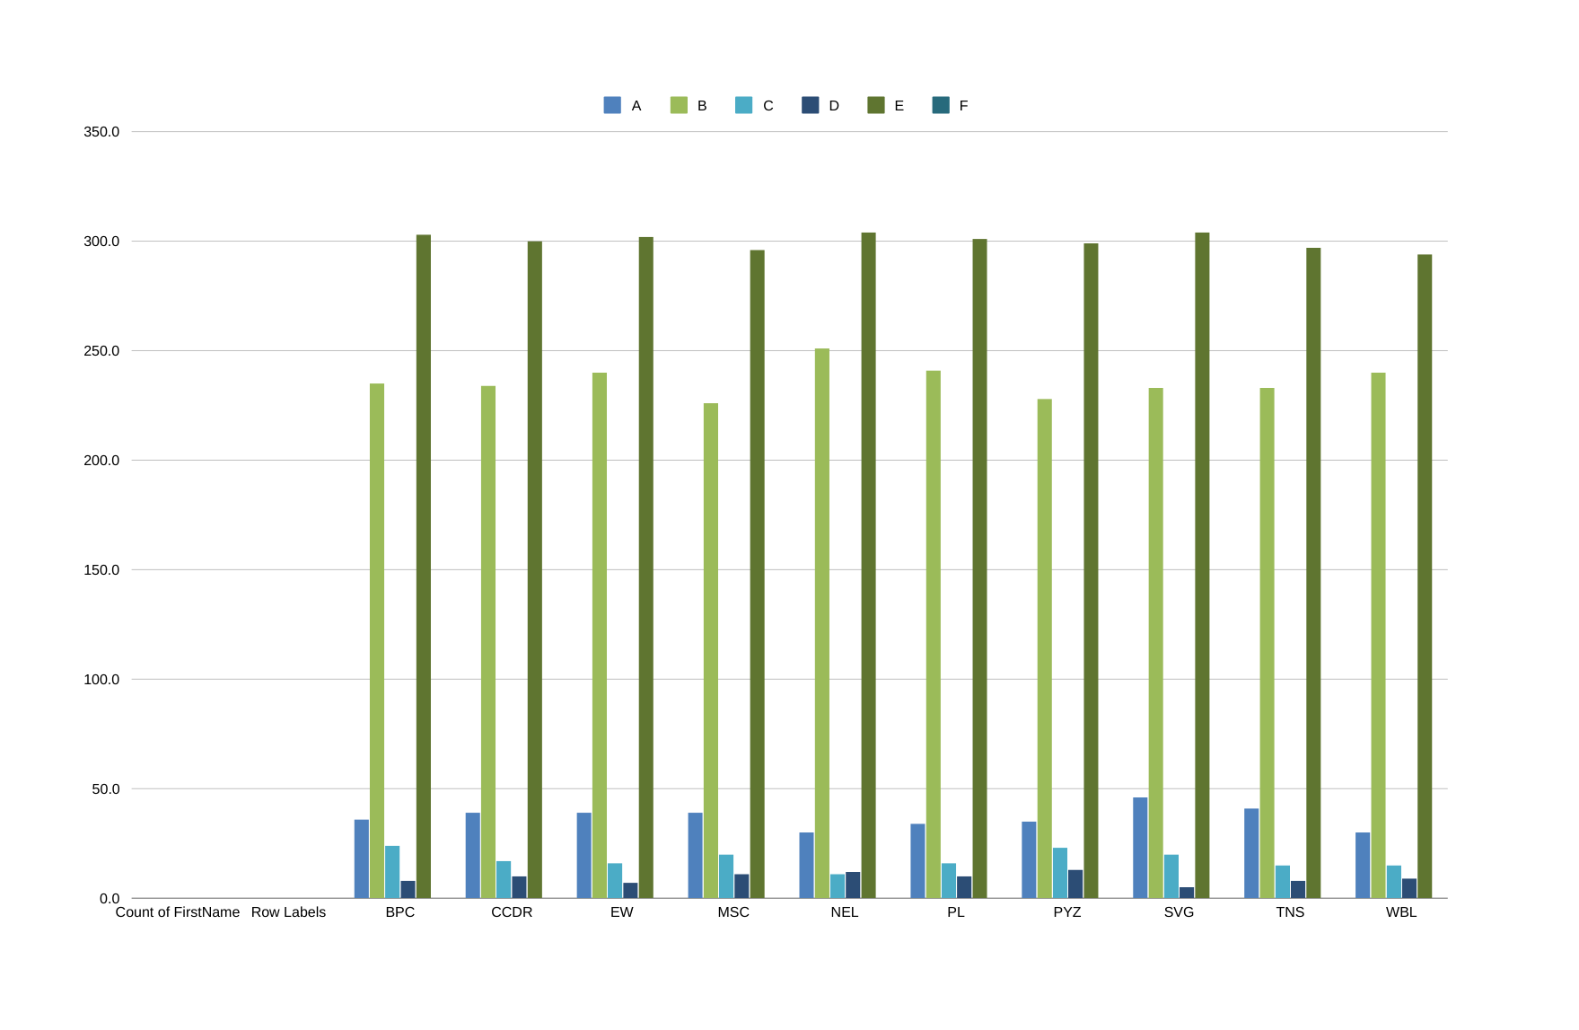
RESULTS
11

Slide 12
conclusion
Effective employee data analysis is vital for organizations aiming to balance employee growth with organizational success.
By thoroughly evaluating factors such as performance, appreciation, promotions, and increments, companies can drive motivation and productivity.
This approach not only enhances job satisfaction but also creates a work environment that fosters continuous personal development and aligns with the organization’s long-term goals. In conclusion, data-driven strategies empower organizations to support individual and collective growth.

