Slide 1
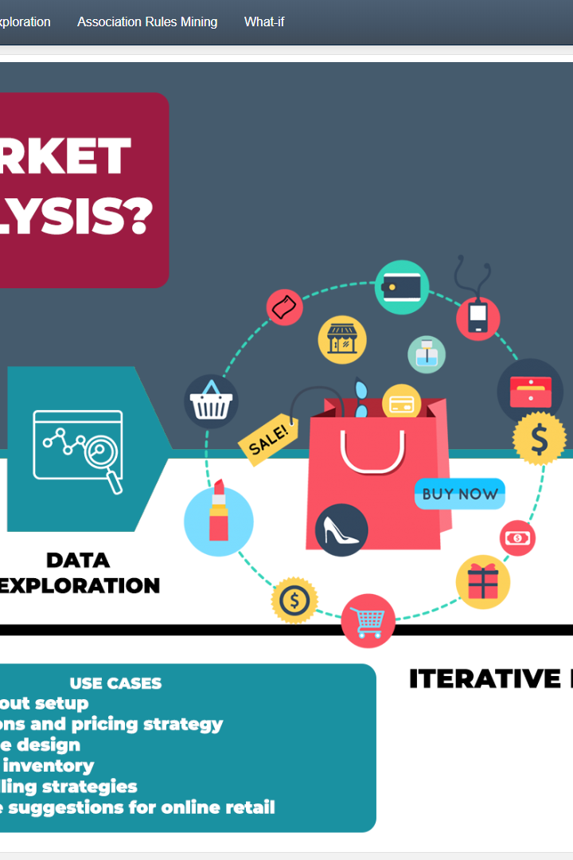

Market Basket Analysis
Discover the potential of market basket analysis: a powerful statistical technique to identify patterns in customer transactions, increase sales and improve your retail strategy.
JA
by Janani Azhaguvel

Slide 2

Definition of Market Basket Analysis
1
What is Market Basket Analysis?
2
Chain Rule Principle
Customers are more likely to purchase items that are related to other items in their cart and not other items in the store.
A statistical technique used to identify associations in customer transactions data and generate insights into consumer behaviour.
3
Benefits
Increased sales and customer loyalty, improved inventory management, and targeted marketing.

Slide 3



Importance of Market Basket Analysis
Retail Strategy
Data Analytics
Customer Engagement
Gain insight into customer buying habits, discover consumer preferences, and optimize product offerings.
Extract valuable insights from large datasets to improve decision-making and gain a competitive advantage.
Personalize marketing efforts, increase customer satisfaction and loyalty.

Slide 4
Market Basket Analysis Techniques
1
Association Rules
Identify itemsets (groups of items) that appear frequently together and generate "rules" that suggest additional items to purchase.
2
Support Measure
The number of transactions that contain a certain itemset divided by the total number of transactions.
3
Confidence Measure
The percentage of transactions containing the antecedent that also contain the consequent.
4
Lift Measure
The ratio of the observed support to the expected support if the itemsets were independent.

Slide 5
Applications of Market Basket Analysis
Retail Sales Analysis
Cross-selling and Upselling
Identify product combinations that are frequently purchased together and group them together on the store floor to increase sales.
Offer complimentary or upgraded products to customers based on their purchase history and preferences.
Supply Chain Management
Online Recommendations
Uncover inefficiencies or bottlenecks in inventory management and improve product availability.
Provide personalized product recommendations and improve customer experience.

Slide 6

Challenges and Limitations of Market Basket Analysis
1
Large Dataset Processing
Complex analytical processes can be time-consuming and require advanced data management techniques.
2
Interpretation of Association Rules
While algorithms can find associations, it is up to the analyst to make sense of them and determine actionable insights.

Slide 7


Conclusion
Summary of Key Points
Future Trends in Market Basket Analysis
Market Basket Analysis provides valuable insights into customer behaviour, which can be used to increase sales and customer loyalty.
The use of artificial intelligence and machine learning will enable even more complex and sophisticated analysis, driving continued growth and innovation.

