Slide 1

AGENT-ORCHESTRATED AUTOMATED QUESTION PAPER VALIDATION USING MCP TOOLS AND RAG
Student Name: Janani Sri S K
Register Number: 2024178024
Class: MCA, Regular
Institution: College of Engineering, Guindy
Guide Name & Designation: Dr. K. Kulothungan , Associate Professor

Slide 2

INTRODUCTION
Question paper quality directly affects learning outcomes and assessment fairness
Current evaluation of question papers is completely manual
Faculty manually assess Bloom’s level, difficulty, and CO alignment
Manual evaluation is subjective and inconsistent
Advances in NLP, embeddings, and RAG enable automated academic evaluation
This project proposes an AI-driven solution for question validation

Slide 3
PROBLEM STATEMENT
Manual system exists to evaluate typed examination questions
Bloom’s Taxonomy classification depends on evaluator experience
Course Outcome (CO) mapping is manually performed
Difficulty balance checking is time-consuming
Rubric creation lacks syllabus grounding
Evaluation of one question paper takes 10–45 minutes

Slide 4
BASE PAPER
Rubric-Aligned Automated Essay Grading and Personalized Feedback Generation using Multi-Task BERT LLM - IEEE ICIMIA 2025
Problem Addressed
Manual essay evaluation is time-consuming, subjective, and inconsistent
Existing automated grading systems lack:
Rubric alignment
Interpretability
Personalized feedback
Key Techniques Used
Transformer Model: BERT (fine-tuned)
Multi-Task Learning: Parallel rubric prediction
Rubric Dimensions: Concept, Elaboration, Coverage,
Comparison, Criticism, Usage
Evaluation Metrics: Precision, Recall, F1, QWK score
(≈ 0.79)
Relevance to this Project
Validates:
CO-aligned evaluation
Explainable scoring
Rubric-based academic assessment
Inspires:
Bloom & CO evaluation modules
Structured template generation
AI-assisted academic validation

Slide 5
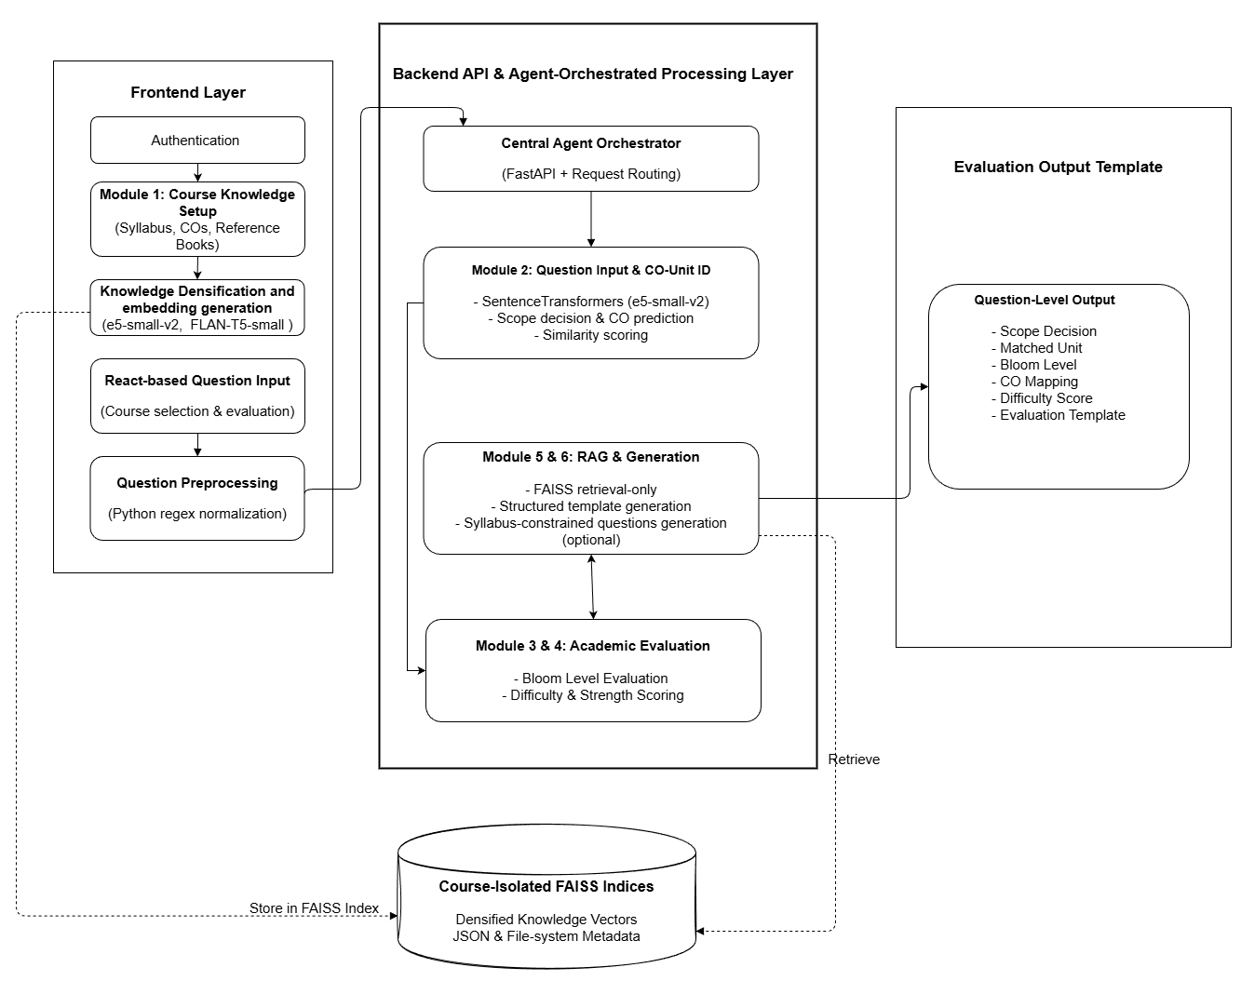
ARCHITECTURE

Slide 6
PLATFORM / TOOLS / LANGUAGE
Language: Python (AI pipeline & backend), JavaScript (frontend)
Backend Framework: FastAPI (agent orchestration and MCP-style tool APIs)
AI / NLP Models: Sentence-BERT (e5-small-v2) – embeddings, syllabus matching, CO mapping
ML Utilities: NumPy – similarity scoring and strength computation Regex-based preprocessing – text normalization
Vector Database: FAISS (CPU-based) – syllabus, subtopic, and book embedding retrieval
Frontend: ReactJS, Tailwind CSS
Execution Environment: Local CPU-based system (inference-only) with limited external LLM usage for controlled generation tasks

Slide 7
MODULES - COMPLETED
MODULE 1: COURSE KNOWLEDGE SETUP & DENSIFICATION
Professor uploads syllabus, Course Outcomes (COs), and reference book PDFs
Syllabus text is normalized and split into atomic subtopics
Reference books are extracted, chunked, and semantically matched to syllabus units
Sentence-BERT (e5-small-v2) generates embeddings for syllabus and book content
Book and syllabus embeddings are densified using weighted fusion (30 and 70 ratio)
All vectors are stored in course-isolated FAISS indices
A course-level domain embedding is created for scope validation
Input
Official course syllabus
Course Outcomes (COs)
Reference book PDFs
Output
Atomic syllabus subtopics
Densified unit embeddings
Course-level domain embedding
Course-isolated FAISS index with metadata

Slide 8
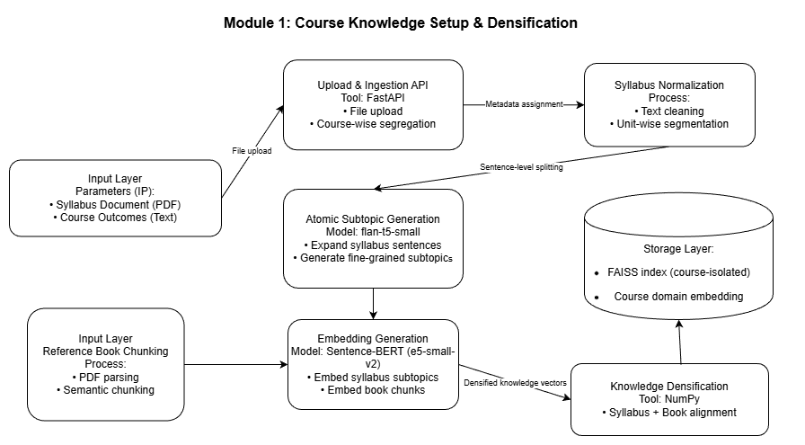

Slide 9
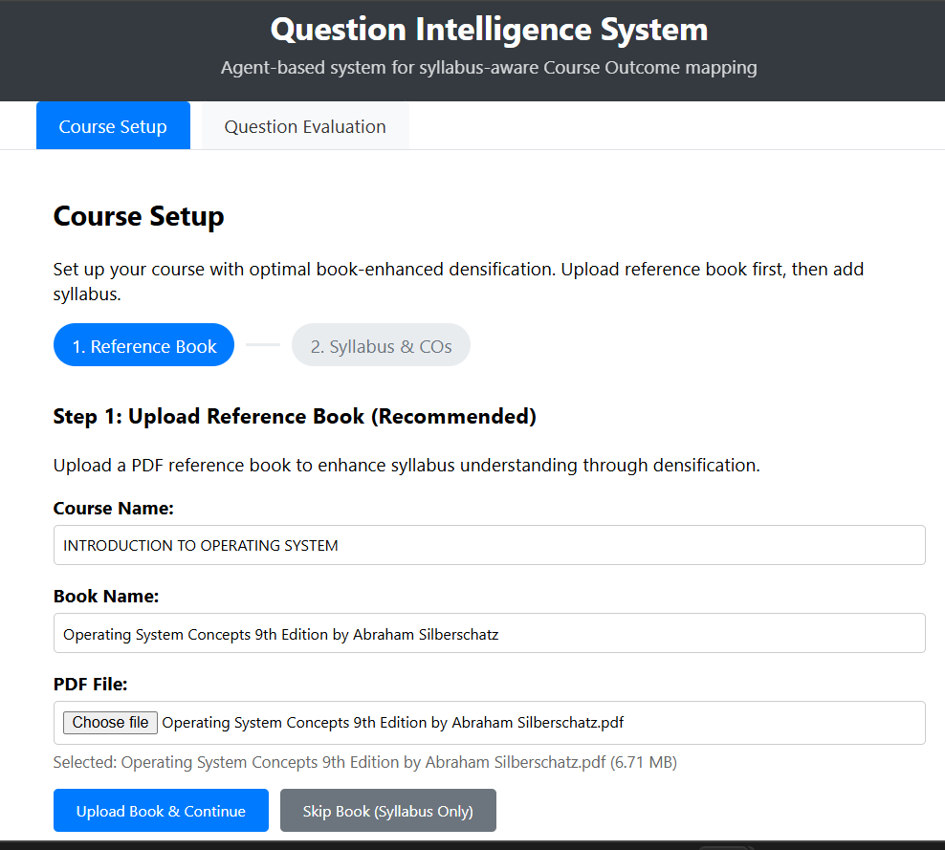
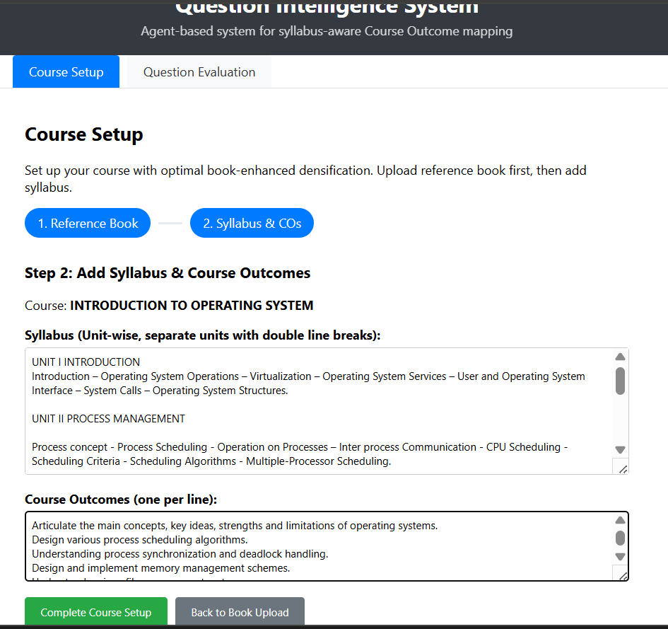

Slide 10
MODULE 2: QUESTION INPUT, EVALUATION ENTRY & CO–UNIT IDENTIFICATION
Question text is cleaned and normalized using regex-based preprocessing
Sentence-BERT (e5-small-v2) generates the question embedding
Request is routed through a central agent orchestrator via FastAPI
Semantic similarity search is performed on course-isolated FAISS index
The system identifies the most relevant syllabus unit and Course Outcome (CO)
Faculty selects the course and enters a question through the React-based UI
Similarity scores are returned to ensure explainable decisions
Input
Faculty-entered question
Selected course identifier
Output
In-syllabus / scope decision
Matched syllabus unit
Predicted Course Outcome (CO)
Similarity confidence scores

Slide 11
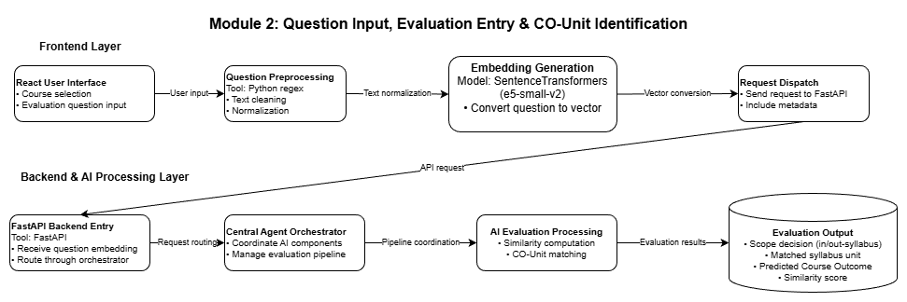

Slide 12
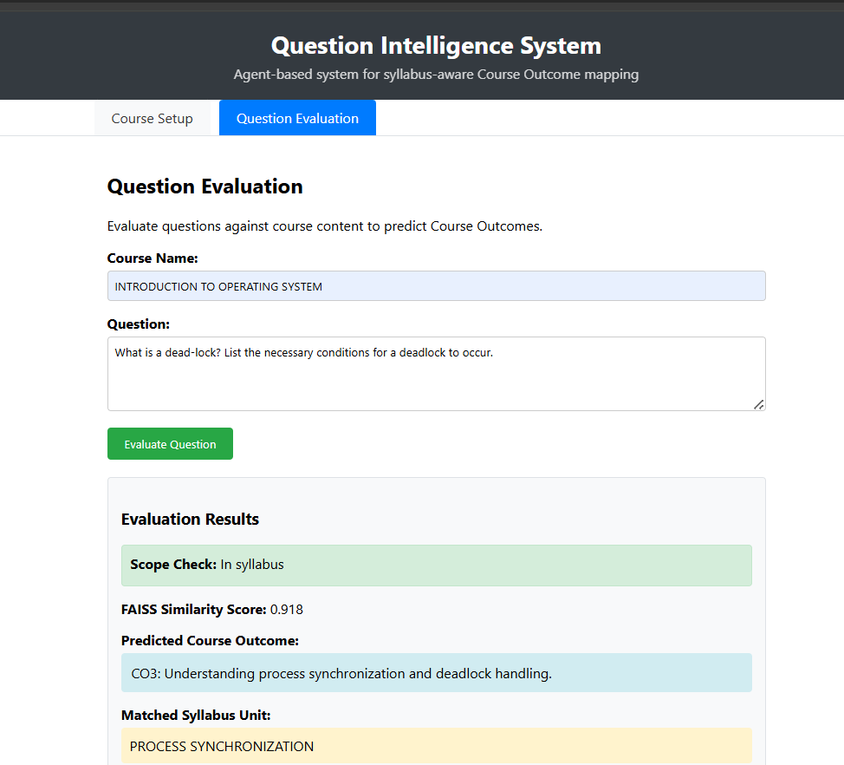
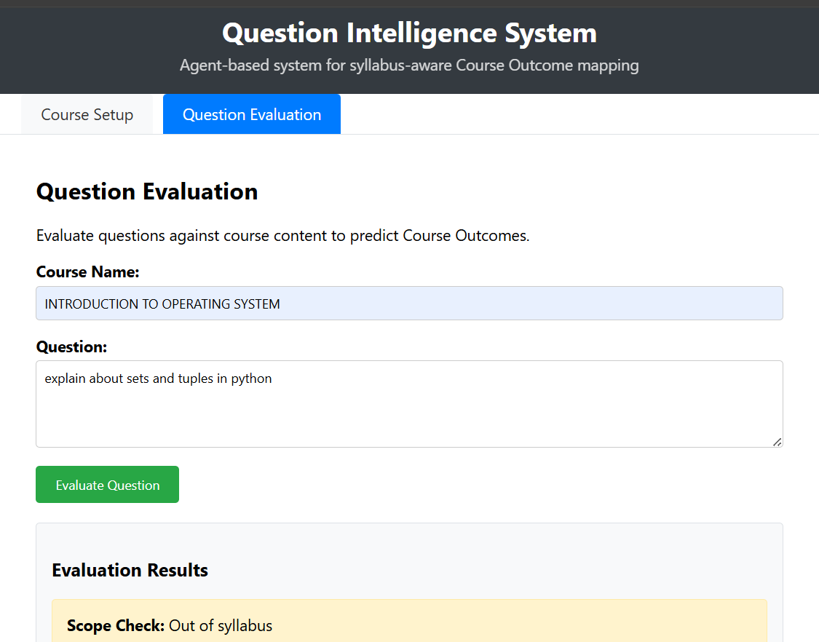

Slide 13
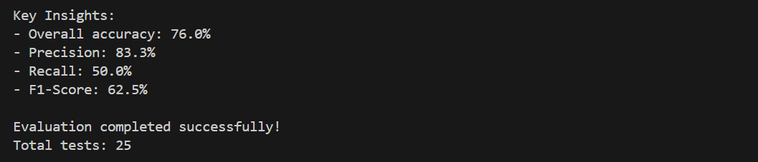
Evaluation Metrics

Slide 14
Module 4: Difficulty & Strength Scoring
Difficulty is estimated using semantic complexity signals from embeddings.
Cognitive depth is derived from Bloom level and syllabus coverage.
Overall question strength is computed using NumPy-based scoring logic.
Outputs objective difficulty and strength scores.
Module 5: Agent-Orchestrated RAG & Template Generator
A central Agent Orchestrator coordinates all modules.
FAISS-based RAG fetches syllabus- and unit-aligned content, including book chunks.
Retrieved context is used to generate evaluation templates.
Produces structured question-level analytics.
Module 6: Syllabus-Constrained Question Generation Engine
Questions are generated using syllabus units, book chunks, COs, and Bloom levels.
flan-t5-small (transformer) is used for controlled question generation.
Generated questions are self-validated using the same evaluation pipeline.
Outputs syllabus-safe questions tagged with CO, Bloom level, and difficulty.

Slide 15
References
Jamsandekar S. S. et al., Rubric-Aligned Automated Essay Grading using Multi-Task BERT, IEEE ICIMIA, 2025.
Chandrapati L. M. and Rao C. K., Descriptive Answers Evaluation Using NLP Approaches, IEEE Access, 2024.
Chen C. H. and Shiu M. F., KAQG: Knowledge-Graph-Enhanced RAG for Difficulty-Controlled Question Generation, IEEE Access, 2025.
Scott J. et al., Generative AI-Powered Curriculum Development using RAG and ADDIE, IEEE ISNCC, 2025.
Wei M. et al., Determined Multi-Label Learning via Similarity-Based Prompt, IEEE ICME, 2025.
Zhong J. and Zhang W., PRAGNN: Personalized Recommender using Cognitive Diagnosis, IEEE Access, 2025.
Li Y. et al., Personalized English Test Question Recommendation using Bi-GRU and BERT, IEEE ICICNCT, 2025.

Slide 16
THANK YOU

