Slide 1
Finding Leaf nodes and the count
of them in a Binary Tree
K. Sri Viraja

Slide 2
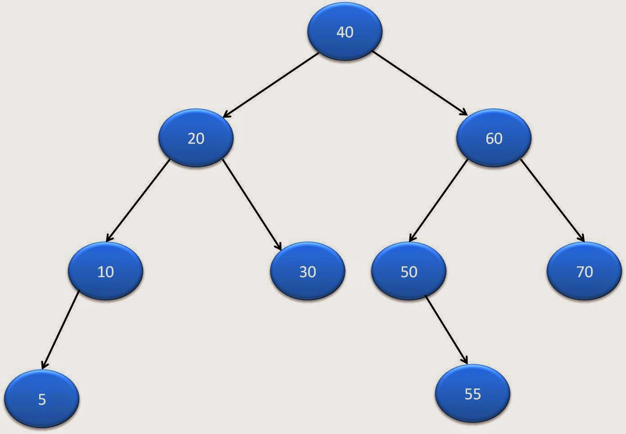
Defining the Node:
public static class TreeNode
{
int data;
TreeNode left;
TreeNode right;
TreeNode(int data)
{
this.data=data;
}
}

Slide 3
Finding Leaf Nodes:
public static void printLeafNodes(TreeNode node) {
if(node==null){System.out.println("null Part");
return;}
System.out.println("Processing: "+node.data);
if(node.left == null && node.right == null) {
System.out.println("Output is: "+node.data);
}
printLeafNodes(node.left);
System.out.println("Right: ");
printLeafNodes(node.right);
}

Slide 4
Finding count of Leaf Nodes:
public static int getLeafCountOfBinaryTree(TreeNode node)
{
if(node == null)
return 0;
if(node.left ==null && node.right==null)
return 1;
else
return getLeafCountOfBinaryTree(node.left)+ getLeafCountOfBinaryTree(node.right);
}

Slide 5
Structuring the Binary Tree:
TreeNode rootNode=createBinaryTree(); // function call in main()
public static TreeNode createBinaryTree()
{
TreeNode rootNode =new TreeNode(40);
TreeNode node20=new TreeNode(20);
TreeNode node10=new TreeNode(10);
rootNode.left=node20;
rootNode.right=node60;
node20.left=node10;
node20.right=node30;
node10.left=node5;
node50.right=node55;
return rootNode;
}

Slide 6
Output :
Printing leaf nodes in binary tree :
Processing: 40
Processing: 20
Processing: 10
Processing: 5
Output is: 5
null Part
Right:
null Part
Right:
null Part
Right:
Processing: 30
Output is: 30
null Part
Right:
null Part

Slide 7
Right:
Processing: 60
Processing: 50
null Part
Right:
Processing: 55
Output is: 55
null Part
Right:
null Part
Right:
Processing: 70
Output is: 70
null Part
Right:
null Part
Number of leaf nodes in binary tree :4

Slide 8
Right:
Processing: 60
Processing: 50
null Part
Right:
Processing: 55
Output is: 55
null Part
Right:
null Part
Right:
Processing: 70
Output is: 70
null Part
Right:
null Part
Number of leaf nodes in binary tree :4

